Slide 1
#01 Radar and be seen looking
Training slides

Slide 2
EFFECTIVE PRESENCE AND LANGUAGE
The first six strategies focus on maximising your presence on the wing and ensuring effective communication.
These techniques promote dynamic security and safety, allowing you to build relationships and promote change.
#01 Radar and be seen looking
#02 Assertive body language
#03 Strong voice
#04 Clear directions
#05 Purpose not power
#06 Code switching
Notes:
EFFECTIVE PRESENCE AND LANGUAGE TECHNIQUES
EXPLAIN
The technique that we are looking at today is one of the six ‘Effective Presence and Language’ techniques. These foundational techniques provide a basis for any interaction you might have with a prisoner. They focus on having presence on the wing and communicating effectively with prisoners. Consequently, these techniques help to promote dynamic security and safety allowing officers to focus on building relationships and promoting change amongst prisoners. For officers to be effective and impactful in their roles it is crucial that they master this set of techniques.

Slide 3
Recap of previous technique
Notes:
RECAP PREVIOUS TECHNIQUE
What was the technique we covered last week?
What does the technique look to do?
What are the success checks for the technique?
CELEBRATE SUCCESSES
We have had some great successes this week including…
I would like to shoutout XXXXX because…
Does anyone want to shout out one of their colleagues?

Slide 4

#01 Effective presence and language
  RADAR AND BE SEEN LOOKING
    Scan your surroundings often and let prisoners see you doing it.
Notes:
INTRODUCE NEW TECHNIQUE: RADAR AND BE SEEN LOOKING
TRAINER NOTE: (Pause a moment to allow people to read the overview of the technique on slide.)
EXPLAIN
This technique is about two things:
Firstly, making sure you are aware of what is happening on the wing by ensuring that you are regularly scanning your surroundings. As a prison officer effective scanning involves positioning yourself carefully, looking behind you regularly and patrolling around the landings. Scanning is of course important for maintaining security and order on the wing. It ensures that officers are aware of what is happening in their area of work. If officers don’t scan their surroundings, then they may fail to spot subtle but important changes on the wing for example:
Uneaten bread disappearing, could avoid us facing drunk prisoners next week.
A prisoner who has stopped showering, could allow us to identify and address welfare problems early.
Angry looks and whispered threats, could alert us to potential violence.
Secondly, this technique is about ensuring that prisoners are aware that you are looking. When people know they’re being observed, they act differently.
Showing that we’re aware of what’s going on encourages prisoners to do what they should be doing.
Just as we exaggerate the act of checking the mirror, we can use exaggerated movements, like tilting our head, or moving our whole body to look. Showing prisoners that we’re alert encourages them to do things they’re happy to be seen doing.

Slide 5
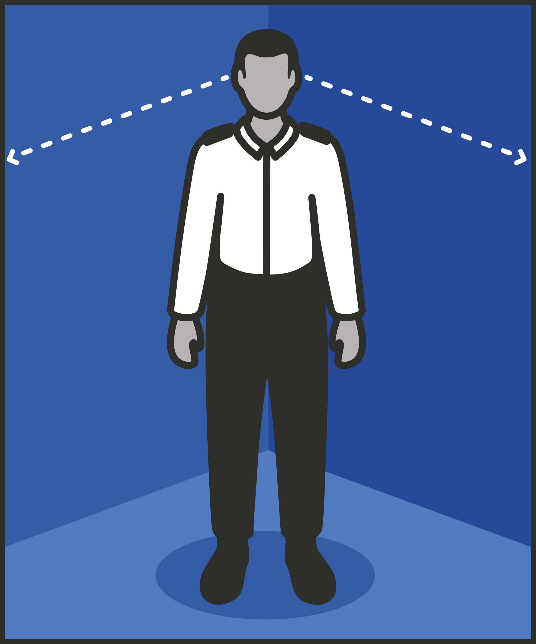
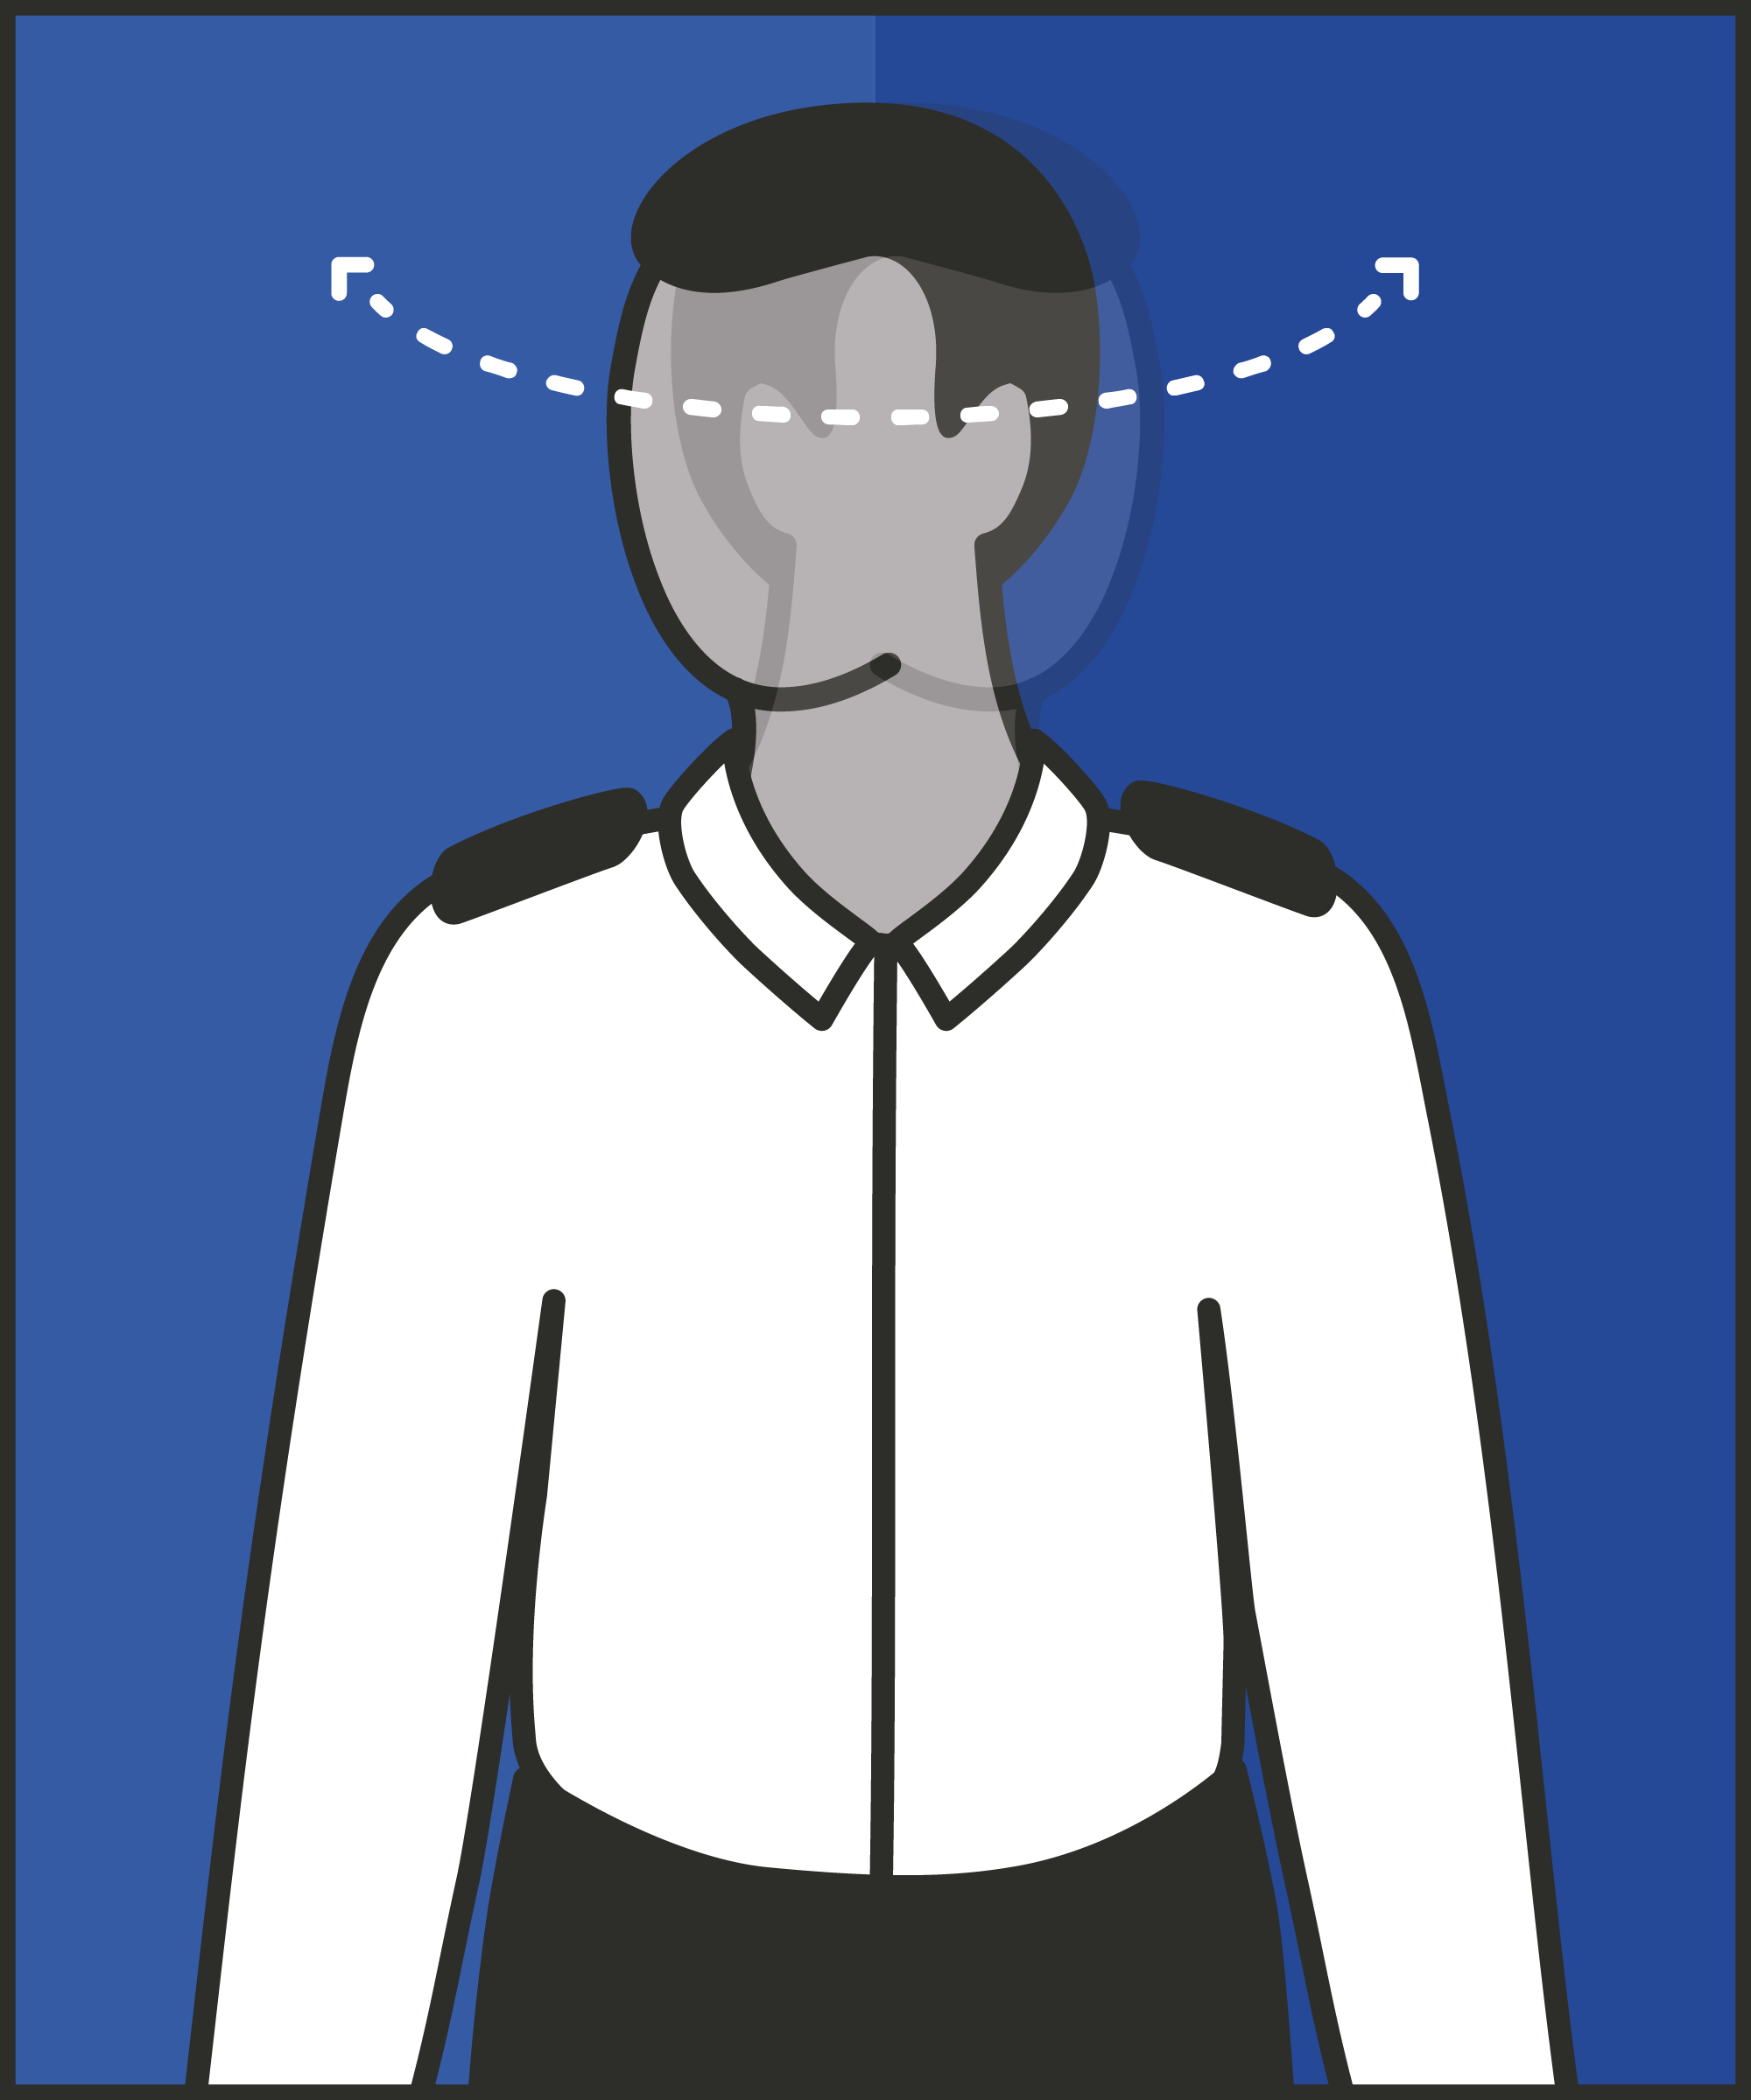
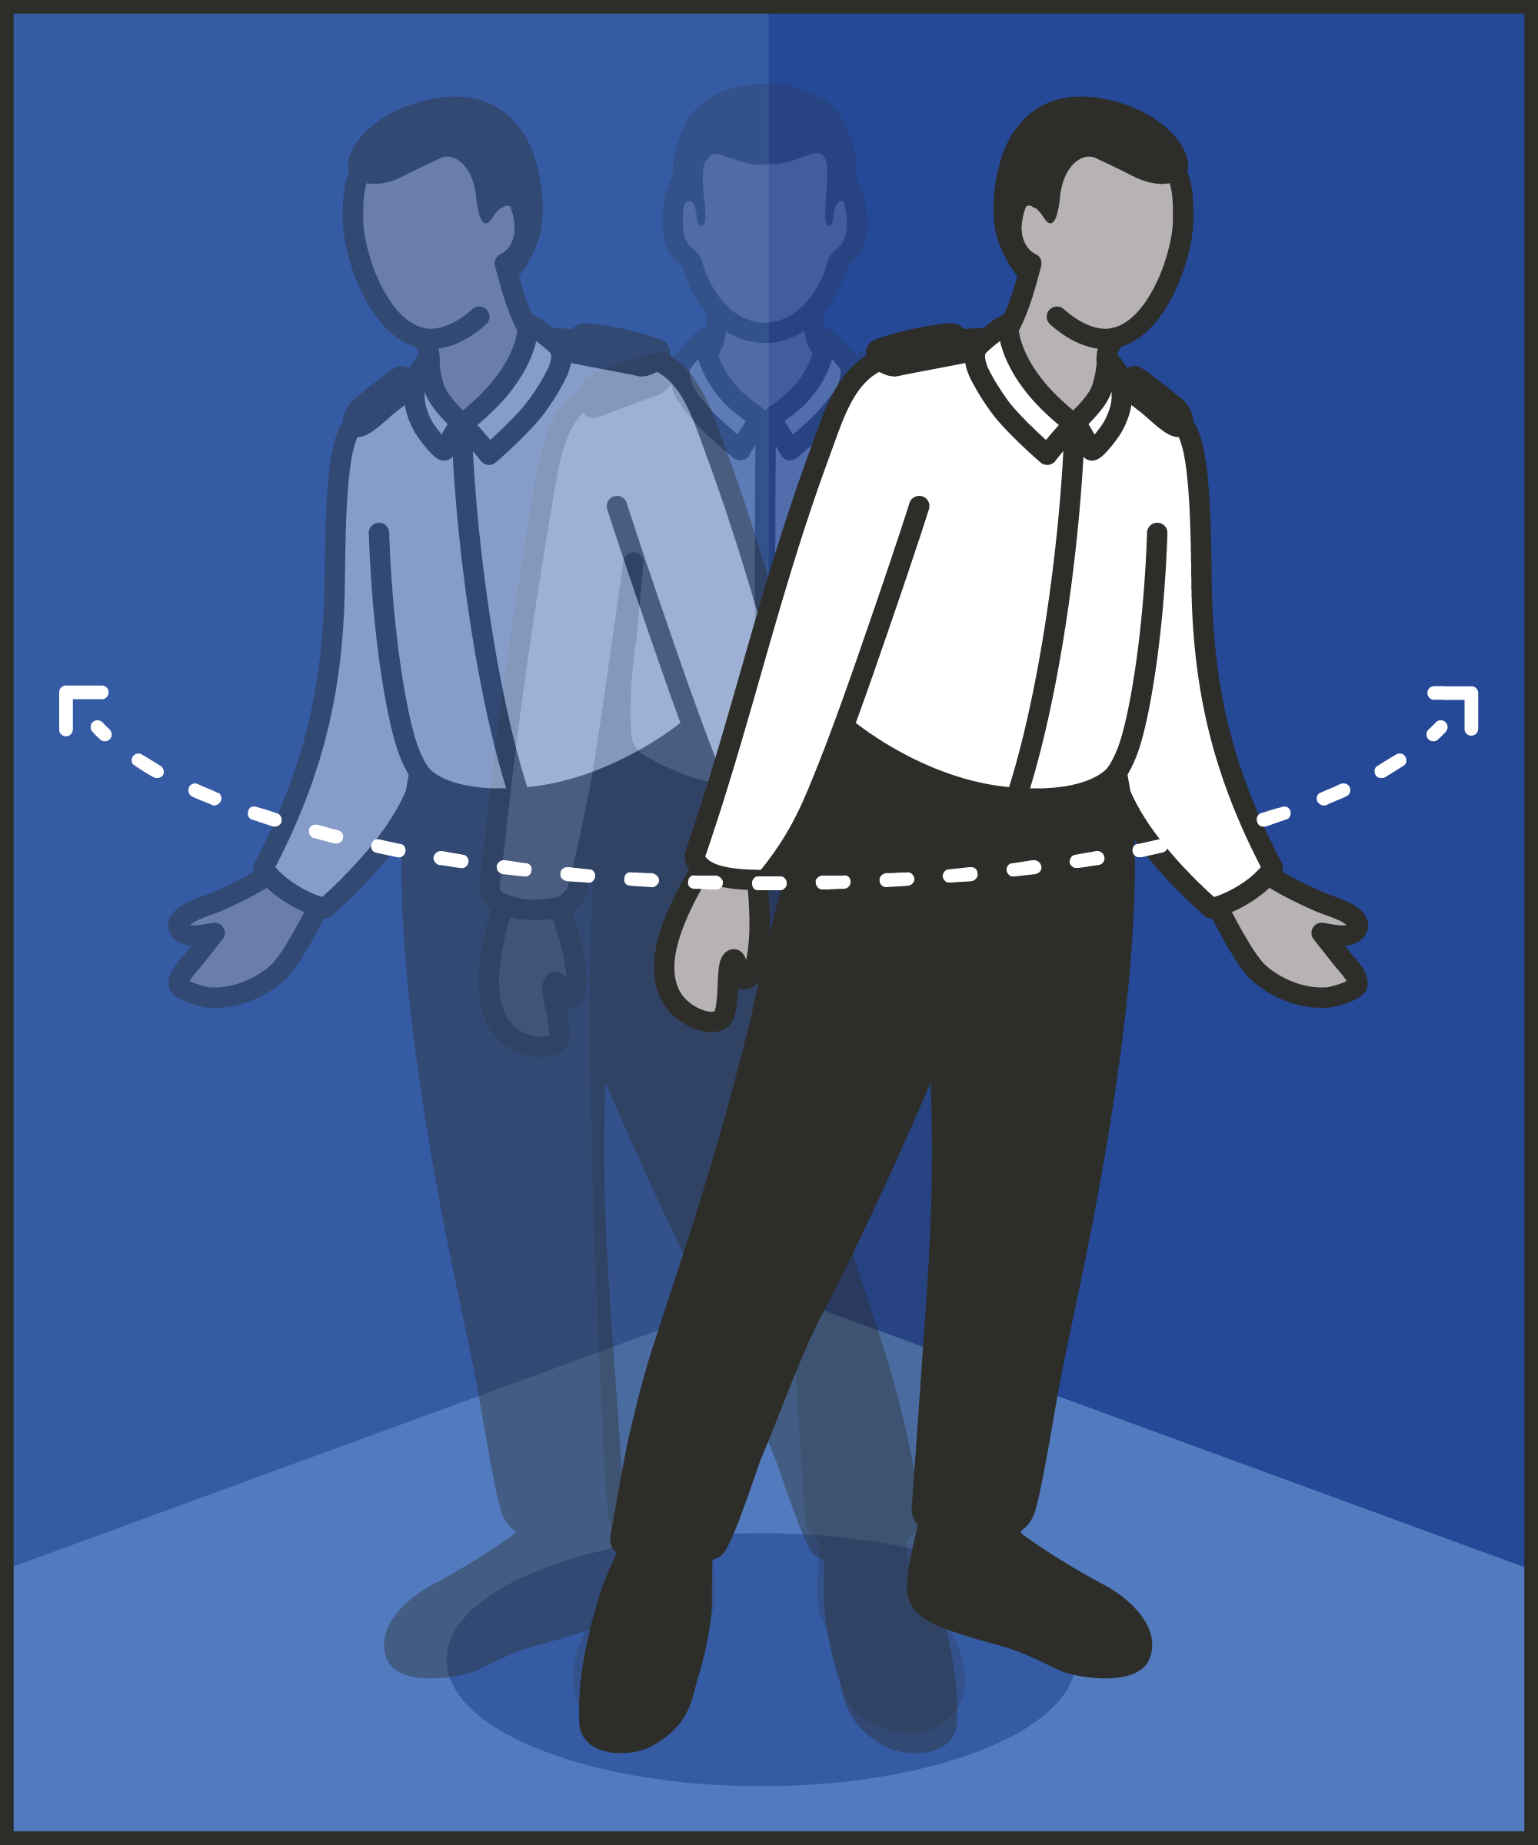
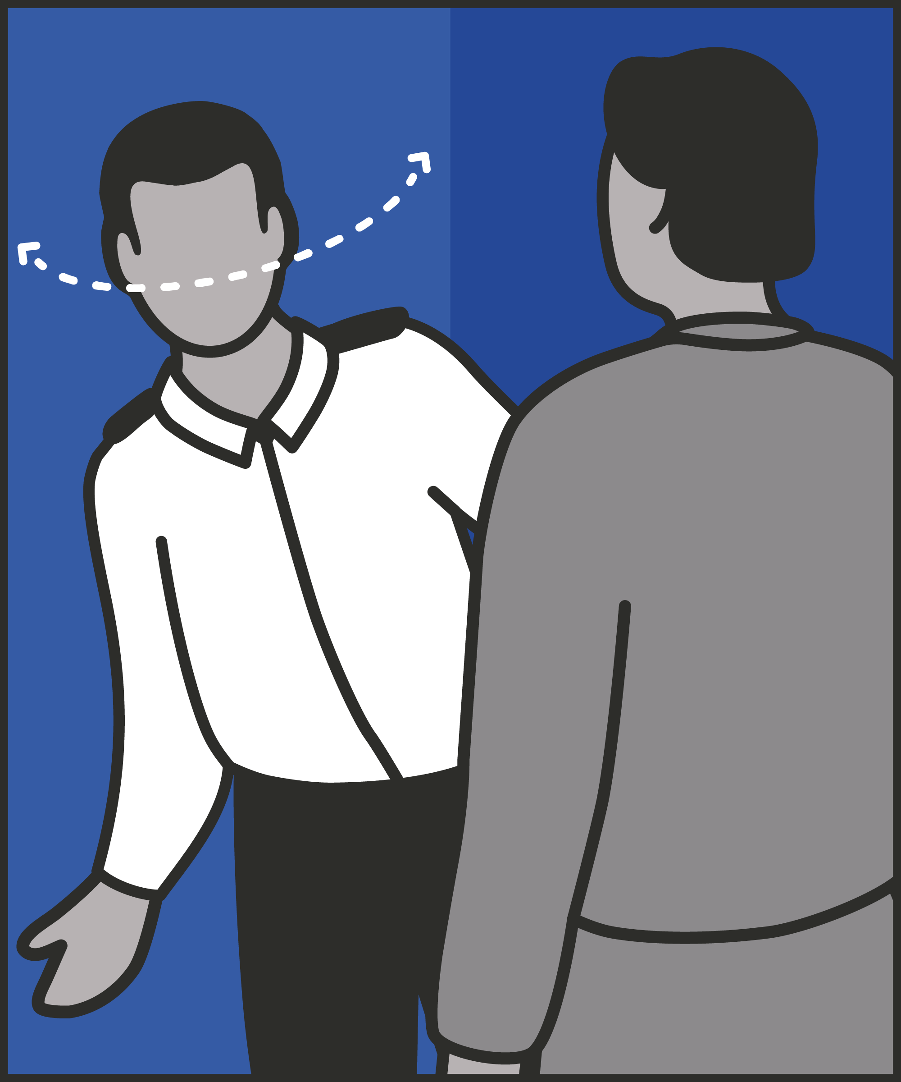
Position yourself appropriately
  Be seen and easily see everywhere for maximum awareness.
Scan
  Look around regularly so you are fully aware at all times.
Exaggerate
  Make it clear you are looking and aware of what is going on.
Explain
  If someone is talking to you, explain you are listening but also need to keep an eye on what else is going on.
Notes:
INTRODUCE STEPS: RADAR AND BE SEEN LOOKING
EXPLAIN
We are now going to go through each of the steps for this technique.
Position yourself appropriately: Wherever you are on the wing, there are almost always better and worse ways to position yourself. You want to position yourself where you can be seen by prisoners and easily see everywhere for maximum awareness. For example, if you are pausing to observe, it may be better to do this at the end of the landing, where you can see the length of the landing without turning your head – rather than the middle, where you have to turn your head through 180 degrees to see everyone.
Scan: Scanning involves looking around regularly, so you are always aware of what is happening. As a rule of thumb, aim to do this every ten seconds. Think about blind spots too: doorways and alcoves you can’t immediately see. We can’t check all of them every ten seconds. But we can move position frequently, so nowhere goes unobserved for long.
Exaggerate: Exaggerate every movement. You could flick your eyes left to right and see everything but remember we want prisoners to be aware that we are observing what they are doing. Instead turn your whole head. Move your whole body. If you’re looking down from one landing to the next, peer down on tip toes. If you’re scanning to the left, take a step forward and peer round. If your actions don’t feel slightly over the top, you’re probably not exaggerating it enough. We need to make what we’re doing unambiguous. A prisoner at the far end of the landing can’t see where you’re looking. They can see you leaning around to peer the length of the landing.
Explain: If someone is talking to you when you are using this technique then you shouldn’t simply stop. Keep scanning, and show you’re doing it, even while you’re talking. However. you should explain to the person that you are listening but that you also need to keep an eye on what is happening on the landings. If you are facing away from the rest of the landing, you could ask them to swap places with you, ensuring you can talk to them and still see everything else. Alternatively, if the conversation needs more time and attention, you might ask the prisoner to wait, and – if possible – come back to them when the rest of the landing are locked up, and you can give them more attention.

Slide 6
Turn and talk
Using the Pocket Guide as a reference:
Do you use this technique as part of your practice? If so, how and when?
Which of the steps do you use?
Which of the steps do you want to work on?
Notes:
TURN AND TALK: RADAR AND BE SEEN LOOKING
PAIRED DISCUSSION
In pairs I would like you to discuss the following questions using the pocket guide as reference (p10):
Do you use this technique as part of your practice? If so, how and when?
Which of the steps do you use?
Which of the steps do you want to work on?
WHOLE GROUP FEEDBACK
(Get whole group feedback following paired discussions.)

Slide 7
Model video
INSERT MODEL VIDEO ONTO SLIDE
Notes:
MODEL VIDEO: RADAR AND BE SEEN LOOKING
TRAINER NOTE: If possible, insert the model video onto this slide ahead of starting your session. (You can find the online link to the videos here: https://unlockedgrads.org.uk/leading-prison-landings/the-videos/ or by pressing CTRL+CLICK on the box on the slide.)
EXPLAIN VIDEO
We are now going to watch the model video for this technique. While you are watching the video try to see if you can identify the success checks as they are met.
EXPLAIN POTENTIAL PITFALLS
Now that you have a better understanding of this technique, I want to explain some potential pitfalls that officers can make when trying to use it:
Getting caught up in conversations and tasks: What’s in front of us can absorb us. This might be an incident, but it could be something as simple as a conversation. You may want to show you’re listening, but you are still responsible for everyone under your charge. Remember also that the prisoner you’re speaking to could have been told to distract you, so something else can happen unobserved.
Seeming inattentive or uninterested: It's hard to maintain eye contact during a conversation while also keeping an eye on the wing. We will be looking away from them some of the time, and this may make us seem uninterested and inattentive. If we are to keep ourselves and the wing safe, there isn’t really an option: we cannot allow ourselves to focus entirely on one prisoner, to the exclusion of everyone else. To mitigate this, we can explain to the prisoner that we need to keep an eye on what is happening on the landings but assure them that we are still listening to what they are saying.
Scanning too subtly: Exaggerating our movements may seem… exaggerated, and over the top. But it’s essential if we want prisoners at the far end of the wing to know that we’re watching. Once we get used to it, it should come to feel natural.

Slide 8

Practice – radar and be seen looking
Roles
Timing
Participant A: Prisoner
Scripting: 1 min
Participant B: Prison officer
Practice: 2 min
Success checks
Feedback: 1 min
Position yourself appropriately
Scan around you
Exaggerate your actions
Explain you are listening
Practice: 2 min
Feedback: 1 min
Notes:
PRACTICE: RADAR AND BE SEEN LOOKING
EXPLAIN THE PRACTICE (NB: you can change the times for scripting, practice and feedback as needed.)
We are now going to practise using the technique radar and be seen looking:
When might you use the technique of radar and be seen looking? Think about a prisoner or group of prisoners you are working with when you have needed to, or will need to, use this technique. For example, during association, whilst on the yard or supervising the serving of meals, etc.
To remind you, the success checks for this practice are:
READ SUCCESS CHECKS FROM SLIDE
(Check all have chosen a real-life scenario – choose people to share theirs if time.)
You each now have 1 minute to script what you would say and do in the scenario you have chosen, using the success checks.
(Trainer then allocate pairs.)
Person nearest the door is going to be the prisoner first (Participant A) and the other will be the officer (Participant B).
For practice round 1, Participant B explain your scenario to your partner – they will be playing the role of the prisoner.
Ok, when I say go, you will have 2 minutes to run the practice using the scenario Participant B has given. If you finish before the 2 minutes, give feedback and practice again, making improvements.
Remember to stay in role throughout.
Go.
START PRACTICE
(Circulate during practice and give live feedback to pairs, as necessary.)
EXPLAIN THE FEEDBACK
Participant A, you will now give feedback to your partner.
Referring to the success checks, tell them what they did well and what could they improve on?
(If there is time, you could ask the participants to do a second round of practice implementing the feedback.)
SWITCH ROLES
Now switch roles and repeat the practice and feedback cycle.
WHOLE GROUP FEEDBACK
How was it?
How did it feel?
What feedback did you get?

Slide 9
Next steps: Observations, feedback and tracking
Notes:
EXPLAIN NEXT STEPS FOR OBSERVATIONS
When will next observations take place?
Who will be conducting the observations?
EXPLAIN NEXT STEPS FOR FEEDBACK
When can they expect to get feedback on their observations?
How will feedback be delivered?
EXPLAIN NEXT STEPS FOR TRACKING
How will coaching be tracked?
Are there any updates to share with staff?

Slide 10
As you use this technique in your everyday work, you may find it useful to refer back to Leading Prison Landings: A Pocket Guide, or the full training manual, Leading Prison Landings: The Unlocked Guide to Jailcraft.

