Slide 1
#02 Assertive body language
Training slides

Slide 2
EFFECTIVE PRESENCE AND LANGUAGE
The first six strategies focus on maximising your presence on the wing and ensuring effective communication.
These techniques promote dynamic security and safety, allowing you to build relationships and promote change.
#01 Radar and be seen looking
#02 Assertive body language
#03 Strong voice
#04 Clear directions
#05 Purpose not power
#06 Code switching
Notes:
EFFECTIVE PRESENCE AND LANGUAGE TECHNIQUES
EXPLAIN
The technique that we are looking at today is one of the six ‘Effective Presence and Language’ techniques. These foundational techniques provide a basis for any interaction you might have with a prisoner. They focus on having presence on the wing and communicating effectively with prisoners. Consequently, these techniques help to promote dynamic security and safety allowing officers to focus on building relationships and promoting change amongst prisoners. For officers to be effective and impactful in their roles it is crucial that they master this set of techniques.

Slide 3
Recap of previous technique
Notes:
RECAP PREVIOUS TECHNIQUE
What was the technique we covered last week?
What does the technique look to do?
What are the success checks for the technique?
CELEBRATE SUCCESSES
We have had some great successes this week including…
I would like to shoutout XXXXX because…
Does anyone want to shout out one of their colleagues?

Slide 4
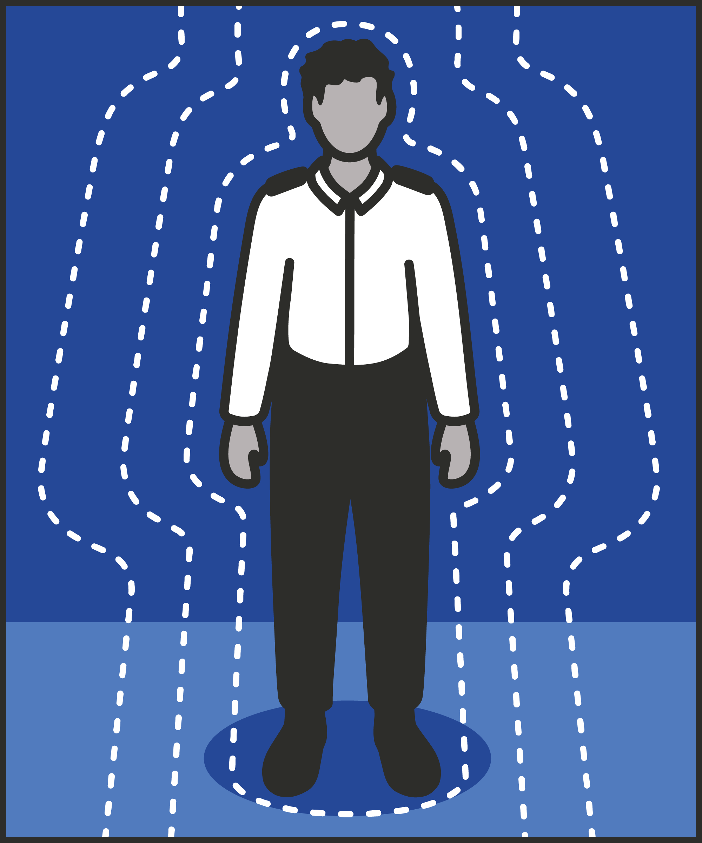
#02 Effective presence and language
  ASSERTIVE BODY LANGUAGE
    Stand in a confident, balanced and relaxed posture.
Notes:
INTRODUCE NEW TECHNIQUE: ASSERTIVE BODY LANGUAGE
TRAINER NOTE: (Pause a moment to allow people to read the overview of the technique on slide.)
EXPLAIN
Assertive body language means positioning our body and hands to project both confidence and authority as well as a relaxed and open manner.
As a prison officer, the words we choose are important. But words have their limits.
The wing may be noisy. Prisoners may not hear or understand everything we say. They may be thinking about something else entirely.
Body language helps us communicate both what we want prisoners to do, and our positive and constructive intent.
Through utilising assertive body language, we demonstrate the confidence needed to maintain order in prison and balance this with the warmth and openness needed to build trust and relationships.
This allows us to achieve our immediate goals, in maintaining a safe and orderly prison, and to work towards more ambitious goals of rehabilitation.
Pursuing this strategy means being intentional about body language. Working out whether our feet, knees, shoulders, hands and head are all in the right place may seem like a lot to deal with initially. We will take it step by step, practise, and it will start to feel natural.

Slide 5
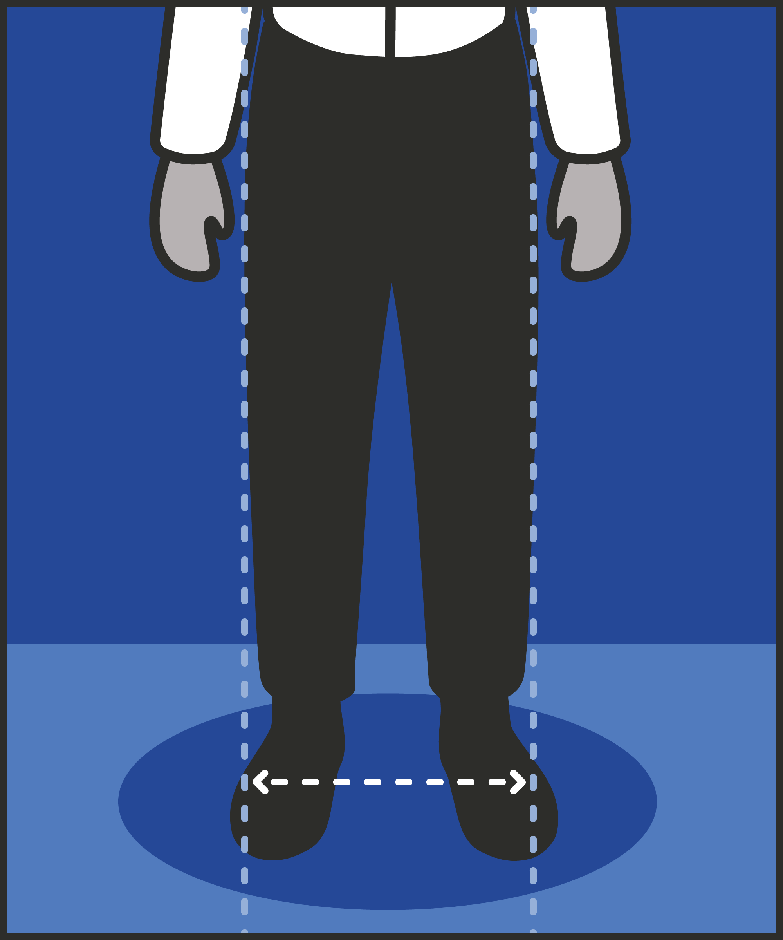
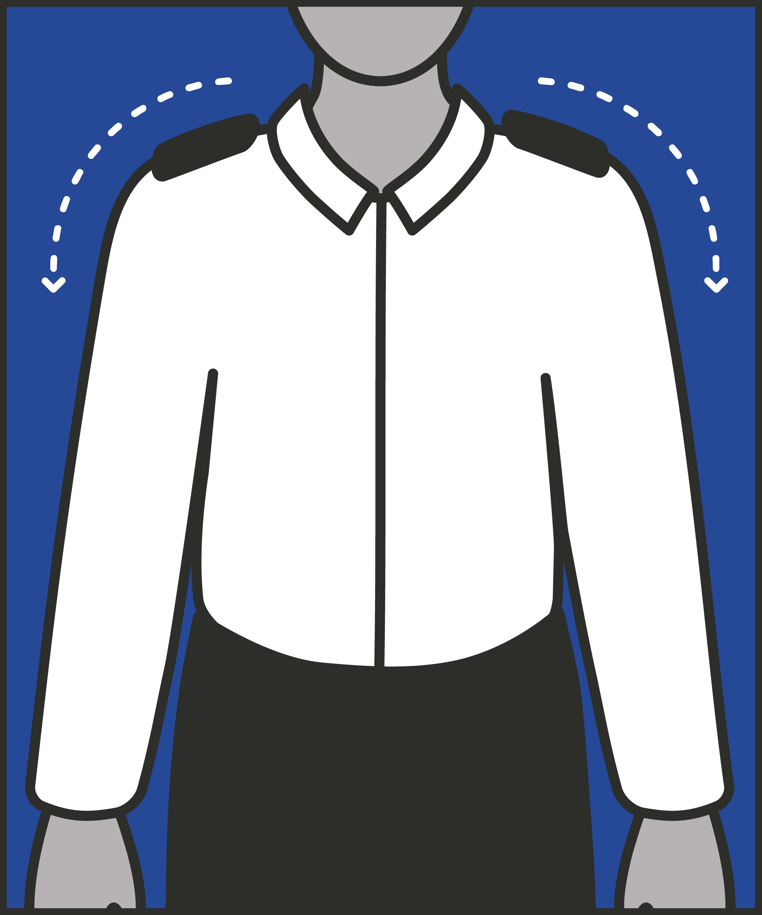
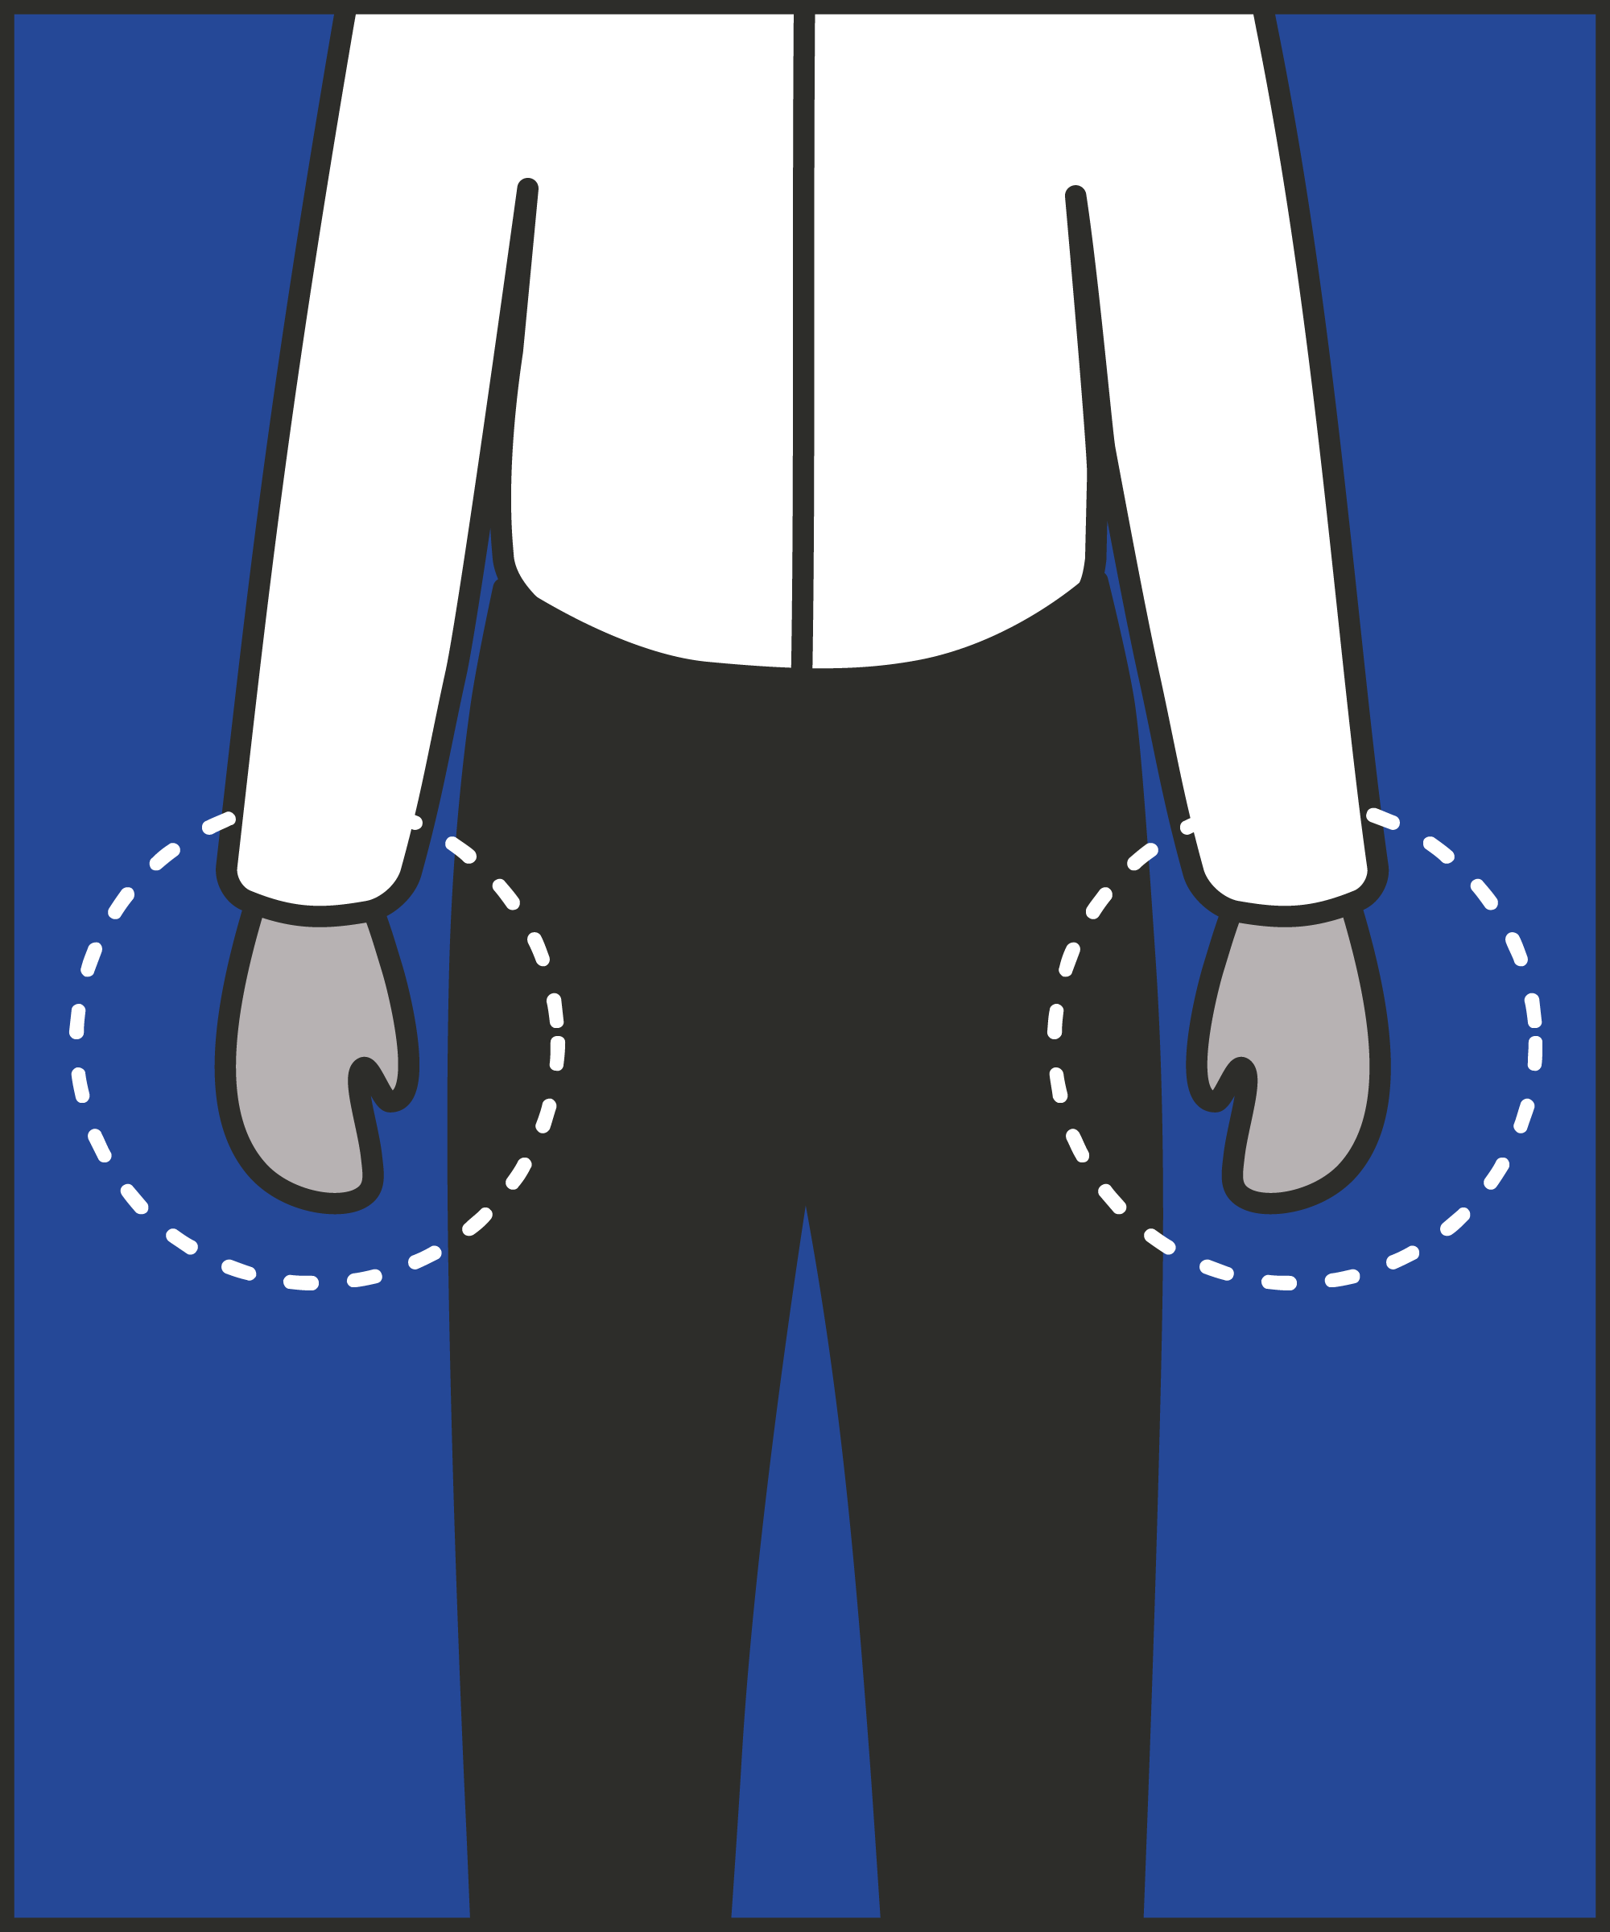
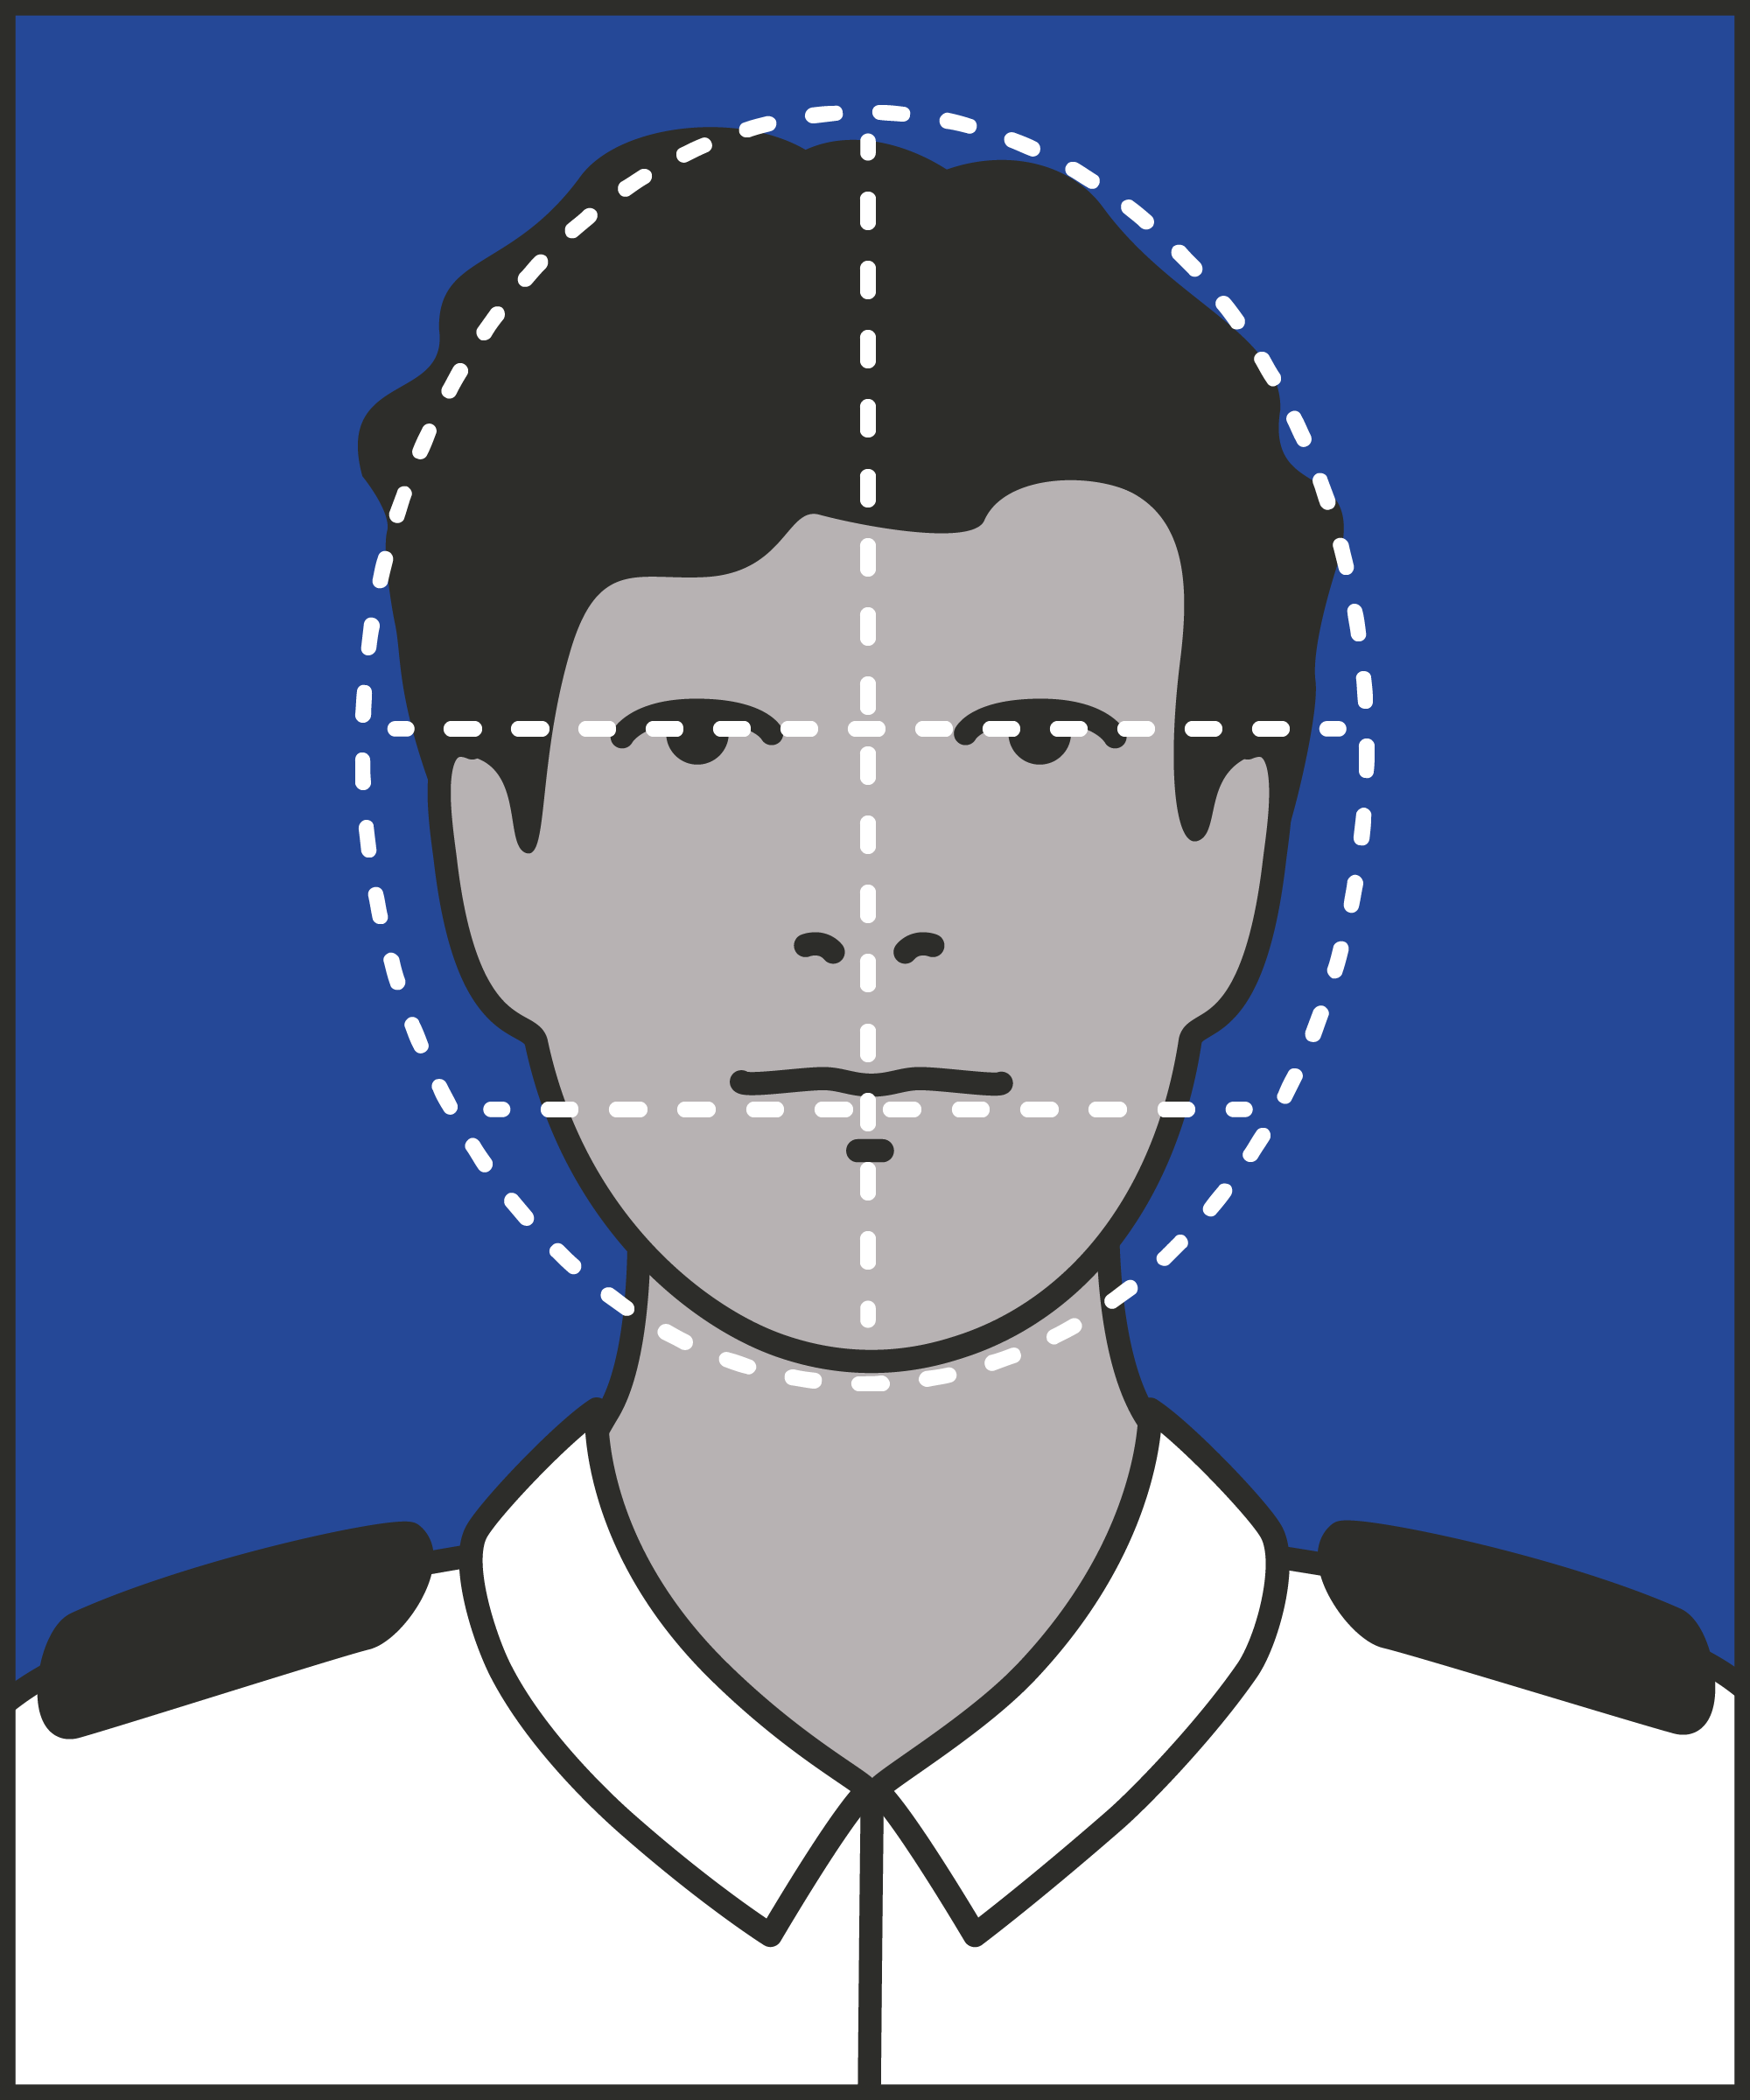
Feet
  Keep your feet hip-width apart in a comfortable stance.
Shoulders
  Keep shoulders relaxed.
Hands
  Keep your hands free and relaxed.
Facial expression
  Maintain a calm, relaxed facial expression.
Notes:
INTRODUCE STEPS: ASSERTIVE BODY LANGUAGE
EXPLAIN
We are now going to go through each of the steps for this technique.
Feet: Firstly, keep your feet hip-width apart, one foot slightly in front of the other. Keeping your feet at this width slightly broadens your frame, helping the rest of your body to straighten and square up. This position is also a stable one – it gives you lots of support. Try to keep your feet in one position for a while. If you are frequently shuffling them around or changing your balance, you look less in control.
Shoulders: You want to project – and feel – calm and relaxed. If your shoulders are tensed up, breathe out, and let them fall slightly.
Hands: You need to keep your hands free, open and relaxed. Try to avoid crossing your arms, which looks nervous and makes it harder to respond rapidly to changes in the situation. Similarly, keep your hands out of your pockets so you can use them quickly if needed.
Facial expression: You want to maintain a calm and relaxed facial expression. You are trying to project both authority and calm. You are in control of the situation, and your body language shows this. But that doesn’t mean you are tense. Your expression is neutral, ready to discuss, to observe, or to act, as required: neither excited nor hostile. You also want to look open to, and face towards, the speaker. This allows you to address them, and to respond to facial expression and gestures. Consider also those around you – you may want to move to a position where you can see other prisoners more easily.

Slide 6
Turn and talk
Using the Pocket Guide as a reference:
Do you use this technique as part of your practice? If so, how and when?
Which of the steps do you use?
Which of the steps do you want to work on?
Notes:
TURN AND TALK: ASSERTIVE BODY LANGUAGE
PAIRED DISCUSSION
In pairs I would like you to discuss the following questions using the pocked guide as a reference (p12):
Do you use this technique as part of your practice? If so, how and when?
Which of the steps do you use?
Which of the steps do you want to work on?
WHOLE GROUP FEEDBACK
(Get whole group feedback following paired discussions.)

Slide 7
Model video
INSERT MODEL VIDEO ONTO SLIDE
Notes:
MODEL VIDEO: ASSERTIVE BODY LANGUAGE
TRAINER NOTE: If possible, insert the model video onto this slide ahead of starting your session. (You can find the online link to the videos here: https://unlockedgrads.org.uk/leading-prison-landings/the-videos/ or by pressing CTRL+CLICK on the box on the slide.)
EXPLAIN VIDEO
We are now going to watch the model video for this technique. While you are watching the video try to see if you can identify the success checks as they are met.
EXPLAIN POTENTIAL PITFALLS
Now that you have a better understanding of this technique, I want to explain some potential pitfalls that officers can make when trying to use it:
Smile selectively. In most situations, smiling is welcome: we smile to express warmth, good humour and friendliness. But in a socially tense situation smiling can be misinterpreted. A prisoner may see a smile as superior: that the smiler is looking down on them in some way. Or a smile may come across as nervous and placatory. This isn’t to say don’t smile. In moments of humour or warmth, smiling is completely appropriate. But we recommend keeping a smile out of your neutral, everyday assertive stance. Save it for when it’s merited.

Slide 8

Practice – assertive body language
Roles
Timing
Participant A: Prisoner
Scripting: 1 min
Participant B: Prison officer
Practice: 2 min
Success checks
Feedback: 1 min
Feet hip-width apart, comfortable
Shoulders relaxed
Hands free and relaxed
Calm, relaxed facial expression
Practice: 2 min
Feedback: 1 min
Notes:
PRACTICE: ASSERTIVE BODY LANGUAGE
EXPLAIN THE PRACTICE (NB: you can change the times for scripting, practice and feedback as needed.)
We are now going to practise using the technique assertive body language:
When might you use the technique of assertive body language? Think about a prisoner or group of prisoners you are working with when you have needed to, or will need to, use this technique. For example, when managing volatile behaviour, searching prisoners or giving a prisoner direct instructions, etc.
To remind you, the success checks for this practice are:
READ SUCCESS CHECKS FROM SLIDE
(Check all have chosen a real-life scenario – choose people to share theirs if time.)
You each now have 1 minute to script what you would say and do in the scenario you have chosen, using the success checks.
(Trainer then allocate pairs.)
Person nearest the door is going to be the prisoner first (Participant A) and the other will be the officer (Participant B).
For practice round 1, Participant B explain your scenario to your partner – they will be playing the role of the prisoner.
Ok, when I say go, you will have 2 minutes to run the practice using the scenario Participant B has given. If you finish before the 2 minutes, give feedback and practice again, making improvements.
Remember to stay in role throughout.
Go.
START PRACTICE
(Circulate during practice and give live feedback to pairs, as necessary.)
EXPLAIN THE FEEDBACK
Participant A, you will now give feedback to your partner.
Referring to the success checks, tell them what they did well and what could they improve on?
(If there is time, you could ask the participants to do a second round of practice implementing the feedback.)
SWITCH ROLES
Now switch roles and repeat the practice and feedback cycle.
WHOLE GROUP FEEDBACK
How was it?
How did it feel?
What feedback did you get?

Slide 9
Next steps: Observations, feedback and tracking
Notes:
EXPLAIN NEXT STEPS FOR OBSERVATIONS
When will next observations take place?
Who will be conducting the observations?
EXPLAIN NEXT STEPS FOR FEEDBACK
When can expect to get feedback on their observations?
How will feedback be delivered?
EXPLAIN NEXT STEPS FOR TRACKING
How will coaching be tracked?
Are there any updates to share with staff?

Slide 10
As you use this technique in your everyday work, you may find it useful to refer back to Leading Prison Landings: A Pocket Guide, or the full training manual, Leading Prison Landings: The Unlocked Guide to Jailcraft.

