Slide 1
#03 Strong voice
Training slides

Slide 2
EFFECTIVE PRESENCE AND LANGUAGE
The first six strategies focus on maximising your presence on the wing and ensuring effective communication.
These techniques promote dynamic security and safety, allowing you to build relationships and promote change.
#01 Radar and be seen looking
#02 Assertive body language
#03 Strong voice
#04 Clear directions
#05 Purpose not power
#06 Code switching
Notes:
EFFECTIVE PRESENCE AND LANGUAGE TECHNIQUES
EXPLAIN
The technique that we are looking at today is one of the six ‘Effective Presence and Language’ techniques. These foundational techniques provide a basis for any interaction you might have with a prisoner. They focus on having presence on the wing and communicating effectively with prisoners. Consequently, these techniques help to promote dynamic security and safety allowing officers to focus on building relationships and promoting change amongst prisoners. For officers to be effective and impactful in their roles it is crucial that they master this set of techniques.

Slide 3
Recap of previous technique
Notes:
RECAP PREVIOUS TECHNIQUE
What was the technique we covered last week?
What does the technique look to do?
What are the success checks for the technique?
CELEBRATE SUCCESSES
We have had some great successes this week including…
I would like to shoutout XXXXX because…
Does anyone want to shout out one of their colleagues?

Slide 4
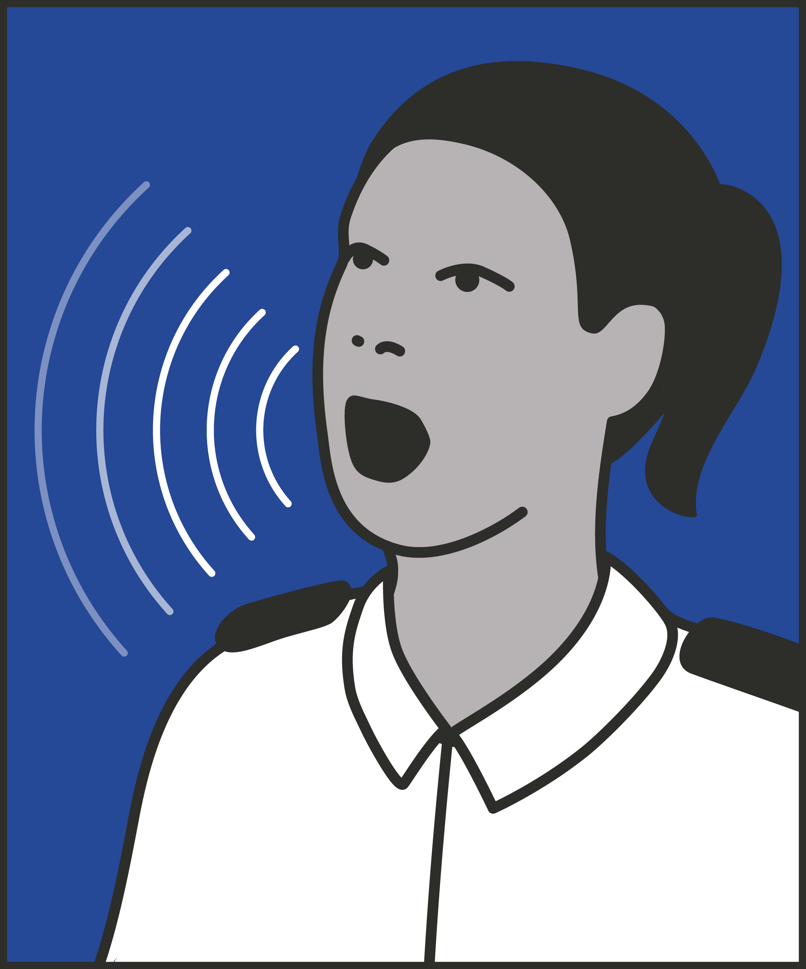
#03 Effective presence and language
  STRONG VOICE
    Speak in an authoritative tone at a measured pace.
Notes:
INTRODUCE NEW TECHNIQUE: STRONG VOICE
TRAINER NOTE: (Pause a moment to allow people to read the overview of the technique on slide.)
EXPLAIN
Using your voice effectively is one of the most important skills a prison officer can have.
Strong voice is all about speaking in an authoritative tone and a measured pace. This allows us to communicate in a clear and confident manner.
You want to speak from your lungs, using deep breaths, not from your throat. This makes the sound more powerful and preserves our voice.
We also want to slow down and speak more deeply.
The goal isn’t to shout or to be too forceful: it’s to be clear and confident in everything we say.
Communicating in this way maintains your authority and assertiveness and it demonstrates that you are calm and confident.
Additionally, some prisoners may struggle to understand our words. A prisoner may have hearing difficulties, additional speech and language needs, or speak English as an additional language. Our tone of voice – combined with our body language and gestures – can help us communicate, particularly with these prisoners.

Slide 5
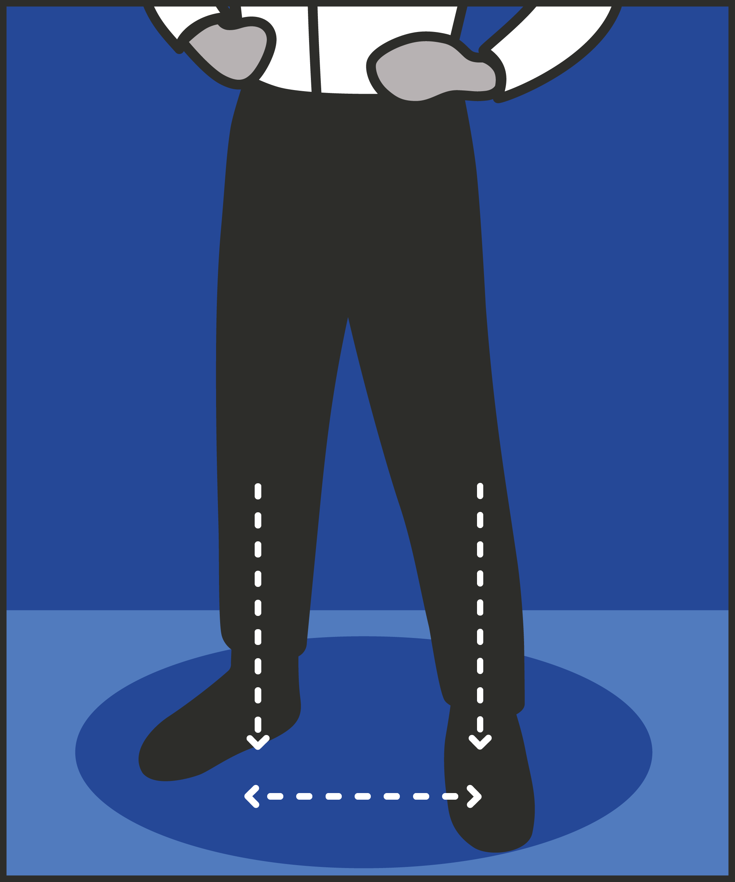

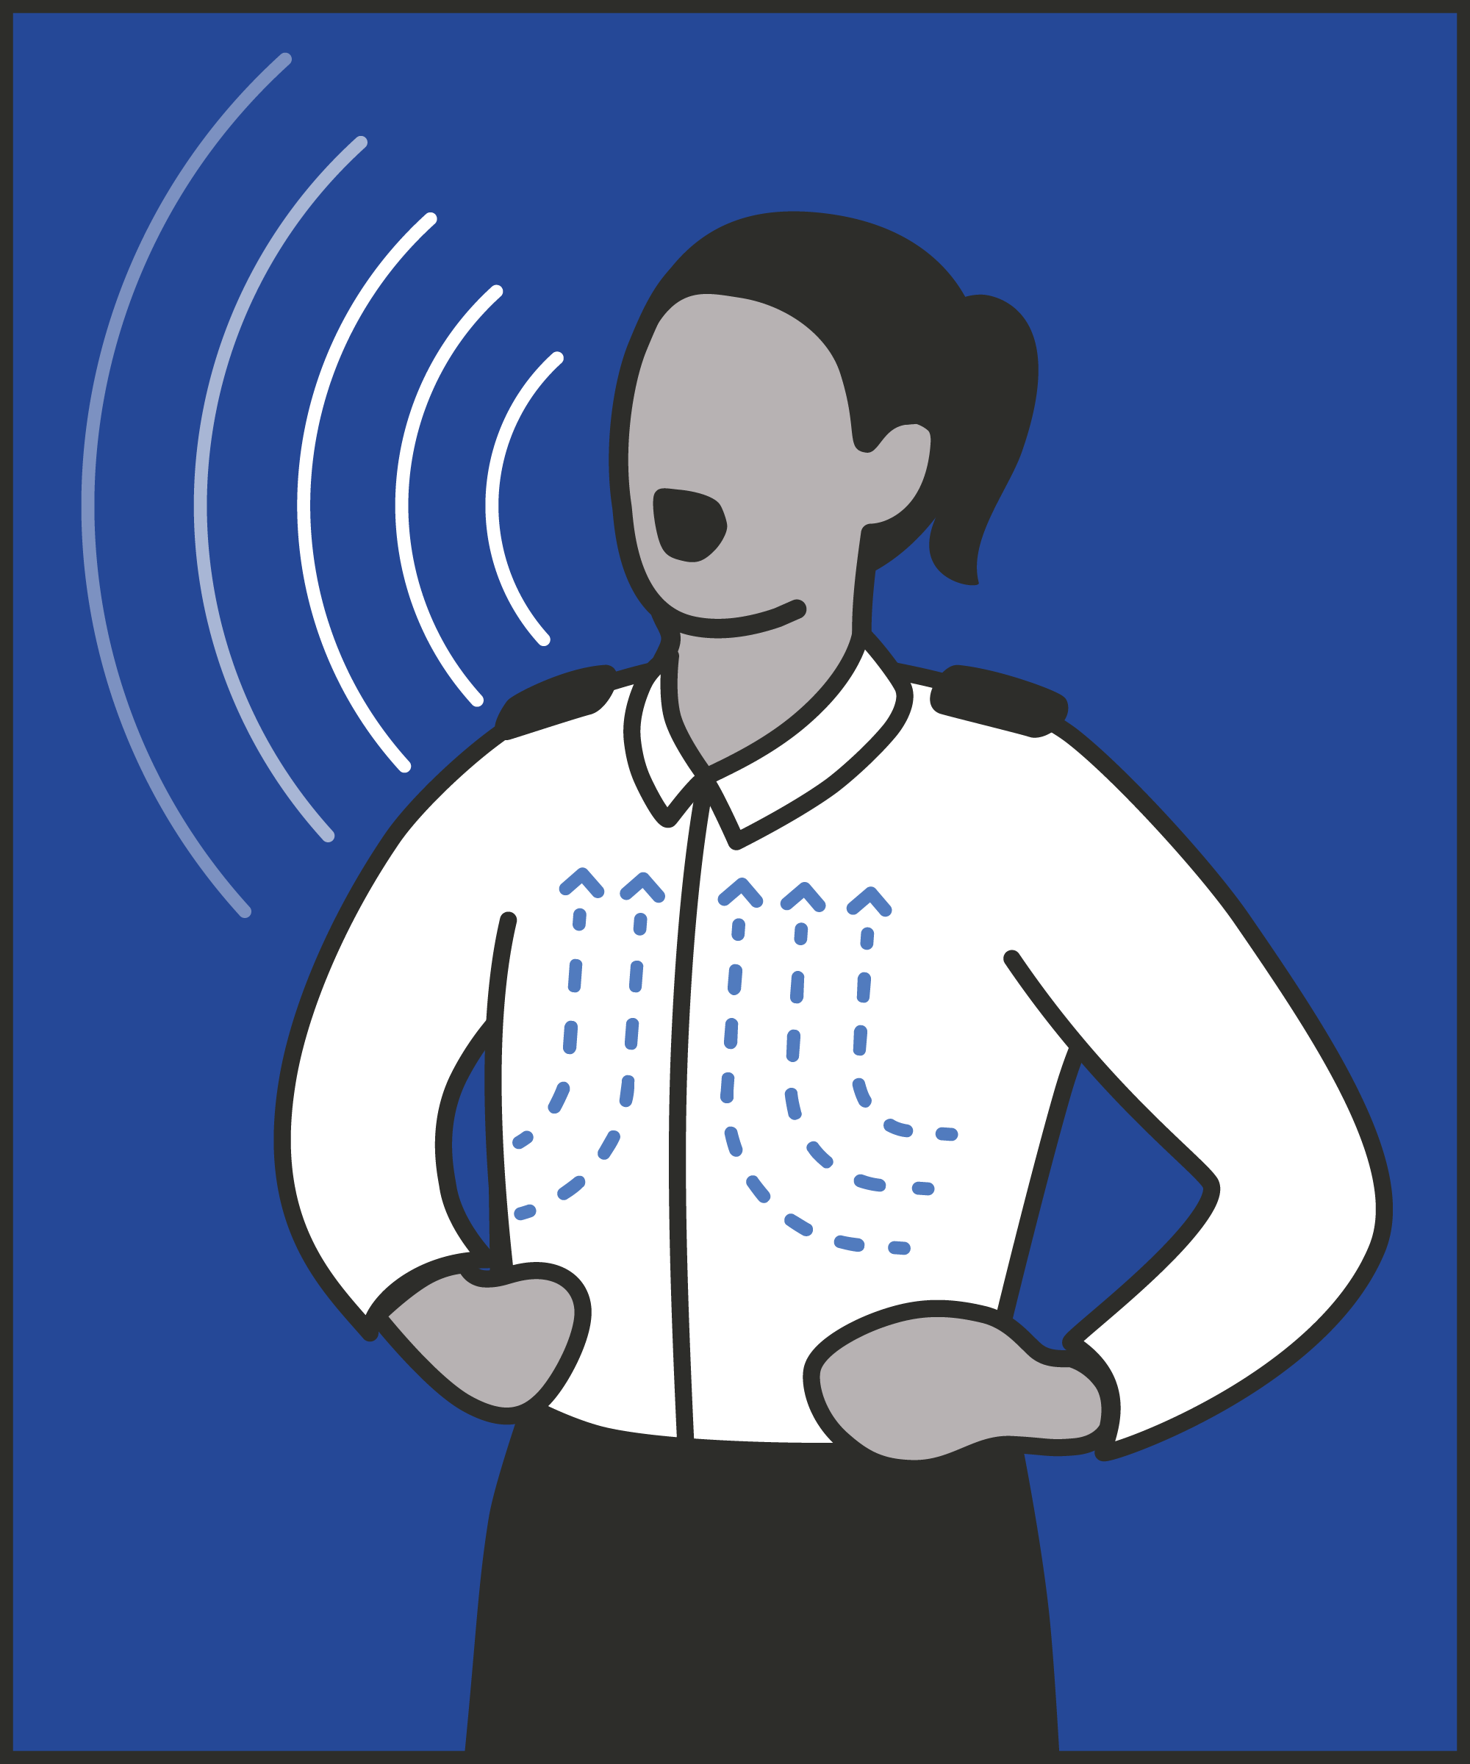

Stance
  Keep an open stance and plant your feet.
Tone
  Use a calm and confident manner.
Voice
  Speak deeply from the lungs to project your voice.
Slow down
  Pause where appropriate to give thinking time.
Notes:
INTRODUCE STEPS: STRONG VOICE
EXPLAIN
We are now going to go through each of the steps for this technique.
Stance: Firstly, you want to plant your feet and open your body up. This helps you to project calm and confidence when delivering your message.
Tone: You want to use a calm and confident tone when delivering your message. You want to avoid shouting because this can send the message that we have lost control or are panicked.
Voice: Deeper sounds come from the lungs and the chest; higher sounds come from the throat. To project authority, we want a deeper tone. This means that we need to speak deeply from the lungs to project your voice. When we practice you want to feel like the sound is coming from the base of your lungs.
Slow down: We tend to speak faster when we’re worried or under pressure, running our words together. This suggests a lack of confidence and makes it harder for prisoners and colleagues to understand what we’re saying. To help with this we need to slow down by pausing between phrases and between words. Consider how you can pronounce each word clearly: emphasise the ‘p’ in stop, the ‘t’ in that. This also helps to calm us down and allows us to choose our next words more carefully.

Slide 6
Turn and talk
Using the Pocket Guide as a reference:
Do you use this technique as part of your practice? If so, how and when?
Which of the steps do you use?
Which of the steps do you want to work on?
Notes:
TURN AND TALK: STRONG VOICE
PAIRED DISCUSSION
In pairs I would like you to discuss the following questions using the pocket guide as a reference (p14):
Do you use this technique as part of your practice? If so, how and when?
Which of the steps do you use?
Which of the steps do you want to work on?
WHOLE GROUP FEEDBACK
(Get whole group feedback following paired discussions.)

Slide 7
Model video
INSERT MODEL VIDEO ONTO SLIDE
Notes:
MODEL VIDEO: STRONG VOICE
TRAINER NOTE: If possible, insert the model video onto this slide ahead of starting your session. (You can find the online link to the videos here: https://unlockedgrads.org.uk/leading-prison-landings/the-videos/ or by pressing CTRL+CLICK on the box on the slide.)
EXPLAIN VIDEO
We are now going to watch the model video for this technique. While you are watching the video try to see if you can identify the success checks as they are met.
EXPLAIN POTENTIAL PITFALLS
Now that you have a better understanding of this technique, I want to explain some potential pitfalls that officers can make when trying to use it:
Shouting. We want to be firm and forceful – but calm and measured. When we’re frustrated, or worried, or under pressure, we may find ourselves raising our voice. There are rare occasions when a shout is needed – calling for help, for example. But in most situations, shouting suggests that we’ve lost control. If you find your voice raising in fear or anger, go back to the steps above: regain control by speaking more deeply and more slowly.

Slide 8

Practice – strong voice
Roles
Timing
Participant A: Prisoner
Scripting: 1 min
Participant B: Prison officer
Practice: 2 min
Success checks
Feedback: 1 min
Open stance and plant your feet
Calm and confident tone
Project your voice
Slow down to give thinking time
Practice: 2 min
Feedback: 1 min
Notes:
PRACTICE: STRONG VOICE
EXPLAIN THE PRACTICE (NB: you can change the times for scripting, practice and feedback as needed.)
We are now going to practise using the technique strong voice:
When might you use the technique of strong voice? Think about a prisoner or group of prisoners you are working with when you have needed to, or will need to, use this technique. For example, when telling prisoners to lock up, de-escalating conflict or instructing non-compliant prisoners, etc.
To remind you, the success checks for this practice are:
READ SUCCESS CHECKS FROM SLIDE
(Check all have chosen a real-life scenario – choose people to share theirs if time.)
You each now have 1 minute to script what you would say and do in the scenario you have chosen, using the success checks.
(Trainer then allocate pairs.)
Person nearest the door is going to be the prisoner first (Participant A) and the other will be the officer (Participant B).
For practice round 1, Participant B explain your scenario to your partner – they will be playing the role of the prisoner.
Ok, when I say go, you will have 2 minutes to run the practice using the scenario Participant B has given. If you finish before the 2 minutes, give feedback and practice again, making improvements.
Remember to stay in role throughout.
Go.
START PRACTICE
(Circulate during practice and give live feedback to pairs, as necessary.)
EXPLAIN THE FEEDBACK
Participant A, you will now give feedback to your partner.
Referring to the success checks, tell them what they did well and what could they improve on?
(If there is time, you could ask the participants to do a second round of practice implementing the feedback.)
SWITCH ROLES
Now switch roles and repeat the practice and feedback cycle.
WHOLE GROUP FEEDBACK
How was it?
How did it feel?
What feedback did you get?

Slide 9
Next steps: Observations, feedback and tracking
Notes:
EXPLAIN NEXT STEPS FOR OBSERVATIONS
When will next observations take place?
Who will be conducting the observations?
EXPLAIN NEXT STEPS FOR FEEDBACK
When can they expect to get feedback on their observations?
How will feedback be delivered?
EXPLAIN NEXT STEPS FOR TRACKING
How will observations and feedback be tracked?
Are there any updates to share with staff?

Slide 10
As you use this technique in your everyday work, you may find it useful to refer back to Leading Prison Landings: A Pocket Guide, or the full training manual, Leading Prison Landings: The Unlocked Guide to Jailcraft.

