Slide 1
#05 purpose not power
Training slides

Slide 2
EFFECTIVE PRESENCE AND LANGUAGE
The first six strategies focus on maximising your presence on the wing and ensuring effective communication.
These techniques promote dynamic security and safety, allowing you to build relationships and promote change.
#01 Radar and be seen looking
#02 Assertive body language
#03 Strong voice
#04 Clear directions
#05 Purpose not power
#06 Code switching
Notes:
EFFECTIVE PRESENCE AND LANGUAGE TECHNIQUES
EXPLAIN
The technique that we are looking at today is one of the six ‘Effective Presence and Language’ techniques. These foundational techniques provide a basis for any interaction you might have with a prisoner. They focus on having presence on the wing and communicating effectively with prisoners. Consequently, these techniques help to promote dynamic security and safety allowing officers to focus on building relationships and promoting change amongst prisoners. For officers to be effective and impactful in their roles it is crucial that they master this set of techniques.

Slide 3
Recap of previous technique
Notes:
RECAP PREVIOUS TECHNIQUE
What was the technique we covered last week?
What does the technique look to do?
What are the success checks for the technique?
CELEBRATE SUCCESSES
We have had some great successes this week including…
I would like to shoutout XXXXX because…
Does anyone want to shout out one of their colleagues?

Slide 4

#05 Effective presence and language
  PURPOSE NOT POWER
    Explain the reason behind your decision, actions and requests so that the prisoner understands why something needs to be done.
Notes:
INTRODUCE NEW TECHNIQUE: PURPOSE NOT POWER
TRAINER NOTE: (Pause a moment to allow people to read the overview of the technique on slide.)
EXPLAIN
Purpose not power is all about explaining the purpose behind the rules or your decisions rather than responding by saying for example:
“Those are the rules.”
“I’m telling you to.”
“If you don’t, I’ll…”
These responses may all be true. But they invite resistance, or at least resentment.
We are telling prisoners that they must act because we’re more powerful than they are. With the support of our colleagues, and the system, we can make them do what we want.
We want prisoners to do as we ask. But we also want to minimise conflict and build good relationships with prisoners.
This means we need to communicate requests and requirements in ways that encourage action and build trust. We can do this by emphasising the purpose of our request, not just our power.
Most immediately effective is to show the prisoner what’s in it for them: the direct benefits. For example, “The sooner you get this done, the sooner you can get to the showers/have lunch/get out to exercise.”
We can also mention longer-term benefits: “I know you’re working towards enhanced: this will be a good step towards that.”
Then, there are the purposes of the system: “The rules exist to make sure everyone’s treated fairly.”
Finally, we can link to underlying values and principles: “It’s the right thing to do.”

Slide 5
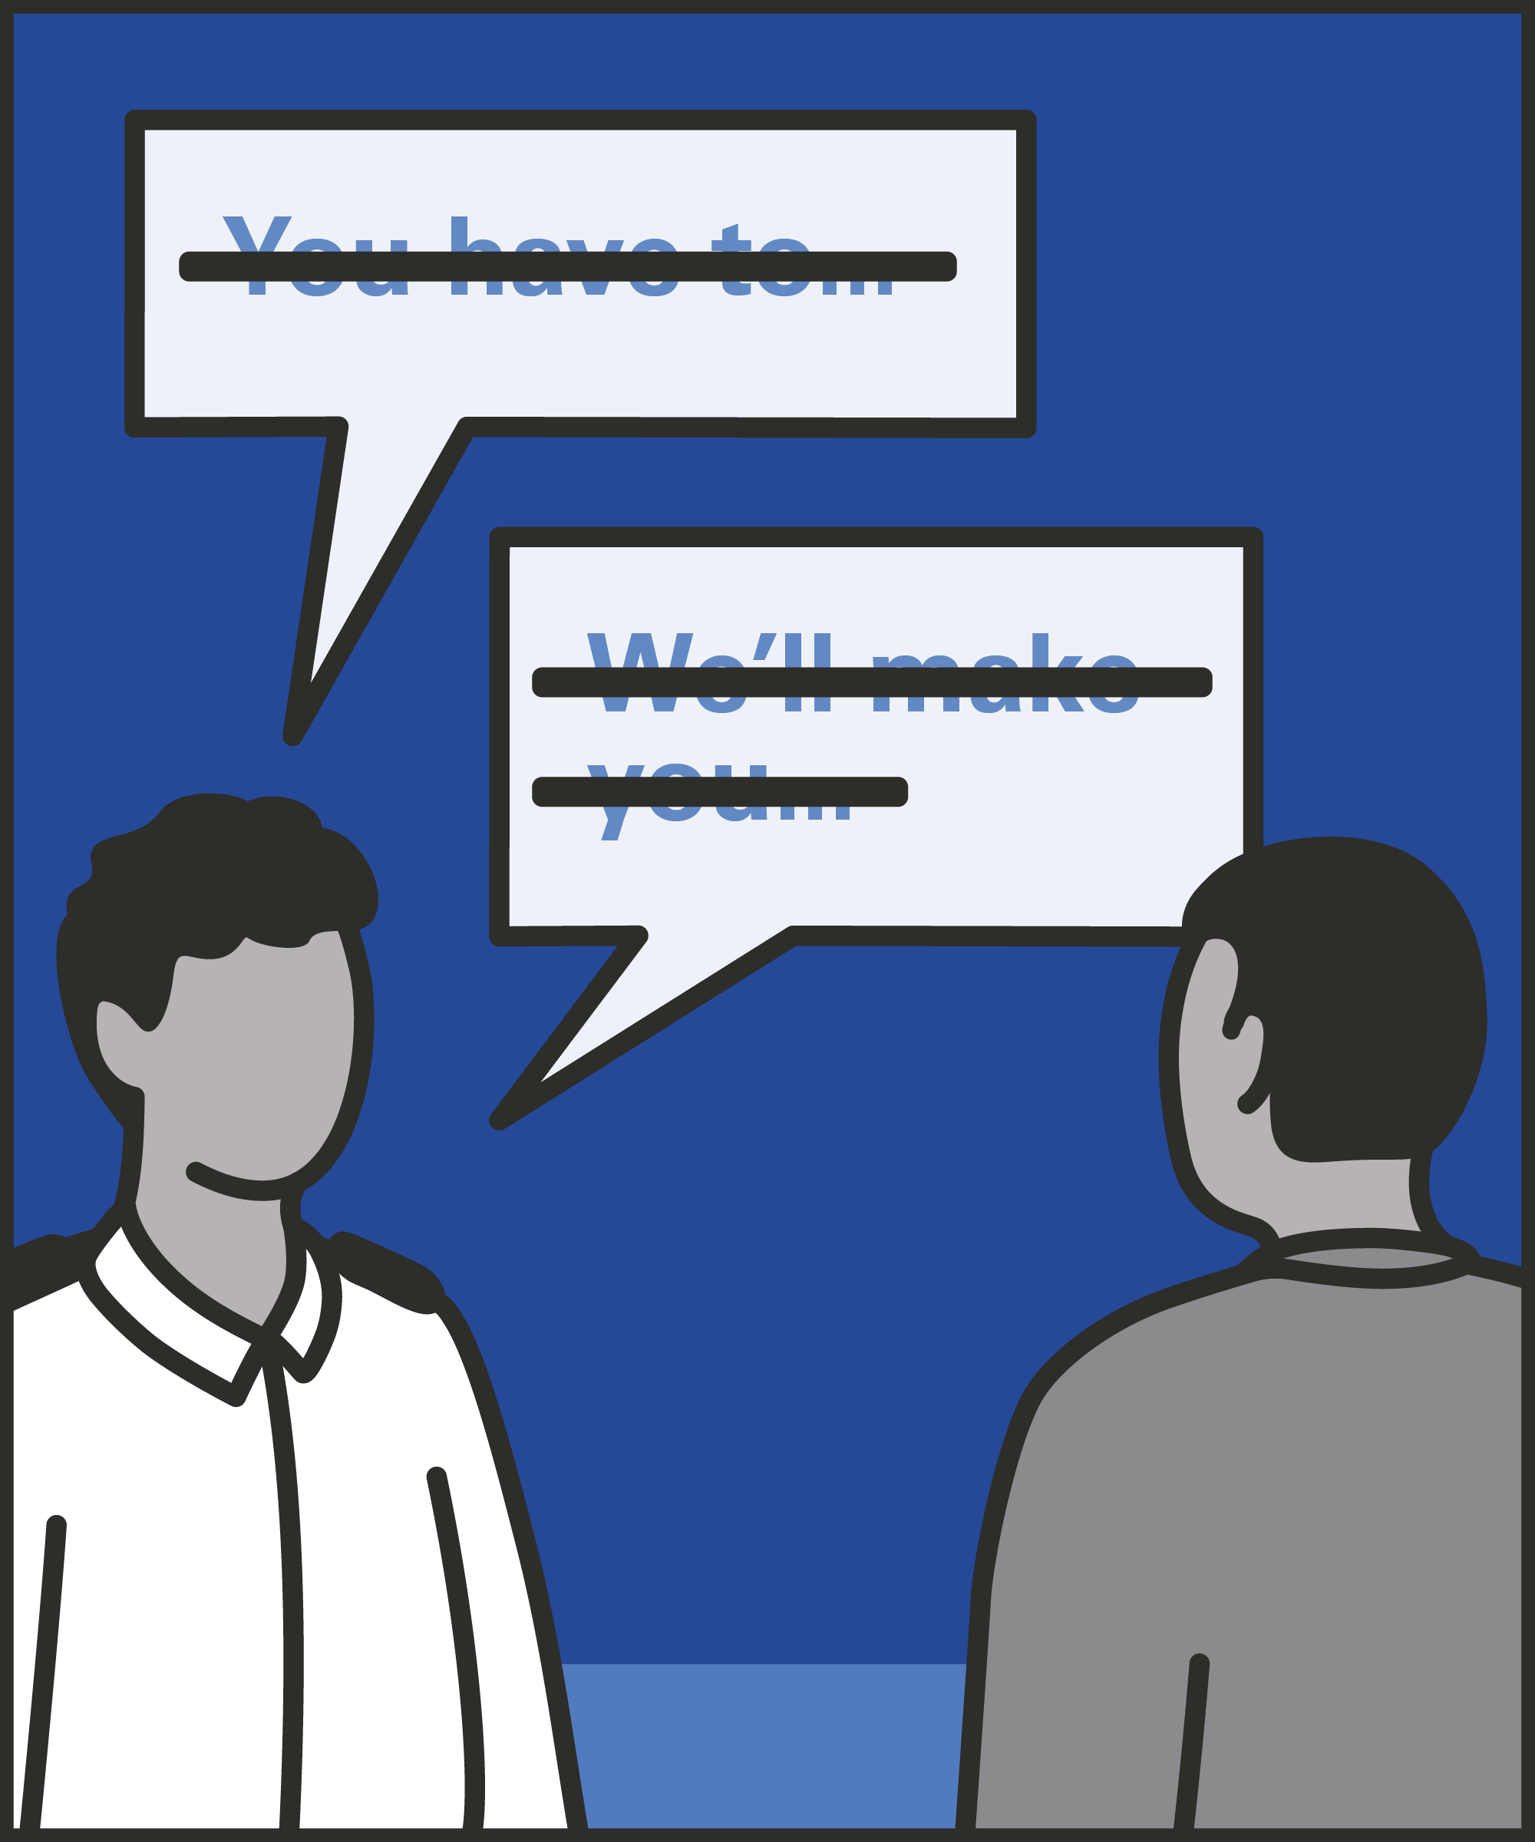


Avoid power language
  Avoid phrases like “you have to” or “we’ll make you” to reduce resistance or resentment.
Explain
  Share the purpose and reasoning behind requests so they feel clear, fair and just.
Narrate
  Talk through your actions in real time to promote transparency and build trust.
Notes:
INTRODUCE STEPS: PURPOSE NOT POWER
EXPLAIN
We are now going to go through each of the steps for this technique.
Avoid using ‘power’ language: Avoid using language that emphasises power, unless you’re giving the prisoner a choice between an action and a consequence. Try to cut out phrases like “You have to,” “We’ll make you,” “You have no choice.” If you fall into using language about power, correct yourself when you notice. For example, you might say “You have to… and it’s the right thing to do in terms of working to get off basic.”
Explain the purpose of your requests and instructions: Whenever you’re planning an action or giving instructions, say why. Why does it matter to the prisoner? Why does it matter for their day today, or for their future? Why does it matter to other prisoners, and to society? There should be a reason for every action: you can explain it by adding just a few extra words to an instruction. For example, “I need everyone ready to get back to the wing” can be followed by “so we can get you fed promptly” or “so we can get the others back to their wings.”
Narrate the purpose during and after action: Explain the purpose as you act, or afterwards. This is particularly important if you have to use coercion or force to get prisoners to do something. As you do it, or afterwards, you can give the rationale, “I’ve done that to keep you safe, now take some time, calm down, and I’ll speak to you in a bit.”

Slide 6
Turn and talk
Using the Pocket Guide as a reference:
Do you use this technique as part of your practice? If so, how and when?
Which of the steps do you use?
Which of the steps do you want to work on?
Notes:
TURN AND TALK: PURPOSE NOT POWER
PAIRED DISCUSSION
In pairs I would like you to discuss the following questions using the pocket guide as a reference (p18):
Do you use this technique as part of your practice? If so, how and when?
Which of the steps do you use?
Which of the steps do you want to work on?
WHOLE GROUP FEEDBACK
(Get whole group feedback following paired discussions.)

Slide 7
Model video
INSERT MODEL VIDEO ONTO SLIDE
Notes:
MODEL VIDEO: PURPOSE NOT POWER
TRAINER NOTE: If possible, insert the model video onto this slide ahead of starting your session. (You can find the online link to the videos here: https://unlockedgrads.org.uk/leading-prison-landings/the-videos/ or by pressing CTRL+CLICK on the box on the slide.)
EXPLAIN VIDEO
We are now going to watch the model video for this technique. While you are watching the video try to see if you can identify the success checks as they are met.
EXPLAIN POTENTIAL PITFALLS
Now that you have a better understanding of this technique, I want to explain some potential pitfalls that officers can make when trying to use it:
Ducking responsibility. One way to emphasise purpose is to explain that you’re following rules, policies and procedures. It’s better to say that an action is “a routine check,” or “I’m just following policy,” than have a prisoner believe we’re singling them out. However, this doesn’t mean we should pin our decisions and responsibilities on others. For example, saying “I’m only doing this because the governors/my manager/the rules say I have to,” suggests we don’t believe in what we’re doing, and we’re not making our own decisions. We might feel like we’re showing the prisoner we’re on their side and building a relationship with them. But a relationship which relies on us not doing our job properly isn’t a healthy one. Point to a purpose and uphold that purpose.

Slide 8

Practice – purpose not power
Roles
Timing
Participant A: Prisoner
Scripting: 1 min
Participant B: Prison officer
Practice: 2 min
Success checks
Feedback: 1 min
Avoid ‘power’ language
Explain the purpose and reasoning
Narrate your actions in real time
Practice: 2 min
Feedback: 1 min
Notes:
PRACTICE: PURPOSE NOT POWER
EXPLAIN THE PRACTICE (NB: you can change the times for scripting, practice and feedback as needed.)
We are now going to practise using the technique purpose not power:
When might you use the technique of purpose not power? Think about a prisoner or group of prisoners you are working with when you have needed to, or will need to, use this technique. For example, when telling a prisoner they can’t have or do something, after a use of force incident, or when conducting a cell search, etc.
To remind you, the success checks for this practice are:
READ SUCCESS CHECKS FROM SLIDE
(Check all have chosen a real-life scenario – choose people to share theirs if time.)
You each now have 1 minute to script what you would say and do in the scenario you have chosen, using the success checks.
(Trainer then allocate pairs.)
Person nearest the door is going to be the prisoner first (Participant A) and the other will be the officer (Participant B).
For practice round 1, Participant B explain your scenario to your partner – they will be playing the role of the prisoner.
Ok, when I say go, you will have 2 minutes to run the practice using the scenario Participant B has given. If you finish before the 2 minutes, give feedback and practice again, making improvements.
Remember to stay in role throughout.
Go.
START PRACTICE
(Circulate during practice and give live feedback to pairs, as necessary.)
EXPLAIN THE FEEDBACK
Participant A, you will now give feedback to your partner.
Referring to the success checks, tell them what they did well and what could they improve on?
(If there is time, you could ask the participants to do a second round of practice implementing the feedback.)
SWITCH ROLES
Now switch roles and repeat the practice and feedback cycle.
WHOLE GROUP FEEDBACK
How was it?
How did it feel?
What feedback did you get?

Slide 9
Next steps: Observations, feedback and tracking
Notes:
EXPLAIN NEXT STEPS FOR OBSERVATIONS
When will next observations take place?
Who will be conducting the observations?
EXPLAIN NEXT STEPS FOR FEEDBACK
When can they expect to get feedback on their observations?
How will feedback be delivered?
EXPLAIN NEXT STEPS FOR TRACKING
How will observations and feedback be tracked?
Are there any updates to share with staff?

Slide 10
As you use this technique in your everyday work, you may find it useful to refer back to Leading Prison Landings: A Pocket Guide, or the full training manual, Leading Prison Landings: The Unlocked Guide to Jailcraft.

