Slide 1
#06 code switching
Training slides

Slide 2
EFFECTIVE PRESENCE AND LANGUAGE
The first six strategies focus on maximising your presence on the wing and ensuring effective communication.
These techniques promote dynamic security and safety, allowing you to build relationships and promote change.
#01 Radar and be seen looking
#02 Assertive body language
#03 Strong voice
#04 Clear directions
#05 Purpose not power
#06 Code switching
Notes:
EFFECTIVE PRESENCE AND LANGUAGE TECHNIQUES
EXPLAIN
The technique that we are looking at today is one of the six ‘Effective Presence and Language’ techniques. These foundational techniques provide a basis for any interaction you might have with a prisoner. They focus on having presence on the wing and communicating effectively with prisoners. Consequently, these techniques help to promote dynamic security and safety allowing officers to focus on building relationships and promoting change amongst prisoners. For officers to be effective and impactful in their roles it is crucial that they master this set of techniques.

Slide 3
Recap of previous technique
Notes:
RECAP PREVIOUS TECHNIQUE
What was the technique we covered last week?
What does the technique look to do?
What are the success checks for the technique?
CELEBRATE SUCCESSES
We have had some great successes this week including…
I would like to shoutout XXXXX because…
Does anyone want to shout out one of their colleagues?

Slide 4
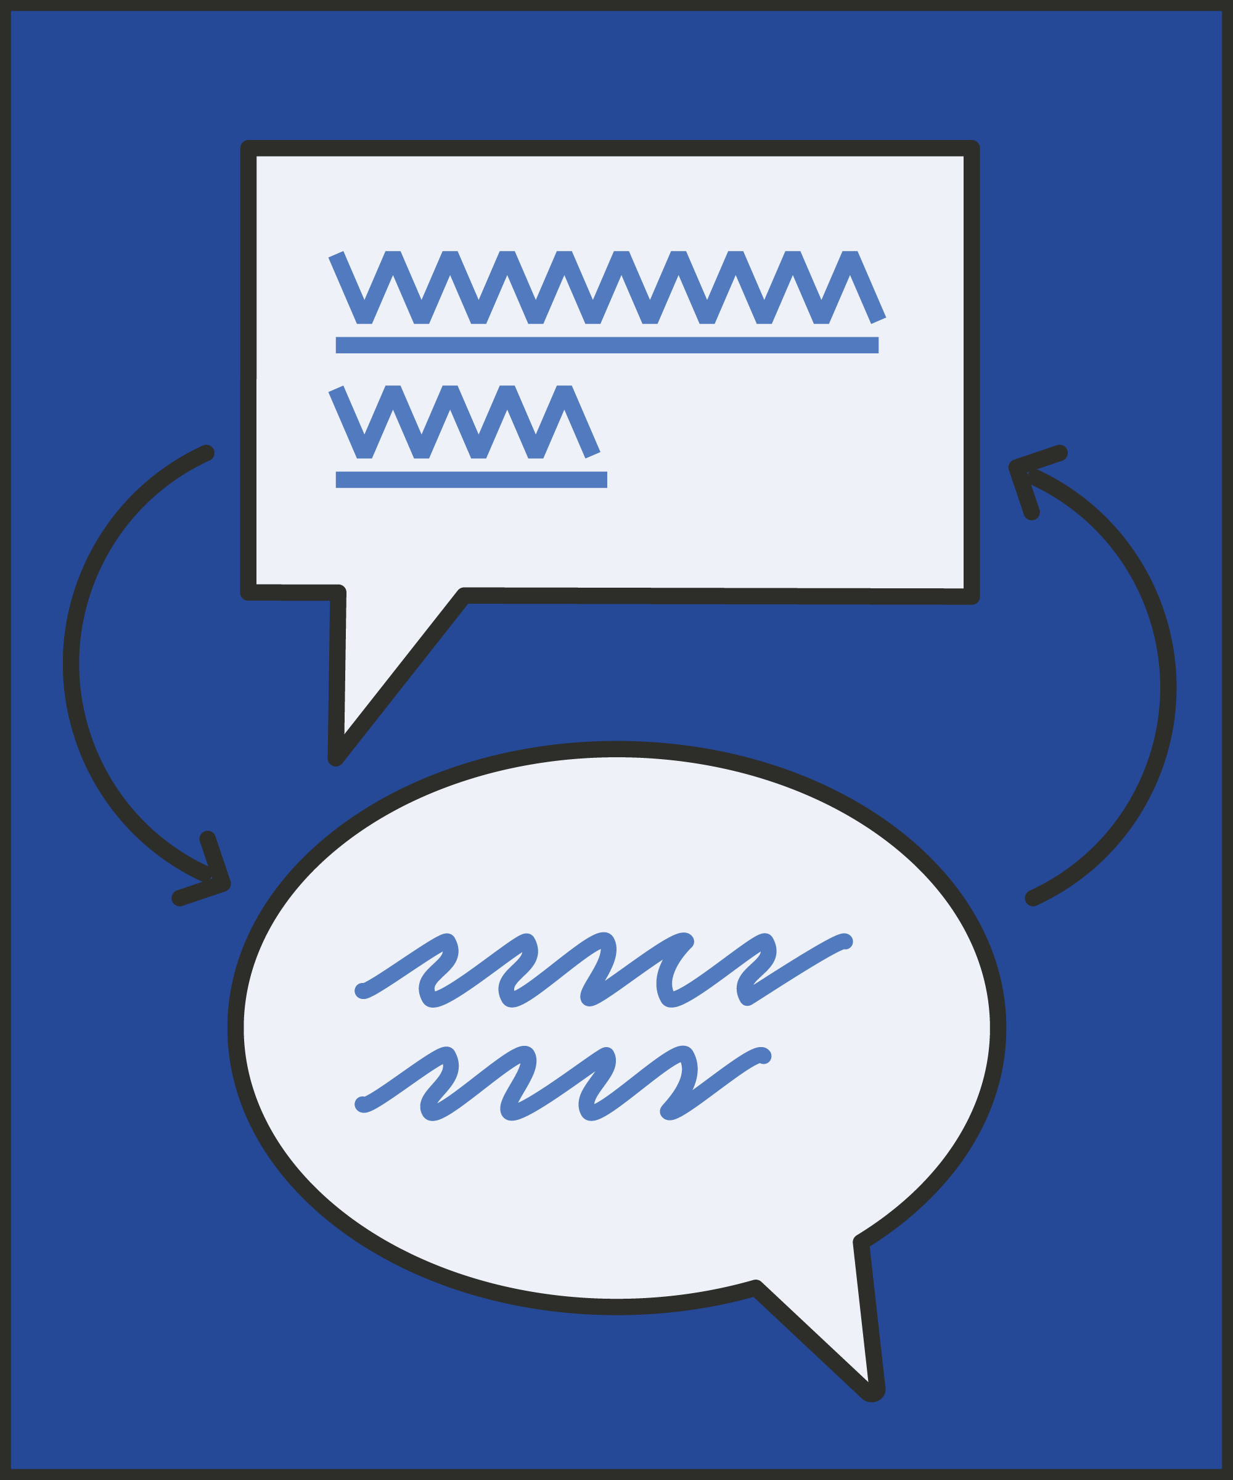
#06 Effective presence and language
  CODE SWITCHING
    Shift your tone and word choice between casual and formal to match the situation and your intent.
Notes:
INTRODUCE NEW TECHNIQUE: CODE SWITCHING
TRAINER NOTE: (Pause a moment to allow people to read the overview of the technique on slide.)
EXPLAIN
Broadly, prison officers can draw on three different tonal registers: casual, formal and urgent.
Firstly, the casual register is used in most of the conversations you would have with most people (both prisoners and staff) on a day-to-day basis.
When using the casual register with prisoners our words and tone seem relaxed and therefore encourage a relaxed response from prisoners.
We are likely to be using this tonal register when having a chat with a prisoner during association or saying “good morning” as you open their cell door.
Secondly, the formal register is more likely to be used when you need to communicate something more urgent or important.
When communicating using the formal register, prisoners are far more likely to understand that the message being conveyed is serious and therefore prisoners are more likely to comply.
Prison officers are likely to use this tone when issuing instructions to prisoners: (e.g.: “I need you to return to your cell now please. We need to get everyone locked up to complete a roll check.”) or when challenging a prisoner whose made an inappropriate comment or behaved poorly.
Lastly, there is the urgent tone. This is when officers need to communicate an urgent message right away. Imagine you have seen two prisoners square up to each other with one grabbing the others shirt, you want to respond right away perhaps saying: “Get off him now.”
Code switching is about effectively shifting your tonal register (both your tone and word choice) between the casual and the formal register to match the situation.
To give an example of when this technique could be used think about this situation. You are having a conversation with a prisoner on the landings talking about a TV show you both watched last night. At this point the officer would be using the casual register. As the conversation goes on the prisoner makes an inappropriate comment towards the member of staff.
This is when the code switch would come into play. The staff member would have to shift from the casual to formal register to demonstrate that the conversation is no longer casual and that an important message needs to be given to the prisoner.

Slide 5
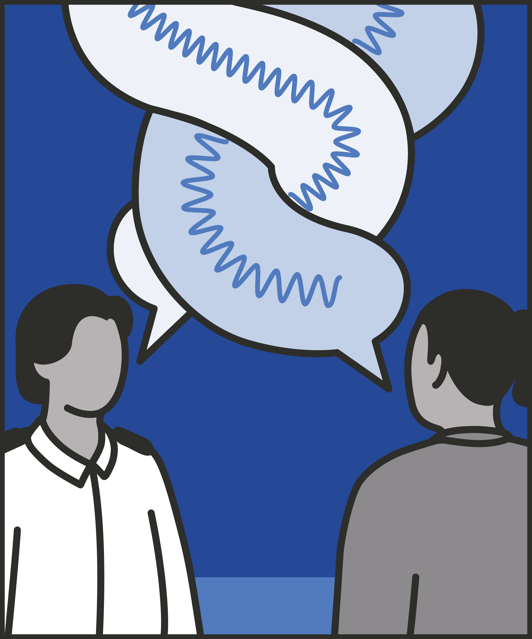
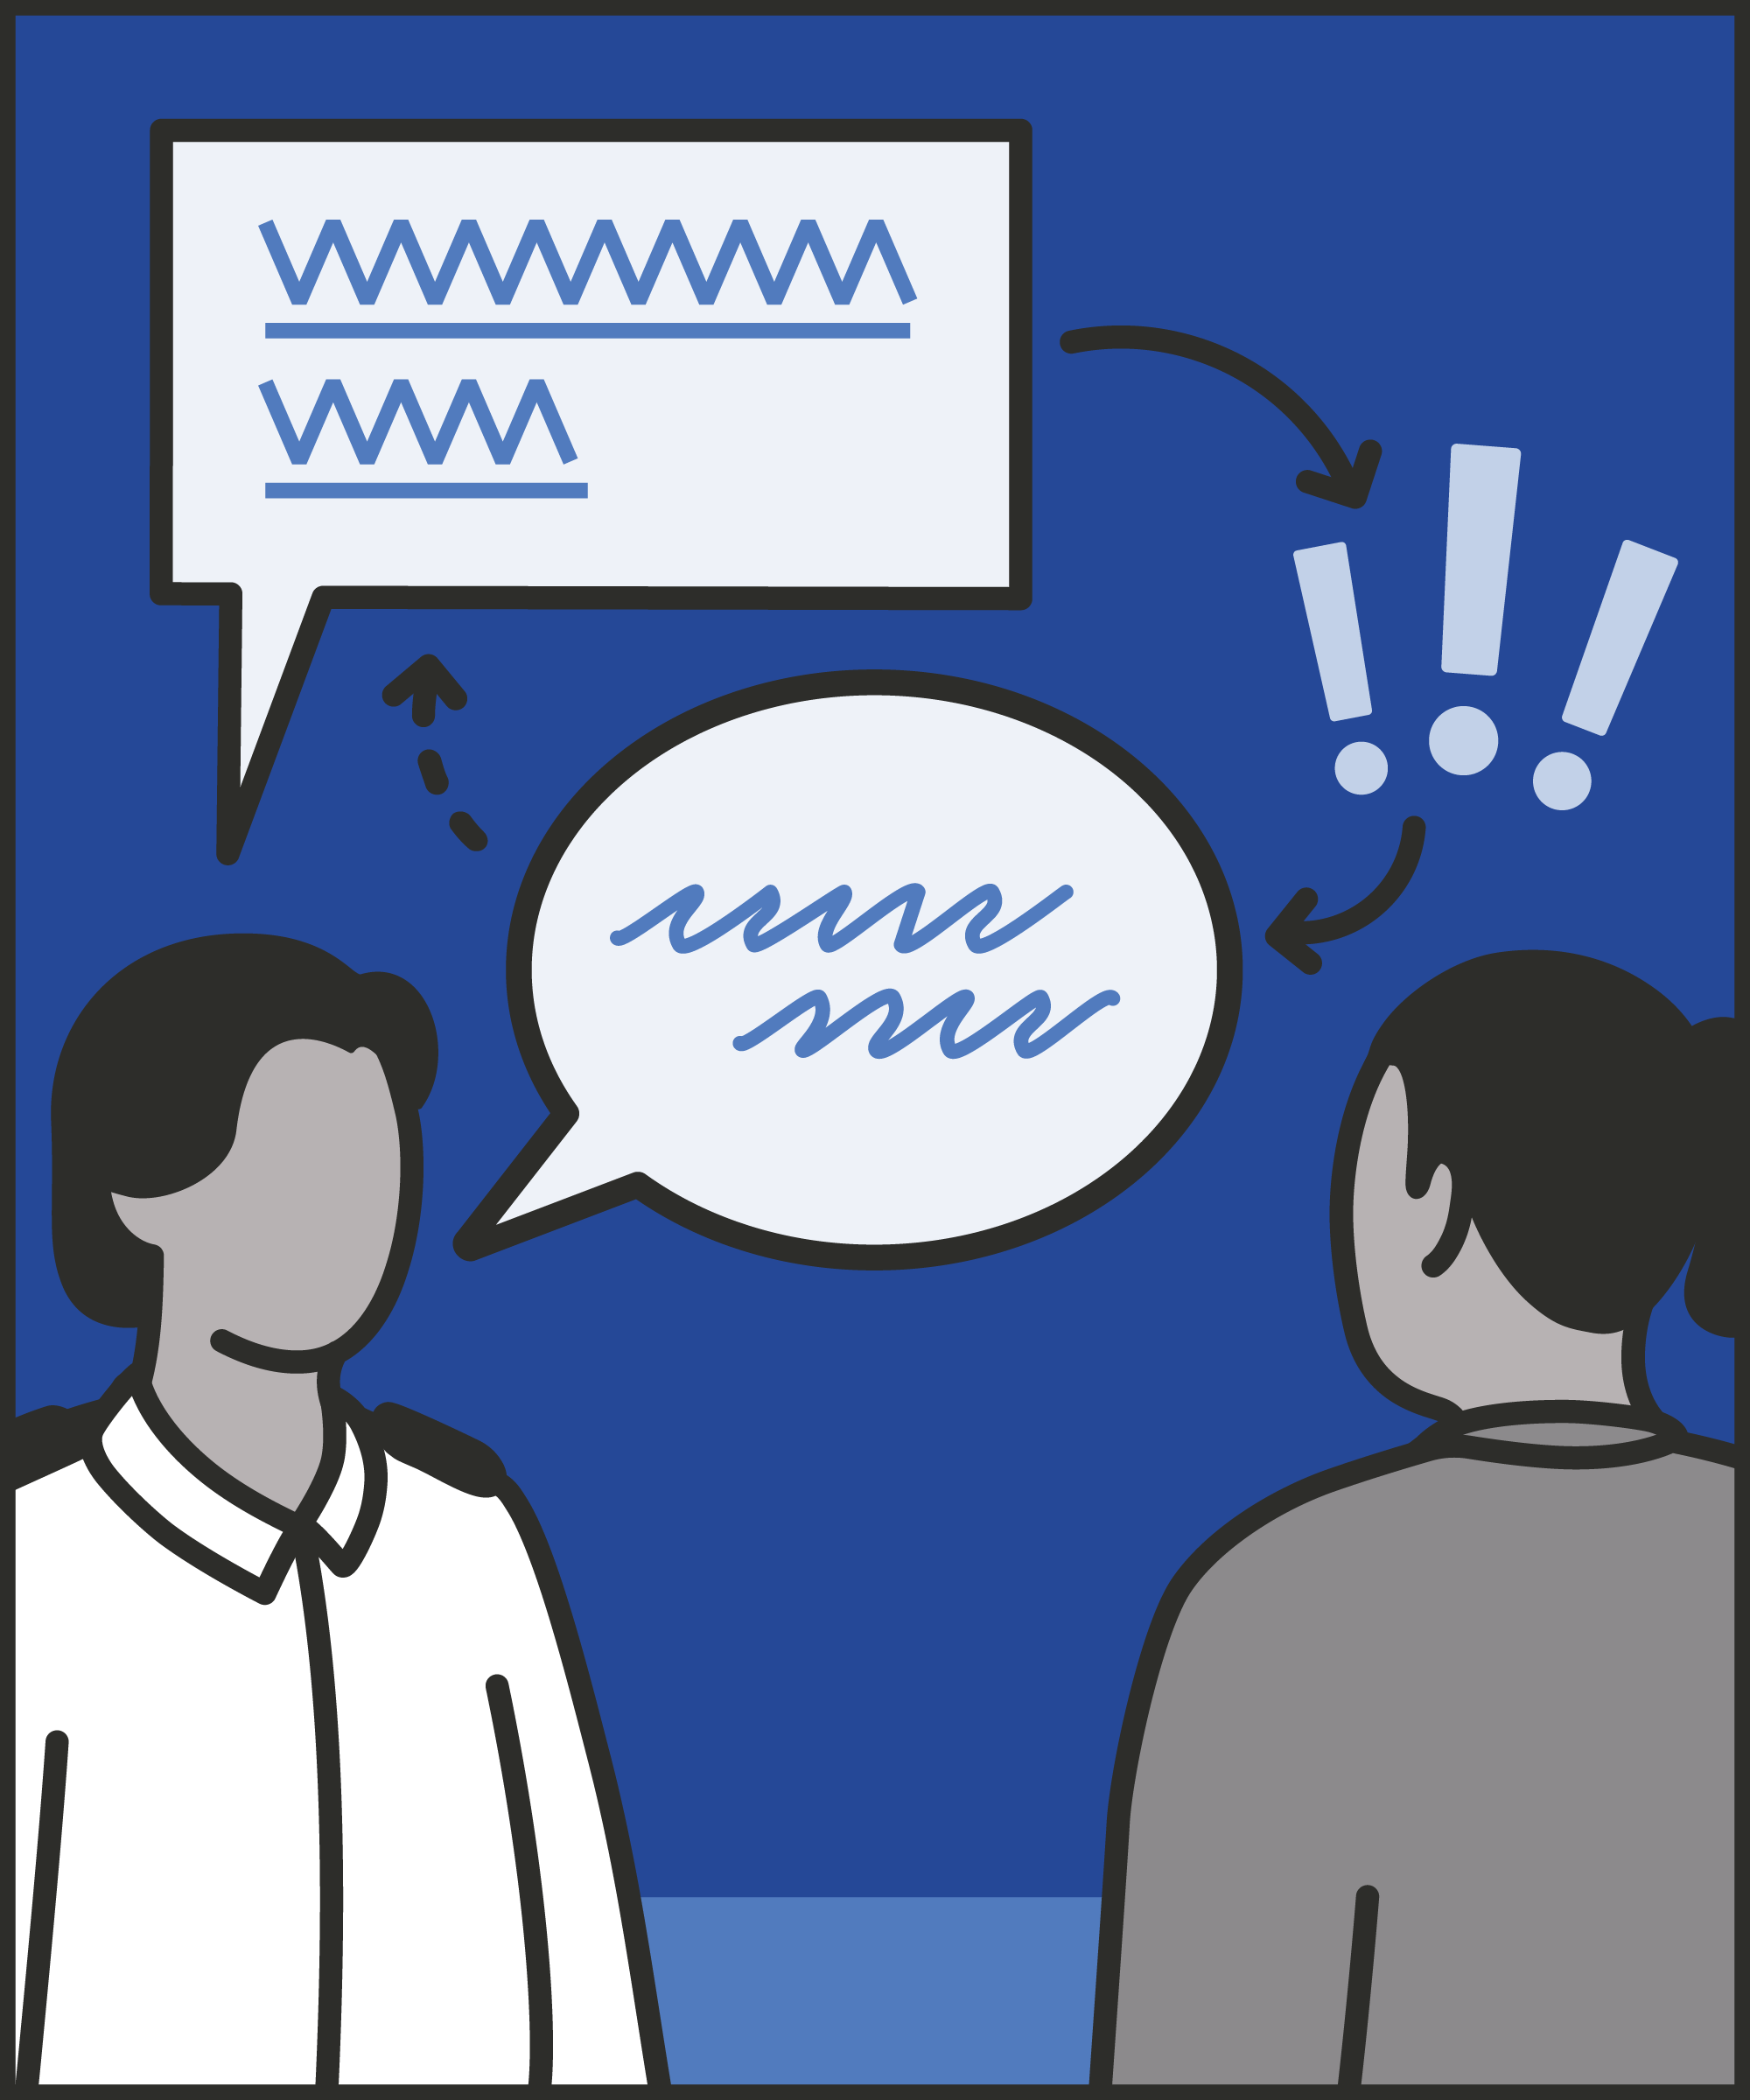
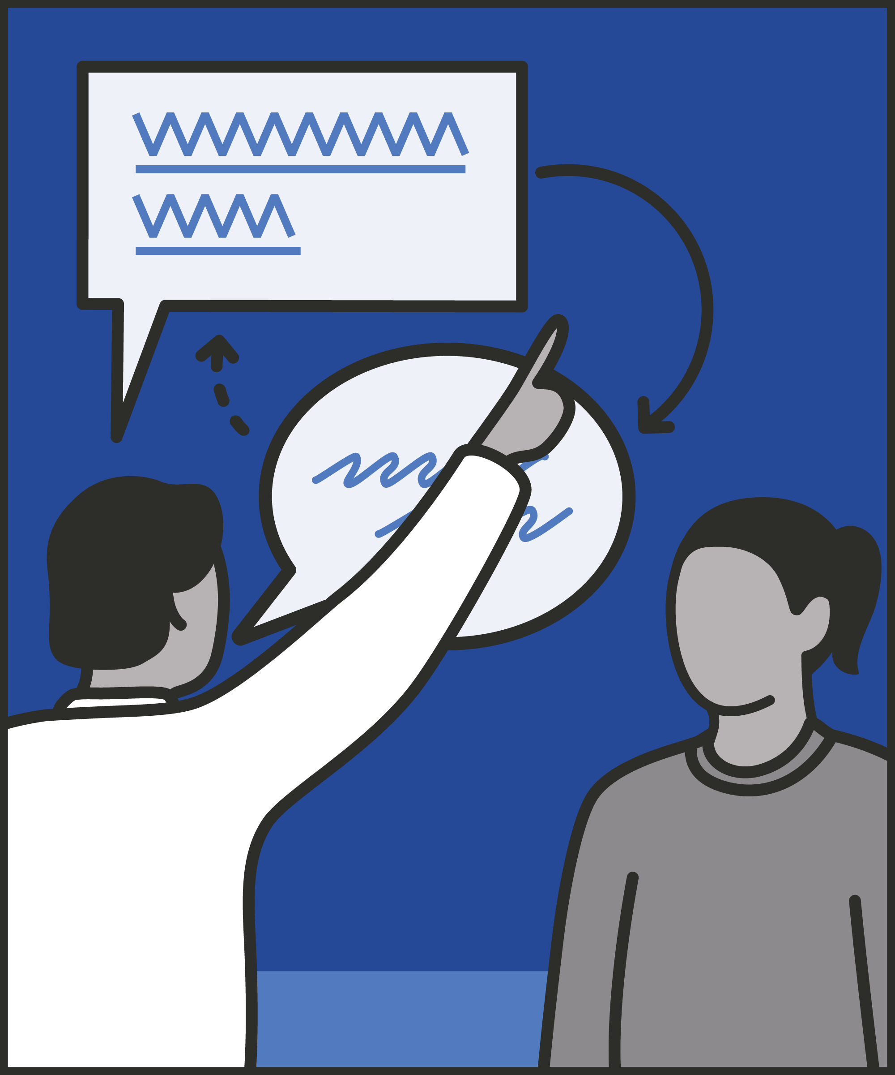
Adapt to the situation
  Speak casually for a relaxed conversation; speak formally to emphasise expectations and instructions.
Switch
  Change tone when required to fit your message to the need, situation and response.
Highlight the change
  Explain the reason for your change in tone and adapt your posture accordingly.
Notes:
INTRODUCE STEPS: CODE SWITCHING
EXPLAIN
We are now going to go through each of the steps for this technique.
Adapt to the situation: To use registers effectively, we need to treat them like tools, taking up the one which is best suited to the situation. Think about the effect we want to have on the prisoner(s) we’re talking to, and the persona we’re adopting. Let’s say we’re projecting warmth, having a chat, and trying to show we care about a prisoner’s wellbeing. We can drop the formality and choose a casual register to emphasise this. Now we need to challenge poor behaviour. We can use a formal register. Just as we monitor our body language, we can monitor the effect of the register we use.
Switch: A conversation may demand more than one register. If we’re having a relaxed conversation about the football with a prisoner, we’ll take on a casual register. “Did you see that penalty last week? Awful shot, all over the place.” Let’s say the prisoner takes things too far: “Anyone tells me they like Chelsea, I bang them up”. We now need to switch to a formal register. We might say, “Let me just stop you there we don’t use aggressive language like that on this wing.” Assuming the prisoner takes our point, we can then switch back to something more casual: “What do you reckon to their chances against Everton?”
Highlight the change: We can further increase the impact of code-switching by highlighting the switch. As we move from formal to casual, we can interrupt the flow of our conversation and take on a more formal stance. As we move from casual back to formal, we can use a bridging phrase to signal the change. So, in response to “Anyone tells me they like Chelsea, I bang them up.” We might pause, draw ourselves up and say, “Let me just stop you there we don’t use aggressive language like that on this wing.” We can then bridge back to a casual register by saying, “Shall we move on? OK, so what do you reckon to their chances against Everton?” It could be helpful to narrate this change for prisoners: “I just need you to understand that what you said wasn’t acceptable. We can relax and talk about the football again now.” The aim of code-switching is to end all interactions on a positive note rather than dwell too long on the negative/inappropriate comment or behaviour. This isn’t always possible for example a prisoner may not back down, and it may not be possible to end the conversation on a positive note.

Slide 6
Turn and talk
Using the Pocket Guide as a reference:
Do you use this technique as part of your practice? If so, how and when?
Which of the steps do you use?
Which of the steps do you want to work on?
Notes:
TURN AND TALK: CODE SWITCHING
PAIRED DISCUSSION
In pairs I would like you to discuss the following questions using the pocket guide as a reference (p20):
Do you use this technique as part of your practice? If so, how and when?
Which of the steps do you use?
Which of the steps do you want to work on?
WHOLE GROUP FEEDBACK
(Get whole group feedback following paired discussions.)

Slide 7
Model video
INSERT MODEL VIDEO ONTO SLIDE
Notes:
MODEL VIDEO: CODE SWITCHING
TRAINER NOTE: If possible, insert the model video onto this slide ahead of starting your session. (You can find the online link to the videos here: https://unlockedgrads.org.uk/leading-prison-landings/the-videos/ or by pressing CTRL+CLICK on the box on the slide.)
EXPLAIN VIDEO
We are now going to watch the model video for this technique. While you are watching the video try to see if you can identify the success checks as they are met.
EXPLAIN POTENTIAL PITFALLS
Now that you have a better understanding of this technique, I want to explain some potential pitfalls that officers can make when trying to use it:
Overusing the casual register. We may find we use the casual register too much. This is particularly likely if we are making an effort to seem friendly and approachable. It may be worth distinguishing when we need to switch into a formal register. When giving an instruction, for example, always switch into the formal register. Clear boundaries make it easier for a prisoner to know what they can do when. Using formal register makes it easier for prisoners to know when we’re giving an instruction, and when they can relax more.
Overusing the formal register. We may also find that we overuse the formal register. This may reflect not feeling secure on the wing and trying to maintain and enforce boundaries with prisoners. This is particularly likely when they are sizing us up as a new officer, trying to see where our boundaries lie. This isn’t to discourage using a formal register: it’s better to start formal and relax when you can. However, if we are spending most of a shift in formal register, we may want to pick a couple of times where we can relax into casual register – and see what the effect is.
Using the urgent register. We are unlikely ever to choose an urgent register. When we’re worried, or feel like we’re losing control, we may find ourselves shouting “Help!” or “Stop that now!” or “Leave him alone!” We have taken on an urgent tone, whether we meant to or not. There’s no immediate solution, what matters is that we note it and try to avoid using it in future. In particular, if we find it happening frequently, try to identify what the trigger is: in what situations do we feel panic and find our register slipping to urgency? We can then remind ourselves to pause briefly, breathe deeply, and stick to a formal tone.

Slide 8

Practice – code switching
Roles
Timing
Participant A: Prisoner
Scripting: 1 min
Participant B: Prison officer
Practice: 2 min
Success checks
Feedback: 1 min
Adapt to the situation
Switch tone when required
Highlight the change in tone
Practice: 2 min
Feedback: 1 min
Notes:
PRACTICE: CODE SWITCHING
EXPLAIN THE PRACTICE (NB: you can change the times for scripting, practice and feedback as needed.)
We are now going to practise using the technique code switching:
When might you use the technique of code switching? Think about a prisoner or group of prisoners you are working with when you have needed to, or will need to, use this technique. For example, when a prisoner crosses a boundary, when enforcing a direct order or after de-escalating a situation, etc.
To remind you, the success checks for this practice are:
READ SUCCESS CHECKS FROM SLIDE
(Check all have chosen a real-life scenario – choose people to share theirs if time.)
You each now have 1 minute to script what you would say and do in the scenario you have chosen, using the success checks.
(Trainer then allocate pairs.)
Person nearest the door is going to be the prisoner first (Participant A) and the other will be the officer (Participant B).
For practice round 1, Participant B explain your scenario to your partner – they will be playing the role of the prisoner.
Ok, when I say go, you will have 2 minutes to run the practice using the scenario Participant B has given. If you finish before the 2 minutes, give feedback and practice again, making improvements.
Remember to stay in role throughout.
Go.
START PRACTICE
(Circulate during practice and give live feedback to pairs, as necessary.)
EXPLAIN THE FEEDBACK
Participant A, you will now give feedback to your partner.
Referring to the success checks, tell them what they did well and what could they improve on?
(If there is time, you could ask the participants to do a second round of practice implementing the feedback.)
SWITCH ROLES
Now switch roles and repeat the practice and feedback cycle.
WHOLE GROUP FEEDBACK
How was it?
How did it feel?
What feedback did you get?

Slide 9
Next steps: Observations, feedback and tracking
Notes:
EXPLAIN NEXT STEPS FOR OBSERVATIONS
When will next observations take place?
Who will be conducting the observations?
EXPLAIN NEXT STEPS FOR FEEDBACK
When can they expect to get feedback on their observations?
How will feedback be delivered?
EXPLAIN NEXT STEPS FOR TRACKING
How will observations and feedback be tracked?
Are there any updates to share with staff?

Slide 10
As you use this technique in your everyday work, you may find it useful to refer back to Leading Prison Landings: A Pocket Guide, or the full training manual, Leading Prison Landings: The Unlocked Guide to Jailcraft.

