Slide 1
#07 warm / firm
Training slides

Slide 2
PREVENTING AND ADDRESSING CONFLICT
The first five strategies in this section support you to pre-empt conflict and address issues authoritatively, effectively and warmly. This helps maintain a safe environment and lays the foundations to help prisoners change. These techniques promote dynamic security and safety, allowing you to build relationships and promote change.
The following five strategies should be used to de-escalate conflict, resolve incidents and promote positive choices. They can be treated as steps followed in order or individually, as appropriate.
#07 Warm / firm
#08 Pre-empting problems
#09 Least invasive intervention
#10 Emotional constancy
#11 Giving effective consequences
#12 Create space to de-escalate
#13 Identify wants
#14 Tactical agreement
#15 Clarify expectations
#16 Give choices
Notes:
PREVENTING AND ADDRESSING CONFLICT
EXPLAIN
The technique that we are looking at today is one of the ten ‘Preventing and Addressing Conflict’ techniques. These techniques can be split into two groups: ‘preventing conflict’ and ‘addressing conflict’ each with five techniques linked to them. The preventing conflict techniques allow you to prevent conflict from happening in the first place. They support you to pre-empt conflict and address issues authoritatively, effectively and warmly. This helps to maintain safe environment and lays the foundations to help prisoners change. Many of these techniques don’t just prevent conflict they also help to keep the smooth day to running of the prison and lead to improved daily interactions between prisoners and staff. Therefore, mastering these techniques not only helps to keep the wing safe but also helps to improves staff/prisoner relationships which in turn contributes to better outcomes for prisoners.

Slide 3
Recap of previous technique
Notes:
RECAP PREVIOUS TECHNIQUE
What was the technique we covered last week?
What does the technique look to do?
What are the success checks for the technique?
CELEBRATE SUCCESSES
We have had some great successes this week including…
I would like to shoutout XXXXX because…
Does anyone want to shout out one of their colleagues?

Slide 4

#07 Preventing and addressing conflict
  WARM / FIRM
    Be warm and firm to maintain high expectations and build strong relationships whilst holding prisoners accountable.
Notes:
INTRODUCE NEW TECHNIQUE: WARM/FIRM
TRAINER NOTE: (Pause a moment to allow people to read the overview of the technique on slide.)
EXPLAIN
Prisoners find punitive and confrontational prison regimes oppressive. But lax regimes make prisoners feel unsafe, and unsupported to change.
Prisoners need clear, firm boundaries – applied fairly, reasonably and warmly.
We must be firm to maintain safety, security and order, and to push prisoners to do their best.
But firmness alone grates: no one likes being treated firmly. If we are warm and firm, we can bring out the best in prisoners.
To help you understand what we mean by warm/firm I will give you an example. Imagine we’re speaking to a prisoner who’s new to the wing and is struggling to adjust. They’ve just done something seriously out of line. We could respond in the following ways:
“That’s not OK, this will go to adjudication,” is pure firmness. It’s the right decision, but it’s articulated so badly that the prisoner is likely to resent it.
“That’s not OK, I know you’re having a tough week, and I want to support you, so I’ll let you off this time. Don’t do it again,” is too warm. We are failing to hold the prisoner to account for their actions.
“That’s not OK, I know you’re having a tough week, and I want to support you. This will go to adjudication. If there’s anything I can do to help you fix things, please tell me,” balances firmness with warmth. We are holding the prisoner accountable, while showing that we want to help.
This example is of giving a consequence, but the same principle applies in any interaction with a prisoner: we want to show the prisoner that we have high expectations and show that we care.

Slide 5
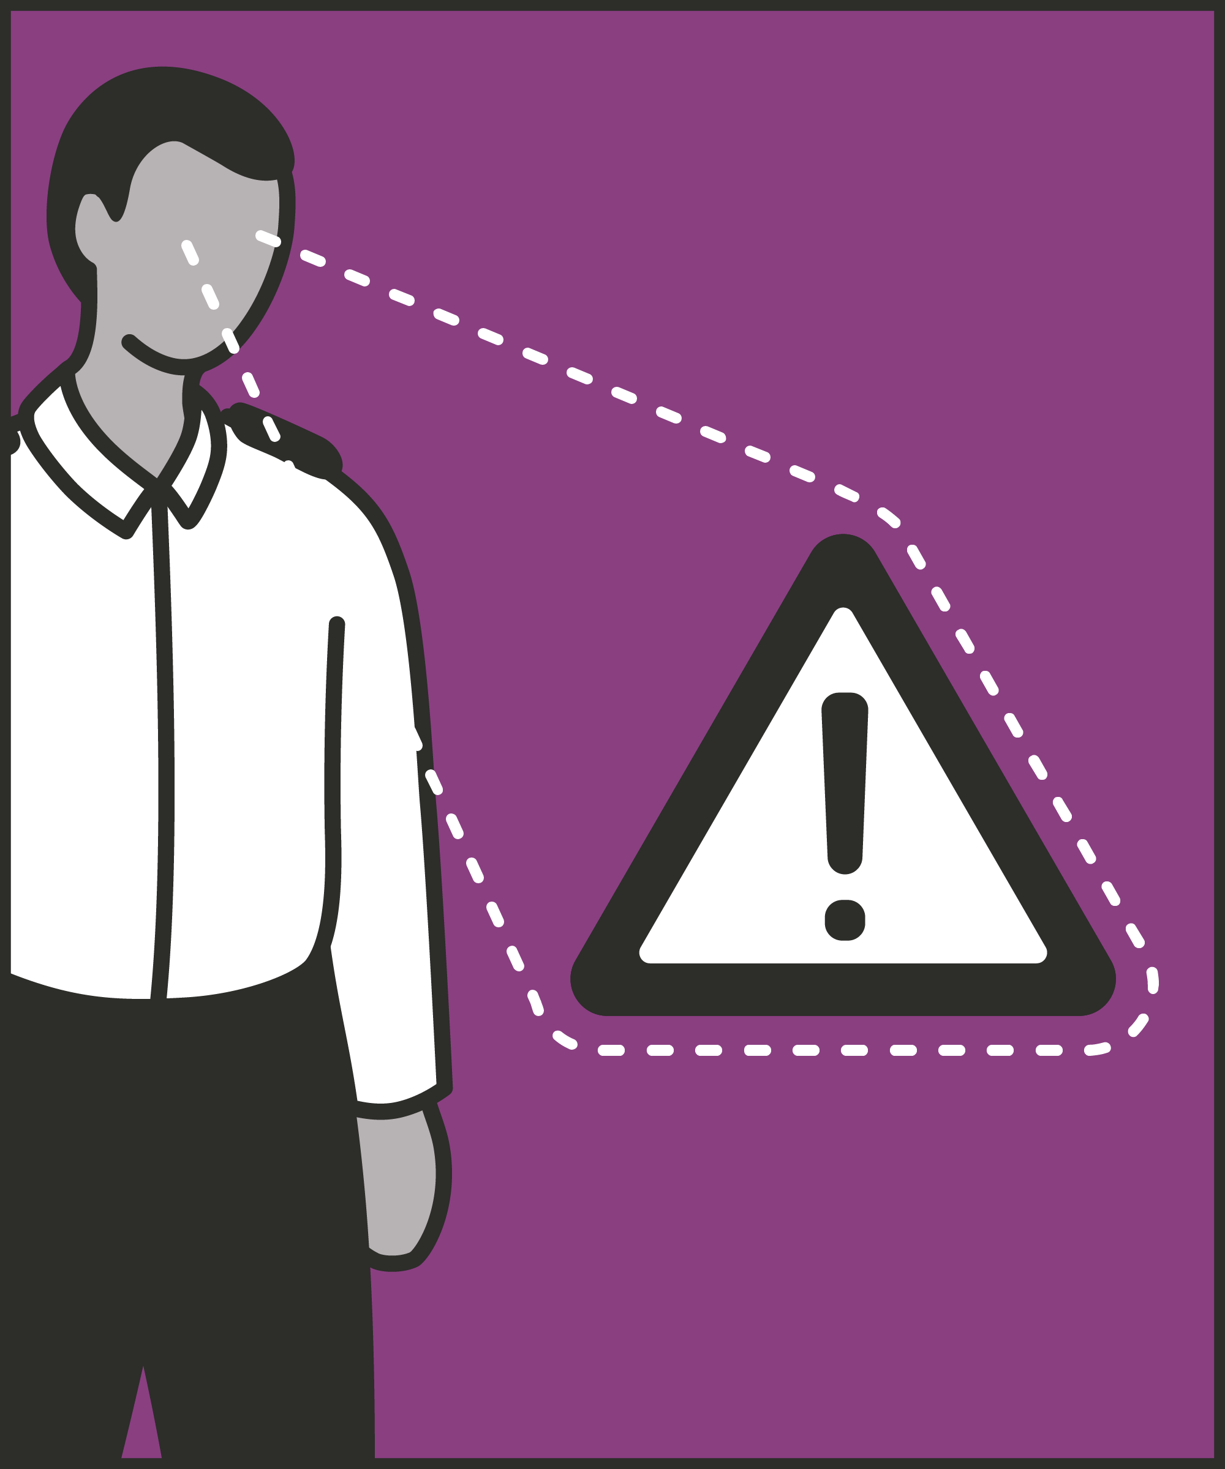
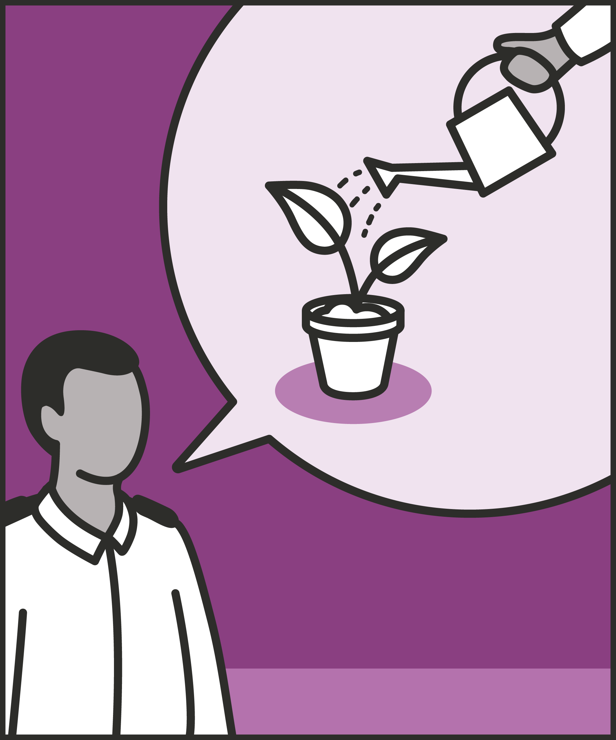

Hold prisoners to high standards
  Always challenge where appropriate; don’t overlook undesirable behaviour; maintain consistency and high expectations.
Articulate standards gently
  Be warm, be kind, be friendly (where appropriate).
Shift and adapt
  Move between warmth and firmness as required to set the right tone for the interaction based on expectations and wanting the best for the prisoner.
Notes:
INTRODUCE STEPS: WARM/FIRM
EXPLAIN
We are now going to go through each of the steps for this technique.
Hold prisoners to high standards: Holding prisoners to a high standard is hard. It’s always tempting not to. Every time we let things go – sliders on the landing, vaping, bad language, rudeness – we avoid confrontation, anger and hassle. We make the next few minutes a lot easier for us and the prisoner. But we also normalise the undesirable behaviour: if one prisoner can misbehave in front of us, so can everyone else. We also make future intervention harder – on this, or anything else. The sooner we enforce high standards, the easier it is to maintain those standards and bring out the best in prisoners.
Articulate standards gently: There are many ways we can articulate those high standards. We want to choose the warmest, kindest, friendliest way possible, without undermining our point. We can choose warmer words: “Look, you’re a reasonable guy, what I need you to do is…” We can listen and show we care: “Tell me how you see it, then we can talk about what’s going to happen.” We can use facial expressions and body language, like a thumbs up or a smile when the prisoner complies. We want to look at every interaction and ask; how can we make this warmer for the prisoner?
Shift and adapt: We can make a firm point using warm words: “We all want to keep this wing a decent place, so I can’t allow you to behave like this.” We may make a firm point, then add warmth: “Stop that now, get off him!” then “Come on, you’re better than this.” We may need to sustain firmness for several sentences to make a point or investigate an issue, then switch back to warmth: “OK, I’ve heard enough, we’ll say no more about it now, I want you to go back and be as positive on the wing as you are normally.”

Slide 6
Turn and talk
Using the Pocket Guide as a reference:
Do you use this technique as part of your practice? If so, how and when?
Which of the steps do you use?
Which of the steps do you want to work on?
Notes:
TURN AND TALK: WARM/FIRM
PAIRED DISCUSSION
In pairs I would like you to discuss the following questions using the pocket guide as a reference (p24):
Do you use this technique as part of your practice? If so, how and when?
Which of the steps do you use?
Which of the steps do you want to work on?
WHOLE GROUP FEEDBACK
(Get whole group feedback following paired discussions.)

Slide 7
Model video
INSERT MODEL VIDEO ONTO SLIDE
Notes:
MODEL VIDEO: WARM/FIRM
TRAINER NOTE: If possible, insert the model video onto this slide ahead of starting your session. (You can find the online link to the videos here: https://unlockedgrads.org.uk/leading-prison-landings/the-videos/ or by pressing CTRL+CLICK on the box on the slide.)
EXPLAIN VIDEO
We are now going to watch the model video for this technique. While you are watching the video try to see if you can identify the success checks as they are met.
EXPLAIN POTENTIAL PITFALLS
Now that you have a better understanding of this technique, I want to explain some potential pitfalls that officers can make when trying to use it:
Being too harsh. Firmness holds prisoners accountable for behaving well. Harshness is something different. We can be firm without being punitive and uncaring. Partly, this is about being warm in being firm. But it also means thinking about where firmness is reasonable, necessary and required. Firmness isn’t a goal: it’s a means to maintain order and bring out the best in prisoners. We want to make firmness an intentional choice for a specific purpose – we don’t want to over-react to a prisoner’s behaviour.
Letting warmth undermine firmness. Attempting to be warm, we may not be firm enough with prisoners we know and like, or with prisoners we are intimidated by. This might mean overlooking small misdemeanours or breaches of the rules – particularly when those rule breaches have been normalised in the prison. But if we want to be able to keep enforcing rules, we need to be firm. Firmness is a necessary measure to build respectful relationships with firm foundations: don’t let the temptation of warmth undermine this.

Slide 8

Practice – warm / firm
Roles
Timing
Participant A: Prisoner
Scripting: 1 min
Participant B: Prison officer
Practice: 2 min
Success checks
Feedback: 1 min
Hold prisoners to high standards
Articulate standards gently
Shift and adapt tone when needed
Practice: 2 min
Feedback: 1 min
Notes:
PRACTICE: WARM/FIRM
EXPLAIN THE PRACTICE (NB: you can change the times for scripting, practice and feedback as needed.)
We are now going to practise using the technique warm/firm:
When might you use the technique of warm/firm? Think about a prisoner or group of prisoners you are working with when you have needed to, or will need to, use this technique. For example, when responding to an incident of self-harm, prompting a wing worker to do something or during a post-incident reflection with a prisoner, etc.
To remind you, the success checks for this practice are:
READ SUCCESS CHECKS FROM SLIDE
(Check all have chosen a real-life scenario – choose people to share theirs if time.)
You each now have 1 minute to script what you would say and do in the scenario you have chosen, using the success checks.
(Trainer then allocate pairs.)
Person nearest the door is going to be the prisoner first (Participant A) and the other will be the officer (Participant B).
For practice round 1, Participant B explain your scenario to your partner – they will be playing the role of the prisoner.
Ok, when I say go, you will have 2 minutes to run the practice using the scenario Participant B has given. If you finish before the 2 minutes, give feedback and practice again, making improvements.
Remember to stay in role throughout.
Go.
START PRACTICE
(Circulate during practice and give live feedback to pairs, as necessary.)
EXPLAIN THE FEEDBACK
Participant A, you will now give feedback to your partner.
Referring to the success checks, tell them what they did well and what could they improve on?
(If there is time, you could ask the participants to do a second round of practice implementing the feedback.)
SWITCH ROLES
Now switch roles and repeat the practice and feedback cycle.
WHOLE GROUP FEEDBACK
How was it?
How did it feel?
What feedback did you get?

Slide 9
Next steps: Observations, feedback and tracking
Notes:
EXPLAIN NEXT STEPS FOR OBSERVATIONS
When will next observations take place?
Who will be conducting the observations?
EXPLAIN NEXT STEPS FOR FEEDBACK
When can they expect to get feedback on their observations?
How will feedback be delivered?
EXPLAIN NEXT STEPS FOR TRACKING
How will observations and feedback be tracked?
Are there any updates to share with staff?

Slide 10
As you use this technique in your everyday work, you may find it useful to refer back to Leading Prison Landings: A Pocket Guide, or the full training manual, Leading Prison Landings: The Unlocked Guide to Jailcraft.

