Slide 1
#08 pre-empting problems
Training slides

Slide 2
PREVENTING AND ADDRESSING CONFLICT
The first five strategies in this section support you to pre-empt conflict and address issues authoritatively, effectively and warmly. This helps maintain a safe environment and lays the foundations to help prisoners change. These techniques promote dynamic security and safety, allowing you to build relationships and promote change.
The following five strategies should be used to de-escalate conflict, resolve incidents and promote positive choices. They can be treated as steps followed in order or individually, as appropriate.
#07 Warm / firm
#08 Pre-empting problems
#09 Least invasive intervention
#10 Emotional constancy
#11 Giving effective consequences
#12 Create space to de-escalate
#13 Identify wants
#14 Tactical agreement
#15 Clarify expectations
#16 Give choices
Notes:
PREVENTING AND ADDRESSING CONFLICT
EXPLAIN
The technique that we are looking at today is one of the ten ‘Preventing and Addressing Conflict’ techniques. These techniques can be split into two groups: ‘preventing conflict’ and ‘addressing conflict’ each with five techniques linked to them. The preventing conflict techniques allow you to prevent conflict from happening in the first place. They support you to pre-empt conflict and address issues authoritatively, effectively and warmly. This helps to maintain safe environment and lays the foundations to help prisoners change. Many of these techniques don’t just prevent conflict they also help to keep the smooth day to running of the prison and lead to improved daily interactions between prisoners and staff. Therefore, mastering these techniques not only helps to keep the wing safe but also helps to improves staff/prisoner relationships which in turn contributes to better outcomes for prisoners.

Slide 3
Recap of previous technique
Notes:
RECAP PREVIOUS TECHNIQUE
What was the technique we covered last week?
What does the technique look to do?
What are the success checks for the technique?
CELEBRATE SUCCESSES
We have had some great successes this week including…
I would like to shoutout XXXXX because…
Does anyone want to shout out one of their colleagues?

Slide 4
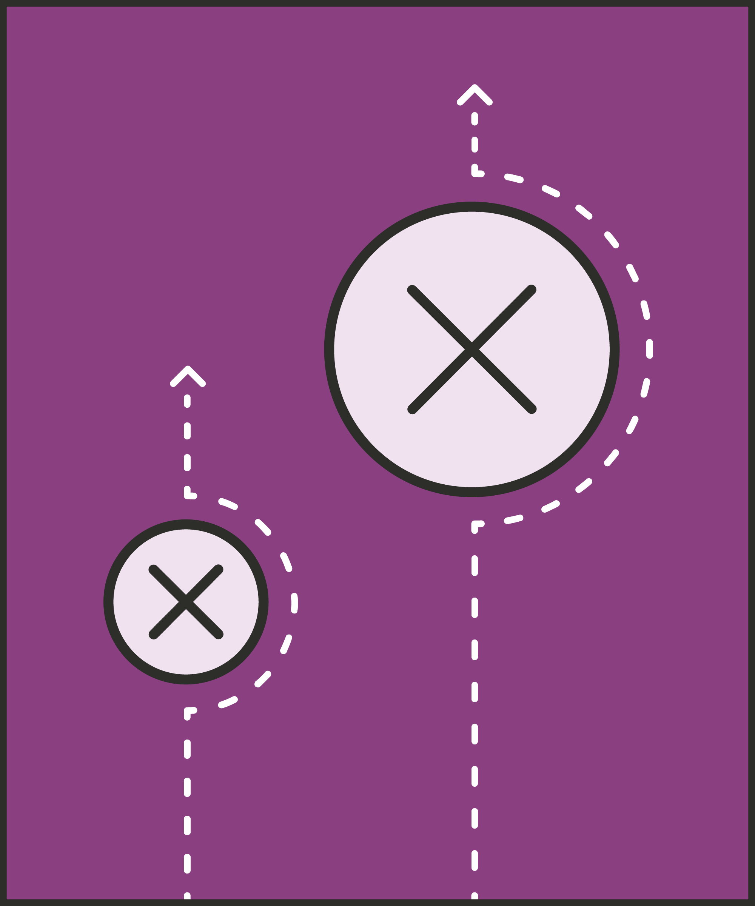
#08 Preventing and addressing conflict
  PRE-EMPTING PROBLEMS
    Spot potential issues before they emerge, then remind or redirect prisoners in order to prevent them.
Notes:
INTRODUCE NEW TECHNIQUE: PRE-EMPTING PROBLEMS
TRAINER NOTE: (Pause a moment to allow people to read the overview of the technique on slide.)
EXPLAIN
It’s easy to spot someone solving a problem. It looks impressive too, when it’s done well. We can admire a prison officer dashing in to boldly defuse a situation.
Pre-empting a problem is harder to spot, and less immediately impressive. But it’s much more powerful. Prevention is better than cure.
We can pre-empt a dispute, a fight, or a problem, using a quiet word, a distraction, or a change in the order we unlock prisoners.
Better to prevent a problem than wait for it to happen, then have to deal with it.
This technique builds on our use of Radar be seen looking (Technique 1): having a constant awareness of what’s going on around us.
We can combine this with our knowledge of prisoners, and relationships with them, to identify potential problems. Who’s having a bad day? Who’s upset, hasn’t slept, hasn’t been eating – anything which may lead to a short temper? Who’s new to the wing and may need some guidance?
This allows us to tackle issues before they emerge.

Slide 5
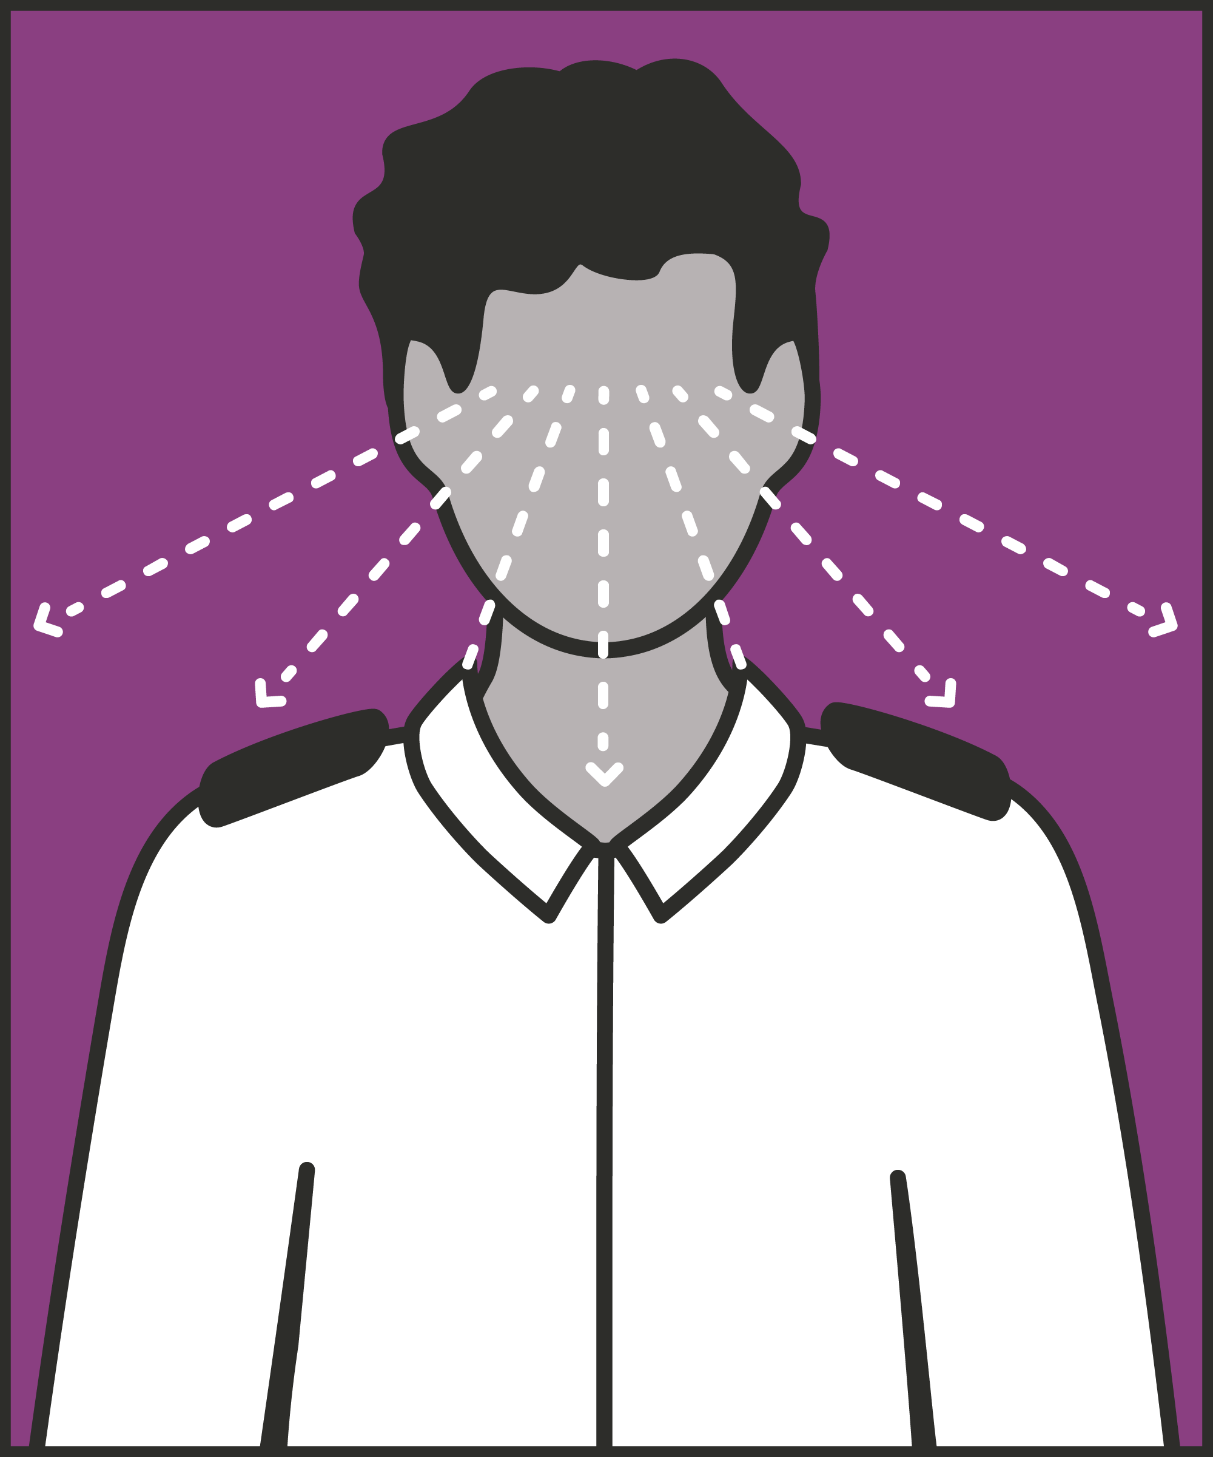


Look for issues
  Find potential problems before they emerge using your knowledge and radar.
Redirect
  Remind prisoners of expectations, plans and previous agreements.
Follow up
  Pass information to colleagues and take further action as needed.
Notes:
INTRODUCE STEPS: PRE-EMPTING PROBLEMS
EXPLAIN
We are now going to go through each of the steps for this technique.
Look for issues: We’ve talked about the value of radar be seen looking (technique 1). This means positioning ourselves where we can see everything and scanning the wing continually, so we know what’s going on. To pre-empt problems, we combine this with our knowledge of prisoners as individuals, and the current problems they face. Who’s acting out of character? Who hasn’t had a visit for a while? Whose sentencing hearing is coming up? Who has had an application rejected? Combining what we see with what we know allows us to identify who may need our attention, and what problems they’re facing.
Redirect: When we see a potential issue, there are a range of strategies we can choose from. We might:
Remind the prisoner of expectations, norms or rules. For example, we could remind them “No vaping on the landing.” Or we could emphasise norms on the wing: “We don’t swear at each other on D Wing.”
Revisit plans and commitments. Most prisoners are looking forward to or working towards something. We can revisit these goals to encourage them to act accordingly: “Remember you’re working towards switching jobs, so best behaviour, OK?”
Divert the prisoner, giving them a job, a task or an activity to distract them from an area or group which might cause trouble. For example, we could ask whether they want to play a game of pool, whether their cell needs a tidy, whether they have enough phone credit – anything which keeps them busy and away from potential issues.
Model the desired behaviour. For example, if a prisoner raises their voice, we might speak to them particularly quietly, encouraging them to match our tone.
We can use our knowledge of the prisoner to tailor what we say. The most powerful messages will be those which appeal to what they want and are working towards.
Follow up: One quiet word might be enough to address the issue. But we might need to follow up. This might mean a second reminder later on, an intelligence report, organising a cell move, or simply passing on what we’ve done to the officers who will be on the wing later.

Slide 6
Turn and talk
Using the Pocket Guide as a reference:
Do you use this technique as part of your practice? If so, how and when?
Which of the steps do you use?
Which of the steps do you want to work on?
Notes:
TURN AND TALK: PRE-EMPTING PROBLEMS
PAIRED DISCUSSION
In pairs I would like you to discuss the following questions using the pocket guide as a reference (p26):
Do you use this technique as part of your practice? If so, how and when?
Which of the steps do you use?
Which of the steps do you want to work on?
WHOLE GROUP FEEDBACK
(Get whole group feedback following paired discussions.)

Slide 7
Model video
INSERT MODEL VIDEO ONTO SLIDE
Notes:
MODEL VIDEO: PRE-EMPTING PROBLEMS
TRAINER NOTE: If possible, insert the model video onto this slide ahead of starting your session. (You can find the online link to the videos here: https://unlockedgrads.org.uk/leading-prison-landings/the-videos/ or by pressing CTRL+CLICK on the box on the slide.)
EXPLAIN VIDEO
We are now going to watch the model video for this technique. While you are watching the video try to see if you can identify the success checks as they are met.
EXPLAIN POTENTIAL PITFALLS
Now that you have a better understanding of this technique, I want to explain some potential pitfalls that officers can make when trying to use it:
Being unclear about reminders or expectations. Sometimes a broad reminder is enough: “Calm day today, OK Gemma?” But some prisoners may struggle to recognise what these broad reminders mean: “I wasn’t making trouble – he owes me and he hasn’t paid me back.” We need to use our knowledge of prisoners to judge when a broad reminder is enough and when we need to offer much more specific guidance: “Calm day today OK Gemma, I’m looking forward to seeing you do something useful during association today, didn’t you say you had an app you want to put in?”
Letting expectations slide. It’s incredibly tempting to let expectations slip. In the moment, it makes an individual officer’s life a lot easier if they overlook vaping, sliders on the landing, bad language, or whatever it is. But once something slips, it’s very hard to bring it back: “Everyone else is doing it, why are you picking on me?” If we actively hold the line and maintain expectations, eventually, we make it easier for ourselves: prisoners push the boundaries less, because they know what they can’t get away with. This also makes it easier for prisoners: if they know what’s going to be enforced, they know how they should behave. It’s not easy, but maintaining expectations is crucial to encouraging the good behaviour we want to see on the wing.

Slide 8

Practice – pre-empting problems
Roles
Timing
Participant A: Prisoner
Scripting: 1 min
Participant B: Prison officer
Practice: 2 min
Success checks
Feedback: 1 min
Look for issues
Redirect or remind the prisoner
Follow up as needed
Practice: 2 min
Feedback: 1 min
Notes:
PRACTICE: PRE-EMPTING PROBLEMS
EXPLAIN THE PRACTICE (NB: you can change the times for scripting, practice and feedback as needed.)
We are now going to practise using the technique pre-empting problems:
When might you use the technique of pre-empting problems? Think about a prisoner or group of prisoners you are working with when you have needed to, or will need to, use this technique. For example, making sure prisoners are dressed appropriately when leaving their cell, proactively approaching prisoners who look agitated, or checking in with prisoners around trigger dates, etc.
To remind you, the success checks for this practice are:
READ SUCCESS CHECKS FROM SLIDE
(Check all have chosen a real-life scenario – choose people to share theirs if time.)
You each now have 1 minute to script what you would say and do in the scenario you have chosen, using the success checks.
(Trainer then allocate pairs.)
Person nearest the door is going to be the prisoner first (Participant A) and the other will be the officer (Participant B).
For practice round 1, Participant B explain your scenario to your partner – they will be playing the role of the prisoner.
Ok, when I say go, you will have 2 minutes to run the practice using the scenario Participant B has given. If you finish before the 2 minutes, give feedback and practice again, making improvements.
Remember to stay in role throughout.
Go.
START PRACTICE
(Circulate during practice and give live feedback to pairs, as necessary.)
EXPLAIN THE FEEDBACK
Participant A, you will now give feedback to your partner.
Referring to the success checks, tell them what they did well and what could they improve on?
(If there is time, you could ask the participants to do a second round of practice implementing the feedback.)
SWITCH ROLES
Now switch roles and repeat the practice and feedback cycle.
WHOLE GROUP FEEDBACK
How was it?
How did it feel?
What feedback did you get?

Slide 9
Next steps: Observations, feedback and tracking
Notes:
EXPLAIN NEXT STEPS FOR OBSERVATIONS
When will next observations take place?
Who will be conducting the observations?
EXPLAIN NEXT STEPS FOR FEEDBACK
When can they expect to get feedback on their observations?
How will feedback be delivered?
EXPLAIN NEXT STEPS FOR TRACKING
How will observations and feedback be tracked?
Are there any updates to share with staff?

Slide 10
As you use this technique in your everyday work, you may find it useful to refer back to Leading Prison Landings: A Pocket Guide, or the full training manual, Leading Prison Landings: The Unlocked Guide to Jailcraft.

