Slide 1
#09 least invasive intervention
Training slides

Slide 2
PREVENTING AND ADDRESSING CONFLICT
The first five strategies in this section support you to pre-empt conflict and address issues authoritatively, effectively and warmly. This helps maintain a safe environment and lays the foundations to help prisoners change. These techniques promote dynamic security and safety, allowing you to build relationships and promote change.
The following five strategies should be used to de-escalate conflict, resolve incidents and promote positive choices. They can be treated as steps followed in order or individually, as appropriate.
#07 Warm / firm
#08 Pre-empting problems
#09 Least invasive intervention
#10 Emotional constancy
#11 Giving effective consequences
#12 Create space to de-escalate
#13 Identify wants
#14 Tactical agreement
#15 Clarify expectations
#16 Give choices
Notes:
PREVENTING AND ADDRESSING CONFLICT
EXPLAIN
The technique that we are looking at today is one of the ten ‘Preventing and Addressing Conflict’ techniques. These techniques can be split into two groups: ‘preventing conflict’ and ‘addressing conflict’ each with five techniques linked to them. The preventing conflict techniques allow you to prevent conflict from happening in the first place. They support you to pre-empt conflict and address issues authoritatively, effectively and warmly. This helps to maintain safe environment and lays the foundations to help prisoners change. Many of these techniques don’t just prevent conflict they also help to keep the smooth day to running of the prison and lead to improved daily interactions between prisoners and staff. Therefore, mastering these techniques not only helps to keep the wing safe but also helps to improves staff/prisoner relationships which in turn contributes to better outcomes for prisoners.

Slide 3
Recap of previous technique
Notes:
RECAP PREVIOUS TECHNIQUE
What was the technique we covered last week?
What does the technique look to do?
What are the success checks for the technique?
CELEBRATE SUCCESSES
We have had some great successes this week including…
I would like to shoutout XXXXX because…
Does anyone want to shout out one of their colleagues?

Slide 4
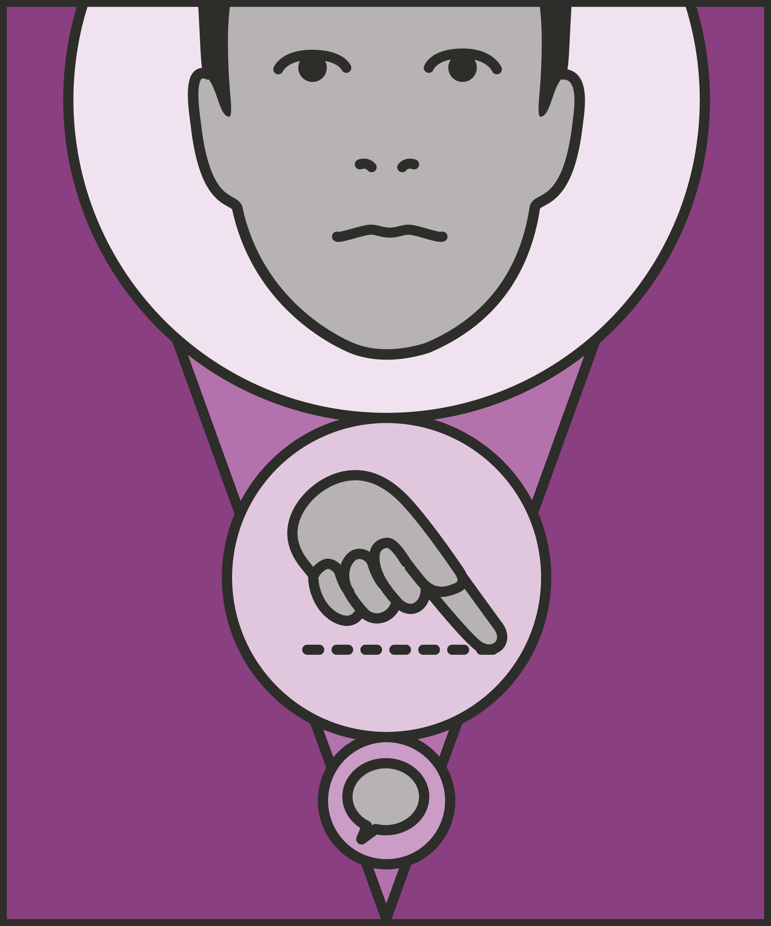
#09 Preventing and addressing conflict
  LEAST INVASIVE INTERVENTION
    Address poor behaviour using the least public, confrontational or controlling approach to minimise disruption or drawing attention to issues.
Notes:
INTRODUCE NEW TECHNIQUE: LEAST INVASIVE INTERVENTION
TRAINER NOTE: (Pause a moment to allow people to read the overview of the technique on slide.)
EXPLAIN
The least invasive intervention is the one which feels least like a command or an intrusion to the prisoner. A gesture – a raised hand, or a point – is less invasive than using words. A request is less invasive than an instruction; an instruction less invasive than an order.
Psychologists describe autonomy – control over what happens to you – as a basic requirement for motivation and personal growth.
Being imprisoned removes almost all your autonomy: over where you go, who you see, what you eat, what you do. The more control we can return to a prisoner, the better.
If necessary, we can issue orders, and even use force, to ensure desired behaviours. Wherever possible however, we want to achieve desired behaviours without using force, without exerting control, perhaps with just a smile, a frown, or a raised eyebrow. So, the less invasive our approach, the more control, and responsibility, the prisoner is likely to feel over their actions.
The least invasive approach also reduces strain on prisoners and prison officers. We can only issue and enforce so many orders. Every time we invoke our authority, prison rules, and potential consequences, we create strain. We strain our relationship with the prisoner. We strain our authority. We strain our emotions. That’s not a reason not to enforce orders. But it is a reason to limit this strain, by making interactions as ‘uninvasive’ as possible.

Slide 5


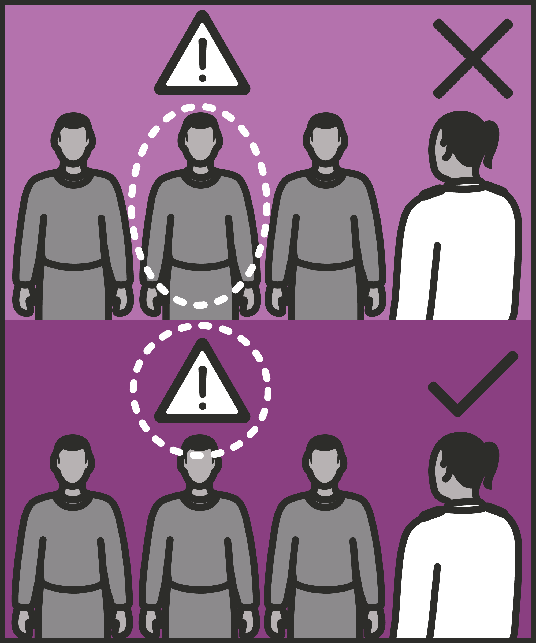
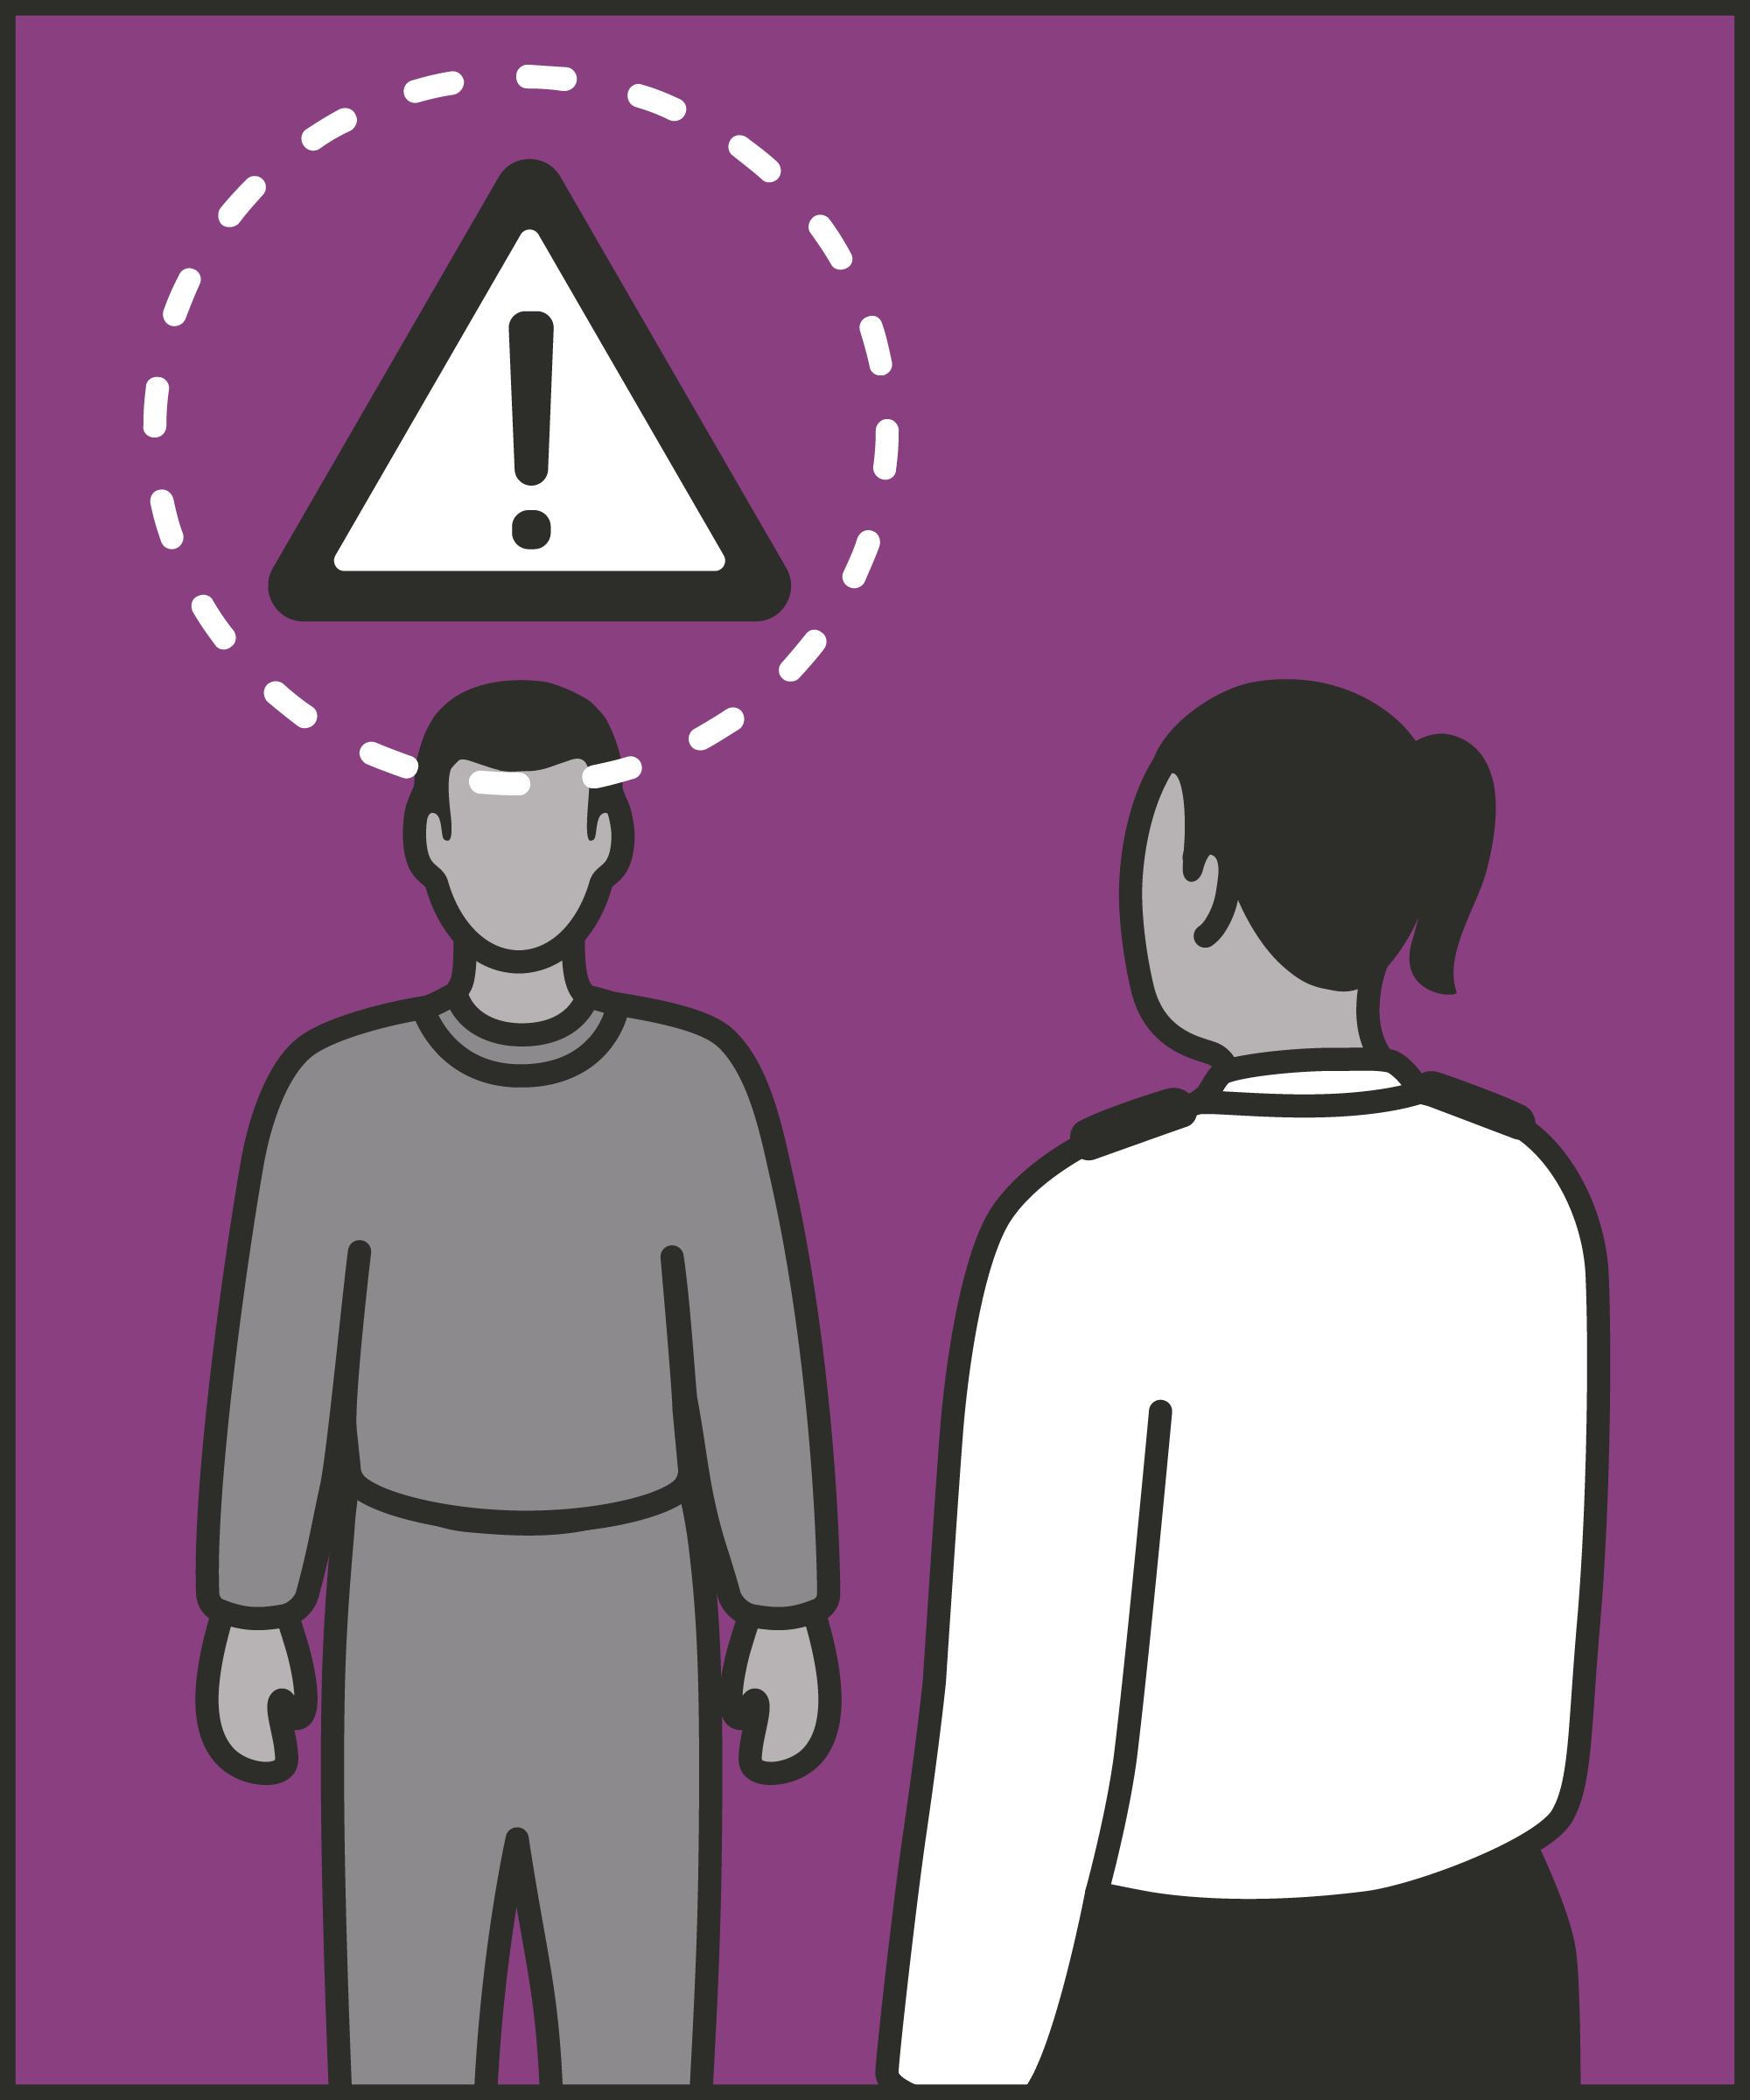
Signal what you want
  Use non-verbal communication where possible, such as gestures, facial expressions and modelling expected behaviours.
Emphasise success
  Use positive statements for what is going well so that others can understand what is expected.
Prefer anonymity to naming prisoners
  In a group scenario, challenge the undesirable behaviour, rather than naming an individual.
Private challenge to public challenge
  Speak to prisoners individually to challenge their behaviour, where possible having a quiet word.
Notes:
INTRODUCE STEPS: LEAST INVASIVE INTERVENTION
EXPLAIN
We are now going to go through each of the steps for this technique.
Signal what you want: In other words, prefer non-verbal communication to verbal. We can communicate many things wordlessly: calm down, quieter, stop, go that way. This has several advantages. It can be particularly helpful when verbal communication is hard: for example, on a noisy wing, with prisoners with limited hearing, or with limited English. Non-verbal communication can include:
Gestures, like pointing to indicate where prisoners should be going.
Eye contact and facial expression, like a raised eyebrow or a surprised look if you see a prisoner doing something wrong.
Modelling: illustrating to a prisoner what they should be doing, like knocking gently on a door, rather than hammering on it.
Emphasise success: Think about how you can emphasise what is going well rather than focusing on what is going wrong. We can turn almost any negative statement into a positive one. For example, instead of “We can’t serve food until the last three of you are in the line,” we could say “We’ve got almost everyone lined up ready to eat.” This makes the same point, but without explicit criticism. It also emphasises that the majority of prisoners are doing the right thing, encouraging the remainder to join them.
Prefer anonymity to naming prisoners. If we need to highlight something that’s wrong, we need not name names. “I need three more people ready,” conveys almost the same message as “I need Frankie, Mo and G ready.” But it preserves their anonymity – and so avoids confrontation – while emphasising that compliance is the norm.
Prefer private to public challenge. When we challenge a prisoner publicly, they may try to save face by responding rudely or angrily. Where possible, have a quiet word first, either by asking them step aside, catching them away from other prisoners, or speaking more quietly.
ADD: Use these principles flexibly. These aren’t rules. If a prisoner is shouting, swearing and threatening others, a more direct approach may be appropriate. We can also switch between these principles as required: for example, beginning with a gesture, then a positive statement, then switching to a private word. Experiment with elements of this strategy to suit the prisoner and the situation.

Slide 6
Turn and talk
Using the Pocket Guide as a reference:
Do you use this technique as part of your practice? If so, how and when?
Which of the steps do you use?
Which of the steps do you want to work on?
Notes:
TURN AND TALK: LEAST INVASIVE INTERVENTION
PAIRED DISCUSSION
In pairs I would like you to discuss the following questions using the pocket guide as a reference (p28):
Do you use this technique as part of your practice? If so, how and when?
Which of the steps do you use?
Which of the steps do you want to work on?
WHOLE GROUP FEEDBACK
(Get whole group feedback following paired discussions.)

Slide 7
Model video
INSERT MODEL VIDEO ONTO SLIDE
Notes:
MODEL VIDEO: LEAST INVASIVE INTERVENTION
TRAINER NOTE: If possible, insert the model video onto this slide ahead of starting your session. (You can find the online link to the videos here: https://unlockedgrads.org.uk/leading-prison-landings/the-videos/ or by pressing CTRL+CLICK on the box on the slide.)
EXPLAIN VIDEO
We are now going to watch the model video for this technique. While you are watching the video try to see if you can identify the success checks as they are met.
EXPLAIN POTENTIAL PITFALLS
Now that you have a better understanding of this technique, I want to explain some potential pitfalls that officers can make when trying to use it:
Being unclear. A less invasive intervention can be oblique. For example, instead of saying “Ali, I want you to stop swearing and get ready to go back to the wing,” we might say, “We’ve got a couple of minutes until we finish here, let’s all get ready.” But Ali may miss the message. A gesture which is clear to us may be alien to some prisoners. We want to make our point clear, without being invasive. In this case, we might go on to say, “Ready means lined up by the gate,” or “Ali, are you done?” or pointing where we want him to go. If prisoners are missing the point, try to make it clearer.
Escalate when necessary. A less invasive intervention is preferable to a more invasive one. But there are times when a more invasive intervention is necessary, and perhaps unavoidable. If one prisoner is running towards another with a clenched fist, no amount of facial expression and polite reminders is going to solve the issue. It’s up to you to decide when these strategies are appropriate, and for whom.

Slide 8

Practice – least invasive intervention
Roles
Timing
Participant A: Prisoner
Scripting: 1 min
Participant B: Prison officer
Practice: 2 min
Success checks
Feedback: 1 min
Signal what you want
Emphasise success
Prefer anonymity to naming
Prefer private to public challenge
Practice: 2 min
Feedback: 1 min
Notes:
PRACTICE: LEAST INVASIVE INTERVENTION
EXPLAIN THE PRACTICE (NB: you can change the times for scripting, practice and feedback as needed.)
We are now going to practise using the technique least invasive intervention:
When might you use the technique of least invasive intervention? Think about a prisoner or group of prisoners you are working with when you have needed to, or will need to, use this technique. For example, when locking up after association, addressing a group of workers to improve standards, or taking prisoners to one side to challenge their behaviour, etc.
To remind you, the success checks for this practice are:
READ SUCCESS CHECKS FROM SLIDE
(Check all have chosen a real-life scenario – choose people to share theirs if time.)
You each now have 1 minute to script what you would say and do in the scenario you have chosen, using the success checks.
(Trainer then allocate pairs.)
Person nearest the door is going to be the prisoner first (Participant A) and the other will be the officer (Participant B).
For practice round 1, Participant B explain your scenario to your partner – they will be playing the role of the prisoner.
Ok, when I say go, you will have 2 minutes to run the practice using the scenario Participant B has given. If you finish before the 2 minutes, give feedback and practice again, making improvements.
Remember to stay in role throughout.
Go.
START PRACTICE
(Circulate during practice and give live feedback to pairs, as necessary.)
EXPLAIN THE FEEDBACK
Participant A, you will now give feedback to your partner.
Referring to the success checks, tell them what they did well and what could they improve on?
(If there is time, you could ask the participants to do a second round of practice implementing the feedback.)
SWITCH ROLES
Now switch roles and repeat the practice and feedback cycle.
WHOLE GROUP FEEDBACK
How was it?
How did it feel?
What feedback did you get?

Slide 9
Next steps: Observations, feedback and tracking
Notes:
EXPLAIN NEXT STEPS FOR OBSERVATIONS
When will next observations take place?
Who will be conducting the observations?
EXPLAIN NEXT STEPS FOR FEEDBACK
When can they expect to get feedback on their observations?
How will feedback be delivered?
EXPLAIN NEXT STEPS FOR TRACKING
How will observations and feedback be tracked?
Are there any updates to share with staff?

Slide 10
As you use this technique in your everyday work, you may find it useful to refer back to Leading Prison Landings: A Pocket Guide, or the full training manual, Leading Prison Landings: The Unlocked Guide to Jailcraft.

