Slide 1
#12 create space to de-escalate
Training slides

Slide 2
PREVENTING AND ADDRESSING CONFLICT
The first five strategies in this section support you to pre-empt conflict and address issues authoritatively, effectively and warmly. This helps maintain a safe environment and lays the foundations to help prisoners change. These techniques promote dynamic security and safety, allowing you to build relationships and promote change.
The following five strategies should be used to de-escalate conflict, resolve incidents and promote positive choices. They can be treated as steps followed in order or individually, as appropriate.
#07 Warm / firm
#08 Pre-empting problems
#09 Least invasive intervention
#10 Emotional constancy
#11 Giving effective consequences
#12 Create space to de-escalate
#13 Identify wants
#14 Tactical agreement
#15 Clarify expectations
#16 Give choices
Notes:
PREVENTING AND ADDRESSING CONFLICT
EXPLAIN
The technique that we are looking at today is one of the ten ‘Preventing and Addressing Conflict’ techniques. These techniques can be split into two groups: ‘preventing conflict’ and ‘addressing conflict’ each with five techniques linked to them. The addressing conflict techniques should be used to de-escalate conflict, resolve incidents and promote positive choices. They can be treated as steps followed in order or individually, as appropriate. It may seem obvious but if officers can regularly and effectively de-escalate conflict & incidents with prisoners then this leads to a safer prison environment that is more conducive to rehabilitation.

Slide 3
Recap of previous technique
Notes:
RECAP PREVIOUS TECHNIQUE
What was the technique we covered last week?
What does the technique look to do?
What are the success checks for the technique?
CELEBRATE SUCCESSES
We have had some great successes this week including…
I would like to shoutout XXXXX because…
Does anyone want to shout out one of their colleagues?

Slide 4
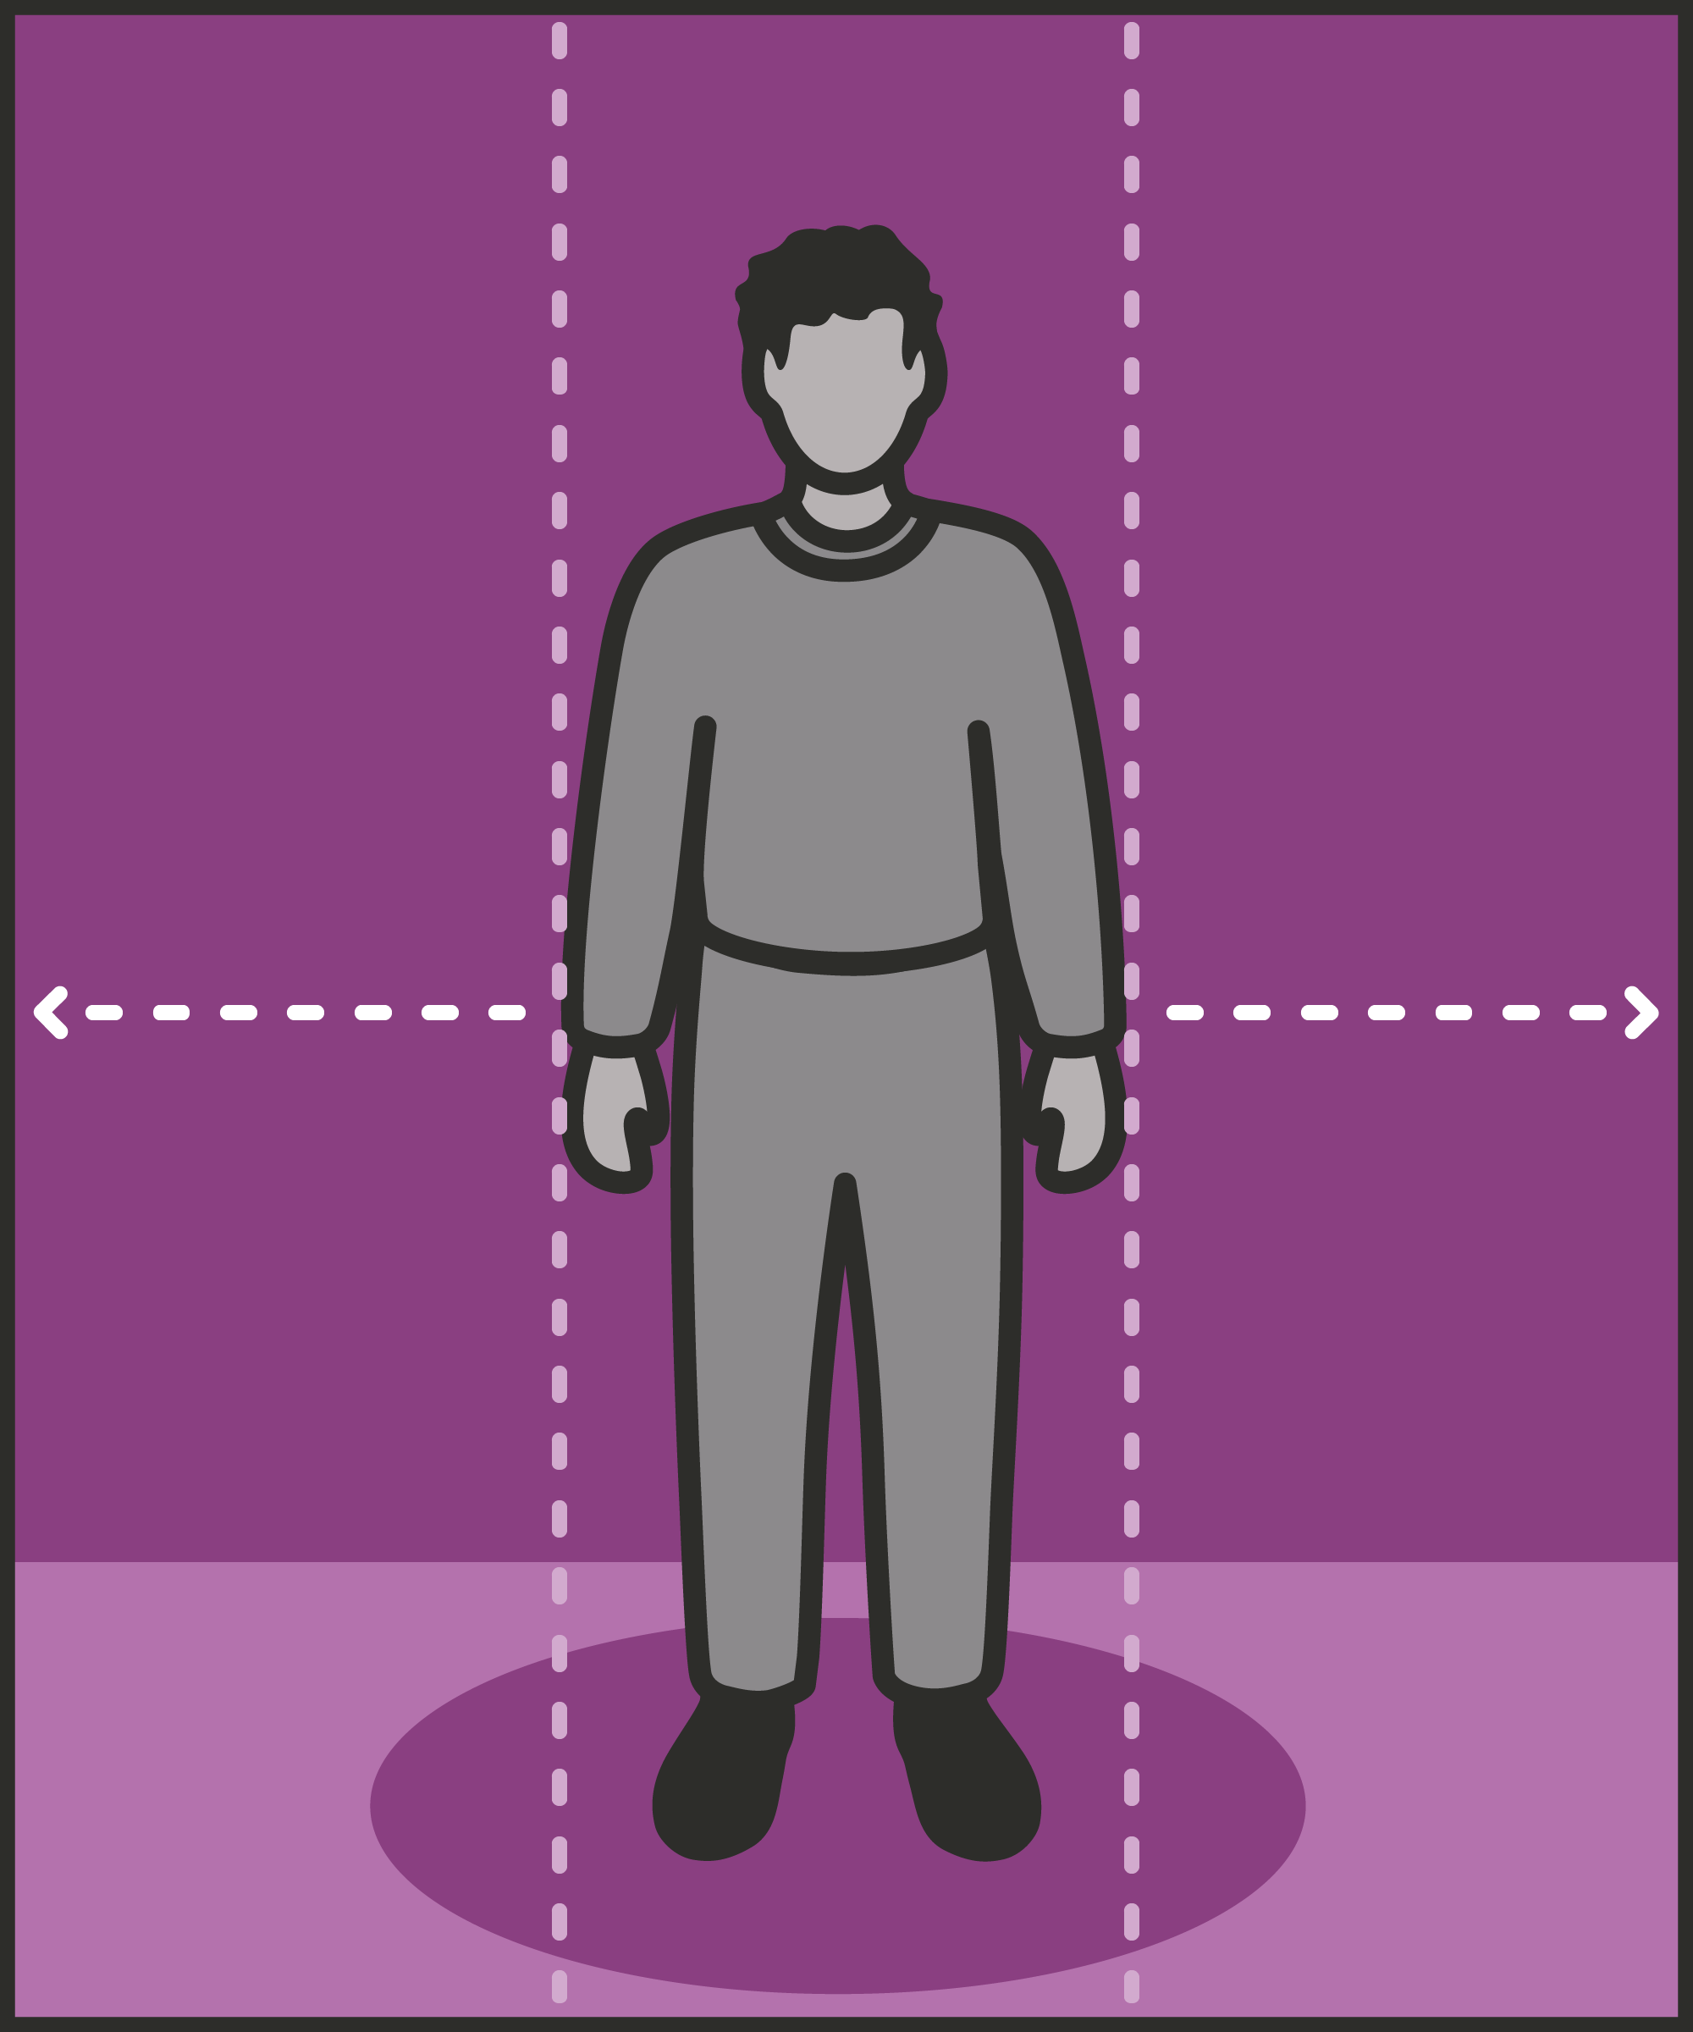
#12 Preventing and addressing conflict
  CREATE SPACE TO DE-ESCALATE
    Separate a prisoner from the incident, so they can calm down before you discuss what happened.
Notes:
INTRODUCE NEW TECHNIQUE: CREATE SPACE TO DE-ESCALATE
TRAINER NOTE: (Pause a moment to allow people to read the overview of the technique on slide.)
EXPLAIN
We face an incident. Perhaps we have an upset prisoner, a fight between prisoners, or a confrontation between a prisoner and an officer. We need to calm things down, understand what’s happened, and find a solution preventing future problems.
The first step is creating the space to de-escalate.
Creating space is not just about creating physical space between the prisoner and an incident. It can mean several things for example:
Moving away from a tense situation to somewhere more private.
Giving the prisoner time to reflect, allowing them to calm down and think about their goals.
Choosing a neutral space to talk, preferably away from the wing.
These may not all be possible: there may not be enough staff on duty to get off the wing and talk. But anything we can do to detach the prisoner from the scene of the incident should help them calm down and respond more positively.
We want to create an environment in which we can take the subsequent de-escalation steps, like finding out what the prisoner wants and giving them choices. Creating space makes this conversation possible.

Slide 5
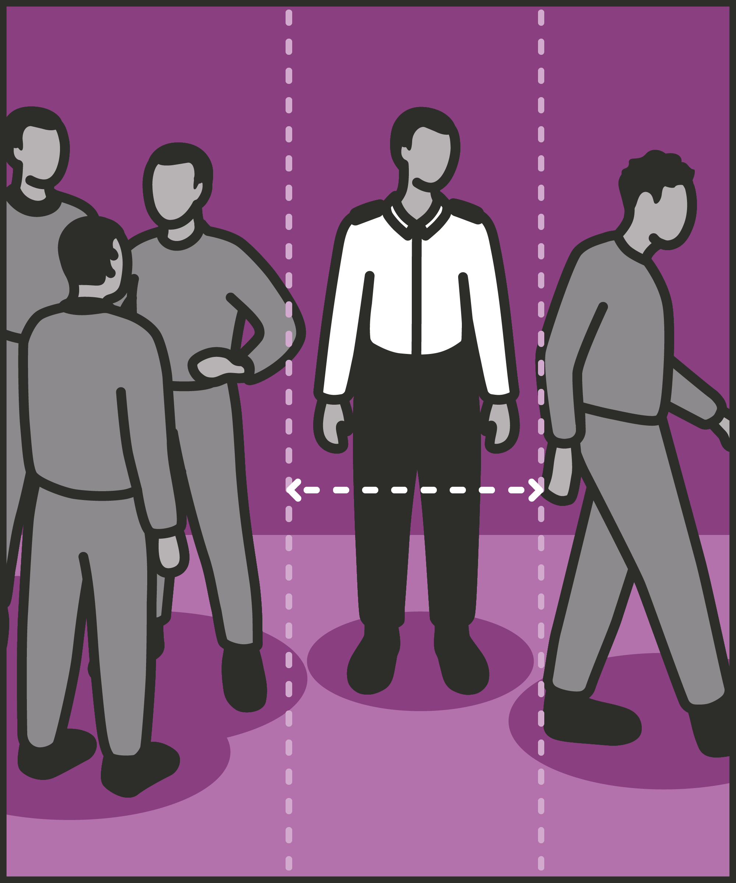

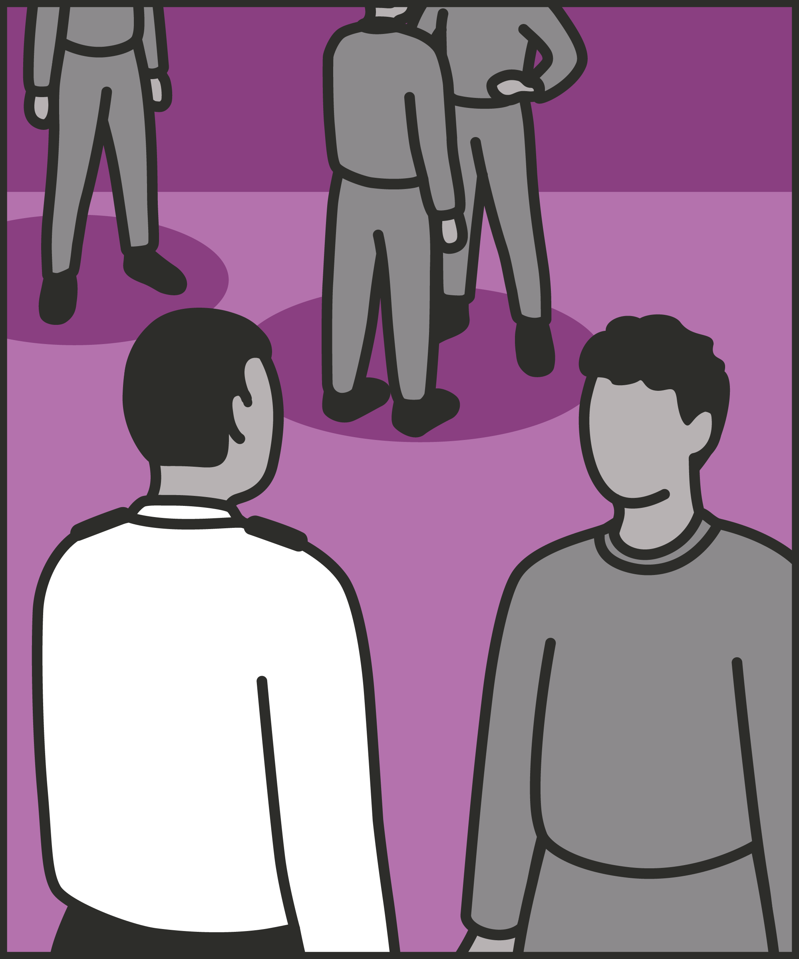
Create space
  Get the prisoner away from the situation.
Give time
  Allow the prisoner to reflect on the situation and calm down. Use that time to plan the conversation.
Choose distance
  Talk to them away from other prisoners, allowing them to talk more freely. Make space between you and the prisoner if needed.
Notes:
INTRODUCE NEW TECHNIQUE: CREATE SPACE TO DE-ESCALATE
EXPLAIN
We are now going to go through each of the steps for this technique.
Create Space: At its simplest, we create space by moving away from a tense situation. When a prisoner can still see or hear the person they’re in conflict with, the conflict can continue. We need space between us and the prisoner, and space between the prisoner and others. In creating this space, we need to choose body language which keeps us safe but shows that we’re calm. This defuses the situation, and makes it easier to start talking carefully, rather than reacting emotionally.
Give time: Before a prisoner is ready to talk honestly about what’s happened, they might need time and space to reflect. They may just need time to calm down and become a little less emotional. They may need time away from prison officers. They may need to rethink what’s happened, what’s been said, and what they’ve done. We want them to think beyond right now and consider what they’re working towards. Giving them time also gives us time to calm down, review what happened, and plan what we’ll say and ask. We might also check in with colleagues, other prisoners or intelligence reports.
Choose distance: If we have more time, or need a longer conversation, we might see if we can find a neutral venue away from other prisoners. This might mean a meeting room, an office away from the wing, or a dedicated room in the Care and Separation Unit. If we are able to get away from cells and landings, we can create privacy, allowing the prisoner to talk more freely.

Slide 6
Turn and talk
Using the Pocket Guide as a reference:
Do you use this technique as part of your practice? If so, how and when?
Which of the steps do you use?
Which of the steps do you want to work on?
Notes:
TURN AND TALK: CREATE SPACE TO DE-ESCALATE
PAIRED DISCUSSION
In pairs I would like you to discuss the following questions using the pocket guide as a reference (p34):
Do you use this technique as part of your practice? If so, how and when?
Which of the steps do you use?
Which of the steps do you want to work on?
WHOLE GROUP FEEDBACK
(Get whole group feedback following paired discussions.)

Slide 7
Model video
INSERT MODEL VIDEO ONTO SLIDE
Notes:
MODEL VIDEO: CREATE SPACE TO DE-ESCALATE
TRAINER NOTE: If possible, insert the model video onto this slide ahead of starting your session. (You can find the online link to the videos here: https://unlockedgrads.org.uk/leading-prison-landings/the-videos/ or by pressing CTRL+CLICK on the box on the slide.)
EXPLAIN VIDEO
We are now going to watch the model video for this technique. While you are watching the video try to see if you can identify the success checks as they are met.
EXPLAIN POTENTIAL PITFALLS
Now that you have a better understanding of this technique, I want to explain some potential pitfalls that officers can make when trying to use it:
Delaying action or response. If we need to respond quickly to a situation – for example, if we think a prisoner is at risk – we may need to modify our approach. For example, we might not want to leave a prisoner alone in their cell before talking. We can still apply the underlying principle. For example, we may not be able to give them half an hour to calm down – but we could instead say, “I’m coming back in two minutes and we’ll talk then – use that time to think about what you want to tell me and what we can do to solve this.” Similarly, we may not be able to get them off the wing, but we could at least move them to the other end of the landing.

Slide 8

Practice – create space to de-escalate
Roles
Timing
Participant A: Prisoner
Scripting: 1 min
Participant B: Prison officer
Practice: 2 min
Success checks
Feedback: 1 min
Create space
Give time
Choose a space to talk
Practice: 2 min
Feedback: 1 min
Notes:
PRACTICE: CREATE SPACE TO DE-ESCALATE
EXPLAIN THE PRACTICE (NB: you can change the times for scripting, practice and feedback as needed.)
We are now going to practise using the technique create space to de-escalate:
When might you use the technique of creating space to de-escalate? Think about a prisoner or group of prisoners you are working with when you have needed to, or will need to, use this technique. For example, when a prisoner is acting up in front of a larger group, a prisoner is lashing out in a public place, or two prisoners are having conflict, etc.
To remind you, the success checks for this practice are:
READ SUCCESS CHECKS FROM SLIDE
(Check all have chosen a real-life scenario – choose people to share theirs if time.)
You each now have 1 minute to script what you would say and do in the scenario you have chosen, using the success checks.
(Trainer then allocate pairs.)
Person nearest the door is going to be the prisoner first (Participant A) and the other will be the officer (Participant B).
For practice round 1, Participant B explain your scenario to your partner – they will be playing the role of the prisoner.
Ok, when I say go, you will have 2 minutes to run the practice using the scenario Participant B has given. If you finish before the 2 minutes, give feedback and practice again, making improvements.
Remember to stay in role throughout.
Go.
START PRACTICE
(Circulate during practice and give live feedback to pairs, as necessary.)
EXPLAIN THE FEEDBACK
Participant A, you will now give feedback to your partner.
Referring to the success checks, tell them what they did well and what could they improve on?
(If there is time, you could ask the participants to do a second round of practice implementing the feedback.)
SWITCH ROLES
Now switch roles and repeat the practice and feedback cycle.
WHOLE GROUP FEEDBACK
How was it?
How did it feel?
What feedback did you get?

Slide 9
Next steps: Observations, feedback and tracking
Notes:
EXPLAIN NEXT STEPS FOR OBSERVATIONS
When will next observations take place?
Who will be conducting the observations?
EXPLAIN NEXT STEPS FOR FEEDBACK
When can they expect to get feedback on their observations?
How will feedback be delivered?
EXPLAIN NEXT STEPS FOR TRACKING
How will observations and feedback be tracked?
Are there any updates to share with staff?

Slide 10
As you use this technique in your everyday work, you may find it useful to refer back to Leading Prison Landings: A Pocket Guide, or the full training manual, Leading Prison Landings: The Unlocked Guide to Jailcraft.

