Slide 1
#14 tactical agreement
Training slides

Slide 2
PREVENTING AND ADDRESSING CONFLICT
The first five strategies in this section support you to pre-empt conflict and address issues authoritatively, effectively and warmly. This helps maintain a safe environment and lays the foundations to help prisoners change. These techniques promote dynamic security and safety, allowing you to build relationships and promote change.
The following five strategies should be used to de-escalate conflict, resolve incidents and promote positive choices. They can be treated as steps followed in order or individually, as appropriate.
#07 Warm / firm
#08 Pre-empting problems
#09 Least invasive intervention
#10 Emotional constancy
#11 Giving effective consequences
#12 Create space to de-escalate
#13 Identify wants
#14 Tactical agreement
#15 Clarify expectations
#16 Give choices
Notes:
PREVENTING AND ADDRESSING CONFLICT
EXPLAIN
The technique that we are looking at today is one of the ten ‘Preventing and Addressing Conflict’ techniques. These techniques can be split into two groups: ‘preventing conflict’ and ‘addressing conflict’ each with five techniques linked to them. The addressing conflict techniques should be used to de-escalate conflict, resolve incidents and promote positive choices. They can be treated as steps followed in order or individually, as appropriate. It may seem obvious but if officers can regularly and effectively de-escalate conflict & incidents with prisoners then this leads to a safer prison environment that is more conducive to rehabilitation.

Slide 3
Recap of previous technique
Notes:
RECAP PREVIOUS TECHNIQUE
What was the technique we covered last week?
What does the technique look to do?
What are the success checks for the technique?
CELEBRATE SUCCESSES
We have had some great successes this week including…
I would like to shoutout XXXXX because…
Does anyone want to shout out one of their colleagues?

Slide 4

#14 Preventing and addressing conflict
  TACTICAL AGREEMENT
    Where you can, agree with a point or concern a prisoner raises to help de-escalate before deciding next steps.
Notes:
INTRODUCE NEW TECHNIQUE: TACTICAL AGREEMENT
TRAINER NOTE: (Pause a moment to allow people to read the overview of the technique on slide.)
EXPLAIN
In simple terms a tactical agreement is finding something to agree with from what the prisoner says.
When a prisoner is angry or upset, they try to prove their point. They try to convince others that they’re in the right.
That’s why agreement is so powerful. Having prepared for a battle, it seems there isn’t one to be fought because the prisoner is initially met with agreement rather than disagreement.
Pursuing this strategy means attending and responding to the prisoner’s concerns. We need to show that we’re listening, that we care, and that we want to solve things.
At the same time, we need to maintain awareness of the wider situation: the potential for violence from the prisoner, the actions of other prisoners, the locations of other officers.
When done right a tactical agreement can be really a powerful step towards de-escalating and resolving a difficult and tense situation.
We will run through the steps and some examples on the next slide.

Slide 5



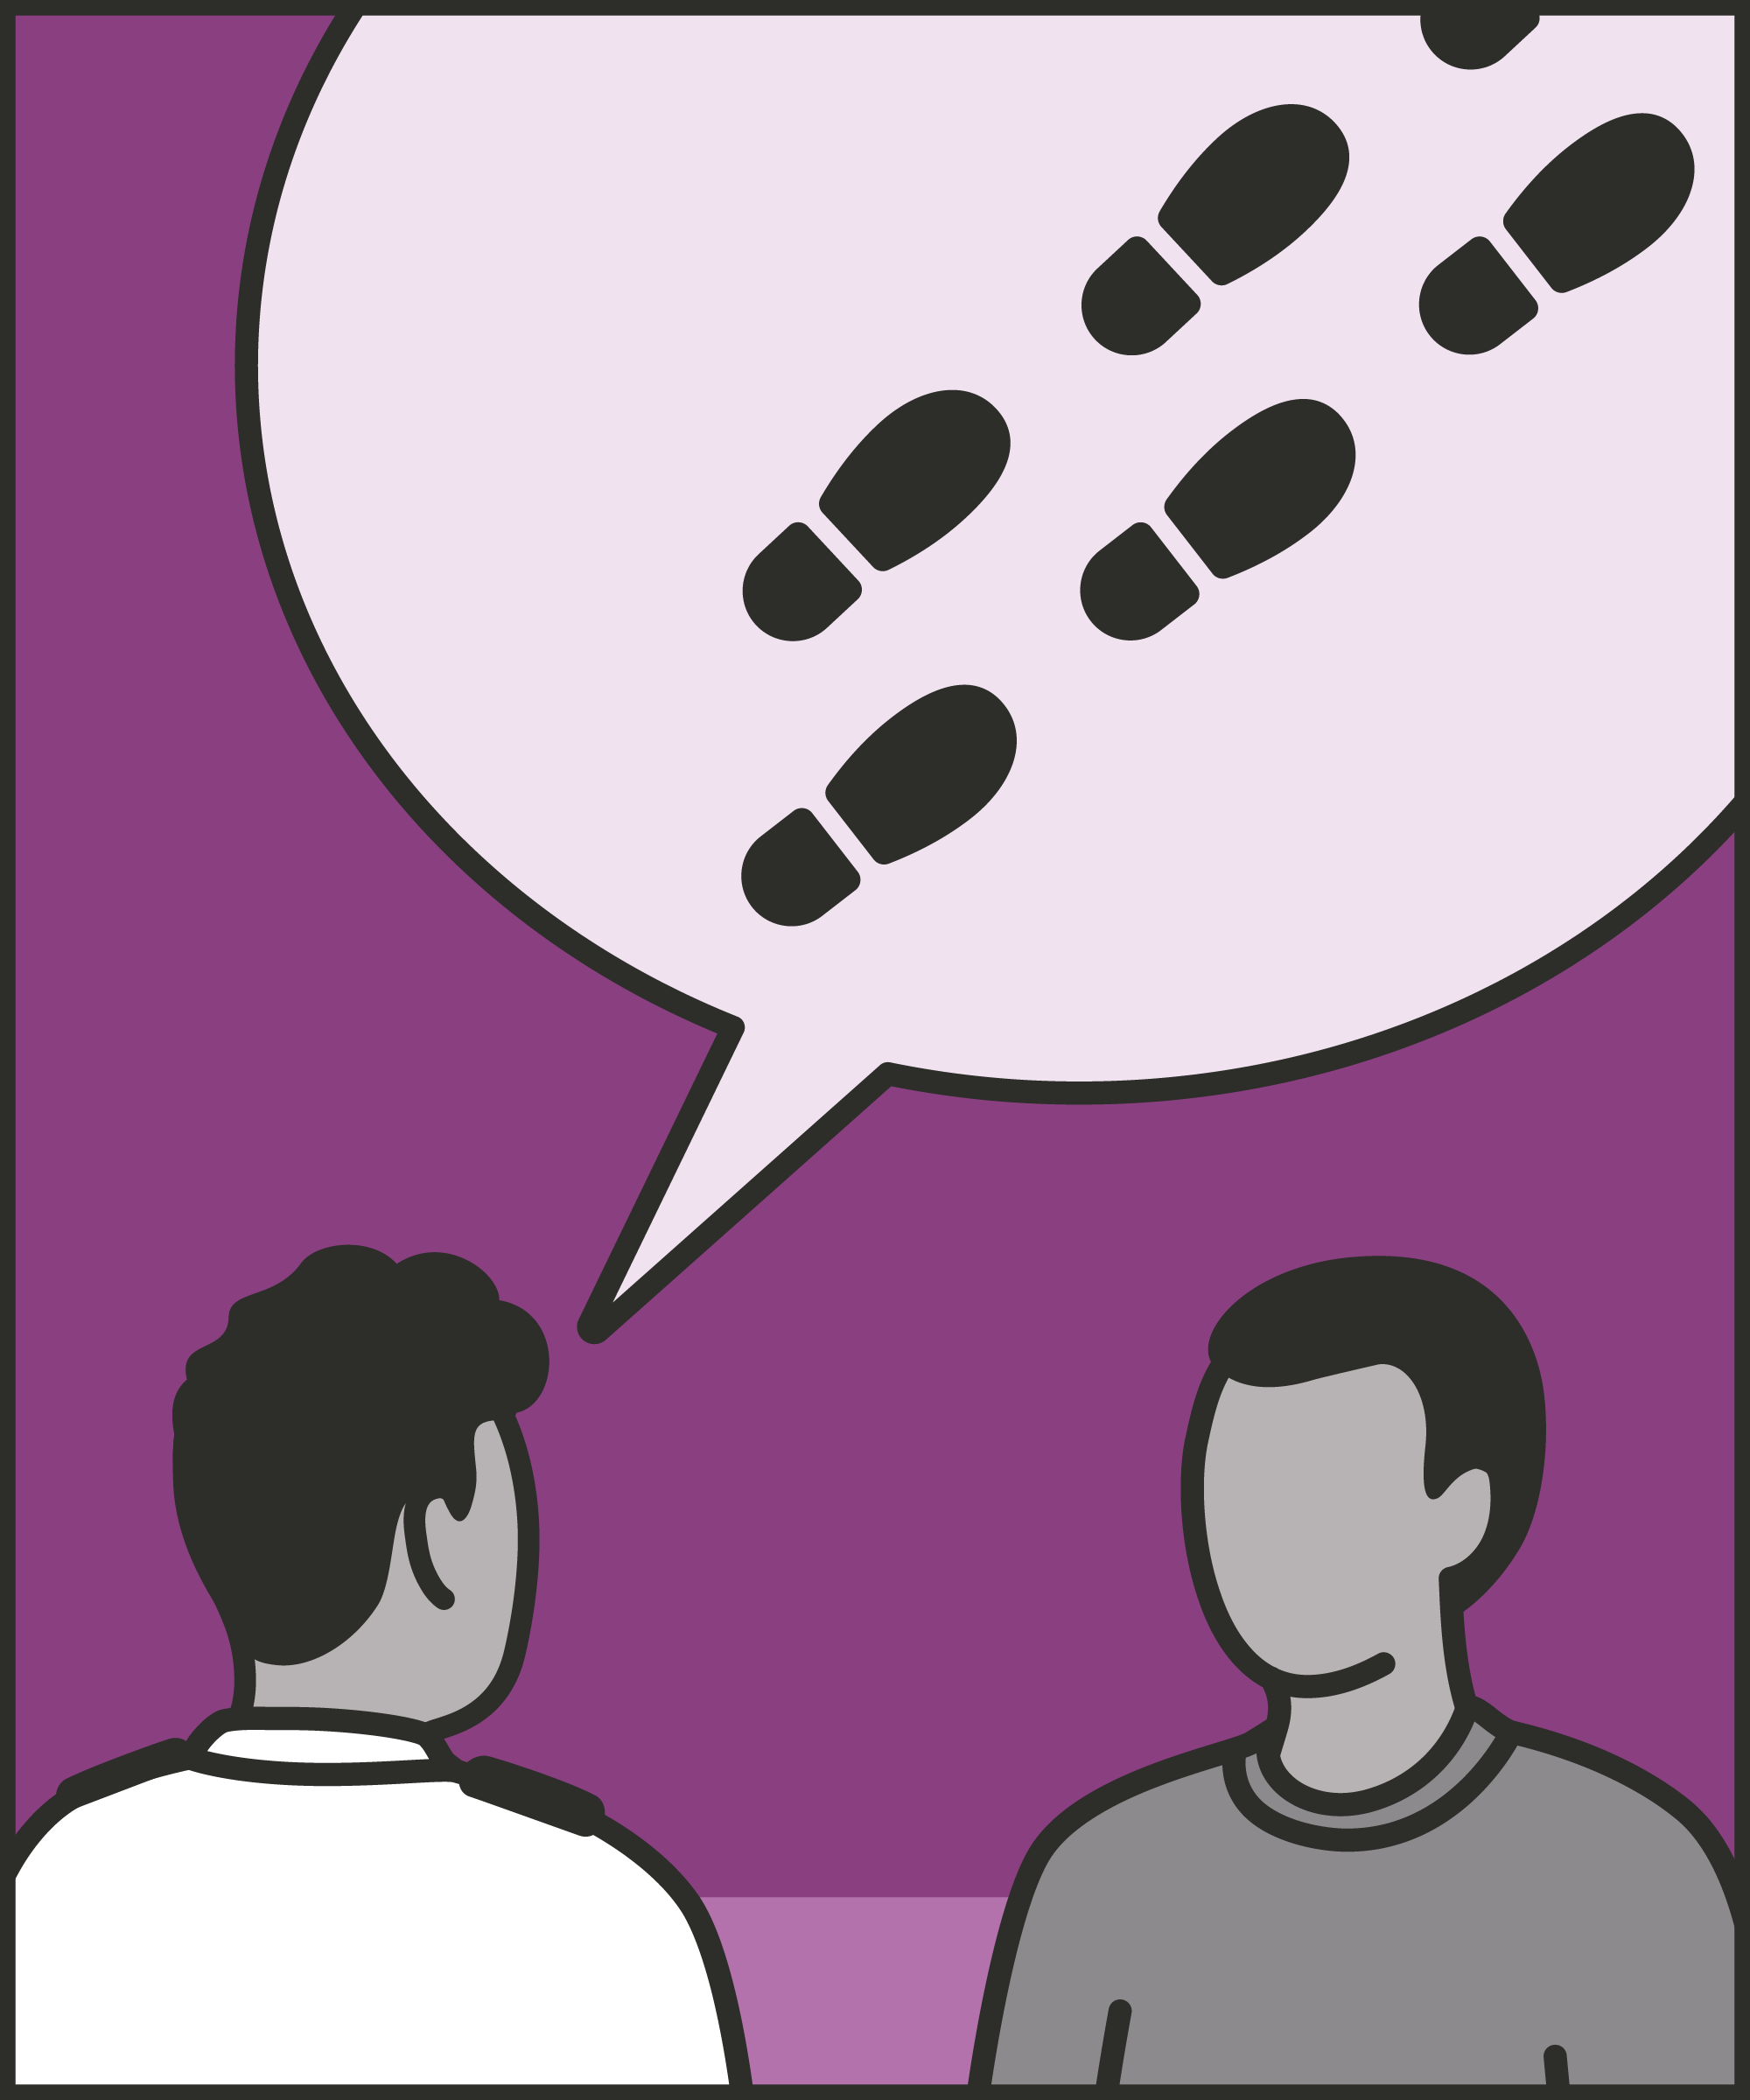
Listen carefully
  Work out why the prisoner is upset, and what they want.
Identify something you can agree with
  Find a shared agreement: the truth, the principle, the possibility, their reality, or simply agree to disagree.
State your agreement
  Express this agreement with sincerity.
Move on
  Start discussing next steps and how to move forward.
Notes:
INTRODUCE NEW TECHNIQUE: TACTICAL AGREEMENT
EXPLAIN
We are now going to go through each of the steps for this technique.
Listen carefully: you want to start by listening carefully and trying to pinpoint why the prisoner is upset and what they want. We aren’t looking to offer them platitudes or advice right now: we want to achieve a meaningful de-escalation. We can only do this if we can understand what they want and what they’re upset about and communicate our understanding.
Identify something you can agree with: As you listen, watch out for something you can agree with the prisoner on. Ask yourself what can I agree with from what the prisoner has said? This might mean agreeing:
With the facts. When a prisoner states a fact, we can agree with it. If a prisoner states they haven’t had a shower for two days, we can agree. “Yes, I know that you didn’t get the chance to make it to the showers.”
With the principle. When a prisoner states something that should be the case, we can agree with the principle. For example, if a prisoner complains that no one listens to them, we might say, “I get it, everyone deserves to be listened to.”
With the odds. Where a prisoner makes a statement, we can agree that it is possible or debatable. For example, imagine a prisoner who says: “Anyone would be angry if they’d be treated like this.” We might agree that “I guess a lot of people would be angry about that.”
With their reality. A prisoner may make statements which are at odds with reality – which you can’t possibly agree are true. For example, a prisoner you frequently struggle with might tell you they are the best-behaved prisoner on the wing and deserve to be on an enhanced regime. If you can’t agree with the truth of the matter, you can agree with their interpretation. In this case, you might tell them: “I get that you see your behaviour as exemplary.”
To disagree. If there’s really nothing you can agree on, you can always agree to disagree. This might sound obvious, or futile. But it can represent a valuable way to close off an unproductive line of conversation, affirm that everyone’s being reasonable, and move on. For example, consider a prisoner who didn’t eat yesterday and is now angry at having a missed a meal. We might say “I appreciate that you feel we should have brought you a different meal, but I think we’re going to have to agree to disagree on this one.”
Where a prisoner has a reasonable grievance and a sense of the pressures on prison staff, it’s easy to agree with the facts and the principles. For example, when a prisoner is upset that the wing smells, we can easily agree. Where a prisoner has a less reasonable grievance or an inaccurate sense of what’s possible, we may not be able to agree with the facts or the principles. For example, we may not agree that a prisoner should be able to move cells at will. But we can still agree with their view of reality and agree to disagree about what can be done.
It is rare that a prisoner doesn’t say anything that you can agree with.
State your agreement: Tell the prisoner what you agree with them on. This shouldn’t be a big thing – too much emphasis may make it seem false or contrived. Instead, our words should feel like a natural part of the conversation.
Move on: Agreement establishes common ground, shows both parties are committed to reasonable discussion, and allows us to go on and solve the underlying issue. So, take advantage of the agreement and (hopefully) the moment of calm it creates to move forward with the discussion.

Slide 6
Turn and talk
Using the Pocket Guide as a reference:
Do you use this technique as part of your practice? If so, how and when?
Which of the steps do you use?
Which of the steps do you want to work on?
Notes:
TURN AND TALK: TACTICAL AGREEMENT
PAIRED DISCUSSION
In pairs I would like you to discuss the following questions using the pocket guide as a reference (p38):
Do you use this technique as part of your practice? If so, how and when?
Which of the steps do you use?
Which of the steps do you want to work on?
WHOLE GROUP FEEDBACK
(Get whole group feedback following paired discussions.)

Slide 7
Model video
INSERT MODEL VIDEO ONTO SLIDE
Notes:
MODEL VIDEO: TACTICAL AGREEMENT
TRAINER NOTE: If possible, insert the model video onto this slide ahead of starting your session. (You can find the online link to the videos here: https://unlockedgrads.org.uk/leading-prison-landings/the-videos/ or by pressing CTRL+CLICK on the box on the slide.)
EXPLAIN VIDEO
We are now going to watch the model video for this technique. While you are watching the video try to see if you can identify the success checks as they are met.
EXPLAIN POTENTIAL PITFALLS
Now that you have a better understanding of this technique, I want to explain some potential pitfalls that officers can make when trying to use it:
Agreeing with the wrong thing. Prison rules and expectations exist for a reason. Let’s go back to the example above of a prisoner who hasn’t managed to have a shower. We can easily agree that not being able to wash is unpleasant, and that, on principle, prisoners should have access to the shower every day. That’s not the same as agreeing, for example, that the current regime is wrong. Agreeing with this weakens your position and authority with prisoners. If prisoners know you believe they deserve to get to the shower, they know you’re human and empathetic. If prisoners know you believe the wing or prison is being poorly run, they might hope you’ll break other rules for them. They might also repeat what you’ve said to other officers, undermining your position.
Undermining colleagues. In a similar vein, a wing and a prison run most effectively when officers work as a team. Agreeing that a situation is, or feels, unfair, is fine. Agreeing that officers on the previous shift treated the prisoner unfairly undermines your relationship with them, and the united front that officers should present. It encourages prisoners to try to play officers off against one another: “Mr Andrews thinks you treat us unfairly.” We can agree with the principle – “I think officers and prisoners should always be polite” – while avoiding discussing our colleague’s actions.
Failing to challenge prisoners. Tactical agreement is a powerful step in the process of de-escalation. It’s not enough on its own. Imagine a de-escalation conversation that ends with tactical agreement. We haven’t addressed the underlying problem. We haven’t encouraged change. We may have left the prisoner thinking they’re in the right. Use tactical agreement as a step, then move on to clarify expectations.

Slide 8

Practice – tactical agreement
Roles
Timing
Participant A: Prisoner
Scripting: 1 min
Participant B: Prison officer
Practice: 2 min
Success checks
Feedback: 1 min
Listen carefully
Find a shared agreement
State your agreement
Discuss how to move forward
Practice: 2 min
Feedback: 1 min
Notes:
PRACTICE: TACTICAL AGREEMENT
EXPLAIN THE PRACTICE (NB: you can change the times for scripting, practice and feedback as needed.)
We are now going to practise using the technique tactical agreement:
When might you use the technique of tactical agreement? Think about a prisoner or group of prisoners you are working with when you have needed to, or will need to, use this technique. For example, a prisoner is expressing their frustrations with a lock down day, exercise has been cancelled or visitors have not been allowed in, etc.
To remind you, the success checks for this practice are:
READ SUCCESS CHECKS FROM SLIDE
(Check all have chosen a real-life scenario – choose people to share theirs if time.)
You each now have 1 minute to script what you would say and do in the scenario you have chosen, using the success checks.
(Trainer then allocate pairs.)
Person nearest the door is going to be the prisoner first (Participant A) and the other will be the officer (Participant B).
For practice round 1, Participant B explain your scenario to your partner – they will be playing the role of the prisoner.
Ok, when I say go, you will have 2 minutes to run the practice using the scenario Participant B has given. If you finish before the 2 minutes, give feedback and practice again, making improvements.
Remember to stay in role throughout.
Go.
START PRACTICE
(Circulate during practice and give live feedback to pairs, as necessary.)
EXPLAIN THE FEEDBACK
Participant A, you will now give feedback to your partner.
Referring to the success checks, tell them what they did well and what could they improve on?
(If there is time, you could ask the participants to do a second round of practice implementing the feedback.)
SWITCH ROLES
Now switch roles and repeat the practice and feedback cycle.
WHOLE GROUP FEEDBACK
How was it?
How did it feel?
What feedback did you get?

Slide 9
Next steps: Observations, feedback and tracking
Notes:
EXPLAIN NEXT STEPS FOR OBSERVATIONS
When will next observations take place?
Who will be conducting the observations?
EXPLAIN NEXT STEPS FOR FEEDBACK
When can they expect to get feedback on their observations?
How will feedback be delivered?
EXPLAIN NEXT STEPS FOR TRACKING
How will observations and feedback be tracked?
Are there any updates to share with staff?

Slide 10
As you use this technique in your everyday work, you may find it useful to refer back to Leading Prison Landings: A Pocket Guide, or the full training manual, Leading Prison Landings: The Unlocked Guide to Jailcraft.

