Slide 1
#15 clarify expectations
Training slides

Slide 2
PREVENTING AND ADDRESSING CONFLICT
The first five strategies in this section support you to pre-empt conflict and address issues authoritatively, effectively and warmly. This helps maintain a safe environment and lays the foundations to help prisoners change. These techniques promote dynamic security and safety, allowing you to build relationships and promote change.
The following five strategies should be used to de-escalate conflict, resolve incidents and promote positive choices. They can be treated as steps followed in order or individually, as appropriate.
#07 Warm / firm
#08 Pre-empting problems
#09 Least invasive intervention
#10 Emotional constancy
#11 Giving effective consequences
#12 Create space to de-escalate
#13 Identify wants
#14 Tactical agreement
#15 Clarify expectations
#16 Give choices
Notes:
PREVENTING AND ADDRESSING CONFLICT
EXPLAIN
The technique that we are looking at today is one of the ten ‘Preventing and Addressing Conflict’ techniques. These techniques can be split into two groups: ‘preventing conflict’ and ‘addressing conflict’ each with five techniques linked to them. The addressing conflict techniques should be used to de-escalate conflict, resolve incidents and promote positive choices. They can be treated as steps followed in order or individually, as appropriate. It may seem obvious but if officers can regularly and effectively de-escalate conflict & incidents with prisoners then this leads to a safer prison environment that is more conducive to rehabilitation.

Slide 3
Recap of previous technique
Notes:
RECAP PREVIOUS TECHNIQUE
What was the technique we covered last week?
What does the technique look to do?
What are the success checks for the technique?
CELEBRATE SUCCESSES
We have had some great successes this week including…
I would like to shoutout XXXXX because…
Does anyone want to shout out one of their colleagues?

Slide 4
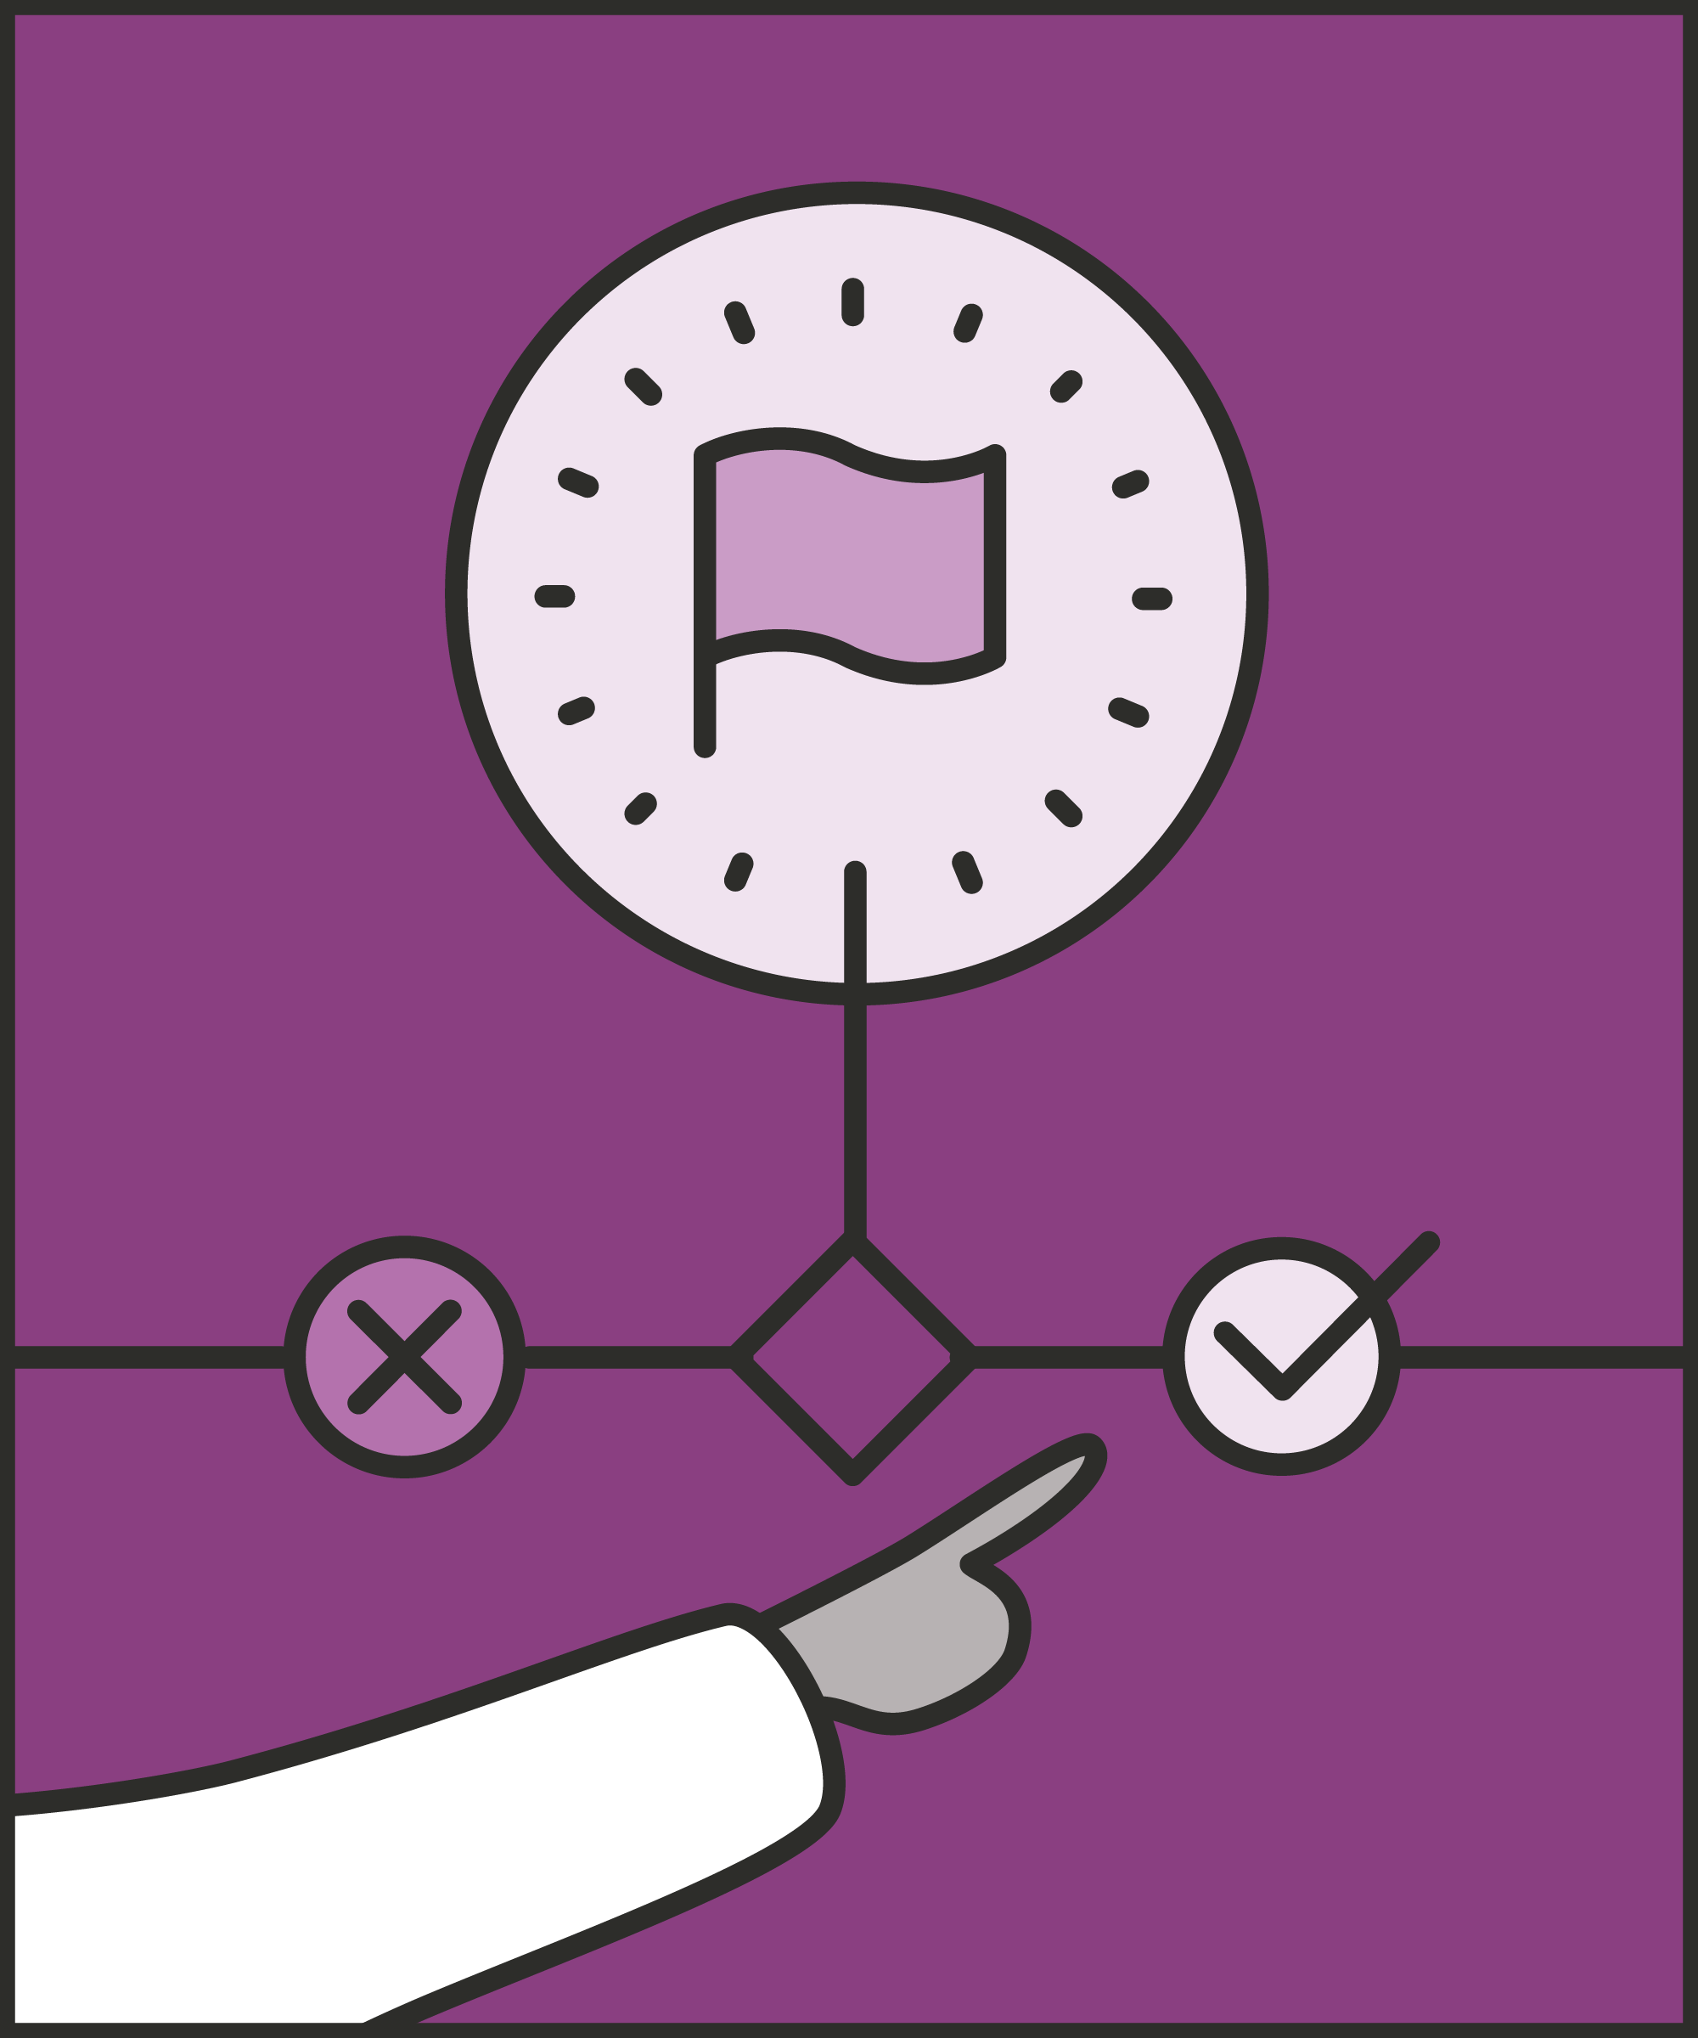
#15 Preventing and addressing conflict
  CLARIFY EXPECTATIONS
    State exactly what you expect from a prisoner, using clear language and explaining the purpose.
Notes:
INTRODUCE NEW TECHNIQUE: CLARIFY EXPECTATIONS
TRAINER NOTE: (Pause a moment to allow people to read the overview of the technique on slide.)
EXPLAIN
Clarifying expectations is often a key part of the de-escalation process. We are halfway to solving the situation.
We’ve listened to the prisoner, found out what they want and used tactical agreement (technique 14).
Calming them down is essential, but de-escalation needs to go further.
The situation isn’t resolved until the prisoner knows what needs to change – what to do, and what not to do – and agrees to act accordingly.
First, we must clarify expectations: we need to convey exactly what the prisoner should be doing, and not doing, and why.
The clearer and more concrete we make expectations, the easier we make it for prisoners to follow them.
It’s easy to give vague requests and instructions: “Stop,” “Don’t do it again,” “Pull it together.” But what does “Pull it together” mean?
Let’s say we want the prisoner to be calm, polite and respectful. The prisoner may believe that avoiding a fight is enough. Ambiguity leaves space for misunderstandings, whether accidental or intentional.
We need to make our expectations as clear as possible. This means making expectations:
Specific: “Pick up all the mess and get the floor mopped” rather than “Get this cleaned up.”
Concrete, rather than abstract: “Stand still, don’t move,” rather than “Hang on there.”
Observable, rather than invisible: “Give me a wave to show me you’re done,” rather than, “When you’re done, wait there.”
Expectations may land more effectively if we add empathy, or a rationale. We’ve discussed the importance of prisoners feeling control over the situation (technique 9: least invasive intervention) and the value of emphasising the purpose of an instruction (technique 5: purpose not power).
We can make our behaviour less controlling if we offer a purpose for the expectation – “This matters because otherwise we can’t keep you safe.” We can also use empathy: “I appreciate you must be fed up with this, but there is no other way to make this work.”
While this technique is part of the “addressing conflict” techniques: it can be applied to other areas as well. You regularly need to clarify expectations with prisoners in situations that aren’t charged.
For example, you may notice a prisoner wearing flip flops on the landing. In this situation you would need to clarify expectations with the prisoner telling them that they need to wear appropriate footwear on the landings and explaining the reasons behind it.

Slide 5
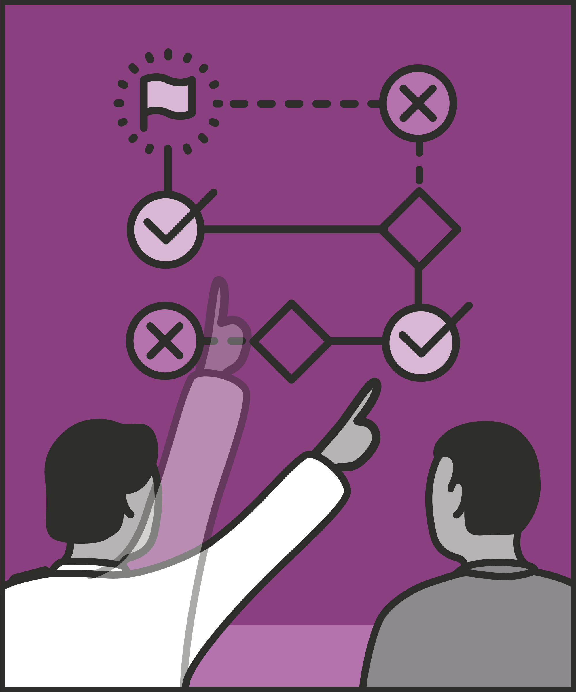
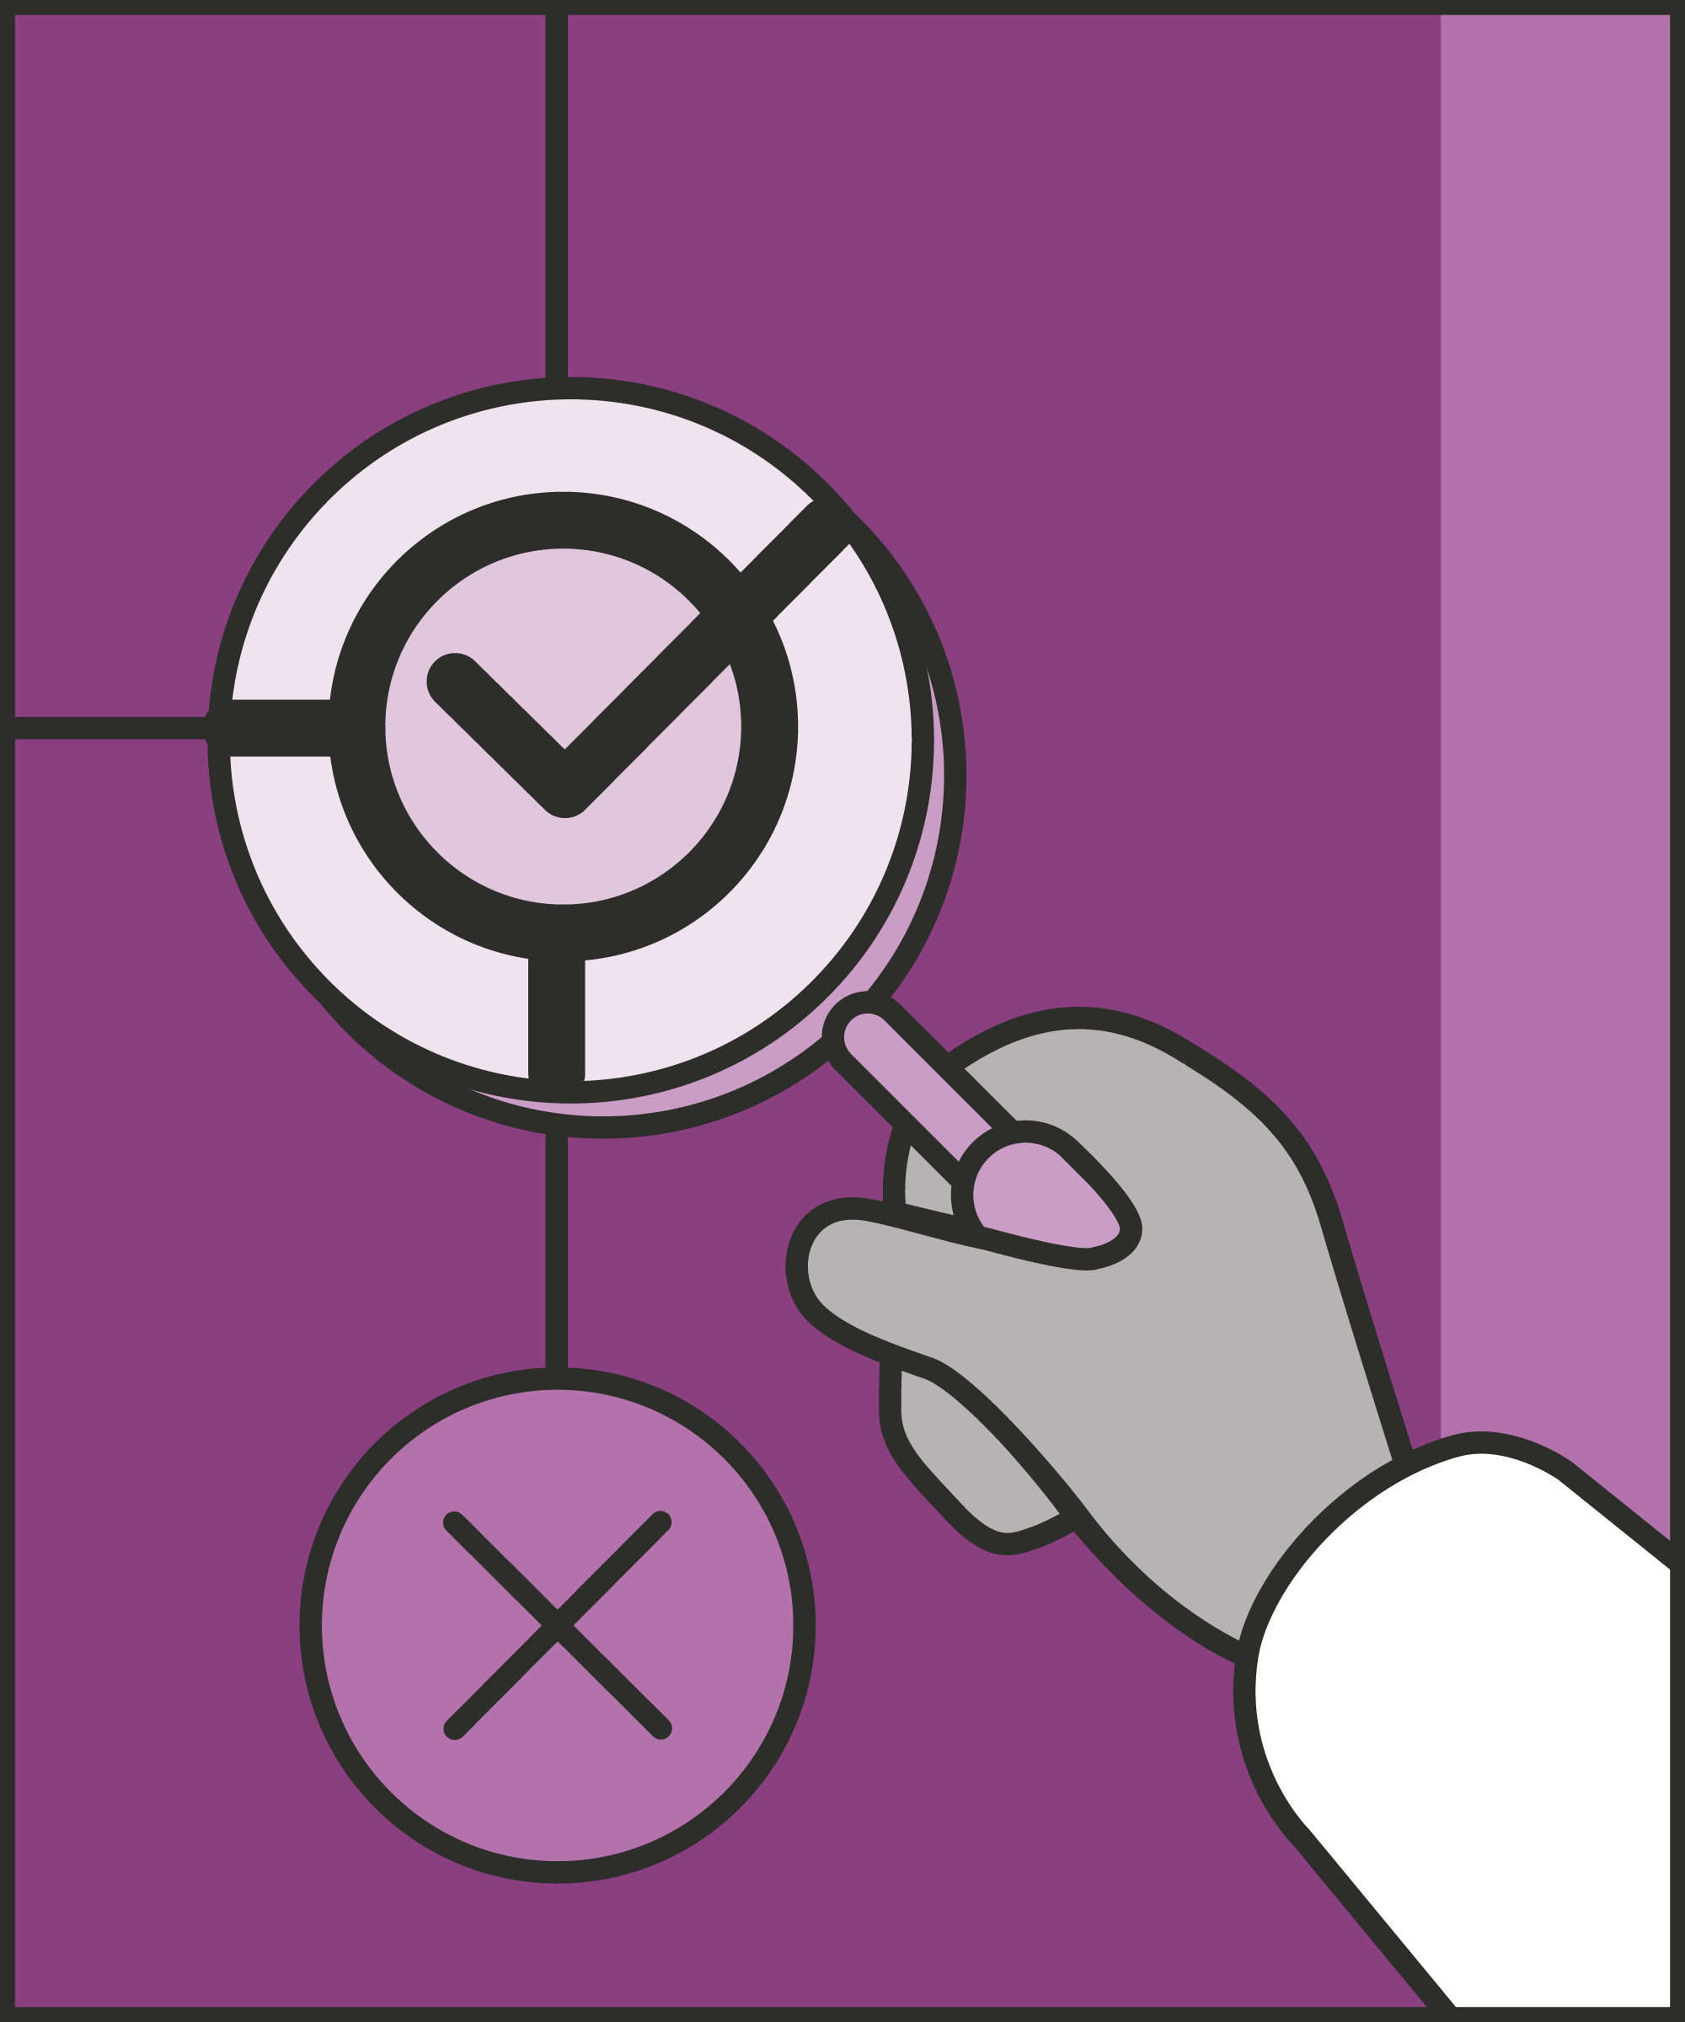
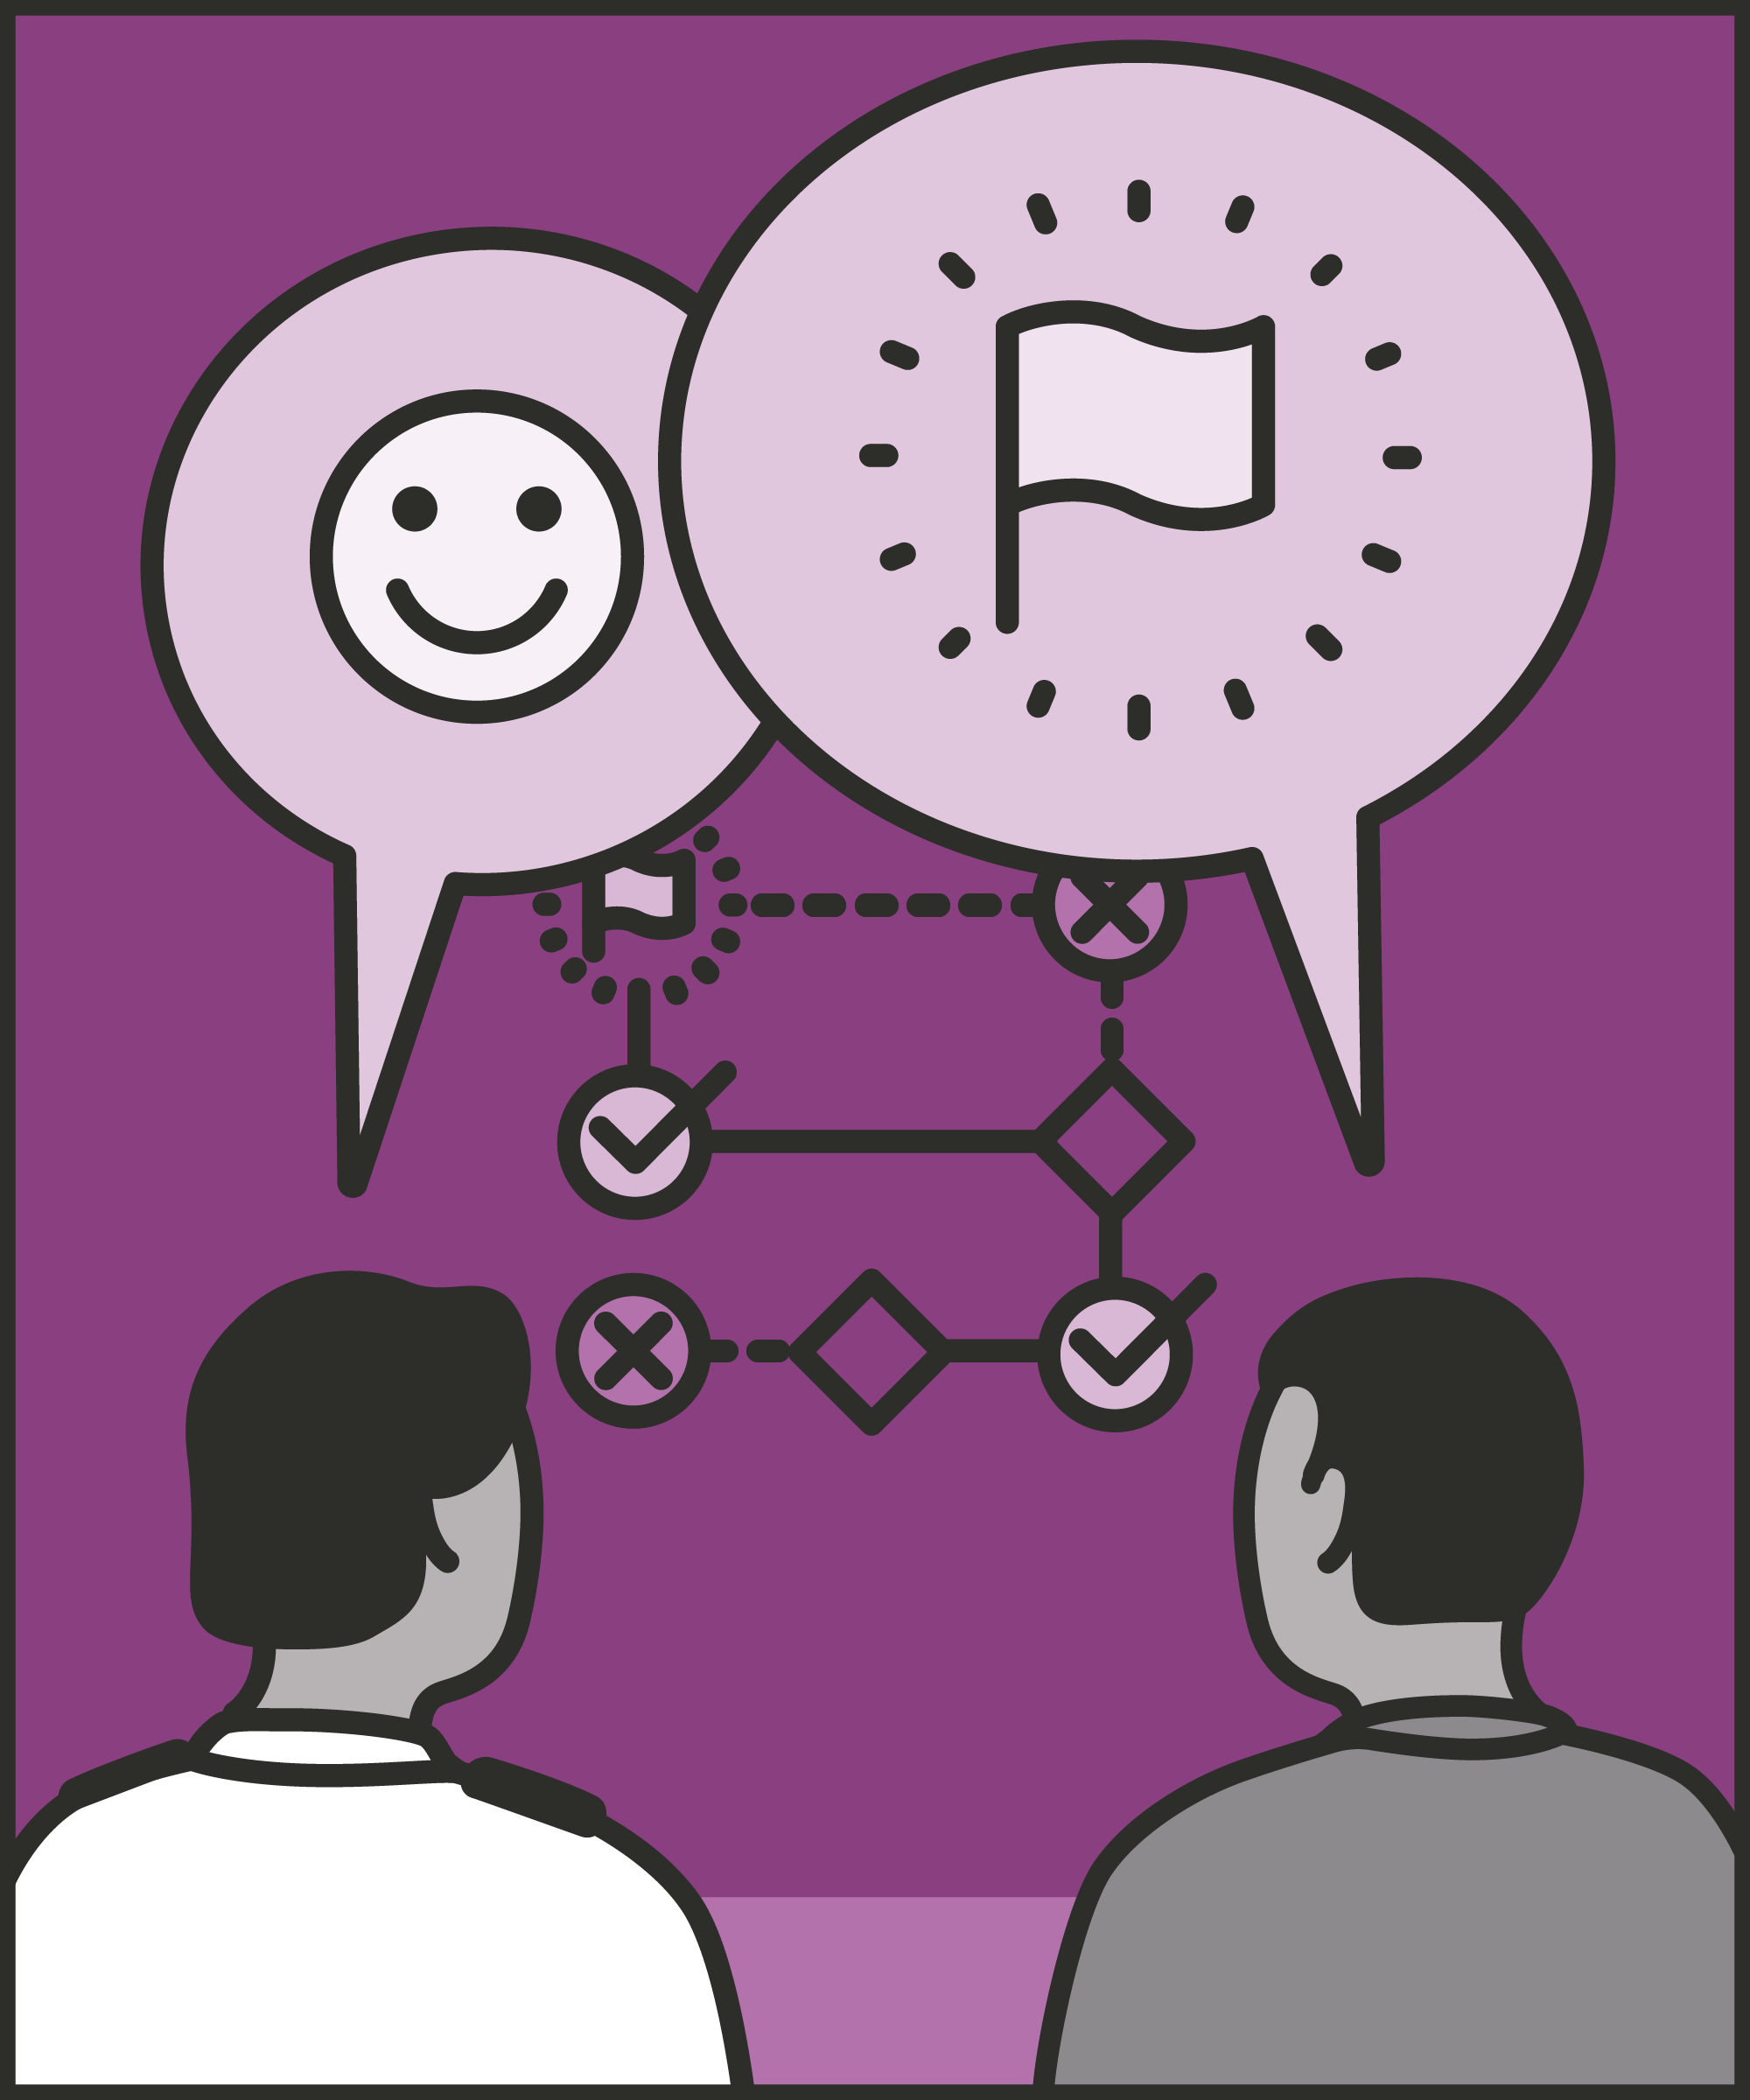
State clearly
  Explain what needs to happen and not happen.
Say exactly what you want to see
  Give clear instructions for actions that you can see and check.
Offer purpose, empathy or both
  Explain the purpose and show empathy to gain buy-in.
Notes:
INTRODUCE NEW TECHNIQUE: CLARIFY EXPECTATIONS
EXPLAIN
We are now going to go through each of the steps for this technique.
State clearly: We cannot expect prisoners to know what’s expected unless we tell them. Expectations may have been different in their last prison, their last wing, or last week with different officers. The more clearly and concretely we articulate expectations, the easier we make it for prisoners to follow them. “Take it easy today,” is ambiguous: a prisoner can interpret it in many ways. “If you see Jake walking towards you, walk away, and towards an officer,” makes the desired behaviour unambiguous.
Say exactly what you want to see: A behaviour is observable if we can see the difference between someone doing it and not doing it. For example, if we ask someone to “concentrate,” “be careful,” or “be reasonable,” we can’t know – for sure – whether they are doing as we asked. But we can take a word like “concentrate,” and ask for observable behaviours which demonstrates concentration. For example, we might say, “When I’m talking to you, I’d like you to look at me so I know you’re listening.” We can’t see “concentration,” but we can see whether a prisoner is looking at us. We can’t see “being careful,” but we can see “take one step at a time on the stairs.” This small tweak means the prisoner knows what we want them to do, and we know whether they’re doing it.
Offer a purpose, empathy or both: People often resent being told what to do. We can make the expectation seem more reasonable with empathy and purpose. For example, if we want a prisoner to step away from another, we could say, “He’ll need more room than that to get past you,” or “I know there’s not much space, but…”

Slide 6
Turn and talk
Using the Pocket Guide as a reference:
Do you use this technique as part of your practice? If so, how and when?
Which of the steps do you use?
Which of the steps do you want to work on?
Notes:
TURN AND TALK: CLARIFY EXPECTATIONS
PAIRED DISCUSSION
In pairs I would like you to discuss the following questions using the pocket guide as a reference (p40):
Do you use this technique as part of your practice? If so, how and when?
Which of the steps do you use?
Which of the steps do you want to work on?
WHOLE GROUP FEEDBACK
(Get whole group feedback following paired discussions.)

Slide 7
Model video
INSERT MODEL VIDEO ONTO SLIDE
Notes:
MODEL VIDEO: CLARIFY EXPECTATIONS
TRAINER NOTE: If possible, insert the model video onto this slide ahead of starting your session. (You can find the online link to the videos here: https://unlockedgrads.org.uk/leading-prison-landings/the-videos/ or by pressing CTRL+CLICK on the box on the slide.)
EXPLAIN VIDEO
We are now going to watch the model video for this technique. While you are watching the video try to see if you can identify the success checks as they are met.
EXPLAIN POTENTIAL PITFALLS
Now that you have a better understanding of this technique, I want to explain some potential pitfalls that officers can make when trying to use it:
Overloading prisoners with multiple expectations: When a prisoner has done something wrong, we may be tempted to set out everything that needs to change. But people can’t hold multiple things in their heads at once. For example, a person can’t multiply 17x42 while also listening attentively to a conversation: we can only focus on one thing at a time. Nor can people change multiple behaviours at once. For example, if a prisoner is concentrating on giving other prisoners personal space, they probably don’t have the mental bandwidth to also use kinder language. Pick the single most important thing you need the prisoner to do and emphasise that.

Slide 8

Practice – clarify expectations
Roles
Timing
Participant A: Prisoner
Scripting: 1 min
Participant B: Prison officer
Practice: 2 min
Success checks
Feedback: 1 min
State clearly what needs to happen
Say exactly what you want to see
Offer purpose, empathy or both
Practice: 2 min
Feedback: 1 min
Notes:
PRACTICE: CLARIFY EXPECTATIONS
EXPLAIN THE PRACTICE (NB: you can change the times for scripting, practice and feedback as needed.)
We are now going to practise using the technique clarify expectations:
When might you use the technique of clarifying expectations? Think about a prisoner or group of prisoners you are working with when you have needed to, or will need to, use this technique. For example, when appointing a wing worker, during an IEP review or during a first keywork session, etc.
To remind you, the success checks for this practice are:
READ SUCCESS CHECKS FROM SLIDE
(Check all have chosen a real-life scenario – choose people to share theirs if time.)
You each now have 1 minute to script what you would say and do in the scenario you have chosen, using the success checks.
(Trainer then allocate pairs.)
Person nearest the door is going to be the prisoner first (Participant A) and the other will be the officer (Participant B).
For practice round 1, Participant B explain your scenario to your partner – they will be playing the role of the prisoner.
Ok, when I say go, you will have 2 minutes to run the practice using the scenario Participant B has given. If you finish before the 2 minutes, give feedback and practice again, making improvements.
Remember to stay in role throughout.
Go.
START PRACTICE
(Circulate during practice and give live feedback to pairs, as necessary.)
EXPLAIN THE FEEDBACK
Participant A, you will now give feedback to your partner.
Referring to the success checks, tell them what they did well and what could they improve on?
(If there is time, you could ask the participants to do a second round of practice implementing the feedback.)
SWITCH ROLES
Now switch roles and repeat the practice and feedback cycle.
WHOLE GROUP FEEDBACK
How was it?
How did it feel?
What feedback did you get?

Slide 9
Next steps: Observations, feedback and tracking
Notes:
EXPLAIN NEXT STEPS FOR OBSERVATIONS
When will next observations take place?
Who will be conducting the observations?
EXPLAIN NEXT STEPS FOR FEEDBACK
When can they expect to get feedback on their observations?
How will feedback be delivered?
EXPLAIN NEXT STEPS FOR TRACKING
How will observations and feedback be tracked?
Are there any updates to share with staff?

Slide 10
As you use this technique in your everyday work, you may find it useful to refer back to Leading Prison Landings: A Pocket Guide, or the full training manual, Leading Prison Landings: The Unlocked Guide to Jailcraft.

