Slide 1
#17 active listening
Training slides

Slide 2
PROMOTING CHANGE
The strategies in this section support you to encourage prisoners to change. They aim to give you the tools to build relationships, understand prisoners’ goals, and support them to make lasting change.
#17 Active listening
#18 Socratic questions
#19 Negative to positive
#20 Commitment to change
#21 Setting goals and recognising progress
#22 Precise praise
#23 Rolling with resistance
Notes:
PROMOTING CHANGE
EXPLAIN
The final seven techniques are the promoting change techniques. They equip officers with practical skills to encourage and support prisoners in making positive changes, no matter how big or small. By helping officers build strong relationships, explore and develop prisoners' goals, and provide ongoing support, these techniques can play a key role in fostering lasting change. Used effectively, they can influence the decisions prisoners make and contribute to more positive outcomes both in custody and beyond.

Slide 3
Recap of previous technique
Notes:
RECAP PREVIOUS TECHNIQUE
What was the technique we covered last week?
What does the technique look to do?
What are the success checks for the technique?
CELEBRATE SUCCESSES
We have had some great successes this week including…
I would like to shoutout XXXXX because…
Does anyone want to shout out one of their colleagues?

Slide 4

#17 Promoting change
  ACTIVE LISTENING
    Focus on understanding what a prisoner is saying and thinking, not just on your own response.
Notes:
INTRODUCE NEW TECHNIQUE: ACTIVE LISTENING
TRAINER NOTE: (Pause a moment to allow people to read the overview of the technique on slide.)
EXPLAIN
A person speaking is constantly monitoring their listeners’ reactions. If we want prisoners to share their hopes, feelings and worries honestly, we need to show that we’re listening, we’re interested, and we want the prisoner to keep talking.
We’re not listening to prove a point or show we’re clever – we’re listening to understand, and to bring out the best in them. This is active listening.
Active listening means taking practical steps to encourage prisoners to speak, and to attend to what they say. It’s the opposite of half listening – while waiting for our chance to speak.
When we listen actively, we try to clear our minds of the desire to interrupt, chip in or argue.
Evidence shows that active listening improves relationships and well-being by making people feel more understood, and it boosts communication effectiveness, leading to better problem-solving and higher satisfaction in both personal and professional settings.

Slide 5
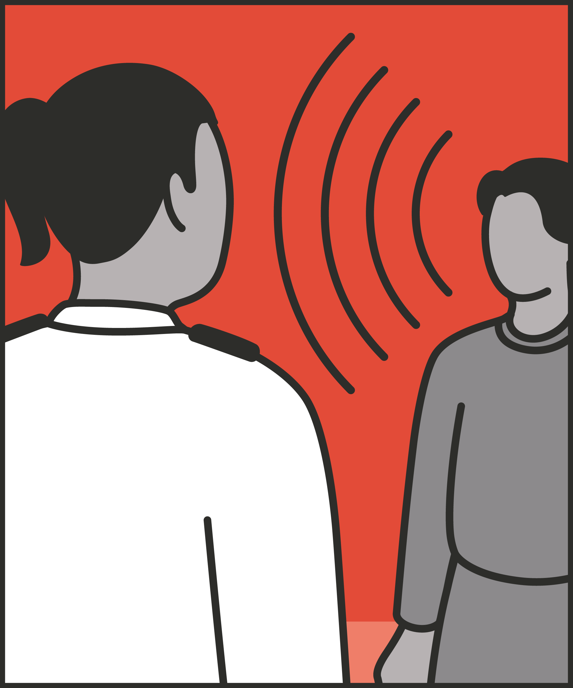



Listen actively
  Consciously decide to listen, not speak.
Show you are listening
  Maintain eye contact, nod, say “yes”, “mmm” etc.
Encourage the prisoner to keep talking
  Stay silent; when needed, ask open and clarifying questions.
Report back what you are hearing
  Show you are truly listening and are engaged with the prisoner’s circumstances by repeating their words back to them.
Notes:
INTRODUCE STEPS: ACTIVE LISTENING
EXPLAIN
We are now going to go through each of the steps for this technique.
Listen actively: This can be the hardest thing about active listening, but it’s crucial. We need to consciously decide that we’re listening – not talking. This means letting go of, or suppressing, the many things we could say. Perhaps we disagree, perhaps we know better, perhaps we have experienced something very similar. If we are to listen actively however, we aren’t going to comment on any of these things right now. Instead, we relax and let them go.
Show you’re listening: Do this through maintaining eye contact or nod along, say “yes” or “mmm” to show you are listening. When we stop trying to chip in, our body is likely to relax. But we also want to show we’re listening. Perhaps we’ll nod as the speaker talks or interject with “mmm” or “right.” We can maintain eye contact. We might also take on a relaxed posture – while maintaining an appropriate distance and stance for personal protection.
Encourage the prisoner to keep talking: You can do this by staying silent and when needed, ask open and clarifying questions. People usually use pauses to chip in or change the subject. With active listening however, a pause is the fragile moment in which we offer support to help the prisoner keep talking. So, rather than interrupting, we might remain attentively silent, waiting for what’s coming next. Or we could ask a clarifying question – “So what happened next?” Ask open questions to help the prisoner talk further. Generally, we prefer not to interrupt. But where we do want to encourage the prisoner to talk further, an open question may be a better way to invite them to speak at length or to go deeper into their feelings. For example, if we see a prisoner is upset, asking, “Are you OK?” doesn’t get us very far. “How did the visit go?” or “What’s on your mind?” may be better ways to get the prisoner talking.
Report back what you are hearing: Show you are truly listening and are engaged with the prisoner’s circumstances by repeating their words back to them. When the prisoner stops, or looks to us for a response, we can show that we’ve truly been listening, and that we are seeking to understand them, by reflecting back what we’ve heard. We might say something like “What I’m hearing is that you’re really disappointed about what’s happening.” Or “Can I check what you’re telling me, it sounds like you’re really excited about this.” If we hear something promising, we might switch from Active listening to supporting the prisoner to plan change, by emphasising something positive they’ve said.

Slide 6
Turn and talk
Using the Pocket Guide as a reference:
Do you use this technique as part of your practice? If so, how and when?
Which of the steps do you use?
Which of the steps do you want to work on?
Notes:
TURN AND TALK: ACTIVE LISTENING
PAIRED DISCUSSION
In pairs I would like you to discuss the following questions using the pocket guide as a reference (p46):
Do you use this technique as part of your practice? If so, how and when?
Which of the steps do you use?
Which of the steps do you want to work on?
WHOLE GROUP FEEDBACK
(Get whole group feedback following paired discussions.)

Slide 7
Model video
INSERT MODEL VIDEO ONTO SLIDE
Notes:
MODEL VIDEO: ACTIVE LISTENING
TRAINER NOTE: If possible, insert the model video onto this slide ahead of starting your session. (You can find the online link to the videos here: https://unlockedgrads.org.uk/leading-prison-landings/the-videos/ or by pressing CTRL+CLICK on the box on the slide.)
EXPLAIN VIDEO
We are now going to watch the model video for this technique. While you are watching the video try to see if you can identify the success checks as they are met.
EXPLAIN POTENTIAL PITFALLS
Now that you have a better understanding of this technique, I want to explain some potential pitfalls that officers can make when trying to use it:
Losing track of what is happening around you: Ideally, active listening demands that we attend fully to the speaker. But no matter how intense the conversation, we need to keep scanning the landing and wing and attending to everything else that’s going on (see radar be seen looking: technique 1). We also need to consider personal safety, our positioning and the positioning of prisoners around us. Finally, we need to think about maintaining appropriate boundaries – and perceptions of appropriate boundaries – in terms of how long we spend with individual prisoners and where we talk to them.
Not challenging appropriately: Understanding the prisoner’s perspective is important, but that doesn’t mean validating abhorrent, illegal or unethical suggestions. For example, if a prisoner makes a racist statement, or describes planning to take revenge after their release, we can listen and understand what they’re saying – then challenge their sentiments and the rationale behind them.

Slide 8

Practice – active listening
Roles
Timing
Participant A: Prisoner
Scripting: 1 min
Participant B: Prison officer
Practice: 2 mins
Success checks
Feedback: 1 min
Listen actively
Show you are listening
Encourage them to keep talking
Repeat back what you are hearing
Practice: 2 mins
Feedback: 1 min
Notes:
PRACTICE: ACTIVE LISTENING
EXPLAIN THE PRACTICE (NB: you can change the times for scripting, practice and feedback as needed.)
We are now going to practise using the technique active listening:
When might you use the technique of active listening? Think about a prisoner or group of prisoners you are working with when you have needed to, or will need to, use this technique. For example, during an ACCT assessment, during a key working session or when communicating with a frustrated prisoner on the landing, etc.
To remind you, the success checks for this practice are:
READ SUCCESS CHECKS FROM SLIDE
(Check all have chosen a real-life scenario – choose people to share theirs if time.)
You each now have 1 minute to script what you would say and do in the scenario you have chosen, using the success checks.
(Trainer then allocate pairs.)
Person nearest the door is going to be the prisoner first (Participant A) and the other will be the officer (Participant B).
For practice round 1, Participant B explain your scenario to your partner – they will be playing the role of the prisoner.
Ok, when I say go, you will have 2 minutes to run the practice using the scenario Participant B has given. If you finish before the 2 minutes, give feedback and practice again, making improvements.
Remember to stay in role throughout.
Go.
START PRACTICE
(Circulate during practice and give live feedback to pairs, as necessary.)
EXPLAIN THE FEEDBACK
Participant A, you will now give feedback to your partner.
Referring to the success checks, tell them what they did well and what could they improve on?
(If there is time, you could ask the participants to do a second round of practice implementing the feedback.)
SWITCH ROLES
Now switch roles and repeat the practice and feedback cycle.
WHOLE GROUP FEEDBACK
How was it?
How did it feel?
What feedback did you get?

Slide 9
Next steps: Observations, feedback and tracking
Notes:
EXPLAIN NEXT STEPS FOR OBSERVATIONS
When will next observations take place?
Who will be conducting the observations?
EXPLAIN NEXT STEPS FOR FEEDBACK
When can they expect to get feedback on their observations?
How will feedback be delivered?
EXPLAIN NEXT STEPS FOR TRACKING
How will coaching be tracked?
Are there any updates to share with staff?

Slide 10
As you use this technique in your everyday work, you may find it useful to refer back to Leading Prison Landings: A Pocket Guide, or the full training manual, Leading Prison Landings: The Unlocked Guide to Jailcraft.

