Slide 1
#19 negative to positive
Training slides

Slide 2
PROMOTING CHANGE
The strategies in this section support you to encourage prisoners to change. They aim to give you the tools to build relationships, understand prisoners’ goals, and support them to make lasting change.
#17 Active listening
#18 Socratic questions
#19 Negative to positive
#20 Commitment to change
#21 Setting goals and recognising progress
#22 Precise praise
#23 Rolling with resistance
Notes:
PROMOTING CHANGE
EXPLAIN
The final seven techniques are the promoting change techniques. They equip officers with practical skills to encourage and support prisoners in making positive changes, no matter how big or small. By helping officers build strong relationships, explore and develop prisoners' goals, and provide ongoing support, these techniques can play a key role in fostering lasting change. Used effectively, they can influence the decisions prisoners make and contribute to more positive outcomes both in custody and beyond.

Slide 3
Recap of previous technique
Notes:
RECAP PREVIOUS TECHNIQUE
What was the technique we covered last week?
What does the technique look to do?
What are the success checks for the technique?
CELEBRATE SUCCESSES
We have had some great successes this week including…
I would like to shoutout XXXXX because…
Does anyone want to shout out one of their colleagues?

Slide 4
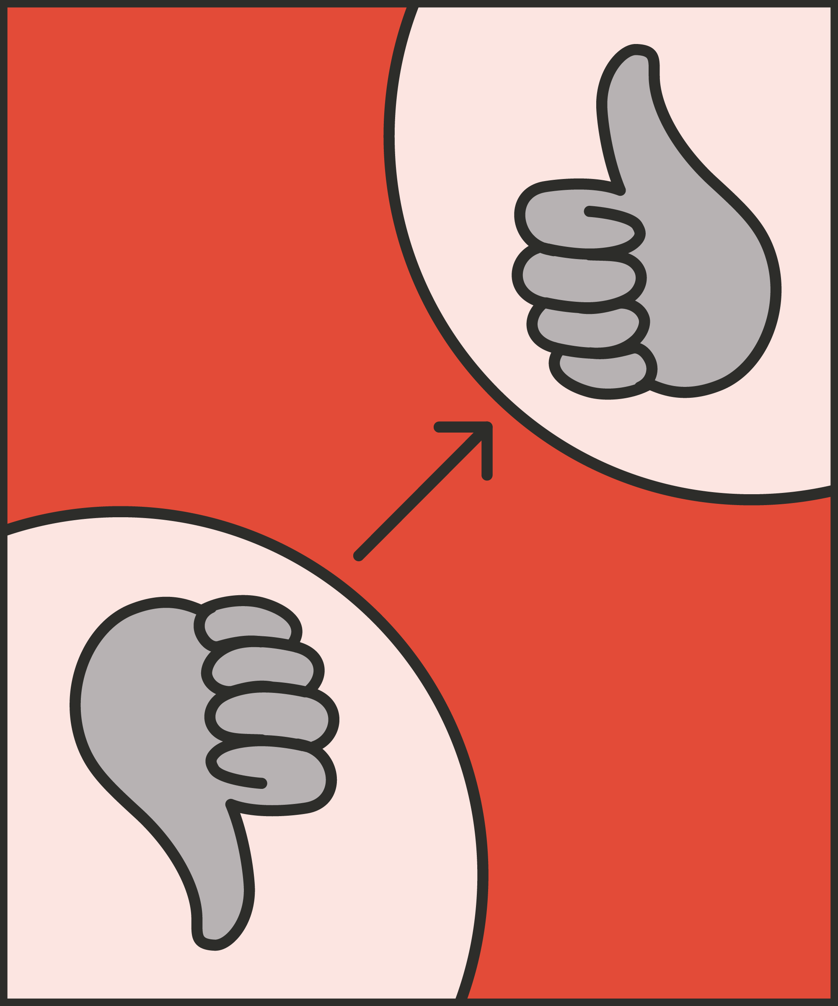
#19 Promoting change
  NEGATIVE TO POSITIVE
    Redirect a prisoner’s negative thoughts towards realistic optimism and positive action.
Notes:
INTRODUCE NEW TECHNIQUE: NEGATIVE TO POSITIVE
TRAINER NOTE: (Pause a moment to allow people to read the overview of the technique on slide.)
EXPLAIN
A prisoner who feels stuck and lacks hope may struggle to take positive action to improve their situation. They may resort to despair and even self-harm.
To help them, prison officers need to encourage them to turn negative thoughts and beliefs into positive thoughts and actions.
However, unchecked optimism is no solution. Prisoners are often in a miserable situation. Their worries and fears may be well-founded.
Imagine a prisoner who can’t get through to their partner. Telling them: “It’ll be fine,” is neither realistic nor honest.
Think about a prisoner who has been recalled to prison for breaching the terms of their licence. There’s no easy consolation. Their current failures and worries may build on years of previous ones: failed jobs, failed relationships, failed releases.
We need to help prisoners towards realistic optimism. They’re still locked up; they have made their mistakes. But there are still choices they can make, actions they can take, and things to work towards.
When a prisoner hints at, or articulates, negativity, we can offer a realistic, positive alternative.
For example, imagine a newly-arrived prisoner who tells you: “I’ve ruined my life.” Telling them “You’re going to be absolutely fine” would be unrealistic and dishonest. Instead, we might say something like “Sure, this is a setback. But there are ways forward.”
We can offer realistic hope, as a first step towards positive action on their part.
This is what the negative to positive technique focuses on: redirecting a prisoner’s negative thoughts towards an optimistic but realistic view that the prisoner can act on.

Slide 5




Acknowledge
  Recognise where the prisoner is coming from (their thoughts or the situation).
Use tactical agreement
  Show understanding and find common ground by agreeing with something that is possible to agree with.
Challenge assumptions
  Give evidence of things that have worked, either for the individual or others previously; ask Socratic questions.
Offer alternatives
  Give hopeful but realistic alternatives and ensure commitment to action.
Notes:
INTRODUCE STEPS: NEGATIVE TO POSITIVE
EXPLAIN
We are now going to go through each of the steps for this technique.
Acknowledge: Before trying to tackle a prisoner’s negative thoughts, acknowledge where they’re coming from. You don’t have to agree with everything. For example, you wouldn’t want to validate statements like “No one cares about me” or “Nothing I can do here will make a difference.” Simply try to recognise and acknowledge where the prisoner’s thinking is coming from.
Use tactical agreement: Tactical agreement (strategy 14) can show understanding and help you to find some common ground. In short: the tactical agreement technique is focused on finding something to agree on from what the prisoner is saying. It’s not about agreeing with everything they are saying but finding an element of what they say to agree with. For example, an officer might agree with a prisoner who is in a negative mindset through saying that: “I can see why it feels like nothing is going to make a difference.”
Challenge assumptions. We can acknowledge there’s something in what the prisoner says, but we also want to begin to challenge their assumptions. We might provide evidence ourselves. For example, we could challenge the idea that “Nothing I can do here will make a difference,” by describing other prisoners we’ve worked with who were able to achieve things in prison. We could say something like “I worked with a prisoner last year who became a Listener. He found he was able to help others and get a better handle on his own emotions.” We could use Socratic questions (strategy 18) to help. For example, we might ask “What would you like to be different when you’re released?” Then, “What can you do now that would help you to work towards this?”
Offer alternatives: Building on the acknowledgement and challenge, we can offer a hopeful, but realistic, alternative. For example, we might say something like “So there are courses and roles you can take on in the prison which will help you to work towards your goals once you’re released.” This hopeful alternative is particularly powerful when combined with a commitment to action (Strategy 20). For example, we might conclude by asking “Shall I get you an application for that course now?”

Slide 6
Turn and talk
Using the Pocket Guide as a reference:
Do you use this technique as part of your practice? If so, how and when?
Which of the steps do you use?
Which of the steps do you want to work on?
Notes:
TURN AND TALK: NEGATIVE TO POSITIVE
PAIRED DISCUSSION
In pairs I would like you to discuss the following questions using the pocket guide as a reference (p50):
Do you use this technique as part of your practice? If so, how and when?
Which of the steps do you use?
Which of the steps do you want to work on?
WHOLE GROUP FEEDBACK
(Get whole group feedback following paired discussions.)
Avoid excessive optimism or vagueness: Prisoners have good cause to feel negative. Vague or excessive optimism is neither honest nor realistic. It’s unlikely to be seen as credible by the prisoner and so undermines their trust in us. When we challenge a negative statement, it may help to first think about the opposite of a negative statement – an unrealistic positive statement. Then seek the midpoint: realistic optimism. For example, if a prisoner says “No one cares about me,” an unrealistic positive response might be “Everybody cares about you.” A more realistic positive statement might be: “Your brother keeps visiting you, and I know your cellmate is looking out for you.

Slide 7
Model video
INSERT MODEL VIDEO ONTO SLIDE
Notes:
MODEL VIDEO: NEGATIVE TO POSITIVE
TRAINER NOTE: If possible, insert the model video onto this slide ahead of starting your session. (You can find the online link to the videos here: https://unlockedgrads.org.uk/leading-prison-landings/the-videos/ or by pressing CTRL+CLICK on the box on the slide.)
EXPLAIN VIDEO
We are now going to watch the model video for this technique. While you are watching the video try to see if you can identify the success checks as they are met.
EXPLAIN POTENTIAL PITFALLS
Now that you have a better understanding of this technique, I want to explain some potential pitfalls that officers can make when trying to use it:
Excessive optimism or vagueness. Prisoners have good cause to feel negative. Vague or excessive optimism is neither honest nor realistic. It’s unlikely to be seen as credible by the prisoner and so undermines their trust in us. When we challenge a negative statement, it may help to first think about the opposite of a negative statement – an unrealistic positive statement. Then seek the midpoint: realistic optimism. For example, if a prisoner says: “No one cares about me,” an unrealistic positive response might be “Everybody cares about you.” A more realistic positive statement might be: “Your brother keeps visiting you, and I know your cellmate is looking out for you.”

Slide 8

Practice – negative to positive
Roles
Timing
Participant A: Prisoner
Scripting: 1 min
Participant B: Prison officer
Practice: 2 min
Success checks
Feedback: 1 min
Acknowledge their thought/opinion
Use tactical agreement
Challenge assumptions
Offer alternatives; commit to action
Practice: 2 min
Feedback: 1 min
Notes:
PRACTICE: NEGATIVE TO POSITIVE
EXPLAIN THE PRACTICE (NB: you can change the times for scripting, practice and feedback as needed.)
We are now going to practise using the technique negative to positive:
When might you use the technique of negative to positive? Think about a prisoner or group of prisoners you are working with when you have needed to, or will need to, use this technique. For example, a prisoner thinks staff do not care about a situation, a prisoner thinks they won’t get the job they want, a prisoner who believes they cannot change, etc.
To remind you, the success checks for this practice are:
READ SUCCESS CHECKS FROM SLIDE
(Check all have chosen a real-life scenario – choose people to share theirs if time.)
You each now have 1 minute to script what you would say and do in the scenario you have chosen, using the success checks.
(Trainer then allocate pairs.)
Person nearest the door is going to be the prisoner first (Participant A) and the other will be the officer (Participant B).
For practice round 1, Participant B explain your scenario to your partner – they will be playing the role of the prisoner.
Ok, when I say go, you will have 2 minutes to run the practice using the scenario Participant B has given. If you finish before the 2 minutes, give feedback and practice again, making improvements.
Remember to stay in role throughout.
Go.
START PRACTICE
(Circulate during practice and give live feedback to pairs, as necessary.)
EXPLAIN THE FEEDBACK
Participant A, you will now give feedback to your partner.
Referring to the success checks, tell them what they did well and what could they improve on?
(If there is time, you could ask the participants to do a second round of practice implementing the feedback.)
SWITCH ROLES
Now switch roles and repeat the practice and feedback cycle.
WHOLE GROUP FEEDBACK
How was it?
How did it feel?
What feedback did you get?

Slide 9
Next steps: Observations, feedback and tracking
Notes:
EXPLAIN NEXT STEPS FOR OBSERVATIONS
When will next observations take place?
Who will be conducting the observations?
EXPLAIN NEXT STEPS FOR FEEDBACK
When can they expect to get feedback on their observations?
How will feedback be delivered?
EXPLAIN NEXT STEPS FOR TRACKING
How will coaching be tracked?
Are there any updates to share with staff?

Slide 10
As you use this technique in your everyday work, you may find it useful to refer back to Leading Prison Landings: A Pocket Guide, or the full training manual, Leading Prison Landings: The Unlocked Guide to Jailcraft.

