Slide 1
#20 commitment to change
Training slides

Slide 2
PROMOTING CHANGE
The strategies in this section support you to encourage prisoners to change. They aim to give you the tools to build relationships, understand prisoners’ goals, and support them to make lasting change.
#17 Active listening
#18 Socratic questions
#19 Negative to positive
#20 Commitment to change
#21 Setting goals and recognising progress
#22 Precise praise
#23 Rolling with resistance
Notes:
PROMOTING CHANGE
EXPLAIN
The final seven techniques are the promoting change techniques. They equip officers with practical skills to encourage and support prisoners in making positive changes, no matter how big or small. By helping officers build strong relationships, explore and develop prisoners' goals, and provide ongoing support, these techniques can play a key role in fostering lasting change. Used effectively, they can influence the decisions prisoners make and contribute to more positive outcomes both in custody and beyond.

Slide 3
Recap of previous technique
Notes:
RECAP PREVIOUS TECHNIQUE
What was the technique we covered last week?
What does the technique look to do?
What are the success checks for the technique?
CELEBRATE SUCCESSES
We have had some great successes this week including…
I would like to shoutout XXXXX because…
Does anyone want to shout out one of their colleagues?

Slide 4

#20 Promoting change
  COMMITMENT TO CHANGE
    Work with a prisoner to build motivation and concrete plans for change, supporting them with any setbacks.
Notes:
INTRODUCE NEW TECHNIQUE: COMMITMENT TO CHANGE
TRAINER NOTE: (Pause a moment to allow people to read the overview of the technique on slide.)
EXPLAIN
Everyone has something they would like to be different. It might be eating better, procrastinating less, losing weight, getting on better with family.
Wishing for change is easy. Going for a run is harder. Getting into the habit of exercising is harder still.
Yet if prisoners – or any of us – are to make changes, we need to build a commitment to change, with a clear sense of its value, and a detailed plan for how to get there.
It is important to mention that it can be easy to ‘other’ prisoners, to judge them and to see them as deficient because of their struggles to make changes (whether that’s anger management, addiction or anything else).
It’s human nature to find it difficult to change and to need support with it.
It takes commitment to move away from criminal behaviour. This technique is about helping people to think about why change is difficult for them, to recognise the benefits of change and the disadvantages of staying as they are.

Slide 5


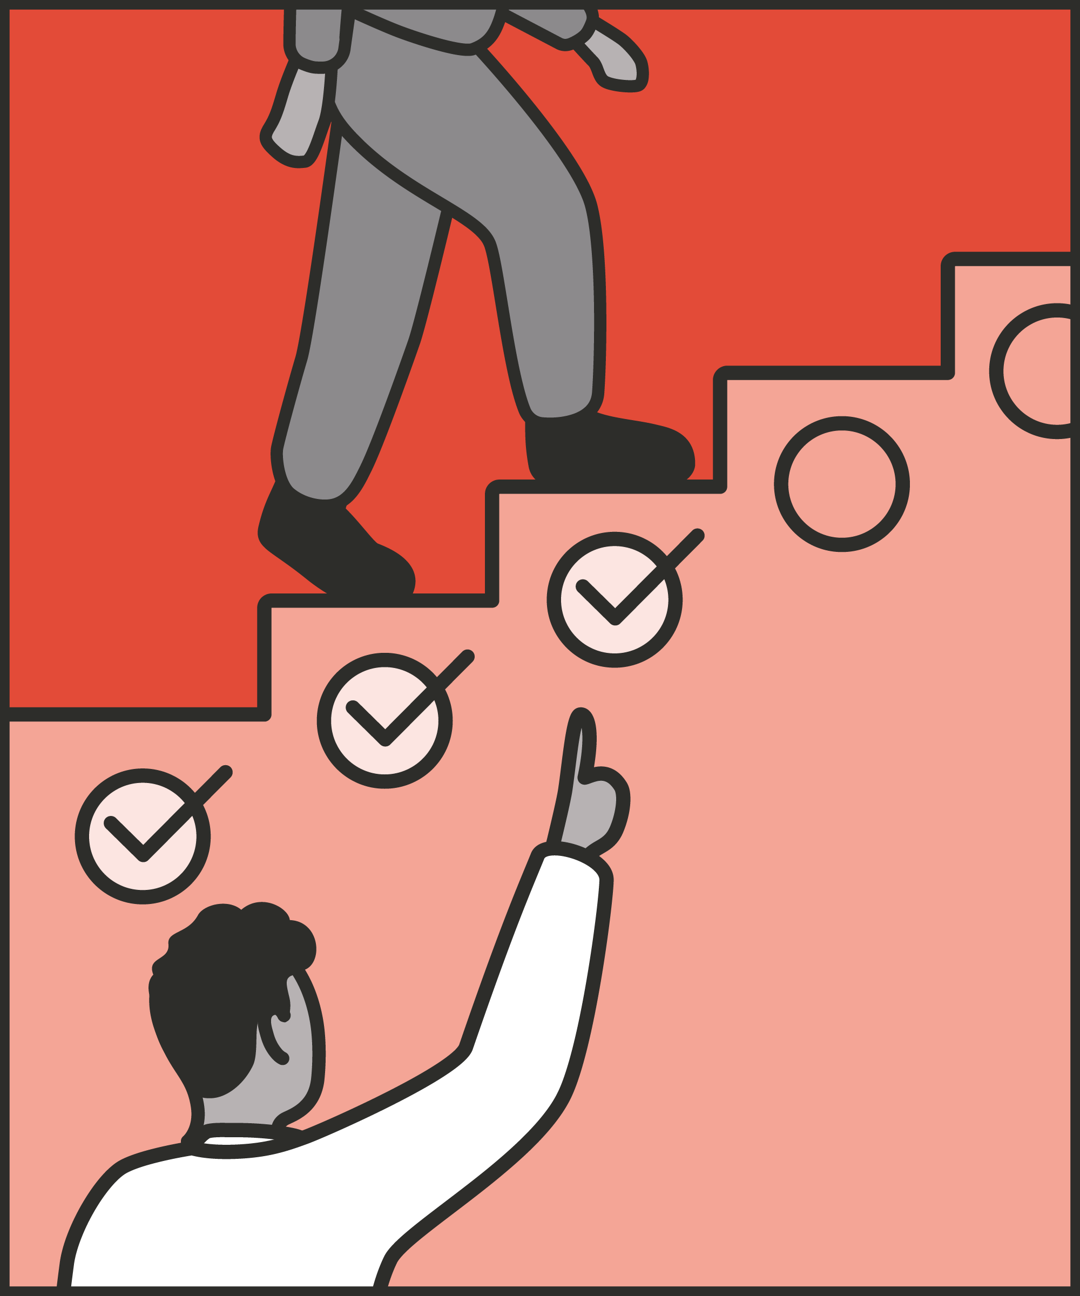

Encourage and echo change talk
  Repeat back the positive comments the prisoner makes.
Build on change talk
  Listen for hints that a prisoner is ready to change and reinforce these ideas by emphasising what is achievable.
Nudge
  Turn wishes into goals, goals into plans, plans into actions.
Support during setbacks
  Acknowledge challenges and then focus on getting the prisoner back on the path they want to follow.
Notes:
INTRODUCE STEPS: COMMITMENT TO CHANGE
EXPLAIN
We are now going to go through each of the steps for this technique.
Encourage and echo change talk: Any talk about change is positive: encourage it. Cynicism and discouragement achieve nothing. Making changes takes time, effort and opportunity: your encouragement and support can make a huge difference. Repeat back what you hear from prisoners: “So you’re saying that you want to come out better than you went in? That sounds worthwhile.”
Build on change talk: Prisoners may start talking about change in limited or half-hearted ways. They may not want to reveal their hopes and fears initially, for fear of cynicism or mockery. Listen for hints that they’re ready to change and amplify them. For example, if a prisoner tells you: “I’d like to get a place on the course – but I’ll probably just get moved again,” focus on what they want and how they can work towards it, not what could go wrong. “That’s a great idea, let’s get your application done.”
Nudge: Help prisoners turn their wishes into goals, their goals into plans, and their plans into action. If a prisoner tells you they wish things were different, ask them why that matters to them, and whether they think they could make things different. If a prisoner tells you they are ready to change, ask them what their first step is going to be.
Support during setbacks: It takes time to build a trusting relationship in which a prisoner is ready to work with you towards change. It takes time – and applications, and support – to develop an idea about change into action. There are almost always setbacks, disappointments and relapses. Be prepared to go back to a prisoner who’s had a disappointing visit, a loss of privileges, or a failed application. This is the point at which they will most need encouragement and support to rebuild their goals and plans. Be ready to talk to them afresh about change, and help them get back on the path they want to follow.

Slide 6
Turn and talk
Using the Pocket Guide as a reference:
Do you use this technique as part of your practice? If so, how and when?
Which of the steps do you use?
Which of the steps do you want to work on?
Notes:
TURN AND TALK: COMMITMENT TO CHANGE
PAIRED DISCUSSION
In pairs I would like you to discuss the following questions using the pocket guide as a reference (p52):
Do you use this technique as part of your practice? If so, how and when?
Which of the steps do you use?
Which of the steps do you want to work on?
WHOLE GROUP FEEDBACK
(Get whole group feedback following paired discussions.)
EXPLAIN POTENTIAL PITFALLS
Now that you have a better understanding of this technique, I want to explain some potential pitfalls that officers can make when trying to use it:
Feeling locked into following these change steps as a sequence: The different kinds of change talk presented above are a way of categorising and thinking about moving towards change. They are not a rigid model, and different people will think about and work towards change differently. For example, if a prisoner feels an intense need to change – “I have to get my life on track” – we may not help by asking their reasons for change. They may be ready to act now. When talking about change, don’t feel you need to move gradually through the steps: “They’ve told me what they desire, next I need to find out if they think they can change.” Instead, try to allow conversation to flow naturally between different kinds of change talk. “They’ve told me what they desire, I wonder if they’ve thought about concrete plans yet… not yet, maybe let’s talk about their reasons for changing first instead.” We can use these types of change talk flexibly to build towards action.
Getting too involved: When we are fighting to help a prisoner change, we may become emotionally involved, both in the change, and with them. We might feel excited and proud when they succeed, disappointed and let down when they struggle. This is understandable – but it’s also a sign we should pause, review the situation, and exercise caution. We may become too involved; our professionalism may lapse. Partly, this can be driven by a prison officer’s self-image as a saviour. When we spot ourselves feeling this involvement – or see it in our colleagues – we need to do two things. First, stop and recall that we are playing a professional role, and that our relationship with any given prisoner is temporary. We can make a big difference to them, but there are limits to the role we can, and should, play. Second, report any conversations about which we – or a colleague – might be concerned.

Slide 7

Practice – commitment to change
Roles
Timing
Participant A: Prisoner
Scripting: 1 min
Participant B: Prison officer
Practice: 2 min
Success checks
Feedback: 1 min
Encourage and echo change talk
Reinforce ideas
Nudge them towards action
Support during setbacks
Practice: 2 min
Feedback: 1 min
Notes:
PRACTICE: COMMITMENT TO CHANGE
EXPLAIN THE PRACTICE (NB: you can change the times for scripting, practice and feedback as needed.)
We are now going to practise using the technique commitment to change:
When might you use the technique of commitment to change? Think about a prisoner or group of prisoners you are working with when you have needed to, or will need to, use this technique. For example, a prisoner who’s wanting to repair a family relationship, a prisoner mentions a course or workshop they’re interested in, a prisoner wanting to come off drugs, etc.
To remind you, the success checks for this practice are:
READ SUCCESS CHECKS FROM SLIDE
(Check all have chosen a real-life scenario – choose people to share theirs if time.)
You each now have 1 minute to script what you would say and do in the scenario you have chosen, using the success checks.
(Trainer then allocate pairs.)
Person nearest the door is going to be the prisoner first (Participant A) and the other will be the officer (Participant B).
For practice round 1, Participant B explain your scenario to your partner – they will be playing the role of the prisoner.
Ok, when I say go, you will have 2 minutes to run the practice using the scenario Participant B has given. If you finish before the 2 minutes, give feedback and practice again, making improvements.
Remember to stay in role throughout.
Go.
START PRACTICE
(Circulate during practice and give live feedback to pairs, as necessary.)
EXPLAIN THE FEEDBACK
Participant A, you will now give feedback to your partner.
Referring to the success checks, tell them what they did well and what could they improve on?
(If there is time, you could ask the participants to do a second round of practice implementing the feedback.)
SWITCH ROLES
Now switch roles and repeat the practice and feedback cycle.
WHOLE GROUP FEEDBACK
How was it?
How did it feel?
What feedback did you get?

Slide 8
Next steps: Observations, feedback and tracking
Notes:
EXPLAIN NEXT STEPS FOR OBSERVATIONS
When will next observations take place?
Who will be conducting the observations?
EXPLAIN NEXT STEPS FOR FEEDBACK
When can they expect to get feedback on their observations?
How will feedback be delivered?
EXPLAIN NEXT STEPS FOR TRACKING
How will coaching be tracked?
Are there any updates to share with staff?

Slide 9
As you use this technique in your everyday work, you may find it useful to refer back to Leading Prison Landings: A Pocket Guide, or the full training manual, Leading Prison Landings: The Unlocked Guide to Jailcraft.

