Slide 1
#21 setting goals and recognising progress
Training slides

Slide 2
PROMOTING CHANGE
The strategies in this section support you to encourage prisoners to change. They aim to give you the tools to build relationships, understand prisoners’ goals, and support them to make lasting change.
#17 Active listening
#18 Socratic questions
#19 Negative to positive
#20 Commitment to change
#21 Setting goals and recognising progress
#22 Precise praise
#23 Rolling with resistance
Notes:
PROMOTING CHANGE
EXPLAIN
The final seven techniques are the promoting change techniques. They equip officers with practical skills to encourage and support prisoners in making positive changes, no matter how big or small. By helping officers build strong relationships, explore and develop prisoners' goals, and provide ongoing support, these techniques can play a key role in fostering lasting change. Used effectively, they can influence the decisions prisoners make and contribute to more positive outcomes both in custody and beyond.

Slide 3
Recap of previous technique
Notes:
RECAP PREVIOUS TECHNIQUE
What was the technique we covered last week?
What does the technique look to do?
What are the success checks for the technique?
CELEBRATE SUCCESSES
We have had some great successes this week including…
I would like to shoutout XXXXX because…
Does anyone want to shout out one of their colleagues?

Slide 4

#21 Promoting change
  SETTING GOALS AND RECOGNISING PROGRESS
    Help a prisoner set manageable, meaningful goals and celebrate their successes.
Notes:
INTRODUCE NEW TECHNIQUE: SETTING GOALS AND RECOGNISING PROGRESS
TRAINER NOTE: (Pause a moment to allow people to read the overview of the technique on slide.)
EXPLAIN
To make lasting changes to their lives, prisoners need to believe they can grow, improve, and change. But it's hard for prisoners to believe this until they see it happening.
A prisoner who feels they keep failing – that they are a failure – won’t change their mind after a pep talk or a few days stuck in their cell.
They need to make progress: they need to set goals and see themselves succeed.
When people set goals, they’re much more likely to act.
Action leads towards success. Success builds belief that they can succeed and change. Belief allows them to pursue bigger changes. Continued success and growing belief allows them to see themselves differently: to take on a new identity.
This technique allows you to set meaningful and achievable goals with prisoners and gives you a blueprint for celebrating prisoner’s successes.

Slide 5
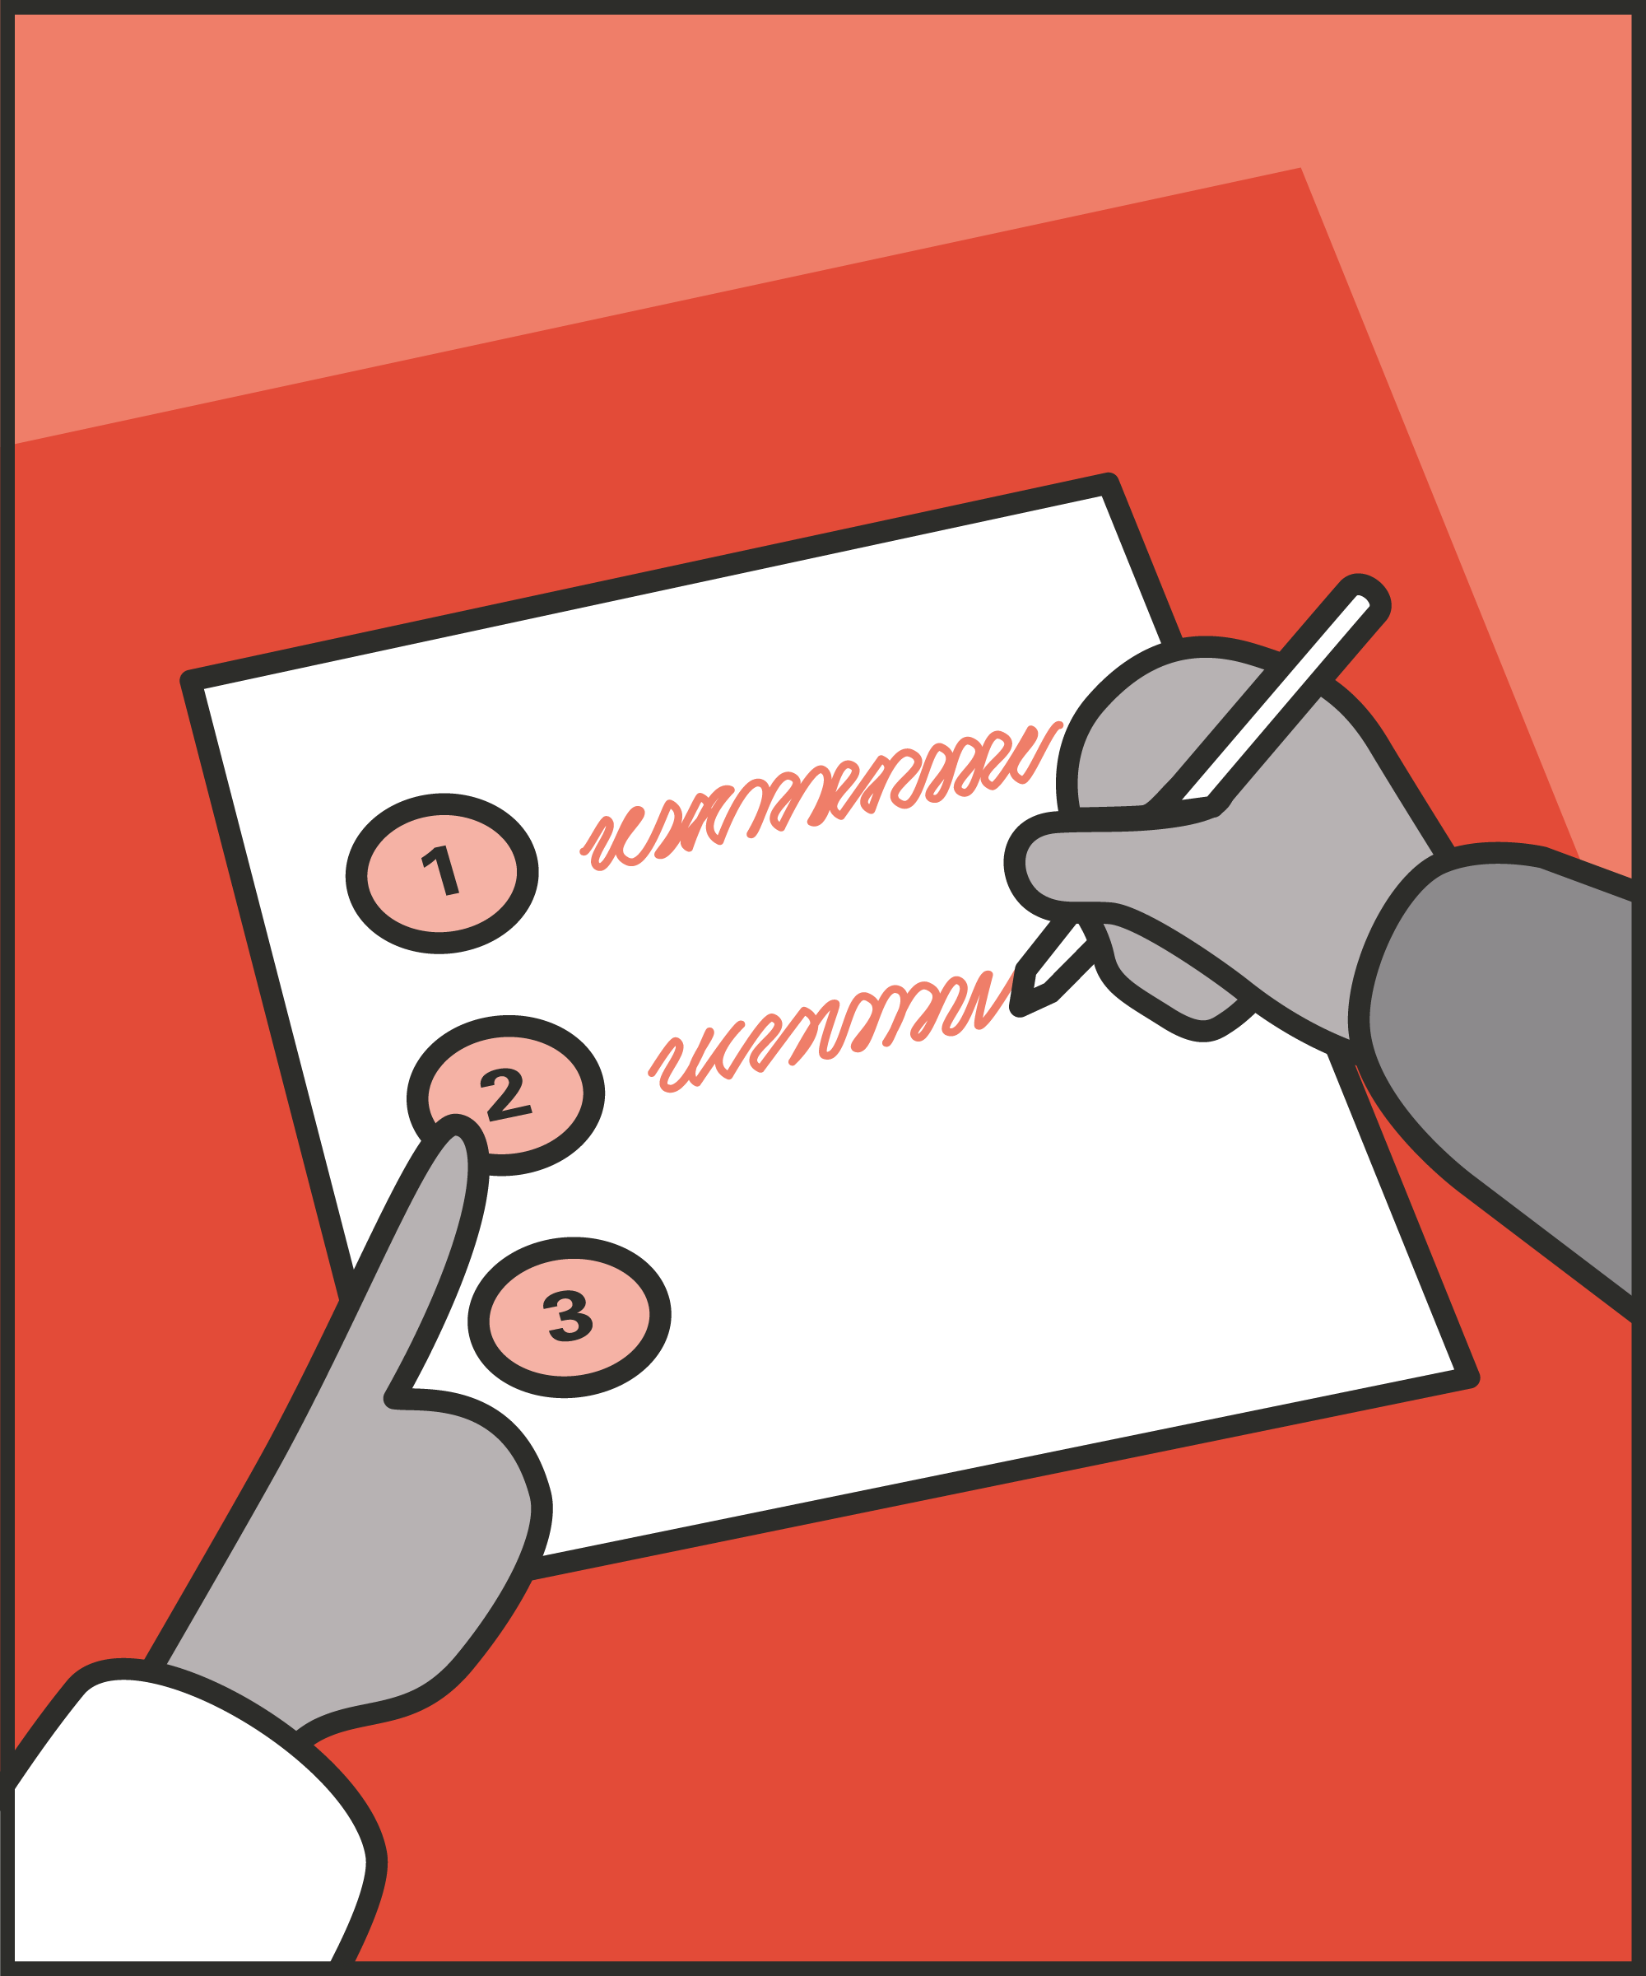

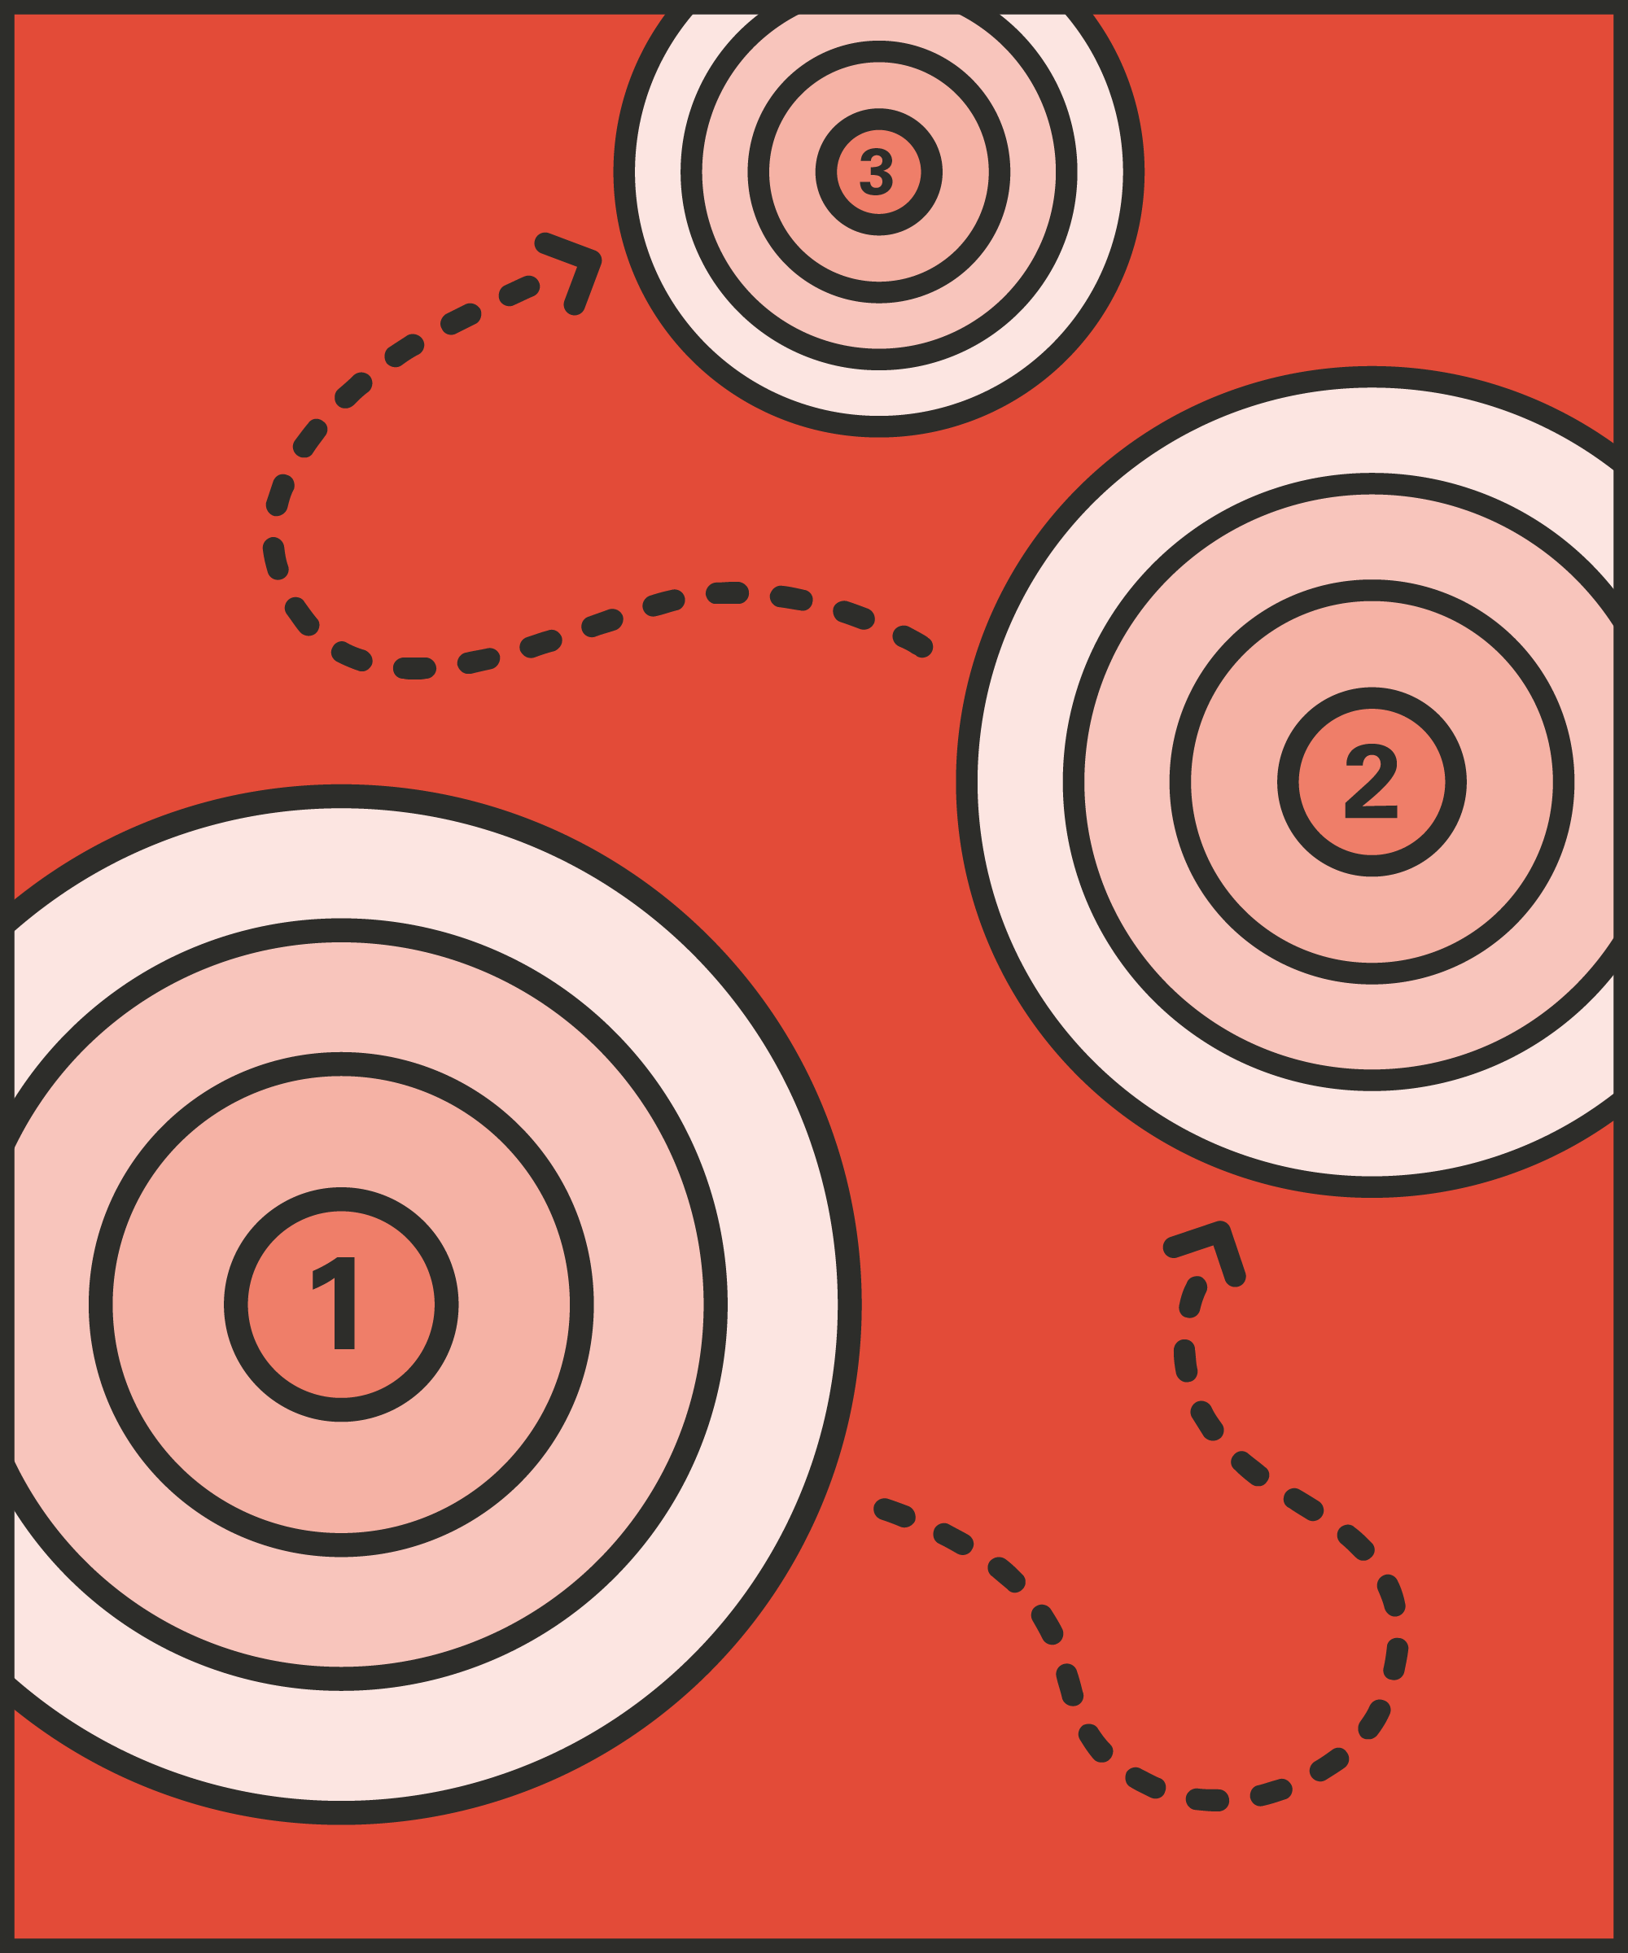
Setting meaningful goals
  Support prisoners to set ambitious but achievable goals.
Support progress
  Recognise and celebrate progress; give reminders and encouragement; offer help.
Recognise and build on progress
  Celebrate successes, no matter how small, and encourage prisoners to keep going. Once one goal is done, look to the next.
Notes:
INTRODUCE STEPS: SETTING GOALS AND RECOGNISING PROGRESS
EXPLAIN
We are now going to go through each of the steps for this technique.
Setting meaningful goals: A goal must be ambitious enough to be worth pursuing, but achievable enough to seem doable. Big goals are great, but they don’t guide next steps. A prisoner may want a settled life, a decent job, and a home: they need immediately achievable goals which work towards this. Similarly, vague goals don’t help much, because they don’t guide action. A prisoner may want to “turn things around:” we need to help them work out how to do this. So we want to help prisoners set goals which are specific, immediate and achievable. For example, we might encourage them to pick an immediate target: “What do you want to be able to do next week?” We might also help to make the goal more specific: “How will you know you’ve succeeded?” Creating a concrete goal, which the prisoner can meet, encourages them to act.
Support progress: We can give prisoners the support, encouragement and guidance they need to pursue the goal. They might need practical help or encouragement, like support in writing an application or preparing for a conversation. We can also simply ask about progress next time we see them. This shows we care and may encourage or remind them to act.
Recognise and build on progress: When a prisoner meets a goal, we can offer them encouragement and validation: “I knew you could do it,” or “well done.” It’s their success, and we want them to feel that, so it’s important we keep the focus on what they’ve done. We might ask “How do you feel now you’ve done that?” or “What did you do that helped you make this work?” Success is a great platform for further action: when a prisoner has successfully completed one goal, we can encourage them to set the next, slightly more challenging goal.

Slide 6
Turn and talk
Using the Pocket Guide as a reference:
Do you use this technique as part of your practice? If so, how and when?
Which of the steps do you use?
Which of the steps do you want to work on?
Notes:
TURN AND TALK: SETTING GOALS AND RECOGNISING PROGRESS
PAIRED DISCUSSION
In pairs I would like you to discuss the following questions using the pocket guide as a reference (p54):
Do you use this technique as part of your practice? If so, how and when?
Which of the steps do you use?
Which of the steps do you want to work on?
WHOLE GROUP FEEDBACK
(Get whole group feedback following paired discussions.)
EXPLAIN POTENTIAL PITFALLS
Now that you have a better understanding of this technique, I want to explain some potential pitfalls that officers can make when trying to use it:
Getting stuck due to setbacks or unrealistic goals. Prisoners won’t succeed in every goal they set. If they’re succeeding every time, their goals may not be challenging enough. But the risk is that they struggle, lose belief, and give up. Perhaps the goal was too difficult. Perhaps they lacked the support, the opportunity or the willpower to pursue it. If we want them to keep making progress, we need to do two things.
First, celebrate their effort and their achievements. Setting a goal, attempting to change, and failing, is a far greater achievement than not even trying.
Second, use this as an opportunity to set a revised and more manageable goal. Failed a course? Let’s re-enrol or find a more appropriate one. Been knocked back trying to rebuild one relationship? Find out who else the prisoner wants to get in touch with.
Failure isn’t a problem – giving up is a problem. Initially, we want to help the prisoner to set a new goal and to keep making progress. Over time, we want them to come to see learning and improvement as a goal, not just success.

Slide 7

Practice – setting goals and recognising progress
Roles
Timing
Participant A: Prisoner
Scripting: 1 min
Participant B: Prison officer
Practice: 2 min
Success checks
Feedback: 1 min
Set meaningful goals
Support them to make progress
Recognise and build on progress
Practice: 2 min
Feedback: 1 min
Notes:
PRACTICE: SETTING GOALS AND RECOGNISING CHANGE
EXPLAIN THE PRACTICE (NB: you can change the times for scripting, practice and feedback as needed.)
We are now going to practise using the technique setting goals and recognising progress:
When might you use the technique of setting goals and recognising progress? Think about a prisoner or group of prisoners you are working with when you have needed to, or will need to, use this technique. For example, during a CSIP review, when encouraging participation in purposeful activity or attempts to improve a prisoner's personal hygiene, etc.
To remind you, the success checks for this practice are:
READ SUCCESS CHECKS FROM SLIDE
(Check all have chosen a real-life scenario – choose people to share theirs if time.)
You each now have 1 minute to script what you would say and do in the scenario you have chosen, using the success checks.
(Trainer then allocate pairs.)
Person nearest the door is going to be the prisoner first (Participant A) and the other will be the officer (Participant B).
For practice round 1, Participant B explain your scenario to your partner – they will be playing the role of the prisoner.
Ok, when I say go, you will have 2 minutes to run the practice using the scenario Participant B has given. If you finish before the 2 minutes, give feedback and practice again, making improvements.
Remember to stay in role throughout.
Go.
START PRACTICE
(Circulate during practice and give live feedback to pairs, as necessary.)
EXPLAIN THE FEEDBACK
Participant A, you will now give feedback to your partner.
Referring to the success checks, tell them what they did well and what could they improve on?
(If there is time, you could ask the participants to do a second round of practice implementing the feedback.)
SWITCH ROLES
Now switch roles and repeat the practice and feedback cycle.
WHOLE GROUP FEEDBACK
How was it?
How did it feel?
What feedback did you get?

Slide 8
Next steps: Observations, feedback and tracking
Notes:
EXPLAIN NEXT STEPS FOR OBSERVATIONS
When will next observations take place?
Who will be conducting the observations?
EXPLAIN NEXT STEPS FOR FEEDBACK
When can they expect to get feedback on their observations?
How will feedback be delivered?
EXPLAIN NEXT STEPS FOR TRACKING
How will coaching be tracked?
Are there any updates to share with staff?

Slide 9
As you use this technique in your everyday work, you may find it useful to refer back to Leading Prison Landings: A Pocket Guide, or the full training manual, Leading Prison Landings: The Unlocked Guide to Jailcraft.

