Slide 1
#22 precise praise
Training slides

Slide 2
PROMOTING CHANGE
The strategies in this section support you to encourage prisoners to change. They aim to give you the tools to build relationships, understand prisoners’ goals, and support them to make lasting change.
#17 Active listening
#18 Socratic questions
#19 Negative to positive
#20 Commitment to change
#21 Setting goals and recognising progress
#22 Precise praise
#23 Rolling with resistance
Notes:
PROMOTING CHANGE
EXPLAIN
The final seven techniques are the promoting change techniques. They equip officers with practical skills to encourage and support prisoners in making positive changes, no matter how big or small. By helping officers build strong relationships, explore and develop prisoners' goals, and provide ongoing support, these techniques can play a key role in fostering lasting change. Used effectively, they can influence the decisions prisoners make and contribute to more positive outcomes both in custody and beyond.

Slide 3
Recap of previous technique
Notes:
RECAP PREVIOUS TECHNIQUE
What was the technique we covered last week?
What does the technique look to do?
What are the success checks for the technique?
CELEBRATE SUCCESSES
We have had some great successes this week including…
I would like to shoutout XXXXX because…
Does anyone want to shout out one of their colleagues?

Slide 4

#22 Promoting change
  PRECISE PRAISE
    Look out for praiseworthy behaviour and progress; pinpoint exactly what the prisoner is doing well when giving praise.
Notes:
INTRODUCE NEW TECHNIQUE: PRECISE PRAISE
TRAINER NOTE: (Pause a moment to allow people to read the overview of the technique on slide.)
EXPLAIN
Imagine that it’s been a noisy, rowdy morning, with cell searches and a mobile phone found. Getting prisoners locked up in time for moves took all your charm, wit and skill – but you did it.
As you start to unlock prisoners for lunch, the SO walks along your landing. They might say, “OK? Good.”
Alternatively, they might say, “Good work this morning, well done.” Most officers would prefer the latter.
Having our efforts and successes appreciated feels good. Having them ignored feels frustrating.
But – more usefully still – the SO might say something like: “Your choice of words with prisoners made a big difference in getting everyone away just now, well done.” This is far more powerful praise:
First, it seems more credible. Anyone can say “Good work” – whether they mean it or not. Praising something specific suggests they really mean it.
Second, precise praise tells us what we’re doing that’s making a difference. We now know why we’re succeeding, and what to keep doing.
The same principles apply when working with prisoners:
Prisoners want to feel that their successes and efforts are recognised, as anyone does.
Praising something specific makes our praise more sincere and more credible.
Precise praise tells prisoners what they should keep doing.
We probably praise others less than we could, or should. Giving praise can feel awkward.
We tend to notice things going wrong more easily than we notice things going right. Or we simply expect things to go right and stop noticing prisoners’ efforts to make this happen. But praise can have a powerful effect.
We want prisoners to feel their efforts are paying off. We want them to feel that their good behaviour is recognised, appreciated, and worth continuing.
If we highlight good behaviour, it may become something prisoners increasingly see as part of their identity and pursue further.
So, however much praise you gave on your last shift, try to double it – assuming it’s deserved – on your next shift.

Slide 5
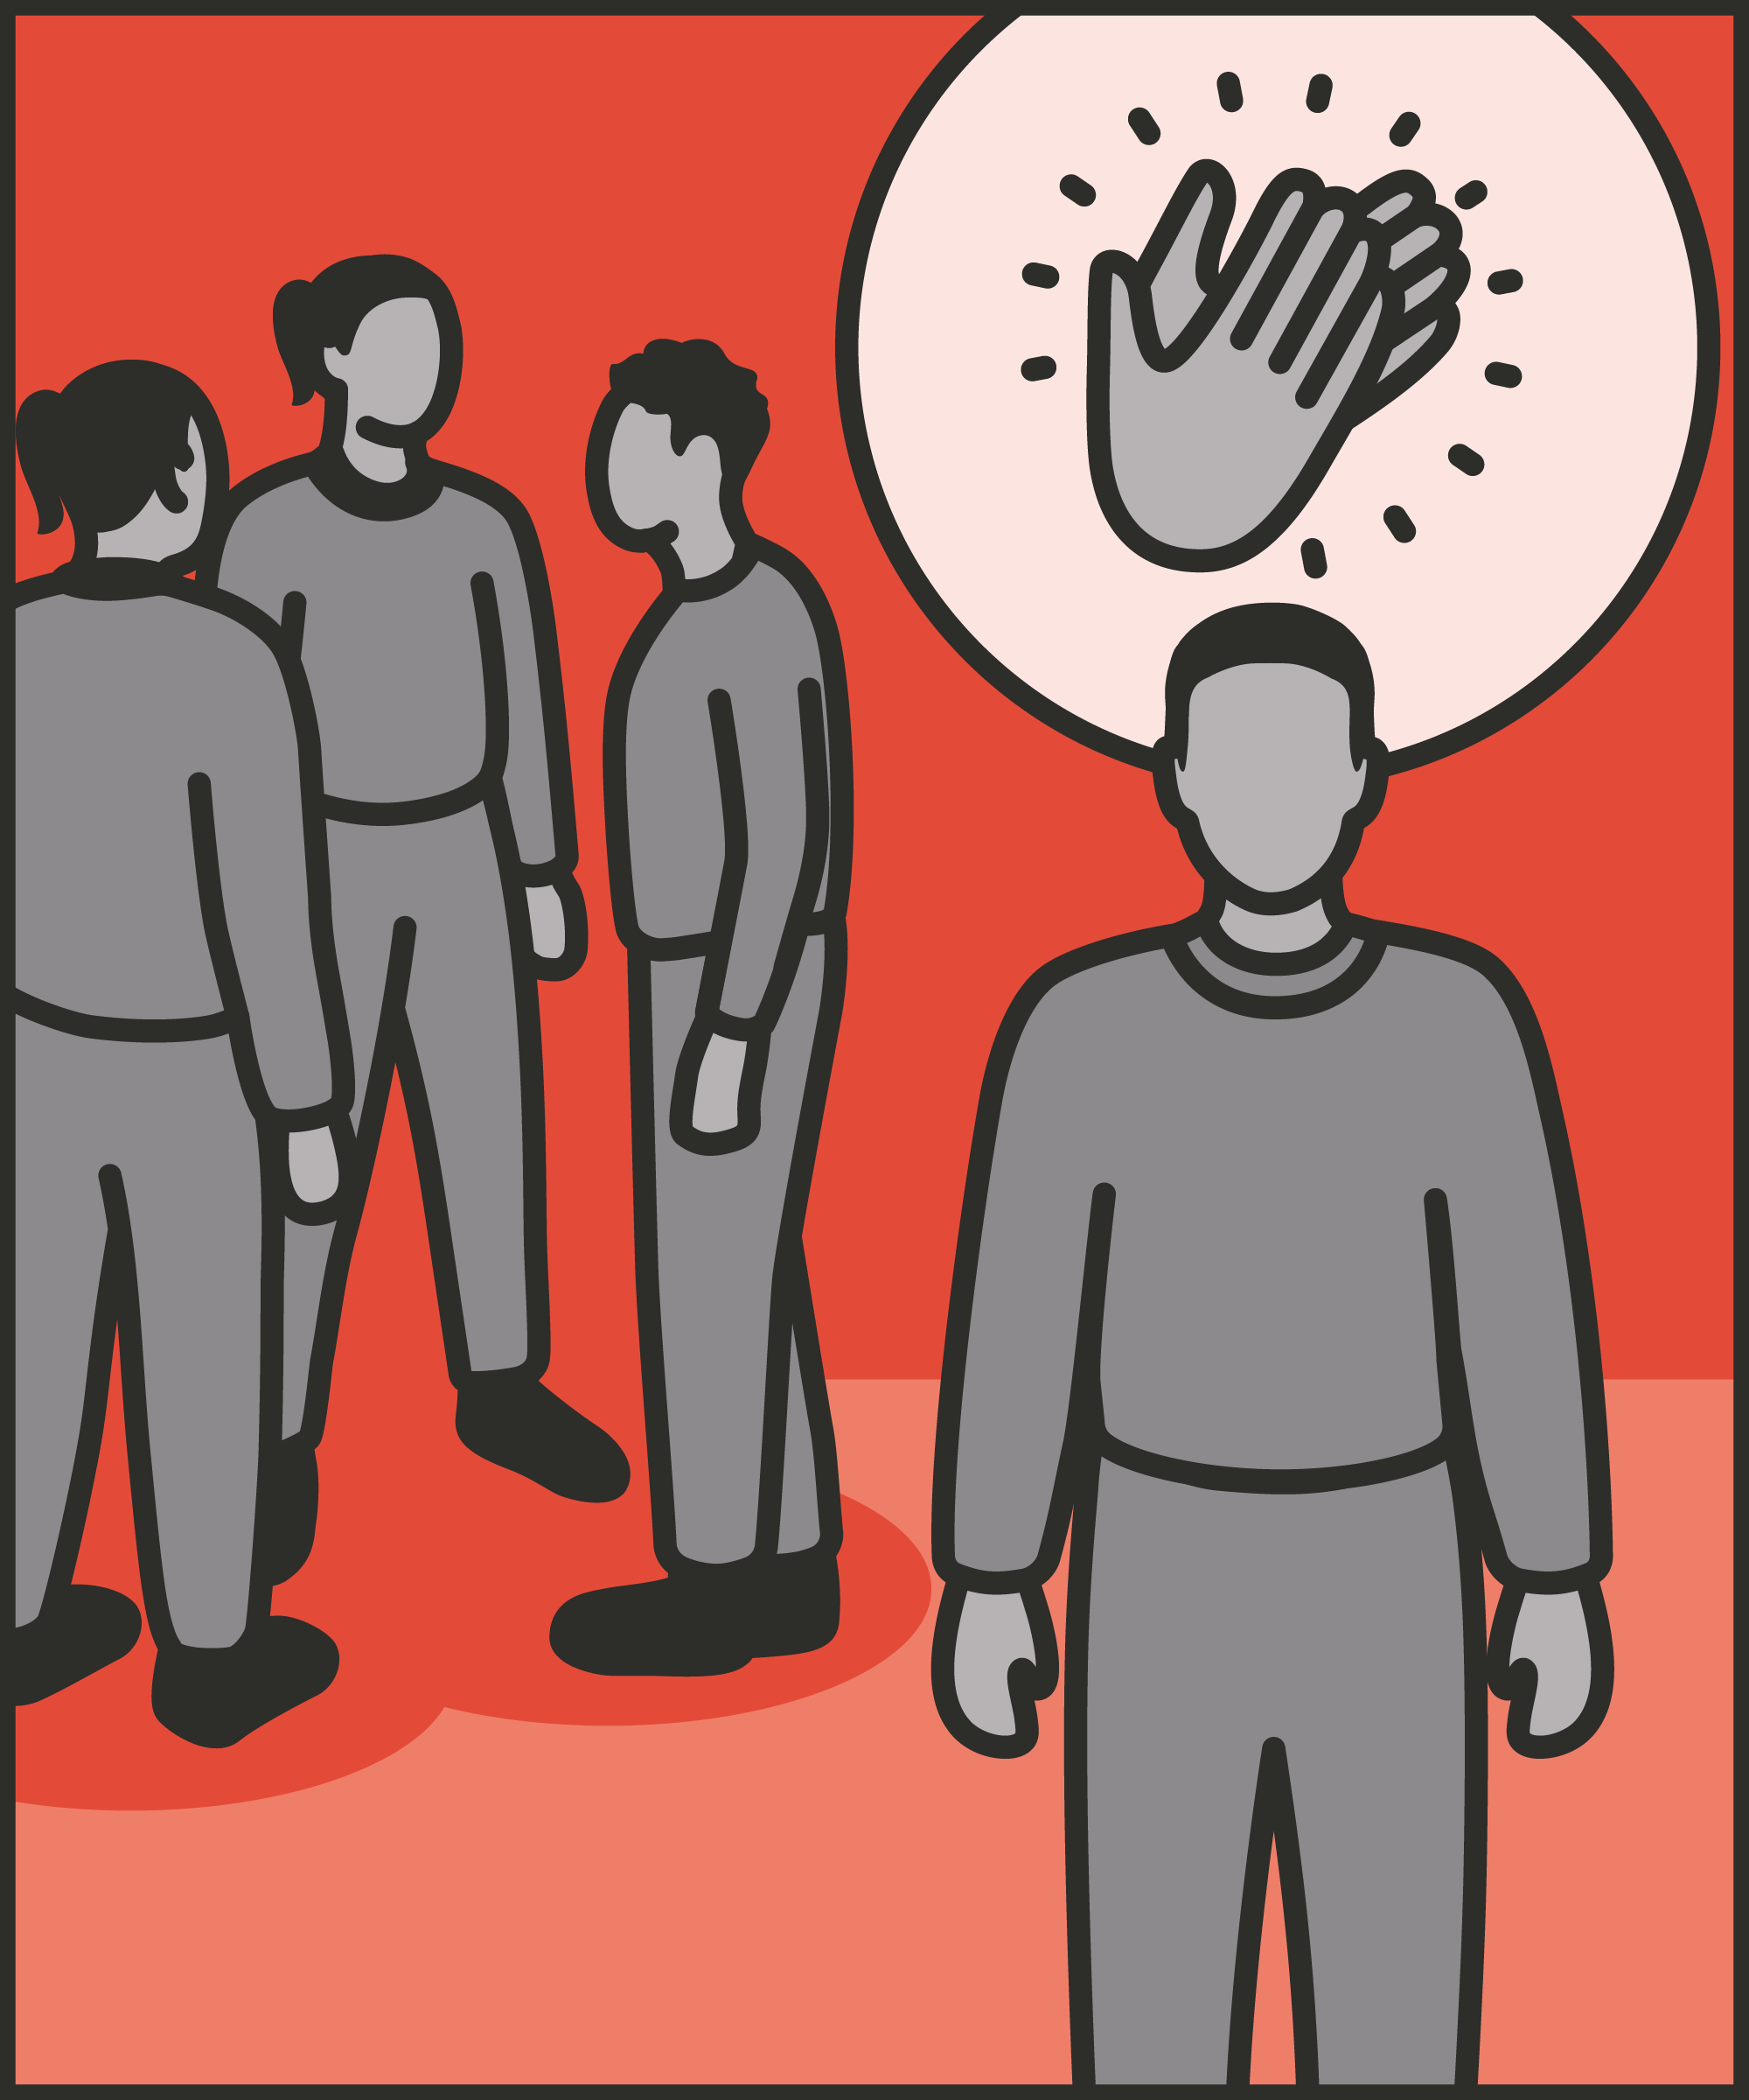
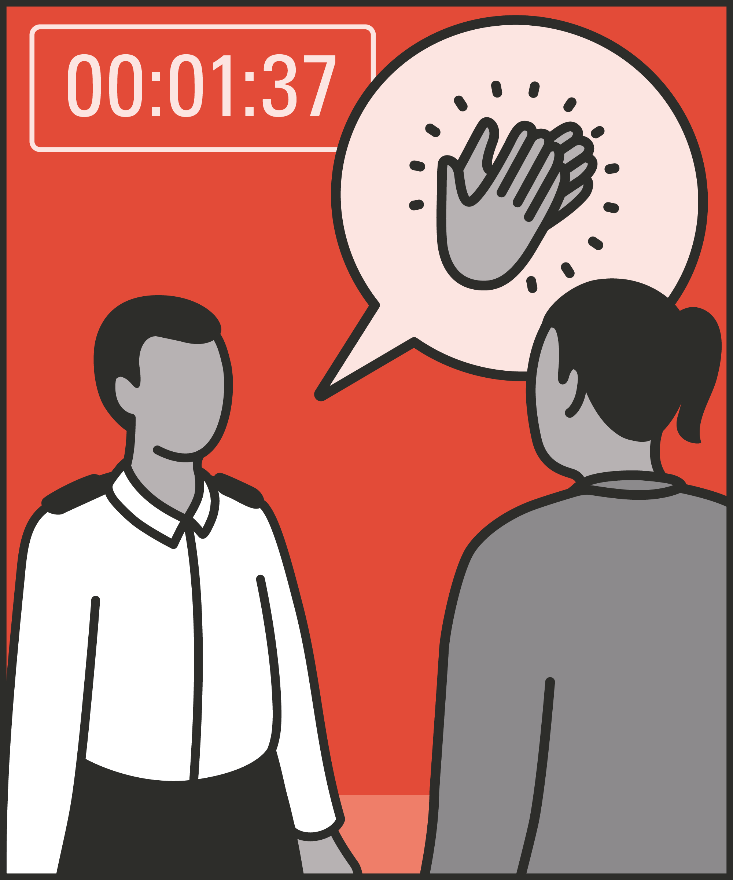
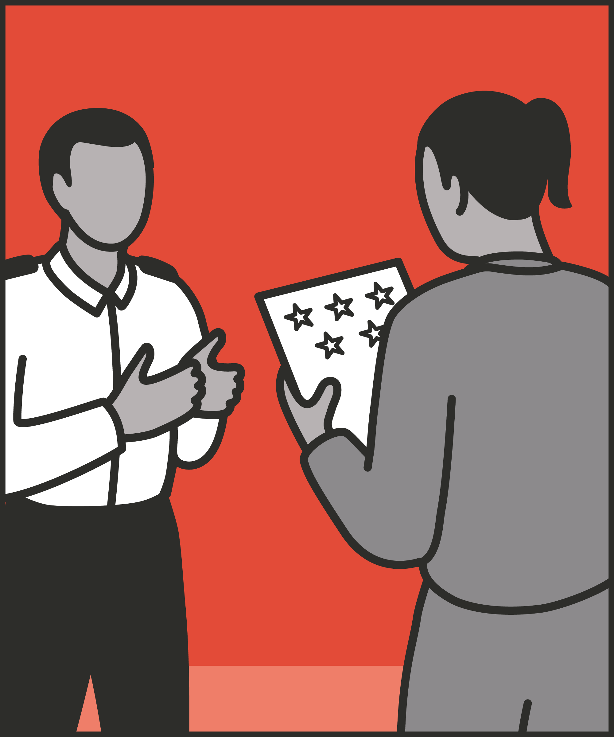

Personal praise
  Where appropriate, praise the actions of individuals, not just a group.
Immediate praise
  Give praise as soon as possible after the event so that it is relevant.
Earned praise
  Only praise things the prisoner has actually done well so that expectations remain high.
Specific praise
  Say exactly what the prisoner has done right to highlight a desirable behaviour they can repeat.
Notes:
INTRODUCE STEPS: PRECISE PRAISE
EXPLAIN
The first thing to emphasise is that as a prison officer much of our attention is spent keeping an eye out for problems. Try to catch prisoners being good as well. As we scan our landing, we might look for prisoners helping out on the landing: we might spot a prisoner helping someone new to the wing, helping with a job that isn’t theirs, or doing something for a prisoner who isn’t feeling well. Through spotting prisoners doing good we find opportunities to praise prisoners. So how can you give precise praise? We are now going to go through each of the steps for this technique.
Personal – If a group deserves praise, we can praise them. But this is less powerful than personal praise. Individual prisoners may discount general praise as not applying to them. Wherever possible, praise the actions of individuals, not just the group.
Immediate – The sooner we give praise, the better. The longer we delay, the less relevant the praise may seem. (That said, delayed praise is better than none whatsoever.)
Earned – We should only praise things the prisoner has actually done well. Praising a half-hearted effort tells the prisoner they’ve done enough. The prisoner may appreciate it – but they now know that a half-hearted effort is enough. We want to be generous in giving praise – while only giving praise when it’s really due.
Specific – Say exactly what the prisoner has done right. “Great work, well done,” doesn’t convey what they’ve done right, or what they should do again. “Great work, your effort really paid off in completing that course,” highlights a desirable behaviour they can repeat. Try to be as specific as possible about what the prisoner has done well to get their praise.

Slide 6
Turn and talk
Using the Pocket Guide as a reference:
Do you use this technique as part of your practice? If so, how and when?
Which of the steps do you use?
Which of the steps do you want to work on?
Notes:
TURN AND TALK: PRECISE PRAISE
PAIRED DISCUSSION
In pairs I would like you to discuss the following questions using the pocked guide as a reference (p56):
Do you use this technique as part of your practice? If so, how and when?
Which of the steps do you use?
Which of the steps do you want to work on?
WHOLE GROUP FEEDBACK
(Get whole group feedback following paired discussions.)

Slide 7
Model video
INSERT MODEL VIDEO ONTO SLIDE
Notes:
MODEL VIDEO: PRECISE PRAISE
TRAINER NOTE: If possible, insert the model video onto this slide ahead of starting your session. (You can find the online link to the videos here: https://unlockedgrads.org.uk/leading-prison-landings/the-videos/ or by pressing CTRL+CLICK on the box on the slide.)
EXPLAIN VIDEO
We are now going to watch the model video for this technique. While you are watching the video try to see if you can identify the success checks as they are met.
EXPLAIN POTENTIAL PITFALLS
Now that you have a better understanding of this technique, I want to explain some potential pitfalls that officers can make when trying to use it:
Prisoners may reject praise. Prisoners need to maintain their standing in front of their peers. They may avoid accepting praise – for example, not acknowledging our words – even if they appreciate it. This isn’t a reason to stop giving praise. We can offer praise in private, rather than in public, and hope that prisoners get used to it, and come to welcome it.
Praising a poor effort. It can be tempting to offer praise when anything goes right, or to use unearned praise to build a relationship. But to be meaningful, praise must reflect additional effort, or significant progress. For example, if we praise a prisoner for going back to their cell on time or joining a queue in an orderly way, we imply that our expectations are low. We can thank prisoners for good behaviour, but we should reserve our praise for when they truly deserve it.

Slide 8

Practice – precise praise
Roles
Timing
Participant A: Prisoner
Scripting: 1 min
Participant B: Prison officer
Practice: 2 min
Success checks
Feedback: 1 min
Praise the individual
Give immediate praise
Praise what they have done well
Be specific with your praise
Practice: 2 min
Feedback: 1 min
Notes:
PRACTICE: PRECISE PRAISE
EXPLAIN THE PRACTICE (NB: you can change the times for scripting, practice and feedback as needed.)
We are now going to practise using the technique precise praise:
When might you use the technique of precise praise? Think about a prisoner or group of prisoners you are working with when you have needed to, or will need to, use this technique. For example, a peer mentor providing good support, a prisoner is moved from basic to standard or a prisoner has managed their emotions well in a difficult situation, etc.
To remind you, the success checks for this practice are:
READ SUCCESS CHECKS FROM SLIDE
(Check all have chosen a real-life scenario – choose people to share theirs if time.)
You each now have 1 minute to script what you would say and do in the scenario you have chosen, using the success checks.
(Trainer then allocate pairs.)
Person nearest the door is going to be the prisoner first (Participant A) and the other will be the officer (Participant B).
For practice round 1, Participant B explain your scenario to your partner – they will be playing the role of the prisoner.
Ok, when I say go, you will have 2 minutes to run the practice using the scenario Participant B has given. If you finish before the 2 minutes, give feedback and practice again, making improvements.
Remember to stay in role throughout.
Go.
START PRACTICE
(Circulate during practice and give live feedback to pairs, as necessary.)
EXPLAIN THE FEEDBACK
Participant A, you will now give feedback to your partner.
Referring to the success checks, tell them what they did well and what could they improve on?
(If there is time, you could ask the participants to do a second round of practice implementing the feedback.)
SWITCH ROLES
Now switch roles and repeat the practice and feedback cycle.
WHOLE GROUP FEEDBACK
How was it?
How did it feel?
What feedback did you get?

Slide 9
Next steps: Observations, feedback and tracking
Notes:
EXPLAIN NEXT STEPS FOR OBSERVATIONS
When will next observations take place?
Who will be conducting the observations?
EXPLAIN NEXT STEPS FOR FEEDBACK
When can they expect to get feedback on their observations?
How will feedback be delivered?
EXPLAIN NEXT STEPS FOR TRACKING
How will coaching be tracked?
Are there any updates to share with staff?

Slide 10
As you use this technique in your everyday work, you may find it useful to refer back to Leading Prison Landings: A Pocket Guide, or the full training manual, Leading Prison Landings: The Unlocked Guide to Jailcraft.

