Slide 1
#24 sustain yourself and build to impact
Training slides

Slide 2
SUSTAINING YOURSELF
Being a prison officer is tough. In this section, we focus on the importance of looking after yourself, both for your own sake and for those you work with.
#24 Sustain yourself and build to impact
Notes:
INTRODUCE NEW TECHNIQUE: SUSTAIN YOURSELF AND BUILD TO IMPACT
TRAINER NOTE: (Pause a moment to allow people to read the overview of the technique on slide.)
EXPLAIN
Being a prison officer is tough. Prisoners have complicated lives, multiple needs, and often poor prior experience in other prisons or with other public services.
There are the institutional issues: ageing buildings, low staff numbers, not enough courses or chances for meaningful activity. Stress, threats, and traumatic events can create feelings of hyper-awareness, cynicism, or compassion fatigue.
This is understandable, but unhealthy, particularly if we take it home with us. It’s not surprising that many officers struggle, and some choose to leave.
We need to be able to sustain ourselves in our role – and we need to keep improving. Indeed, the other strategies we’ve suggested will only succeed if we are able to keep going, remain emotionally constant, and reflect on our own actions.
It is important to acknowledge that sustaining yourself to be ready to work at your best is a personal thing and every prison is different.
In this session we will give you some ideas for what you can do to sustain yourself as a prison officer and have some discussions as a group so people can share their ideas.

Slide 3
Recap of previous technique
Notes:
RECAP PREVIOUS TECHNIQUE
What was the technique we covered last week?
What does the technique look to do?
What are the success checks for the technique?
CELEBRATE SUCCESSES
We have had some great successes this week including…
I would like to shoutout XXXXX because…
Does anyone want to shout out one of their colleagues?

Slide 4

#24 Sustaining yourself
  SUSTAIN YOURSELF AND BUILD TO IMPACT
    Manage your emotions, stick to your standards, look after yourself and work to increase impact.
Notes:
INTRODUCE NEW TECHNIQUE: SUSTAIN YOURSELF AND BUILD TO IMPACT
TRAINER NOTE: (Pause a moment to allow people to read the overview of the technique on slide.)
EXPLAIN
Being a prison officer is tough. Prisoners have complicated lives, multiple needs, and often poor prior experience in other prisons or with other public services.
There are the institutional issues: ageing buildings, low staff numbers, not enough courses or chances for meaningful activity. Stress, threats, and traumatic events can create feelings of hyper-awareness, cynicism, or compassion fatigue.
This is understandable, but unhealthy, particularly if we take it home with us. It’s not surprising that many officers struggle, and some choose to leave.
We need to be able to sustain ourselves in our role – and we need to keep improving. Indeed, the other strategies we’ve suggested will only succeed if we are able to keep going, remain emotionally constant, and reflect on our own actions.
It is important to acknowledge that sustaining yourself to be ready to work at your best is a personal thing and every prison is different.
In this session we will give you some ideas for what you can do to sustain yourself as a prison officer and have some discussions as a group so people can share their ideas.

Slide 5
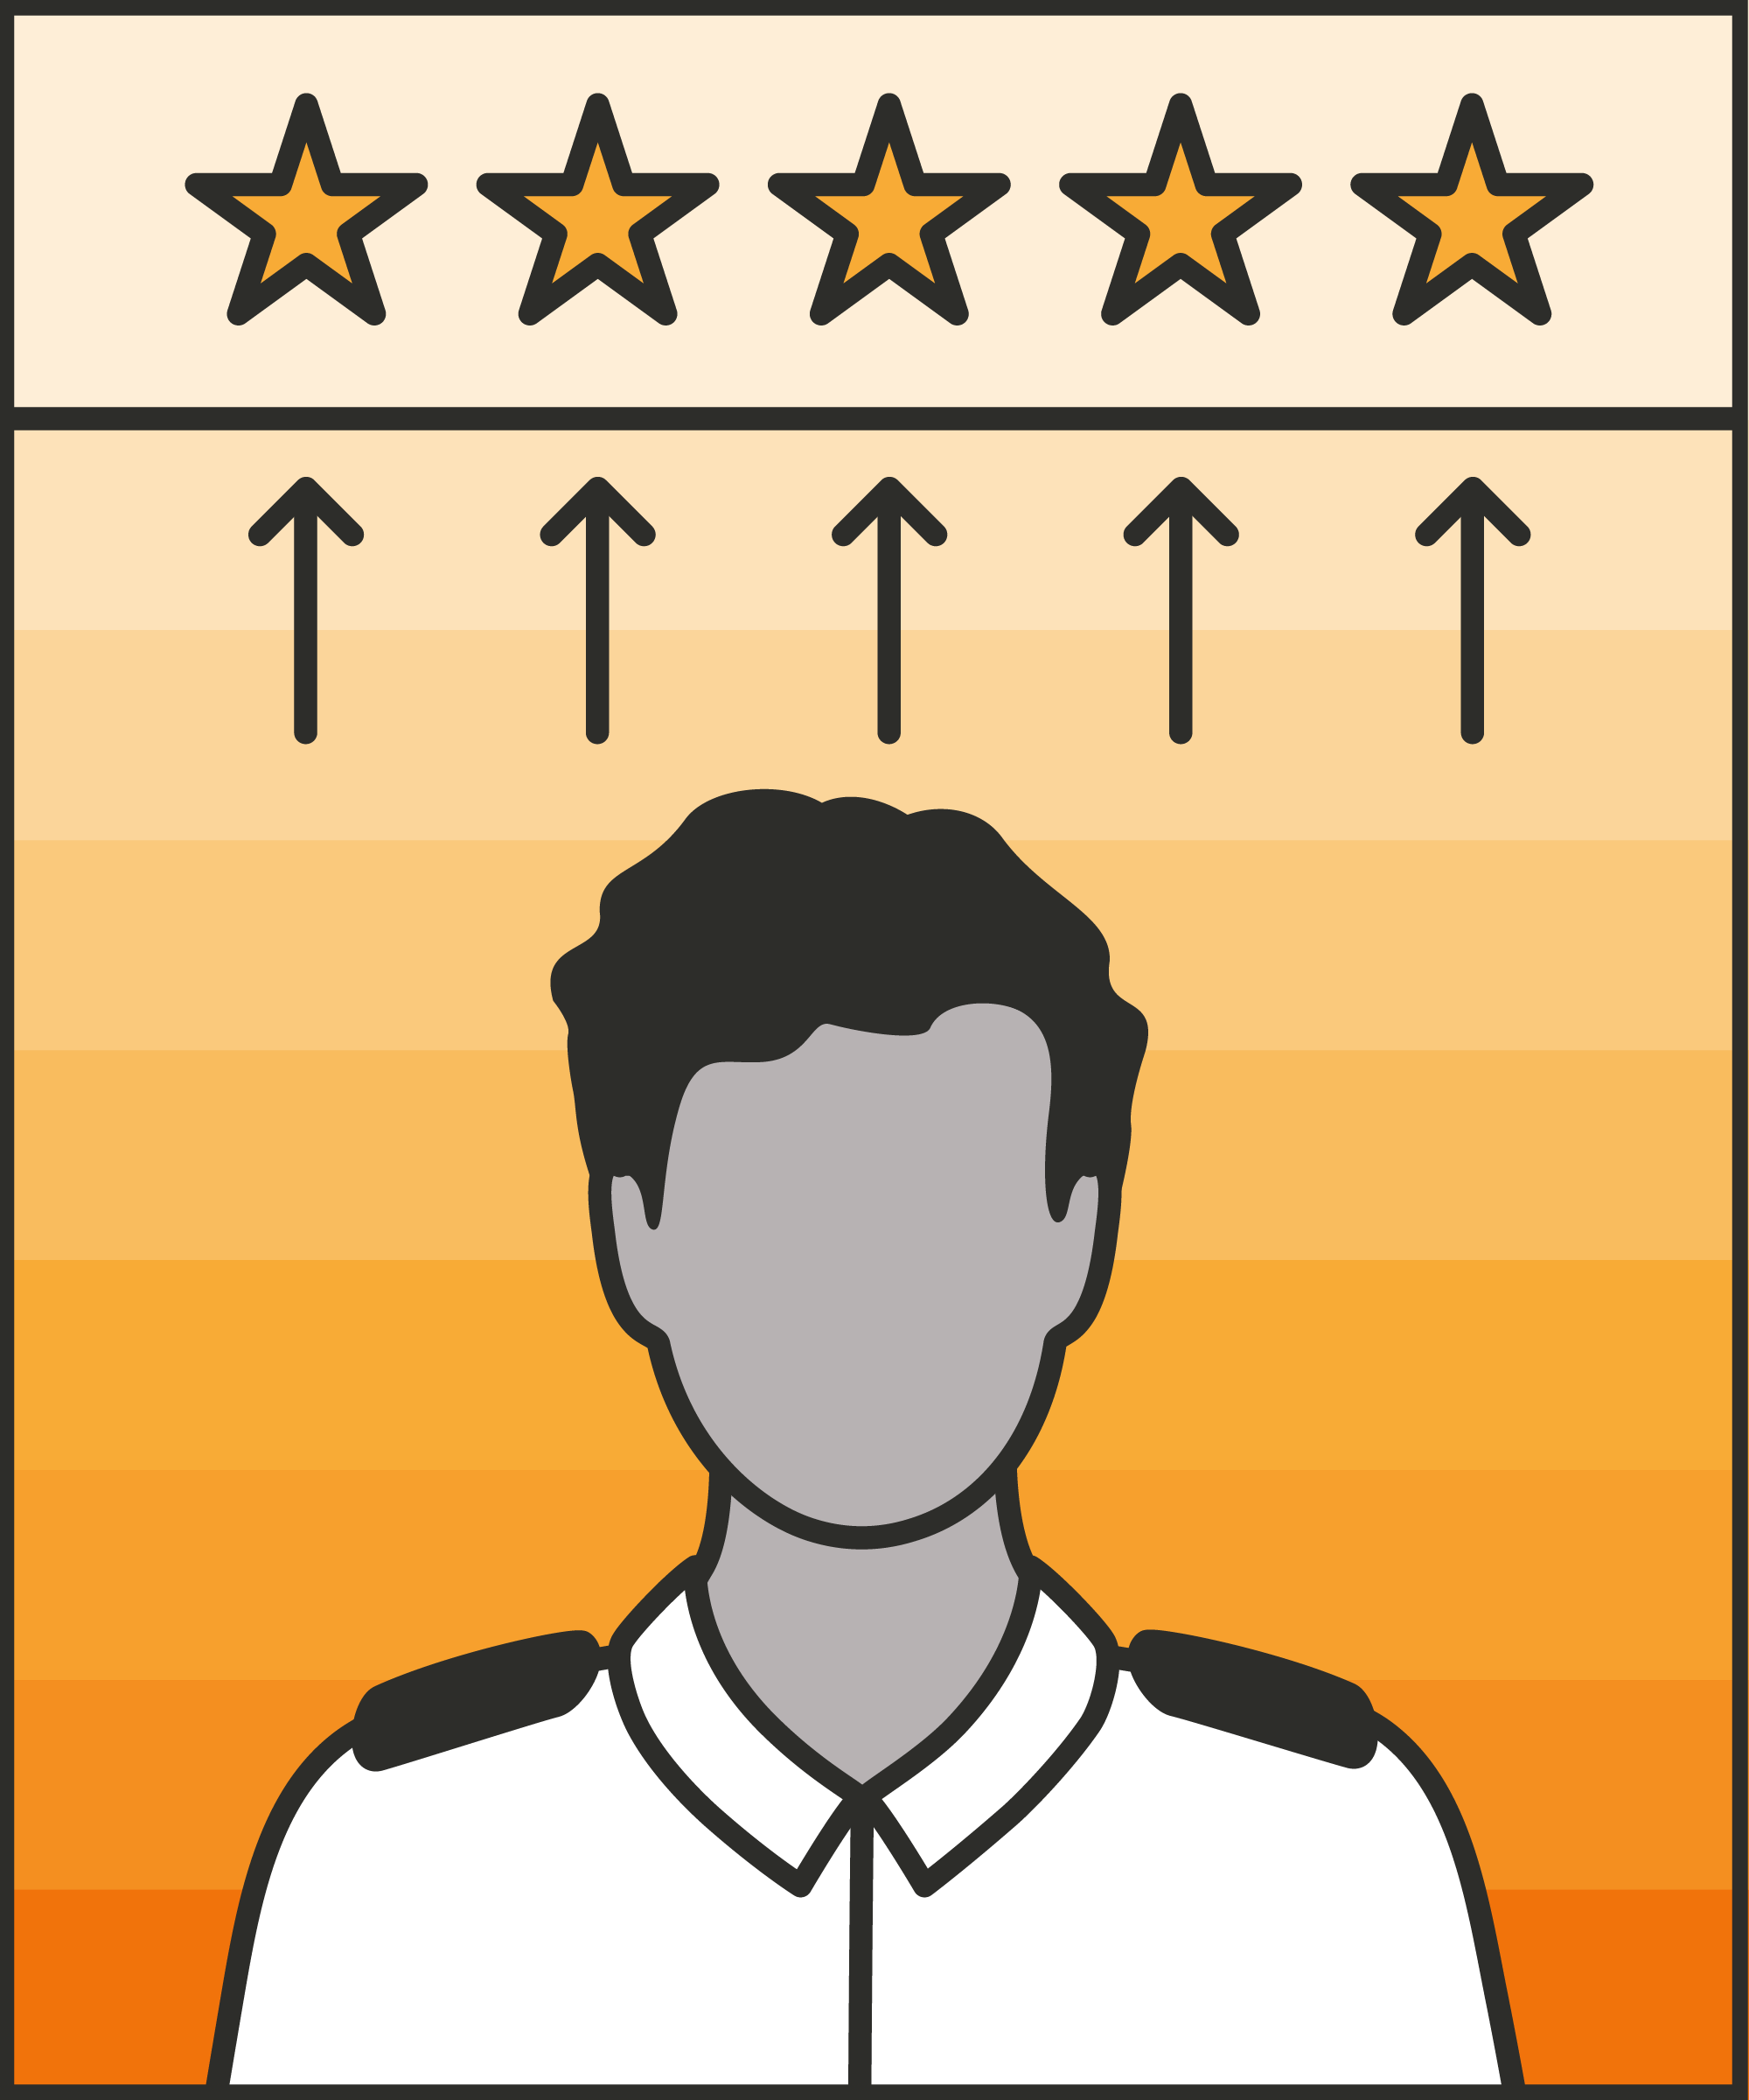
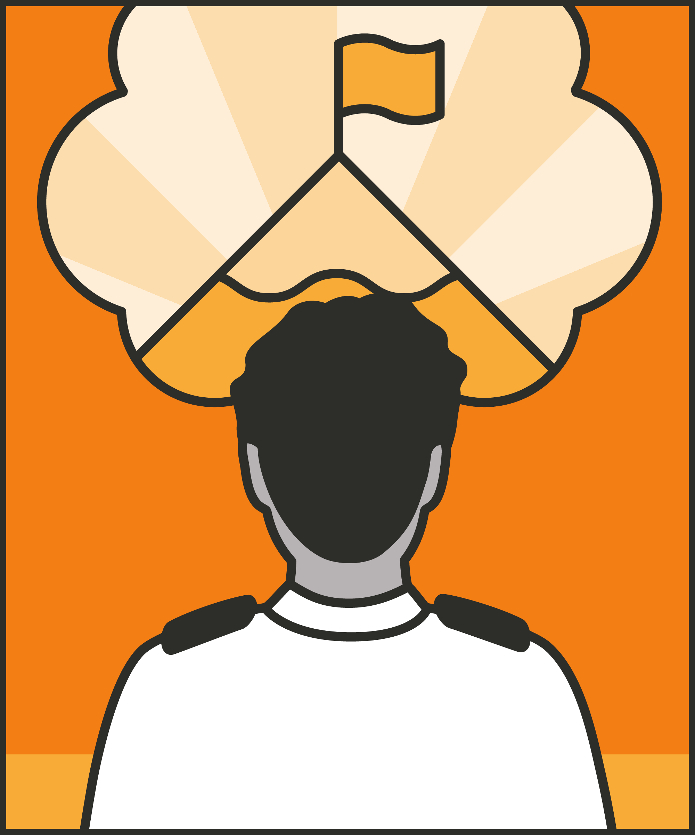
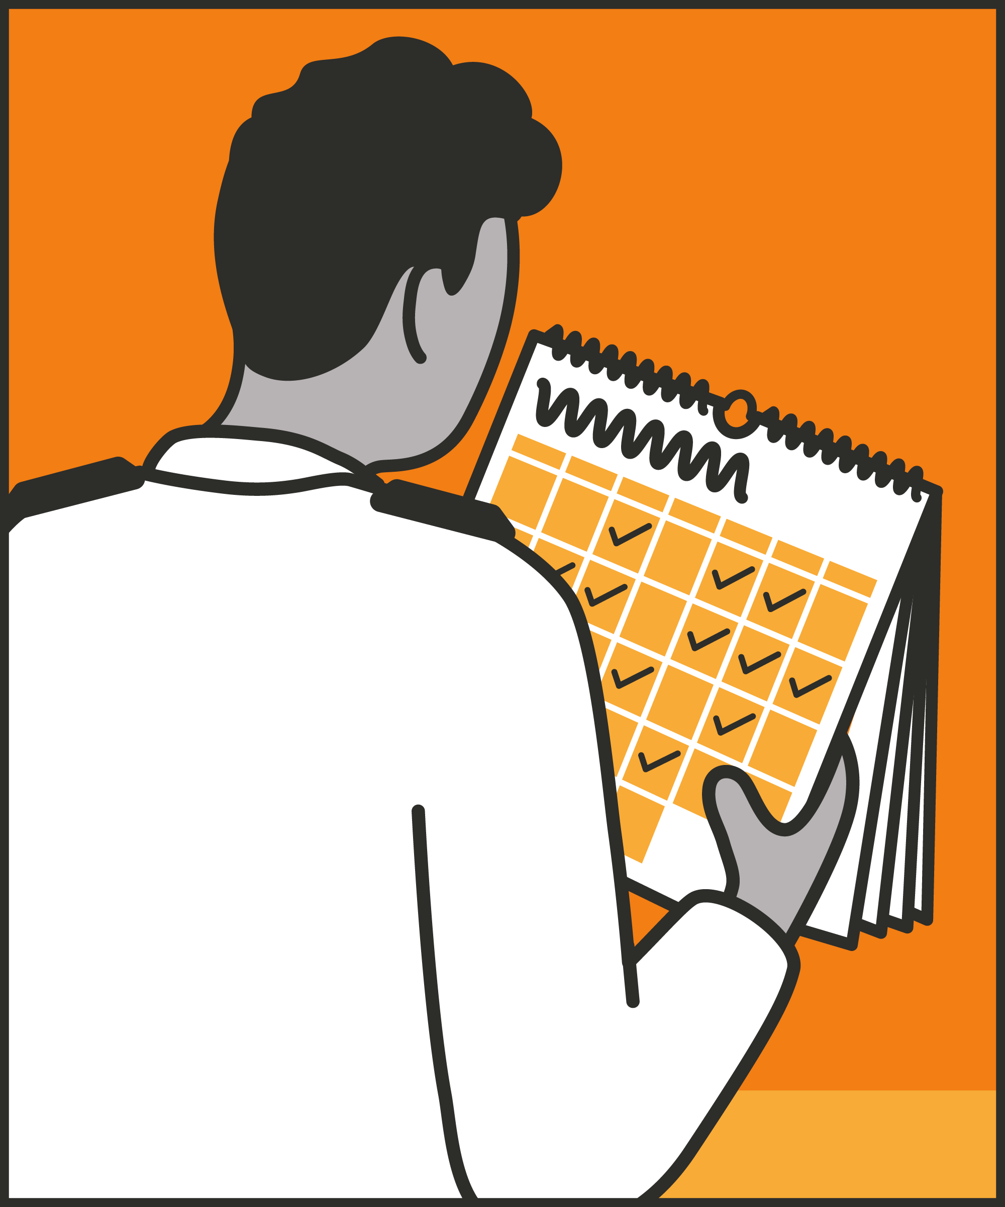
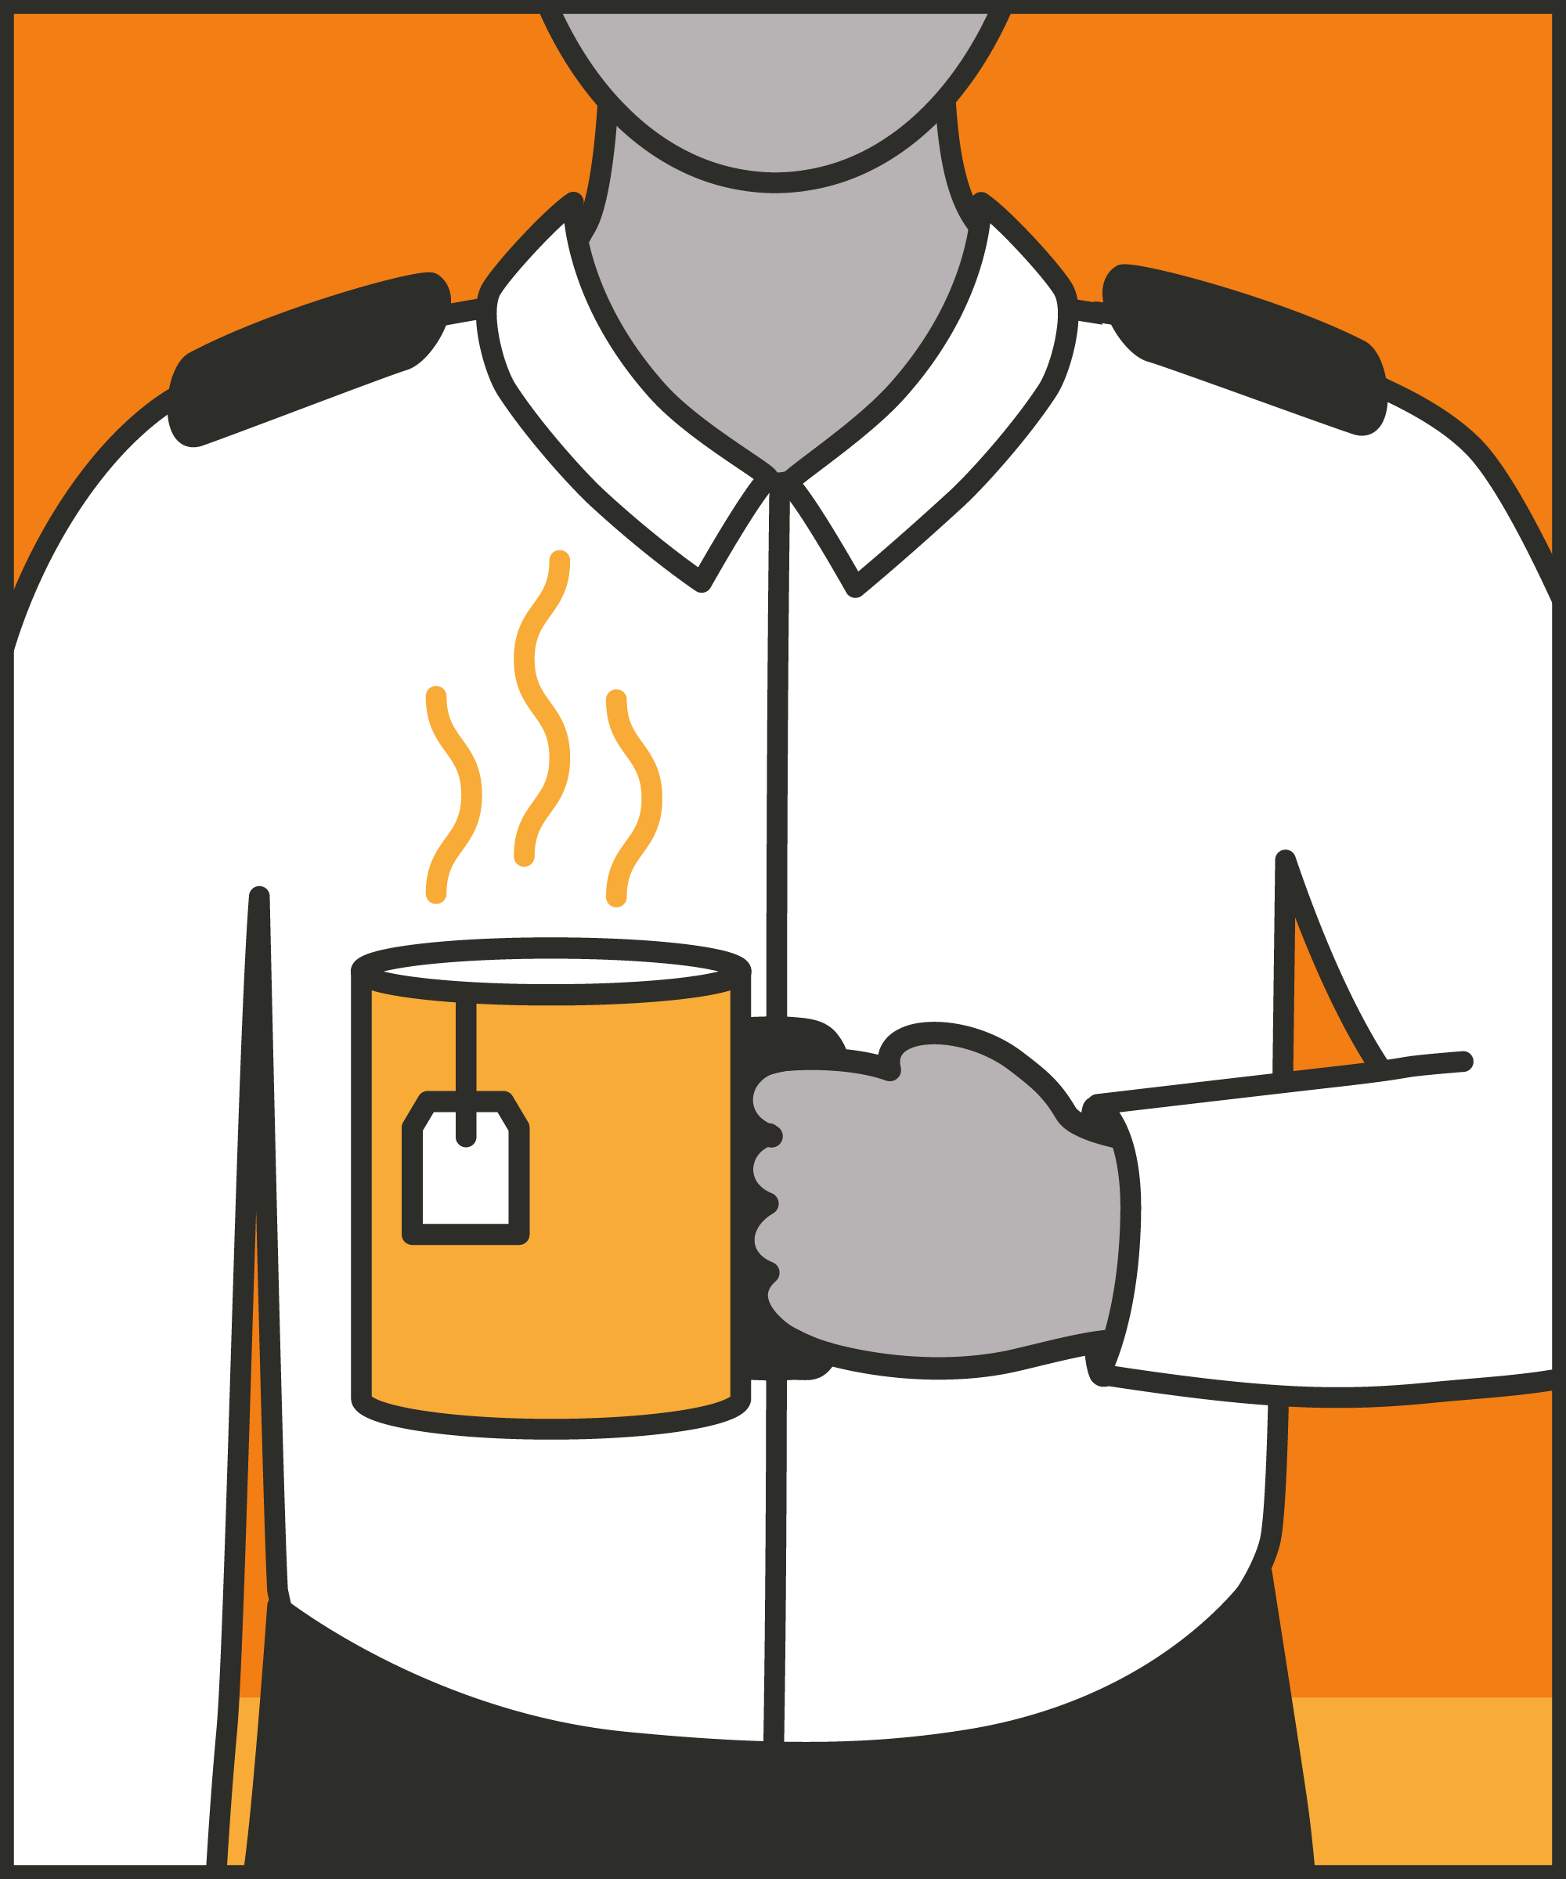
Stick to your standards
  Enforce the rules with warmth and integrity.
Maintain perspective
  Remember your successes: recognise how much is going well, even on a bad day.
Give yourself time to make an impact
  Get the basics of your role right; work towards broader impact when you are ready.
Find ways to decompress
  Record small wins; process events with others and maintain relationships; plan what you need for work; leave work at work; use the commute.
Notes:
INTRODUCE STEPS: SUSTAIN YOURSELF AND BUILD TO IMPACT
TRAINER NOTE: (Pause a moment to allow people to read the overview of the technique on slide.)
EXPLAIN
Stick to your standards: In many prisons, standards and expectations vary. One officer described that when she started at her establishment she noticed that there were many inconsistencies in terms of how staff delivered their roles. This inspired her to ensure “that I’m consistent all the time, or as much as I can be, for the sake of running a regime smoothly and safely.” The officer mentioned that she makes sure to always enforce basic rules, like keeping prisoners in their cells while the prison is in patrol state. With time, this has paid off. Prisoners know what to expect, telling her “I’m not even going to bother asking, because I know you’re going to say no.” This illustrates how sticking to your standards can help officers to sustain themselves in the long run.
Maintain perspective: As a prison officer there’s a lot you can do, but you aren’t going to solve everyone’s issues. One officer said: “there are so many components to the prison that you cannot solve every prisoner’s issues every single day.” As an officer it important to maintain perspective about how much you can do, and what you can expect. On any given day, one prisoner might give you a hard time, but another might thank you. The same officer said that she tries to “take a positive from each day, even if it’s just everyone is alive and behind the doors and safe. Sometimes that’s enough.” Maintaining this perspective helps her keep going.
Give yourself time to make an impact: It can help to have patience in what you expect of yourself. As a prison officer it can often feel like you aren’t making impact even though you are working really hard day after day. This can be highly disheartening and demotivating however it is important to acknowledge that continuing to show up, treat prisoners fairly, and act reliably is powerful in itself. Getting these basics right day after day sets you up to be a successful officer: one that can build relationships and is respected by staff and prisoners alike.
Find ways to decompress: A degree of stress challenges us to do more – but chronic stress without recovery leads to burnout and breakdown. We need routines and rituals to help us recover. We can build small habits into our daily life and working routine which allow us to maintain perspective and deal productively with the stresses and challenges of work. Looking after ourselves is essential if we are to avoid compassion fatigue. Here are some methods that officers have used to decompress:
Decompress during the working day: Think intentionally about when and where you can find space and time during the day, and how you can use it best. For example, if you have a break, where can you best spend it? Who can you best spend it with? You don’t have to spend your break with the same people, doing the same things, every time. If you have time to get out of the prison, you might choose to go for a walk or call someone for a chat. Even within the prison, you might choose to read or talk about something that’s not work. Whenever you get a chance for a break, think about how you can use it to refresh yourself, so you are ready for the rest of your shift.
Record small wins: People are more likely to feel they’ve had a good day at work if they feel they’ve made progress with meaningful work. There are two implications of this. First, each day, think about the small wins you might achieve. Who might you find time to talk to? Who might welcome some encouragement or support? Who will you be working with? Second, make sure you capture the small wins you’ve had. One officer described writing her small wins down: “because then when I have rubbish days I can look back and know I’m making a difference to some people’s lives.”
Rely on – and keep building – relationships: Build a trusted group with whom you can talk through what’s happened, how things are going, and how you’re feeling. Use these colleagues or friends for reassurance and reminders of how well you’re doing – and for challenge and support to keep improving. Maintain your relationships with friends and family, particularly when distance and work pressures get in the way. The people who know you best may be able to offer the best support on the hardest days.
Plan how to get back on an even keel. If you have had a bad day then how are you going to get yourself back on an even keel? How you do that will depend on your personal circumstances: what you like, what you don’t like and what your home situation is. You might want to ask yourself things like: what do I enjoy doing? What helps me relax? What allows me to switch off? Try to actively plan how you will spend time between shifts to get the most out of it. It’s always easy to slump down on the sofa and watch something – but you may switch off more if you do something active, like going for a run, calling a friend, cooking dinner, or just tidying. Find the activities that help you relax and make a habit of doing them. Exercise can be particularly helpful in providing an alternative focus – as can eating and sleeping well.
Leave work at work. There’s not much you can do to fix things at work while you’re at home. You might want to reflect on what’s gone well and what you could do better on your next shift – but once you’ve done that, it’s time to let go. It may help to have a routine to help you to do this.
Use the commute. We can use the journey home intentionally as a time to transition from a work self to a home self. This might mean choosing music or podcasts which will help you relax. Or it could mean picking something to read, if you’re not driving.

Slide 6
Turn and talk
What do you do to sustain yourself:
How do you ensure you stick to your standards and maintain your boundaries?
Notes:
TURN AND TALK: SUSTAINING YOURSELF AND BUILD TO IMPACT
PAIRED DISCUSSION
In pairs I would like you to discuss the following question using the pocket guide as a reference (p62):
How do you ensure you stick to your standards and maintain your boundaries?
WHOLE GROUP FEEDBACK
(Get whole group feedback following paired discussions.)

Slide 7
Turn and talk
What do you do to sustain yourself:
How do you recognise your successes even when you are having a bad day or a bad week at work?
Notes:
TURN AND TALK: SUSTAINING YOURSELF AND BUILD TO IMPACT
PAIRED DISCUSSION
In pairs I would like you to discuss the following question using the pocket guide as a reference (p62):
How do you recognise your successes even when you are having a bad day or a bad week at work?
WHOLE GROUP FEEDBACK
(Get whole group feedback following paired discussions.)

Slide 8
Turn and talk
What do you do to sustain yourself:
How do you continue to work on your practice as an officer?
Notes:
TURN AND TALK: SUSTAINING YOURSELF AND BUILD TO IMPACT
PAIRED DISCUSSION
In pairs I would like you to discuss the following question using the pocket guide as a reference (p62):
How do you continue to work on your practice as an officer?
WHOLE GROUP FEEDBACK
(Get whole group feedback following paired discussions.)

Slide 9
Turn and talk
What do you do to sustain yourself:
What do you do to decompress? How do you find the space and time to do these activities?
Notes:
TURN AND TALK: SUSTAINING YOURSELF AND BUILD TO IMPACT
PAIRED DISCUSSION
In pairs I would like you to discuss the following questions using the pocket guide as a reference (p62):
What do you do to decompress? How do you find the space and time to do these activities?
WHOLE GROUP FEEDBACK
(Get whole group feedback following paired discussions.)

Slide 10
As you use this technique in your everyday work, you may find it useful to refer back to Leading Prison Landings: A Pocket Guide, or the full training manual, Leading Prison Landings: The Unlocked Guide to Jailcraft.

