Slide 1
Instructional coaching training
Overview Training Use

Slide 2
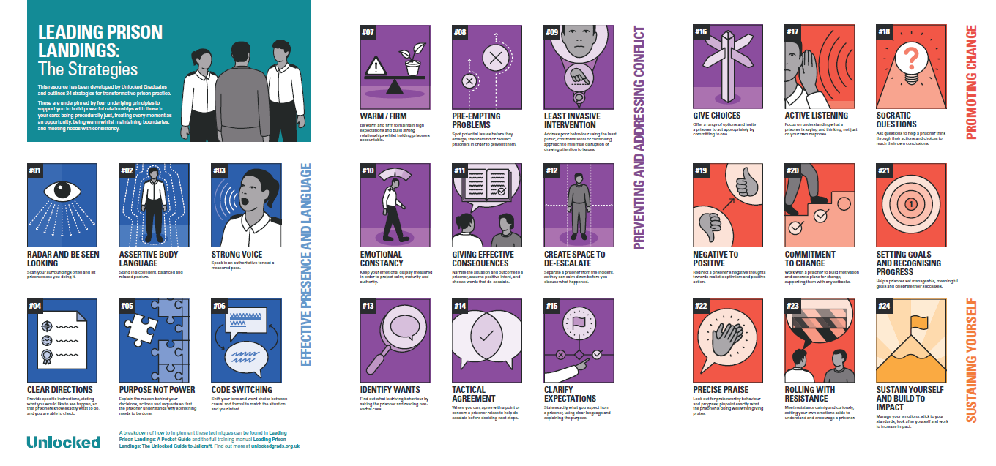
Poster of strategies
Notes:
This resource has been developed by Unlocked Graduates and outlines 24 strategies for transformative prison practice. These are underpinned by four underlying principles to support you to build powerful relationships with those in your care: being procedurally just, treating every moment as an opportunity, being warm whilst maintaining boundaries, and meeting needs with consistency.

Slide 3
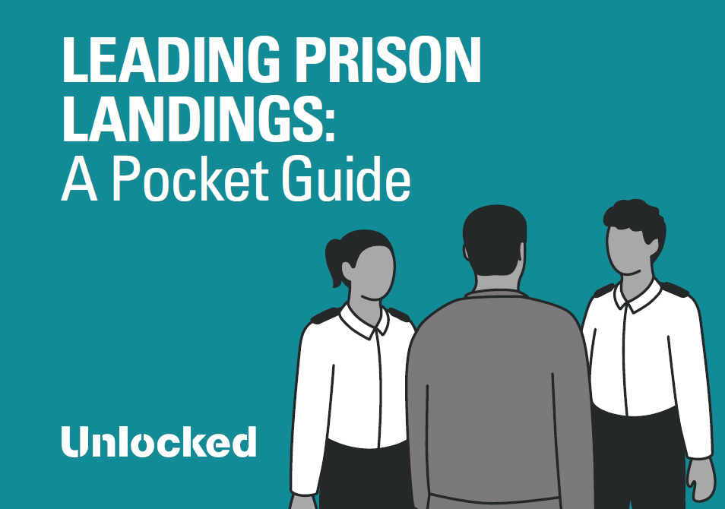
Pocket guide
Notes:
This guide is designed to be a practical resource for anybody working on the frontline of our prisons – whether you have just started on the landings or have decades of experience. Each of the 24 strategies comes with a brief description and visual reminders, as well as a step-by-step breakdown to support you to build them into your everyday practice. You can use it as part of your training, in meetings with a mentor or line manager, or on your own when facing a challenging situation or an opportunity in your work with a particular prisoner.
It may also be useful if you are coaching or managing frontline staff. It provides a clear framework and a common language for the behaviours that we see in the best officers, facilitating feedback discussions and helping prison officers to do their job excellently. To find out more about this model and how to use these techniques, as well as the theory behind our approach, see the full training manual, Leading Prison Landings: The Unlocked Guide to Jailcraft.
The following principles should guide how you apply all of the strategies contained within these pages. They will support you to build strong relationships with the prisoners in your care, creating more positive environments on the landings:
Be procedurally just: Clearly communicating why and how a decision is made leads to a collective sense of fairness.
Treat every moment as an opportunity: Maintain a sense of possibility by using every interaction with a prisoner, however momentary, to create more opportunity for rehabilitation.
Be warm whilst maintaining boundaries: The balance between warmth and firm boundaries is the key to better, more sustainable relationships with prisoners, which are the most effective levers for change.
Meet needs with consistency: Consistency in meeting prisoners’ needs creates clear expectations for all.

Slide 4
Training and instructional coaching model
Group training
Observations
Tracking
Feedback
Creating culture
Effective resources
Instructional coaching
Notes:
The training cycle:
Underpinning it all: Creating culture – this is about shared values, using excellent techniques, know how to do that, and be able to support others to do the same. It leads to consistency, creating a sense of justice and fairness, which is vital for those in prison. Instructional Coaching is for everybody as we can all continue developing to hone our practice and build on skills and expertise.
For every aspect of the Instructional Coaching Model: Effective resources:
Book; Poster; Pocket Guide; Training Slides; Technique Articles
Models: Technique Videos
The training cycle itself:
Group training – Building understanding and awareness of the techniques and steps, shared language, and embedding this in the officer role.
Observations - Putting it into action on the landings having the opportunity for someone to see you using the techniques ready for effective feedback.
Feedback – Enabling reflection of what is going well, which steps need to be worked on, and use of models and practice.
Tracking – Monitoring progress on technique use, impact it is having, and decisions around next step.

Slide 5
Creating culture
Training and instructional coaching model
Shared ‘why’ (using evidence/data) and values
Importance and impact of consistency
Challenge level for motivation and mastery
Modelling and leadership
Effective and positive feedback
Involving staff and sharing excellent practice
Sharing successes and positive outcomes
Notes:
Building culture:
Share the ‘why’ – the purpose behind why you are doing something and the values that underpin the training and techniques.
Consistent use of these techniques leads to sense of fairness and justice for both staff and the prisoners, as well as a sense of inclusion as everyone is being treated and responded to with consistency.
Ensure the right level of challenge, rigour and access for consistent effective training.
This is non-hierarchical – so all staff are developing, all are open to feedback, and all are bought in – this should be modelled by leaders.
Set feedback up as something to be celebrated.
Get staff involved with their feedback, sharing great practice and ideas, running chunks of training.
Celebrate successes – praise, shoutouts, certificates, notice board – as well as the positive outcomes, the positive impact of the training.

Slide 6

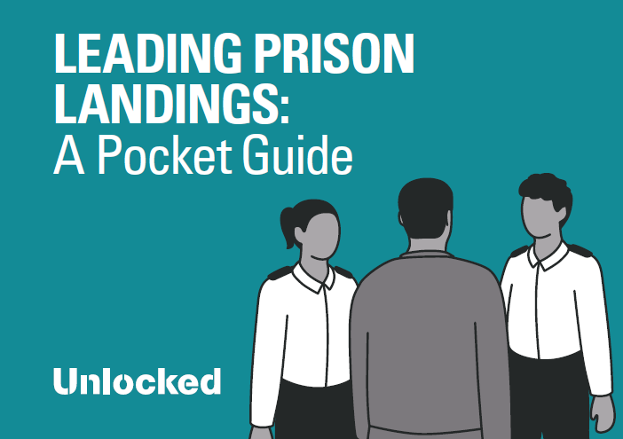
Effective resources
Training and instructional coaching model
Effective, evidence-based techniques and steps
Shared language and understanding
Specific contexts and requirements
Build on existing skills and expertise
Create consistent habits
Notes:
Effective Resources:
Poster (hand-out), Pocket Guide (hand-out), Book (can be found on Amazon), Model videos and Training slides are on the Unlocked Microsite: Leading Prison Landings – Unlocked Graduates
These provide:
Effective, evidence-based techniques and steps – techniques that will develop effective relational practice, leading to positive prisoner outcomes. Prison officers handle situations differently, and what might work for some might not work for others. That is why these shared 24 techniques are excellent for consistent excellent practice, as well as effective feedback and support.
Shared and memorable language and images that are meaningful to everyone, enabling effective implementation. Shared understanding enables development of consistently effective practice and feedback.
Focus training on the needs of the prison (it might be useful to include relevant statistics and data here). Practice them for a range of relevant contexts.
Build on existing skills and expertise – even for those who already use the techniques as part of their practice, having an understanding and awareness of what the techniques and steps are, a shared language, and tools necessary for supporting others to embed this as part of their practice, will lead to excellent professional development.
Create consistent habits – it is very challenging to form new habits. Feedback and practice gives officers the chance to practise deliberately with colleagues and develop confidence, so they form effective relational practice as habit when working with prisoners.

Slide 7
Training and instructional coaching model
Group training
Recap previous technique and celebrate successes
Introduce new technique (if appropriate, or recap steps from previous)
Model new technique
Practice
Outline next steps for observations, feedback and tracking
Notes:
5 stages to the training model:
Re-cap previous technique and celebrate successes. This could be through feedback and/or shoutouts, or other models of celebrating great practice that you use.
Introduce the new technique with steps and potential pitfalls – this will be based on which of the 24 techniques you feel is most important to focus on next based on current context. It is important to note that in some instances, you might feel you want to spend the session going over the previous technique and keeping that as the focus if it is not yet embedded.
Model new technique – this is using the video or can be done live and using examples.
Use practice to put the technique into action based on real and current challenges for your team.
Outline how people will be given the chance to be observed doing it so they can be praised and given feedback for developing even further.

Slide 8
Training and instructional coaching model
Observations
Observer
Planning
Pocket Guide and notes
Supportive and positive
Modelled by all
Notes:
Observations:
The coach observes the officer using the technique.
Agreeing the time, place and plans for the observations is helpful – this is not about catching people out.
Use the pocket guide and take notes ready for relevant feedback linking clearly to the technique and steps.
Observations should be supportive and positive - share evidence of where and why it is working and celebrate success stories to build the positive associations.
Have a non-hierarchical structure and approach so that ‘observations’ are not just for those who need development – we can all improve and be stretched so all should have this opportunity.

Slide 9
Training and instructional coaching model
Feedback
Zoom in on the moment you are feeding back on
Get their aspirational goal (and write it down)
Establish events – go through how it went compared to the goal
Identify which steps went well using the Pocket Guide
Identify which step(s) to work on using the Pocket Guide
Agree the technique and specific step to work on
Use a model (video, or example)
Practise it together
Notes:
Feedback structure (please note, it might be advisable to start with a ‘positive only’ feedback model – highlighting what officers are doing well, giving praise, celebrating successes, and sharing excellent practice):
Zoom in on the moment you are feeding back on.
Get their goal (ensure it is aspirational and filled with high expectations and write it down to clarify and de-personalise) - "before we talk about…what was your goal/what did you want from that interaction/what outcome were you hoping for?” Note this down to refer back to.
Establish events – go through how it went compared to the goal.
Identify which steps went well using the Pocket Guide.
Identify which steps to work on using the Pocket Guide.
Agree the technique and specific step to work on.
Use a model (video, or example).
Practise it together.

Slide 10
Training and instructional coaching model
Tracking
Shoutouts and share successes
Peer celebrations
Self reporting
Coach/line manager reporting
Recording systems
Analysing impact: data, prisoner voice, staff voice
Notes:
Tracking impact:
Shoutouts / successes – this can be tracked.
Peer celebrations – peers can send and share successes.
Self reporting – individuals track their own progress and record this for their line manager/coach.
Coach/line manager reporting – equally, line managers and/or mentors could track the progress of their individual direct reports.
Recording systems – using current internal reporting and recording systems.
Analysing the data: numerical data, prisoner voice, staff voice etc.

Slide 11
Making practice work
Build trust and vulnerability
Celebrate success
Make it fun
Ensure it is in role
Make it useful – use real examples and scenarios
Keep practising
Notes:
Make practice work – both in training sessions, and in feedback:
Build the trust and vulnerability – model it, make it a safe space.
Celebrate success – praise great practice.
Make it fun – giving live feedback is really helpful, and should be enjoyable. It works particularly well in prison contexts as the practice partners often know the prisoner in the example very well, so can bring genuine comments, questions or behaviours for the officer to practise responding to.
Ensure it is in role – don’t allow a half-hearted approach or things like ‘I would say this’ ‘I would do this’ – that won’t work.
Make it useful – use real examples and scenarios – ensure officers are using real scenarios so it is genuine practice and as helpful as possible.
Practise until it can’t go wrong. Re-run it and re-run it so the officer uses feedback between each practice and improves every time

Slide 12







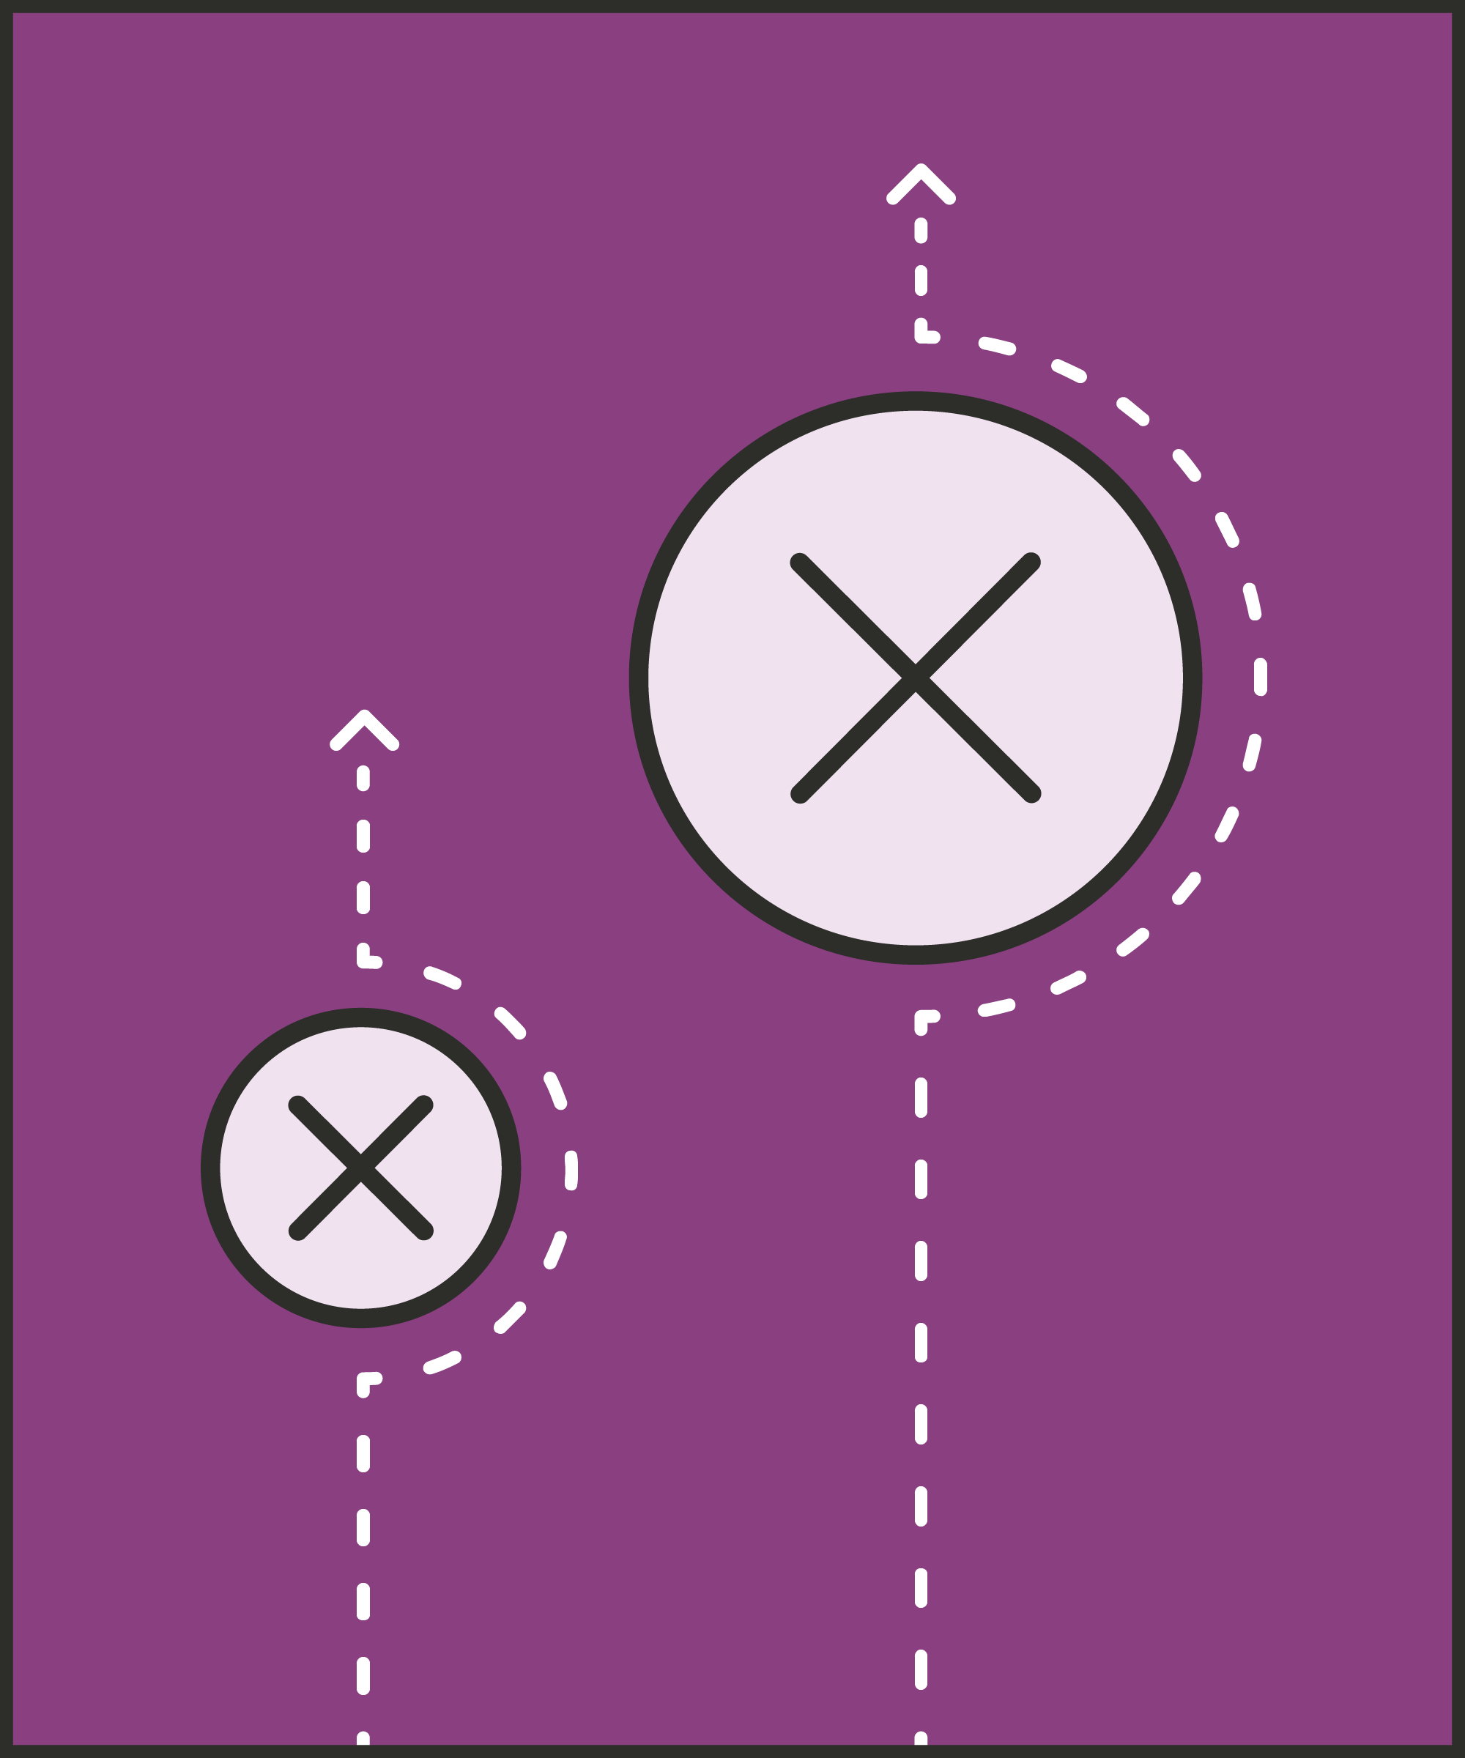



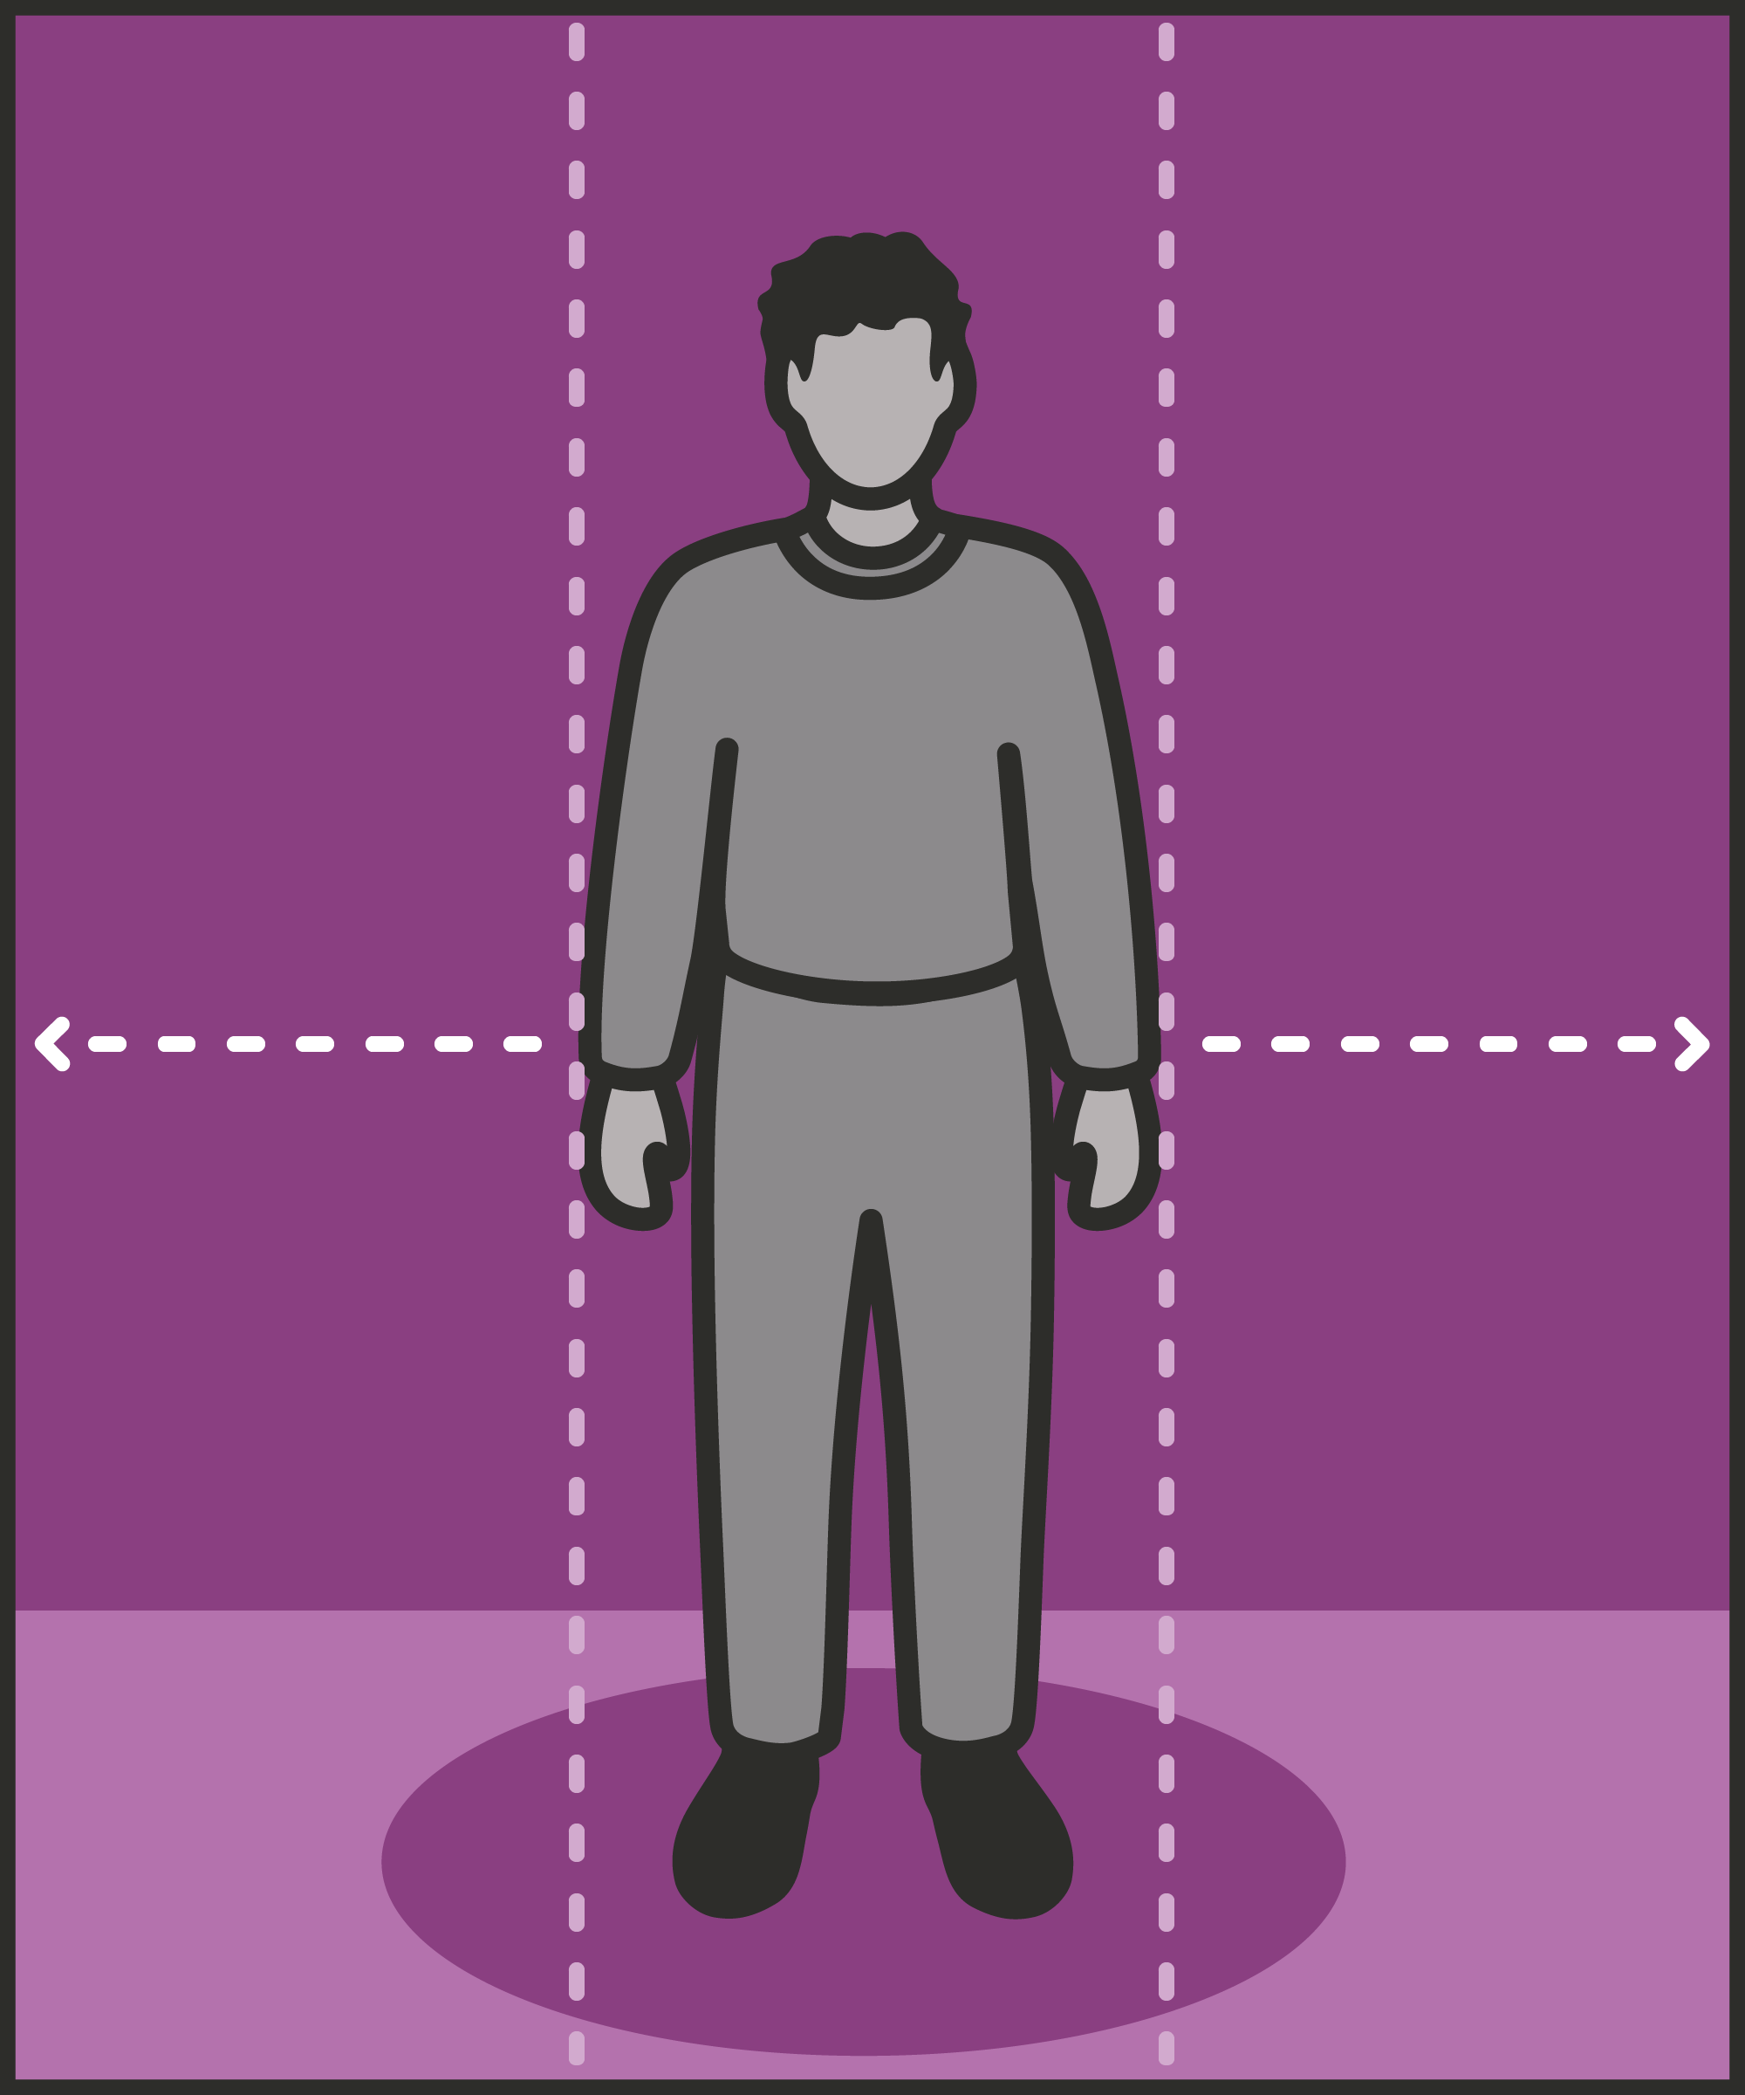
Leading Prison Landings: The strategies (1)
Effective presence and language
#01 Radar and be seen looking
#02 Assertive body language
#03 Strong voice
#04 Clear directions
#05 Purpose not power
#06 Code switching
Preventing and addressing conflict
#07 Warm / firm
#08 Pre-empting problems
#09 Least invasive intervention
#10 Emotional constancy
#11 Giving effective consequences
#12 Create space to de-escalate

Slide 13












Leading Prison Landings: The strategies (2)
Promoting change
#13 Identify wants
#14 Tactical agreement
#15 Clarify expectations
#16 Give choices
#17 Active listening
#18 Socratic questions
Sustaining yourself
#19 Negative to positive
#20 Commitment to change
#21 Setting goals and recognising progress
#22 Precise praise
#23 Rolling with resistance
#24 Sustain yourself and build to impact

Slide 14
As you use these techniques and training slides, you may find it useful to refer back to Leading Prison Landings: A Pocket Guide, or the full training manual, Leading Prison Landings: The Unlocked Guide to Jailcraft.

